Slide 1
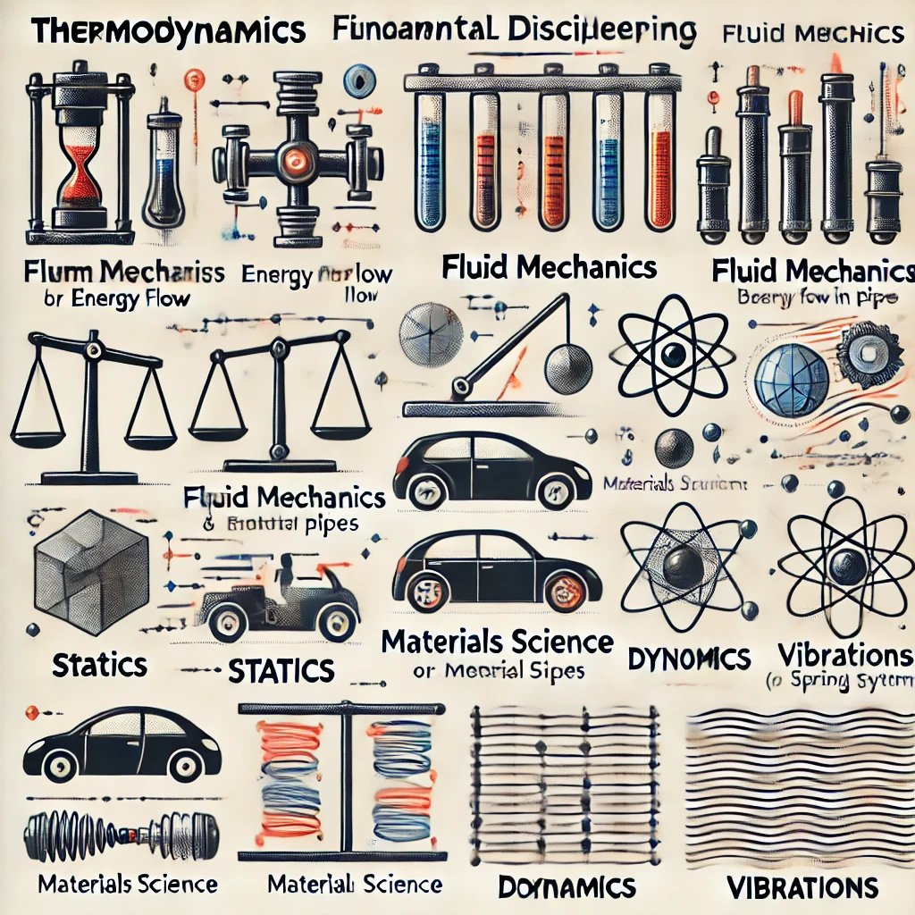

標題叫啥??
教授: 詹魁元
學生: 吳家安、李京睿、王邑安

Slide 2
Introduction
Methods
Results
Discussion

Slide 3
What is machine??
Introduction
Methods
Results
Discussion

Slide 4
What is machine??
Introduction
Methods
Results
Discussion

Slide 5




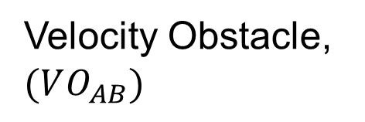

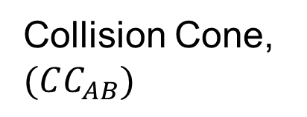





Velocity Obstacle (VO)
$$VO_{AB}=CC_{AB}⊕v_{B}$$
C-space
Velocity space
$${v_{AB}}_{y}$$
$${v_{A}}_{y}$$
Collision Cone, $(CC_{AB})$
Velocity Obstacle, $(VO_{AB})$
$$v_{B}$$
$$r_{A}+r_{B}$$
agent B
$${v_{AB}}_{x}$$
$${v_{A}}_{x}$$
$$(0,0)$$
$$(0,0)$$
$$v_{B}$$
agent A
Introduction
Methods
Results
Discussion

Slide 6
What is machine??
Introduction
Methods
Results
Discussion

Slide 7
What is machine??
Introduction
Methods
Results
Discussion

