Slide 1
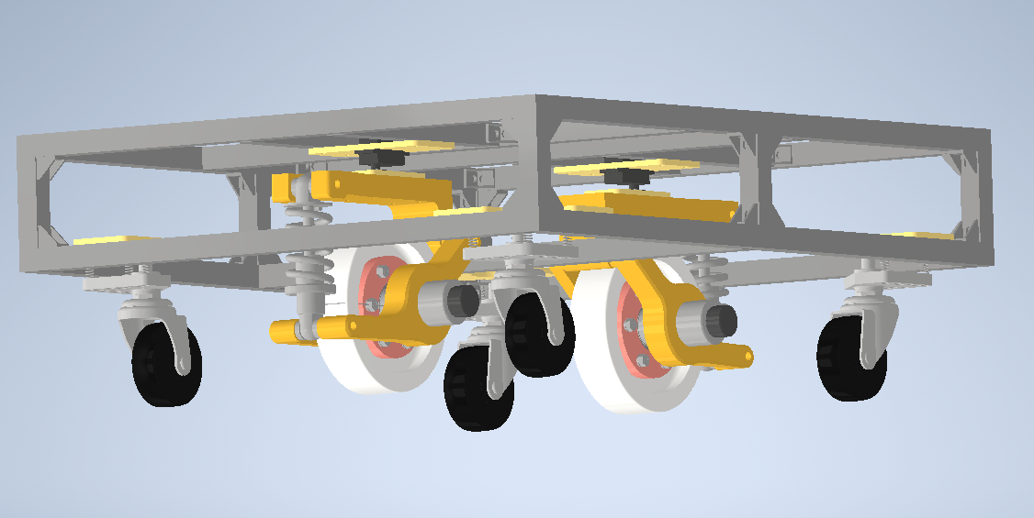
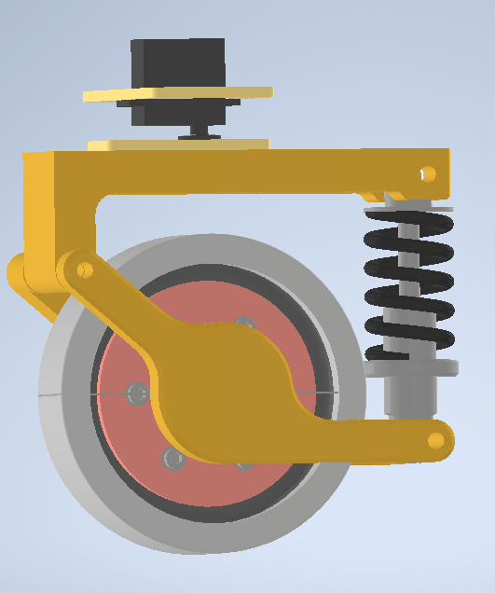
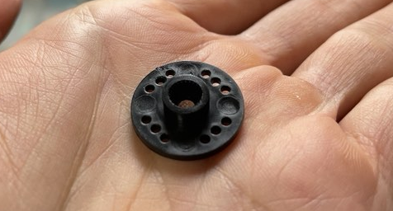
8.5mm

Slide 2




$$\hat{B}$$
}
$$v_{AB}$$
$$A$$
$$δt$$

Slide 3
$$\hat{B}$$
$$v_{AB}$$
$$A$$

Slide 4


$$r_{A}+r_{B}$$
$$r_{A}+r_{B}$$
B
B
$$v_{AB}$$
X
O
O
A
A

Slide 5
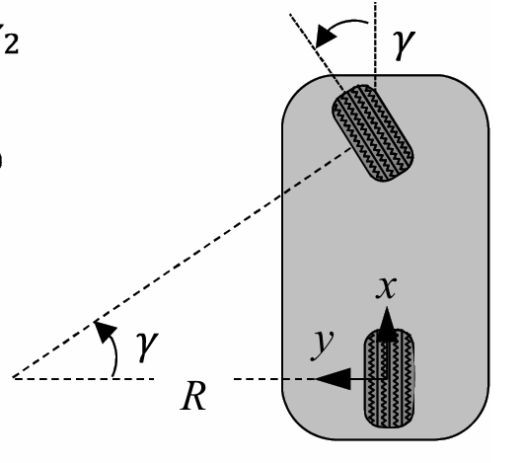



$$φ$$
$$φ$$
$$v_{x}$$

Slide 6
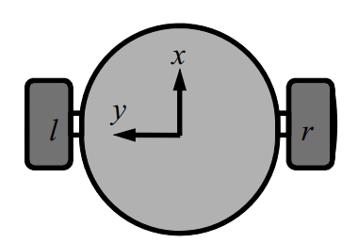


$$v_{l}$$
$$v_{r}$$

Slide 7
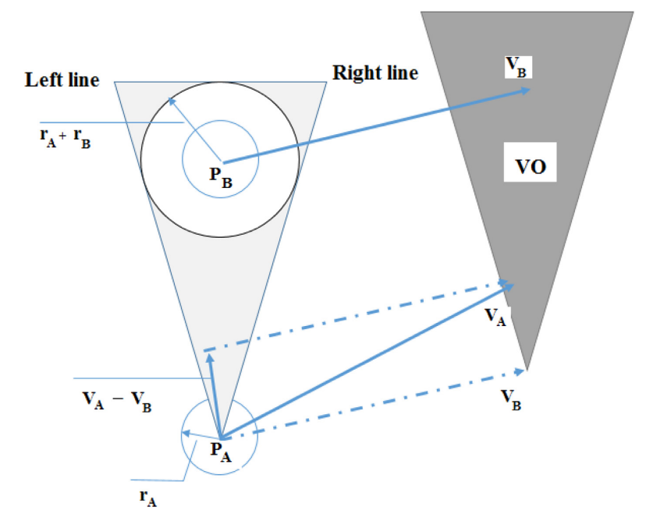
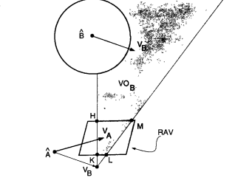


v*
RV
$$v_{y}$$
$$v_{x}$$

Slide 8
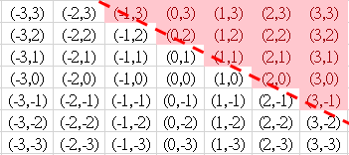


$$v_{y}$$
$$v_{x}$$

Slide 9






With null space
Without null space
$$v_{f}=7$$
$$v_{f}=5$$
$$v_{x}=5$$
$$v_{x}=5$$
$$v_{r}=5$$
$$v_{r}=7$$

Slide 10
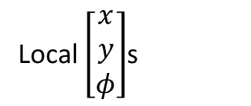

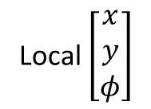
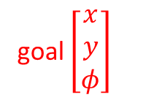
Local $\left[\begin{matrix}x \\ y \\ φ\end{matrix}\right]$s
Global $\left[\begin{matrix}x \\ y \\ φ\end{matrix}\right]$s
simplify
goal $\left[\begin{matrix}x \\ y \\ φ\end{matrix}\right]$
Local $\left[\begin{matrix}x \\ y \\ φ\end{matrix}\right]$

Slide 12
environment
Strategic
Reasonable velocity command
(smooth)
static
Way points
dynamic
MPC
Global planner:
RRT or A* or others
path
Way points

Slide 13








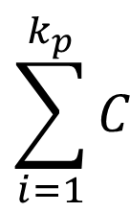
Subject to:
optimization
Equality constraints
$$\sum_{i=1}^{k_{p}}{C}$$
input
Position error
Orientation error
delta input
Inequality constraints
VO

Slide 14
Velocity command
Path planning
path
Path tracker
Robot
error

Slide 15
MPC + VO
VO in hard constraints
MPC + VO
VO in soft constraints
MPC + potential field
Potential field in soft constraints
MPC + potential field
Potential field in hard constraints

Slide 16




Y
Y
$$v_{Y}$$
y
y
Robot
Robot
$$ψ$$
$$ω$$
$$ψ$$
x
x
$$v_{X}$$
X
X

Slide 17




$$v_{y}$$
$$r_{A}+r_{B}$$
$$v_{B}$$
B
VO
Y
0,0
$$v_{B}$$
$$v_{x}$$
A
X
現實空間
速度空間

Slide 18
B
VO
A
?
B
A

Slide 19




$$x_{k+3}$$
$$x_{k+2}$$
$$x_{k+1}$$
$$x_{k}$$

Slide 20





b
Y
robot
a
y
x
$$ψ$$
$$θ$$
$$α$$
$$r_{e}$$
X
L
d
$$r_{c}$$

Slide 21
: Mobile robot
: known intention moving object
: unknown intention moving object

Slide 22
Mobile robot
Mobile robot

Slide 24



$$r_{A}$$
$$r_{B}$$
$$r_{A}$$

Slide 26
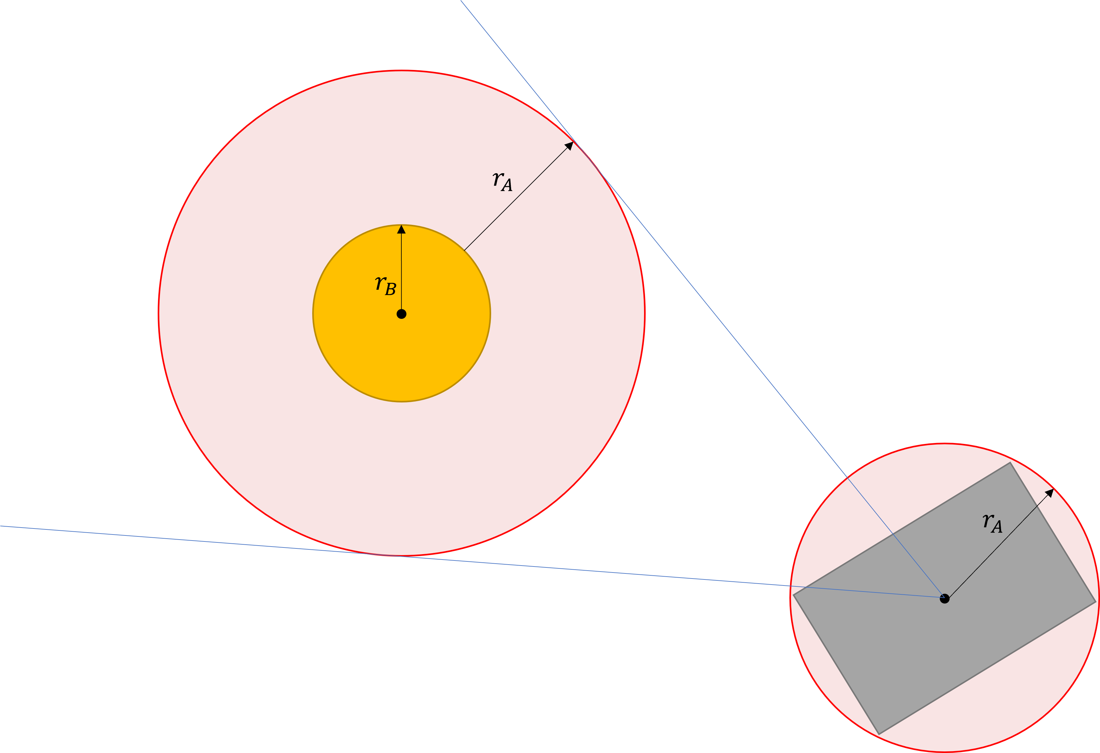
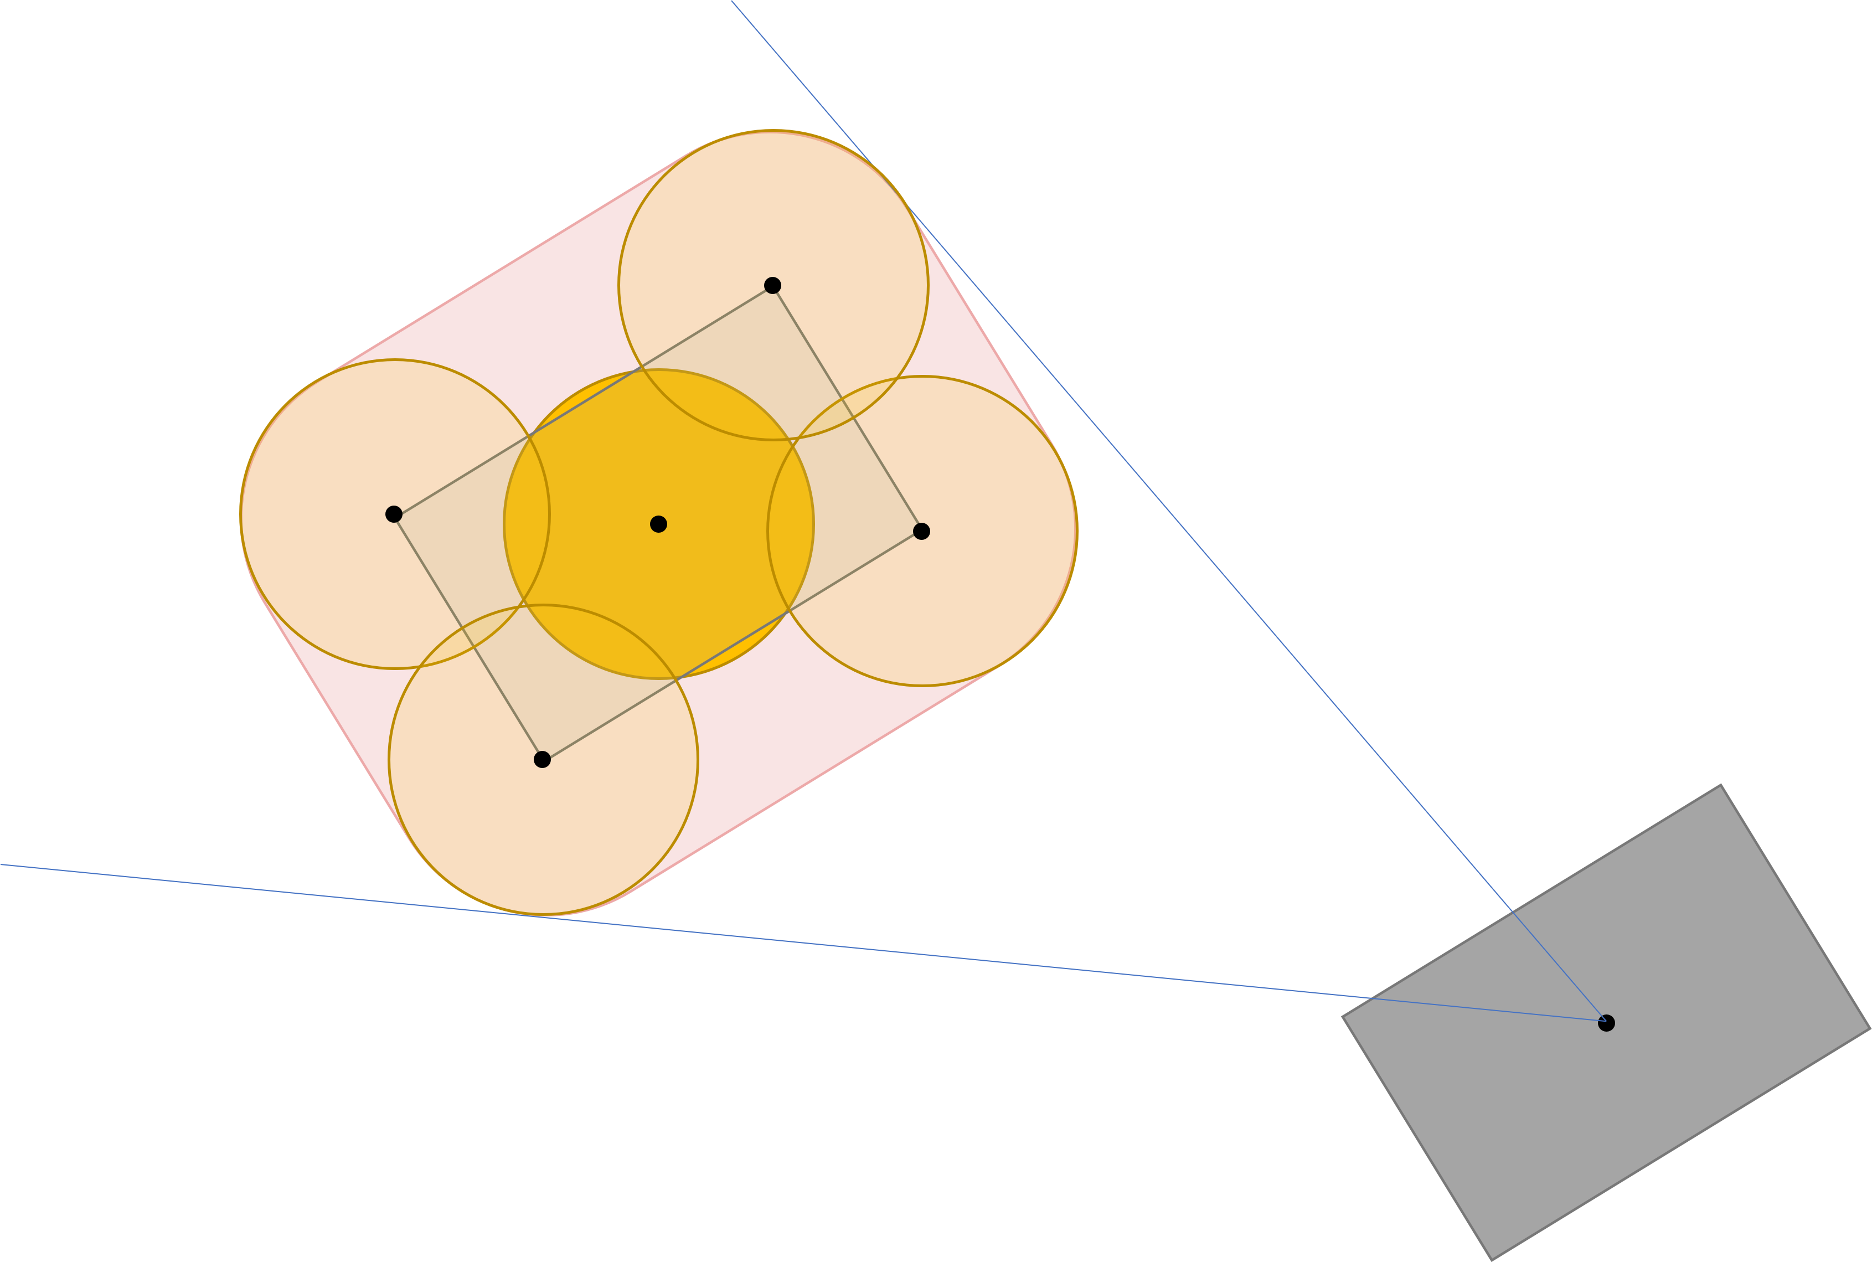

Slide 27


Slide 29





Y’
Y’
Y
Y
Obstacle
$$v_{B}$$
Obstacle
$$v_{B}$$
$$β$$
$$α$$
X
$$α$$
X
X’
X’

Slide 30








Y
Y
Y
$$Sig_{L}(x)$$
$$Sig_{R}(x)$$
$$Sig_{M}(x)$$
$$x_{p}$$
X
$$x_{p}$$
X
$$x_{L}$$
$$x_{R}$$
X
$$y_{lim}$$

Slide 31




Parameters
C++
Python
Optimized results
Simulation
Scenarios setting
Visualization
recording
MPC
Objective function
VO Constraints
Send velocity cmd

Slide 32











$$p_{0}$$
$$v_{1}$$
$$v_{5}$$
$$p_{5}$$
$$p_{1}$$
$$v_{2}$$
$$v_{4}$$
$$v_{3}$$
$$p_{4}$$
$$p_{2}$$
$$p_{3}$$
$$p_{i},v_{i}, i=1,2,3…$$
$$p_{0},v_{0}$$
Dynamic Obstacle

Slide 33
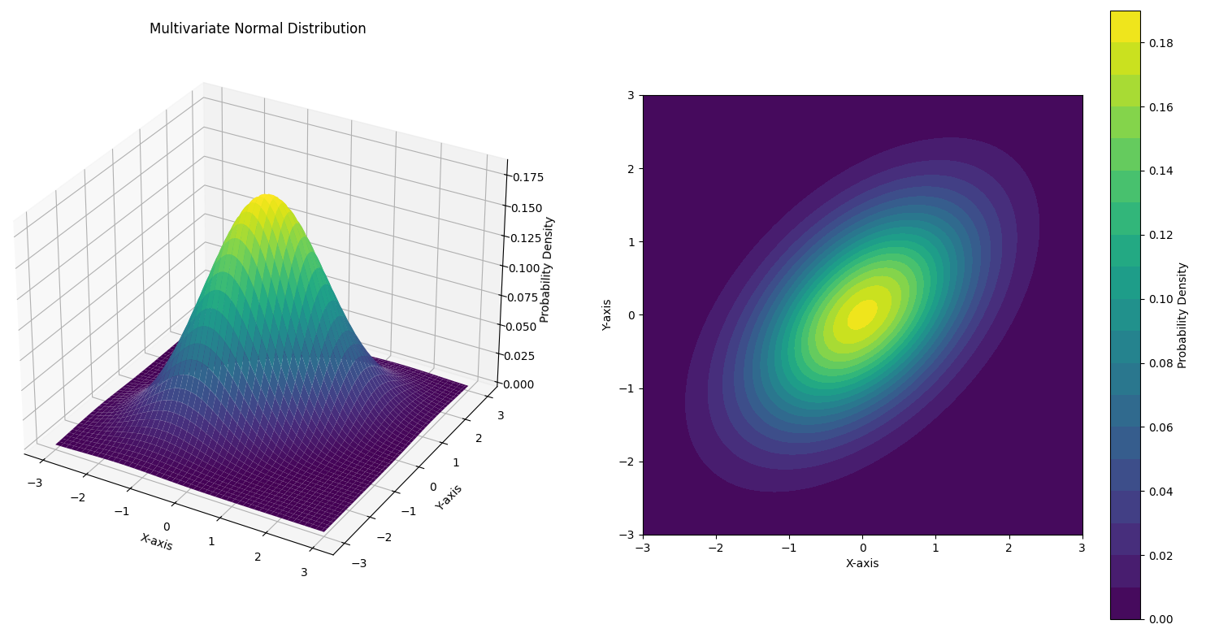
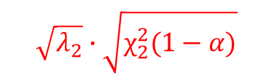
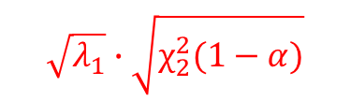
$$\sqrt{λ_{2}}∙\sqrt{χ_{2}^{2}(1−α)}$$
$$\sqrt{λ_{1}}∙\sqrt{χ_{2}^{2}(1−α)}$$

Slide 34
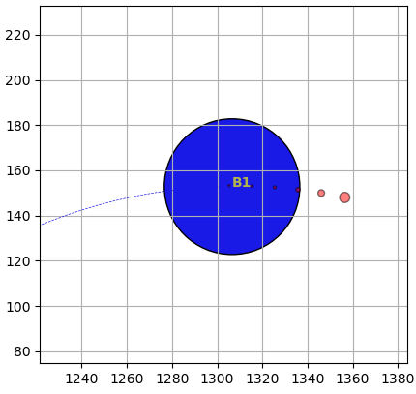
預測區間
移動物體未來多步的位置

