Slide 1
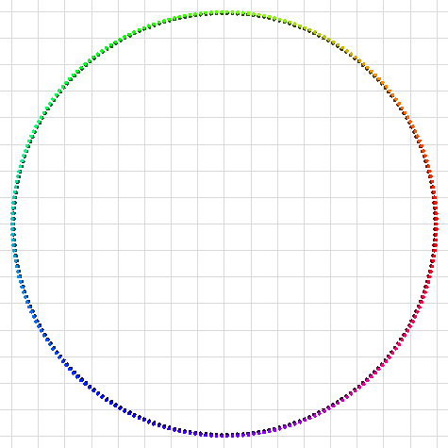
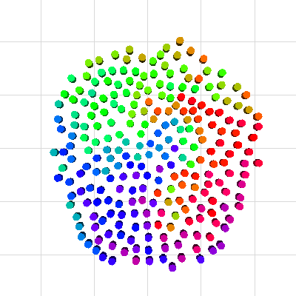
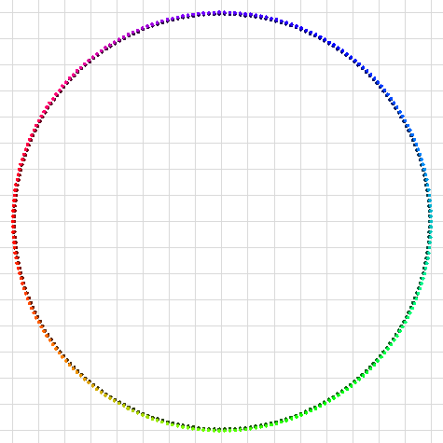
Reciprocal Velocity Obstacles for Real-Time Multi-Agent Navigation
Jur van den Berg
Ming Lin
Dinesh Manocha

Slide 2
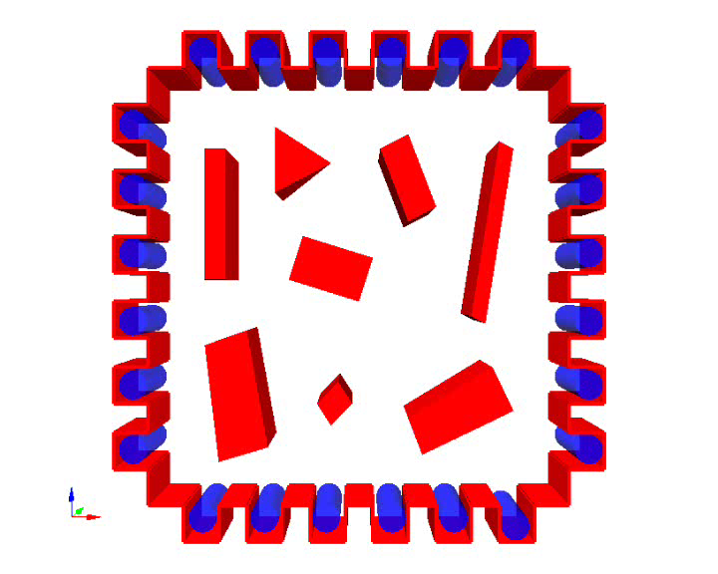
Multi-Agent Navigation
N agents share an environment
Move from start to goal without mutual collisions (and collisions with obstacles)

Slide 3
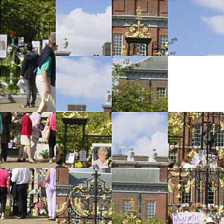
Multi-Agent Navigation
Decoupled
  Simultaneous independent navigation for each agent
  Global path planning and local collision avoidance decoupled
Centralized
  Path planned in composite configuration space

Slide 4
Problem Description
Independent Navigation
Continuous cycle of sensing and acting
Global path planning vs. local navigation
Each cycle: each agent observes other agents (position, velocity)
But does not know what they are going to do
How to act?

Slide 5
Previous Approaches
Potential Field (particle model)
Assume other agent are static obstacles
Assume other agents are moving obstacles (that maintain their current velocity for a while)
  Velocity Obstacles [Fiorini, Shiller, 98]

Slide 6
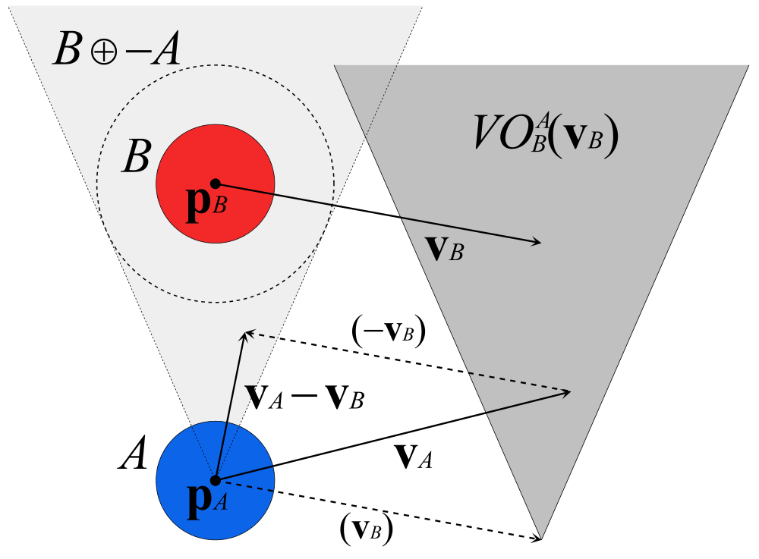
Velocity Obstacle
γ(p, v) = {p + tv | t > 0}
VO^{A}_{B}(v_{B}) = {v_{A} | γ(p_{A}, v_{A} – v_{B}) ∩ B ⊕ –A ≠ ∅}

Slide 7
Using Velocity Obstacles
In each cycle, select velocity outside velocity obstacle of any moving obstacle
For multi-agent navigation?
Agents are not passively moving, but react on each other
Result: oscillations

Slide 8
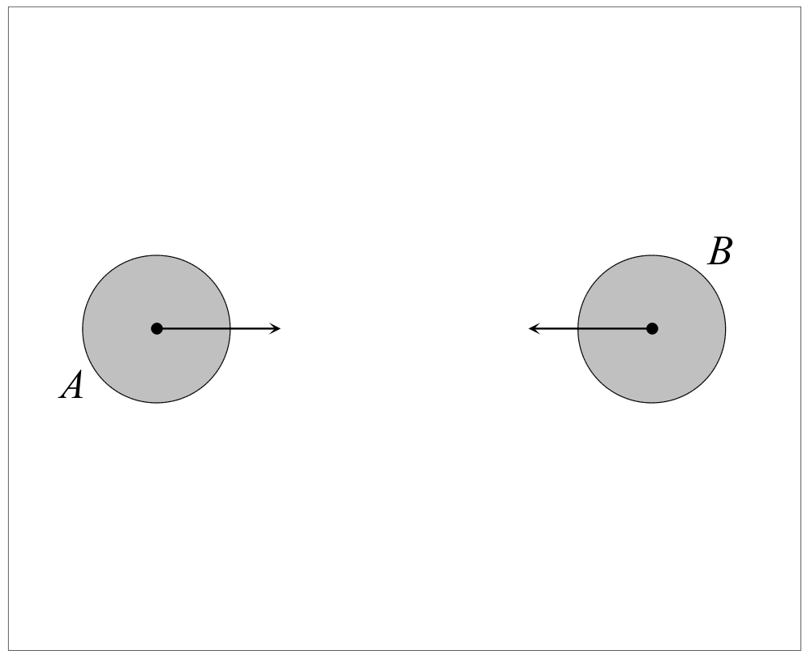
Oscillations
Example: two agents with opposite directions

Slide 9
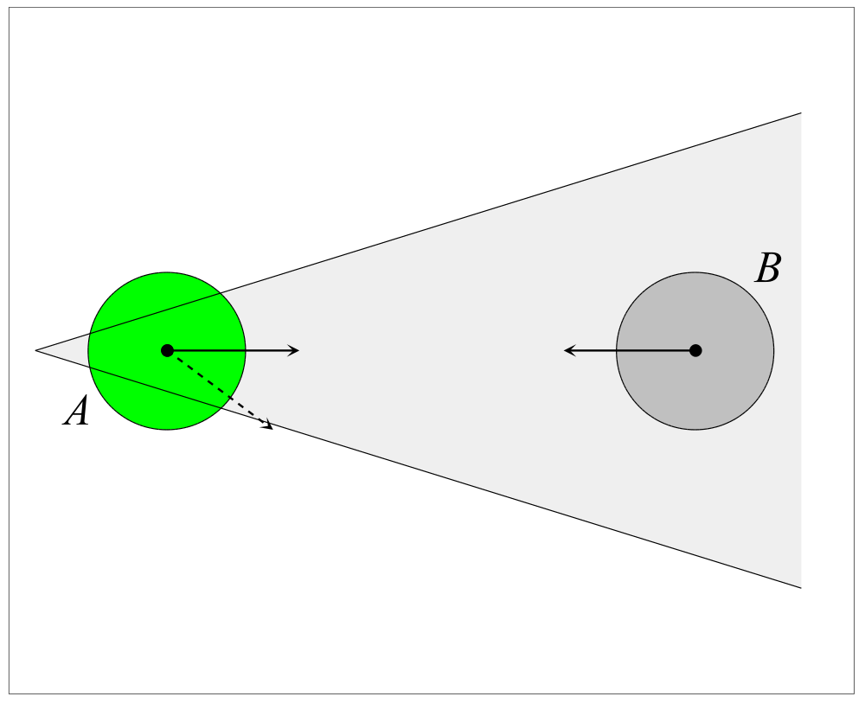
Oscillations
Example: two agents with opposite directions

Slide 10
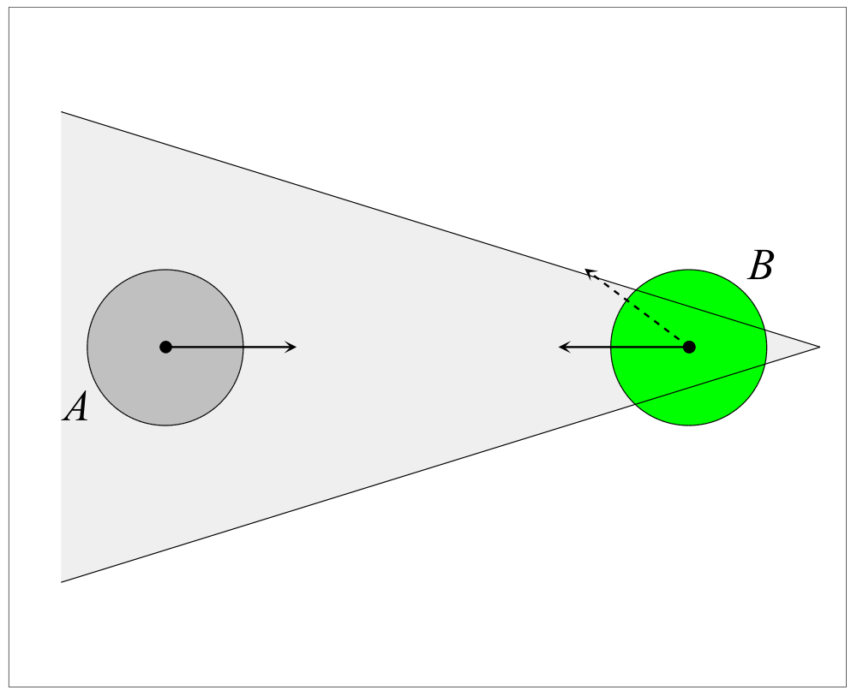
Oscillations
Example: two agents with opposite directions

Slide 11
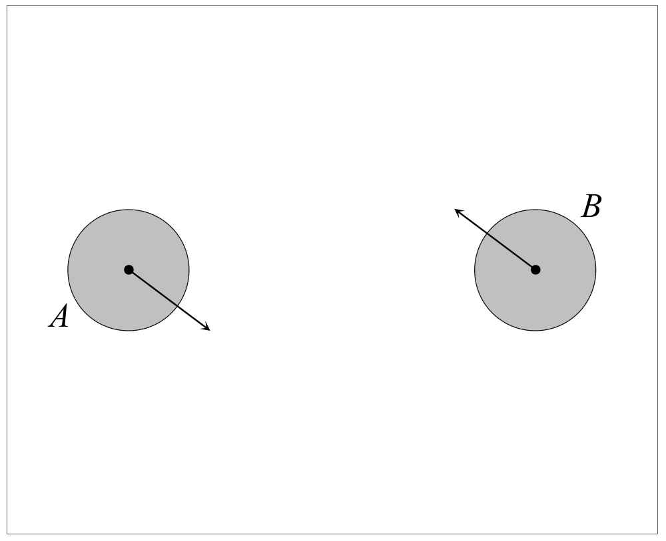
Oscillations
Example: two agents with opposite directions

Slide 12
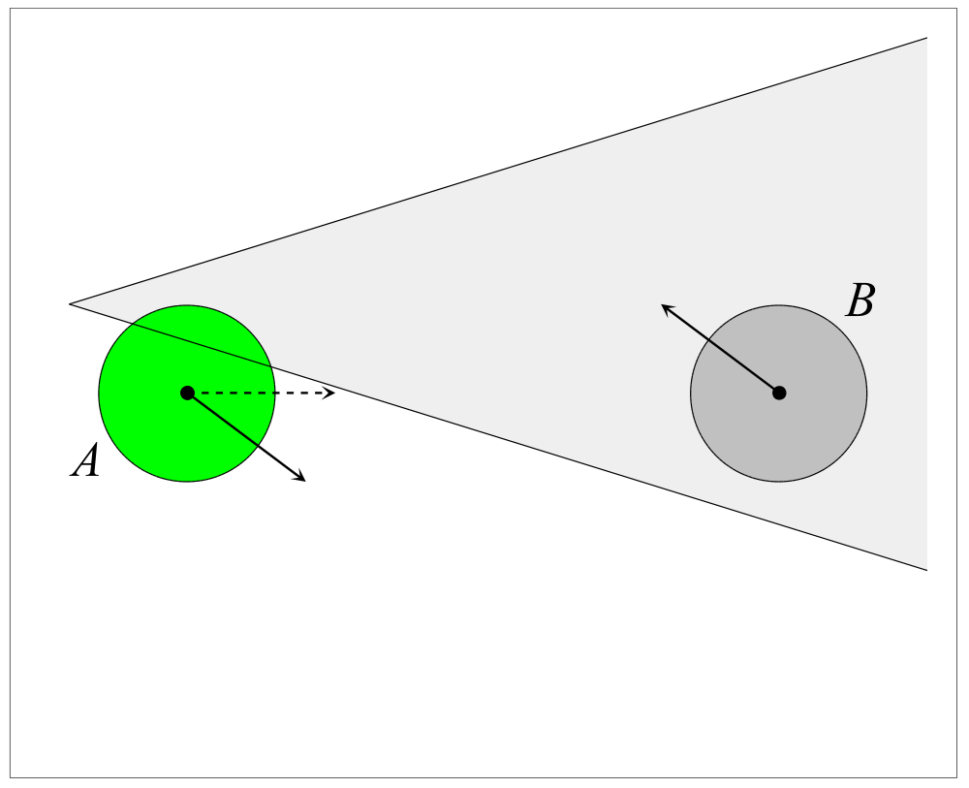
Oscillations
Example: two agents with opposite directions

Slide 13
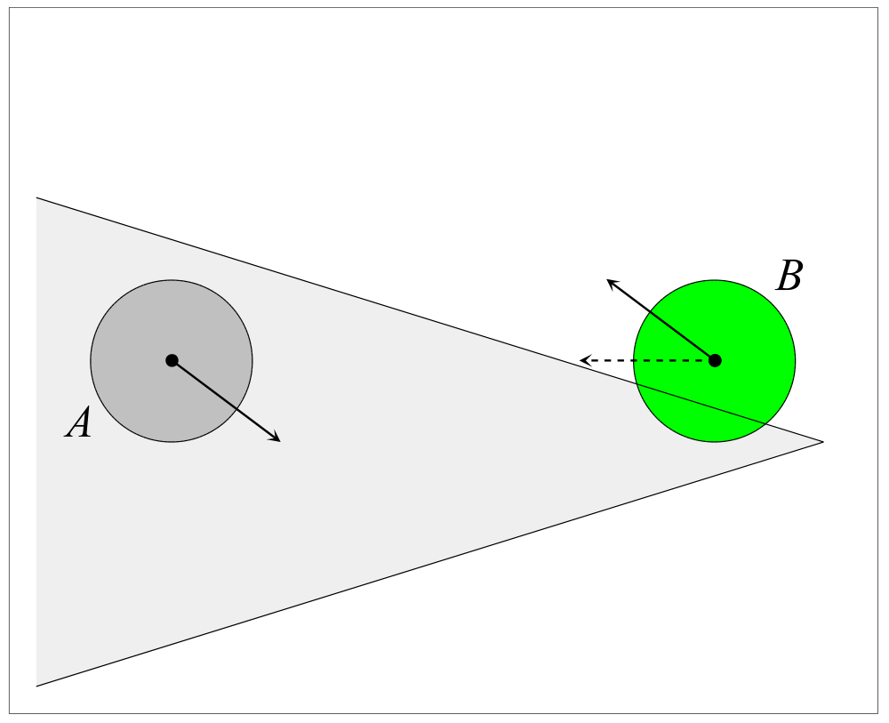
Oscillations
Example: two agents with opposite directions

Slide 14
Oscillations
Example: two agents with opposite directions

Slide 15
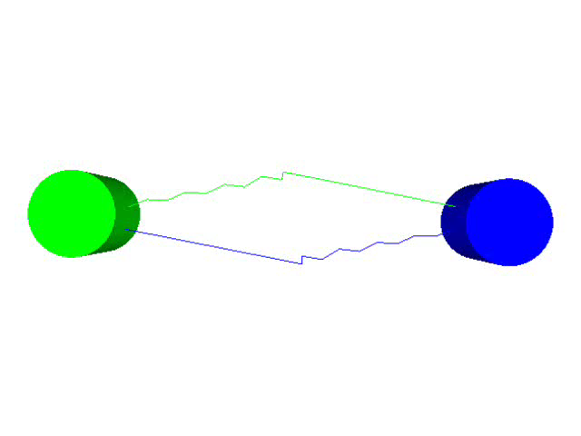
Oscillations
Example: two agents with opposite directions

Slide 16
New Approach
Prevent oscillations
No communication among agents or global coordination
Simple idea: instead of choosing a new velocity outside the velocity obstacle, take the average of a velocity outside the velocity obstacle and the current velocity
Formalized into Reciprocal Velocity Obstacle

Slide 17
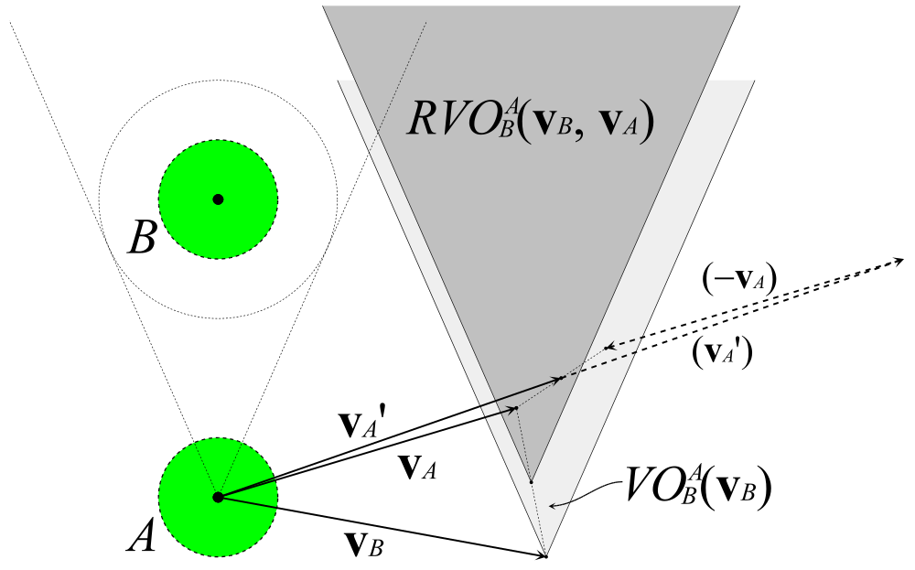
Reciprocal Velocity Obstacle
RVO^{A}_{B}(v_{B}, v_{A}) = {v’_{A} | 2v’_{A} – v_{A} ∈ VO^{A}_{B}(v_{B})}

Slide 18
Oscillations?
Example: two agents with opposite directions

Slide 19
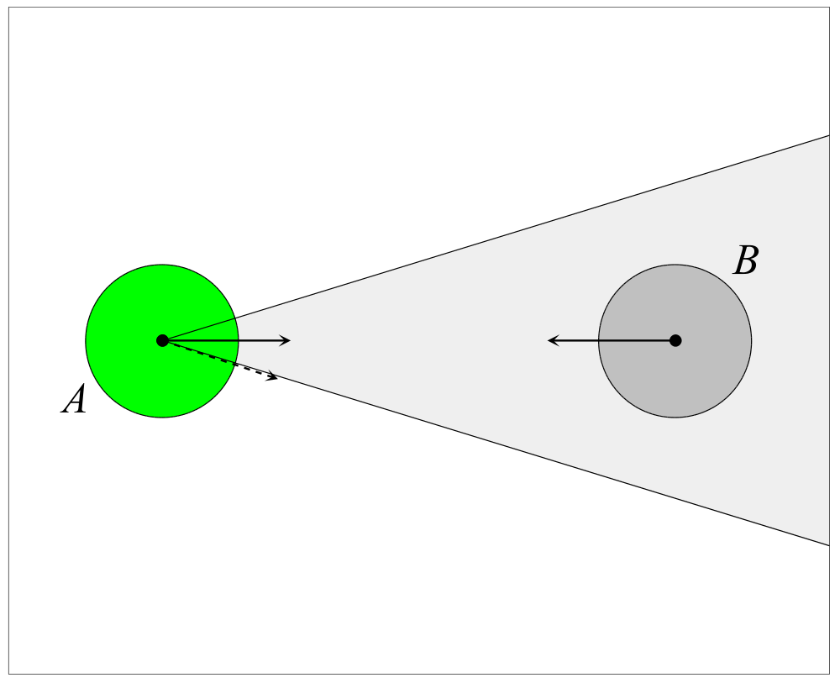
Oscillations?
Example: two agents with opposite directions

Slide 20
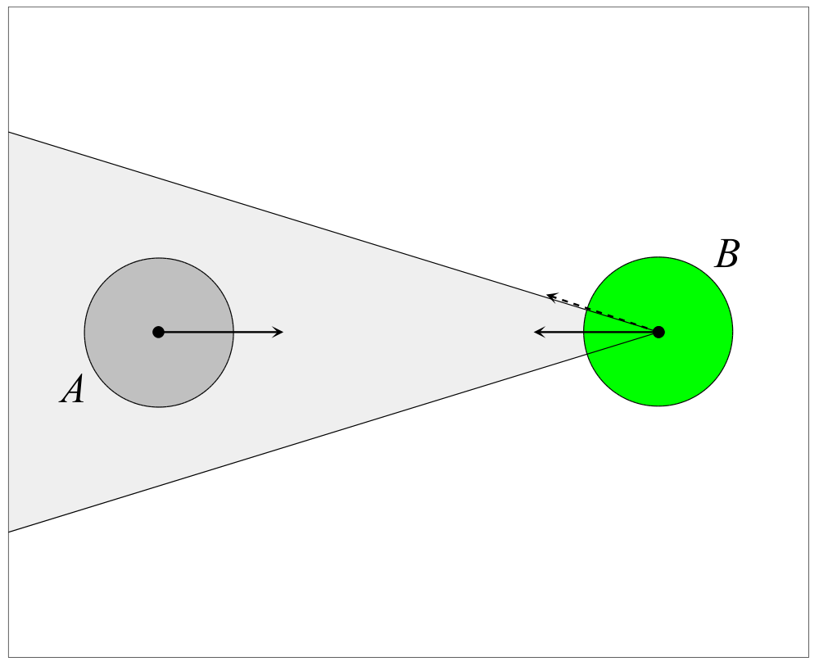
Oscillations?
Example: two agents with opposite directions

Slide 21
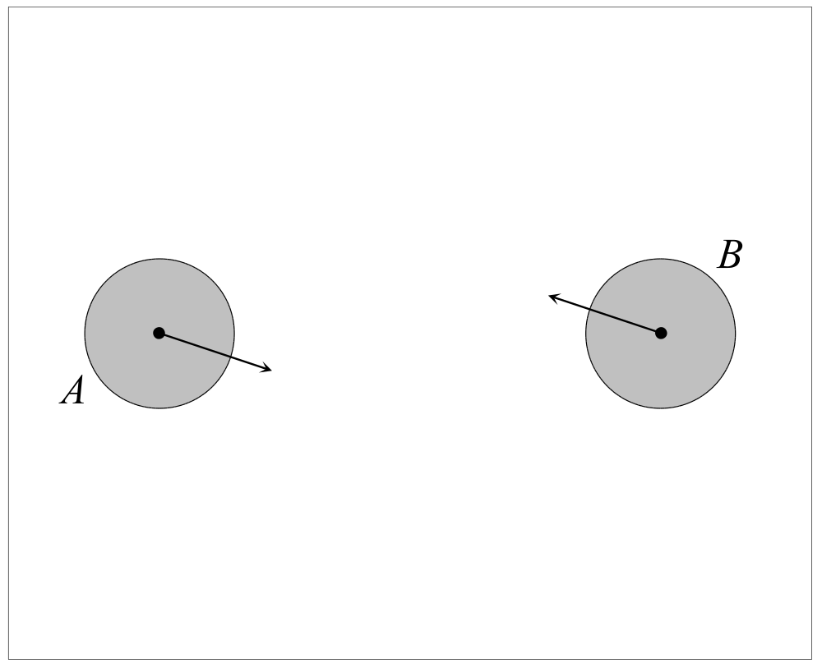
Oscillations?
Example: two agents with opposite directions

Slide 22
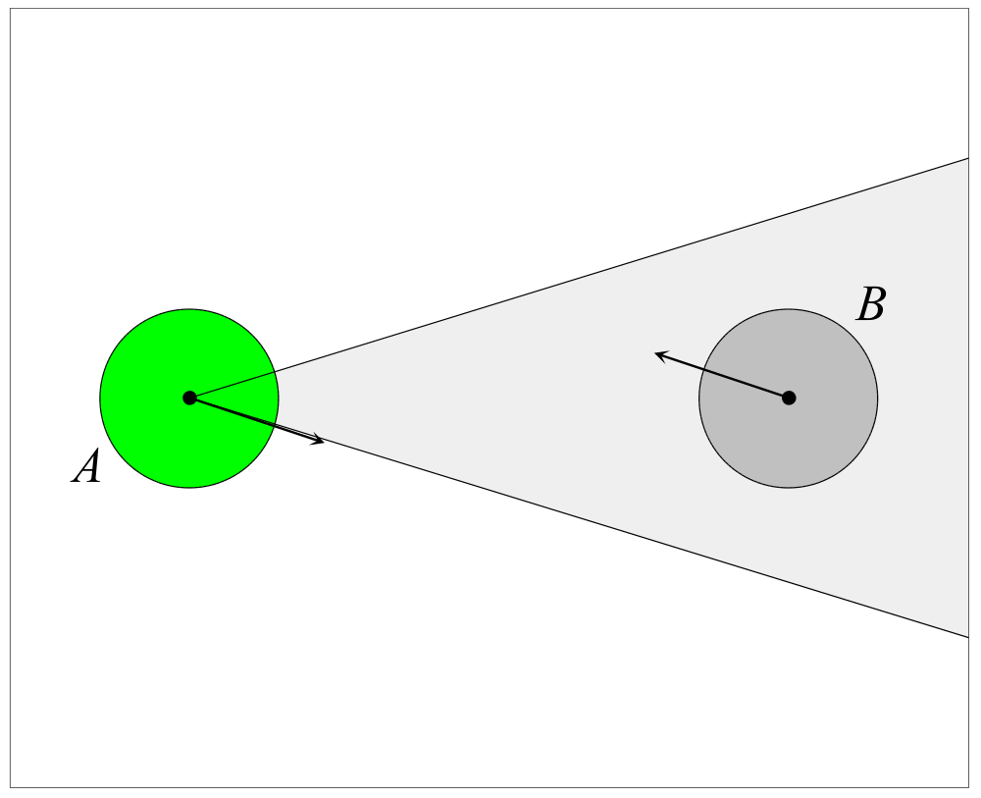
Oscillations?
Example: two agents with opposite directions

Slide 23
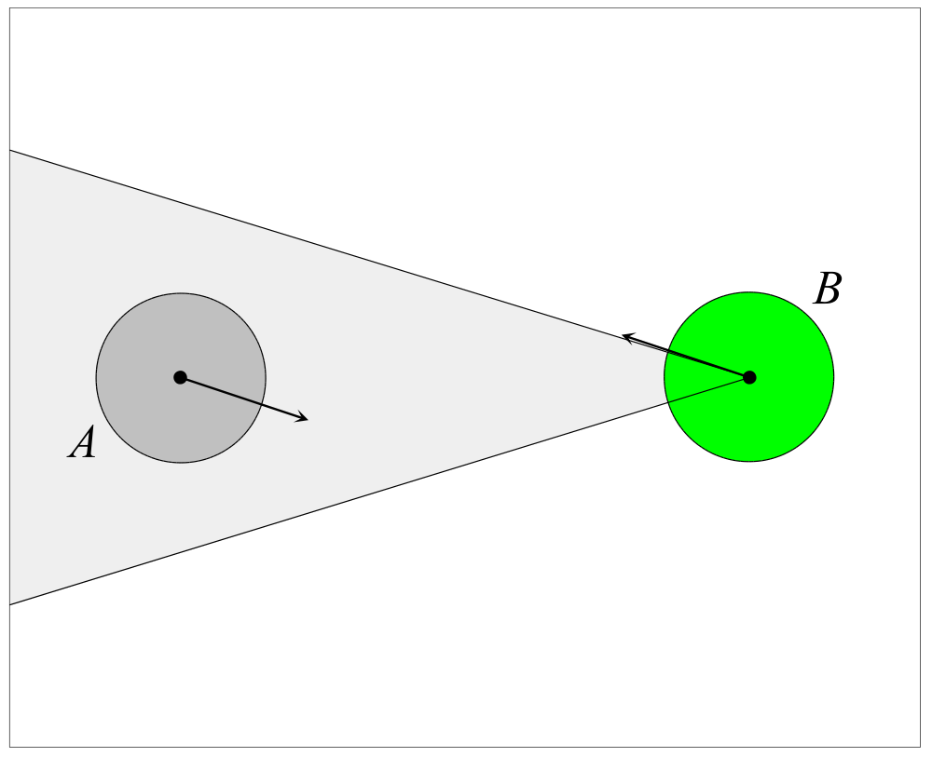
Oscillations?
Example: two agents with opposite directions

Slide 24
No Oscillations
Example: two agents with opposite directions

Slide 25

No Oscillations and Safe
Example: two agents with opposite directions

Slide 26
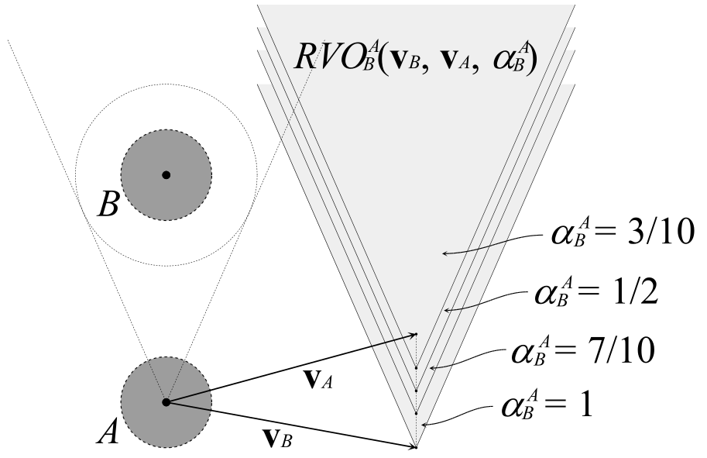
Generalized RVOs
Different distribution of effort in avoiding each other than 50%-50%
Parameter α; α → 0: no effort; α → 1: all effort
RVO^{A}_{B}(v_{B}, v_{A}, α) = {v’_{A} | (1/α)v’_{A} + (1 – 1/α)v_{A} ∈ VO^{A}_{B}(v_{B})}

Slide 27
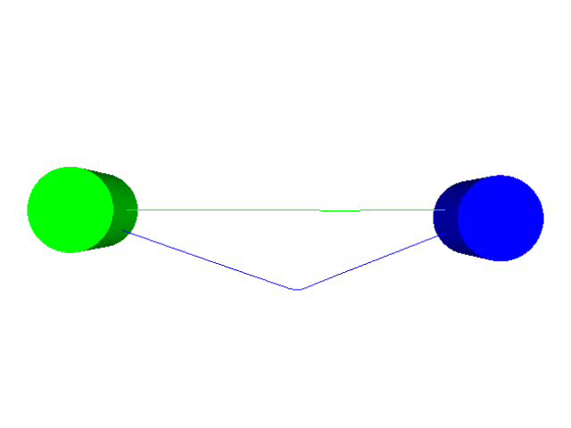
Generalized RVOs
0% - 100%

Slide 28
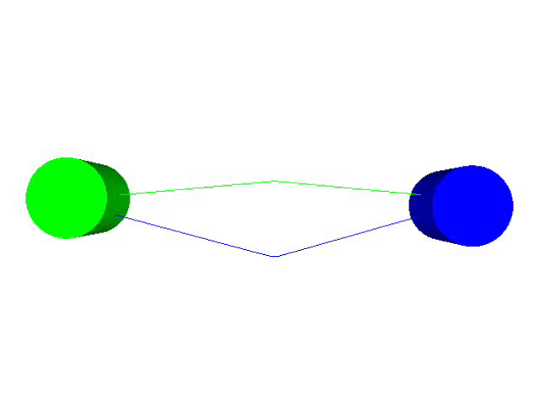
Generalized RVOs
25% - 75%

Slide 29
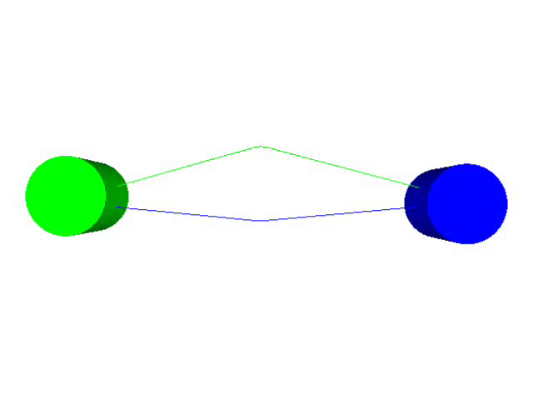
Generalized RVOs
75% - 25%

Slide 30

Generalized RVOs
100% - 0%

Slide 31
Multi-Agent Navigation
N agents A₁, …, A_{N} with positions p₁, …, p_{N}, velocities v₁, …, v_{N}, preferred speeds v^{pref}₁, …, v^{pref}_{N} and goals g₁, …, g_{N}
Time step Δt
Each time step: for each agent:
  Compute preferred velocity
  Select new velocity
  Update position of agent according to new velocity

Slide 32
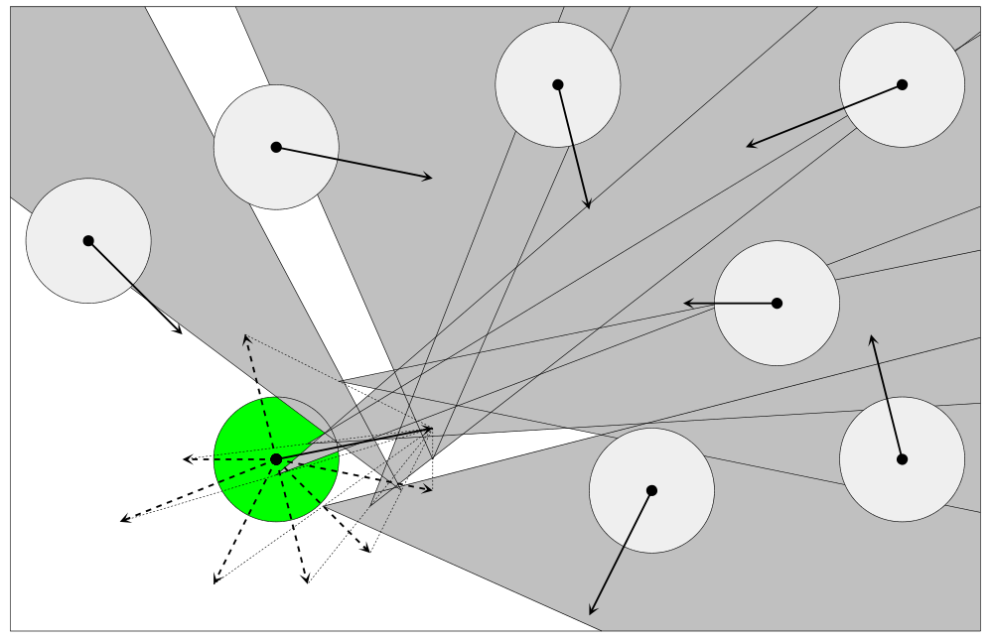
Select New Velocity
Outside the union of the reciprocal velocity obstacles, closest to preferred velocity

Slide 33
Select New Velocity
Environment may become crowded: no valid velocity
Solution: select velocity inside RVO but penalize
  Expected time to collision
  Distance to preferred velocity
Select velocity with minimal penalty

Slide 34
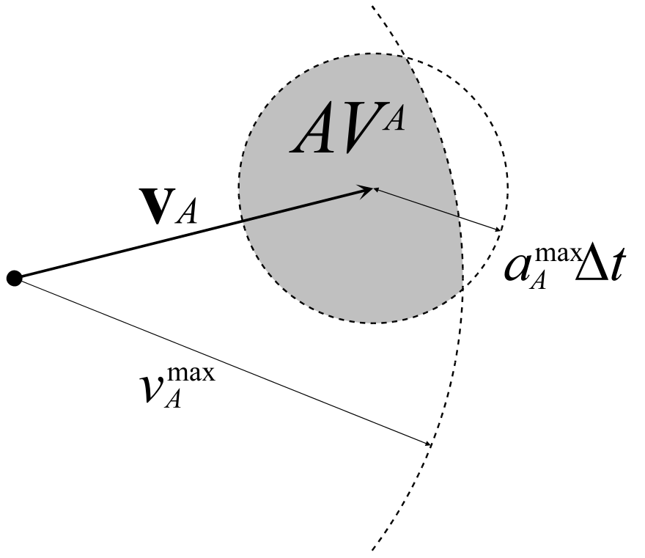
Realism
Dynamics constraints
  Maximum velocity
  Maximum acceleration
  More complicated…
Neighbor region
  More efficient
  Circular neighbor region
  Visibility neighbor region…

Slide 35

Experiments
12 agents
Circle: move to antipodal position on circle

Slide 36
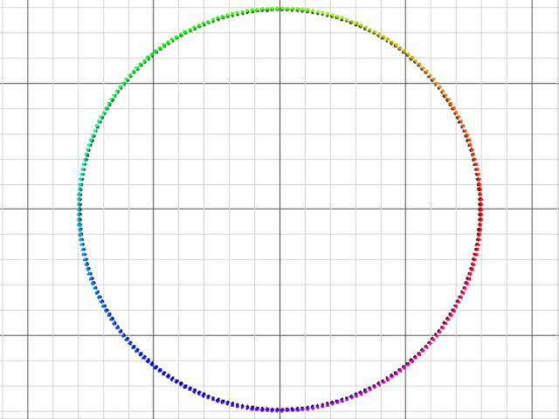
Experiments
250 agents
Circle: move to antipodal position on circle

Slide 37
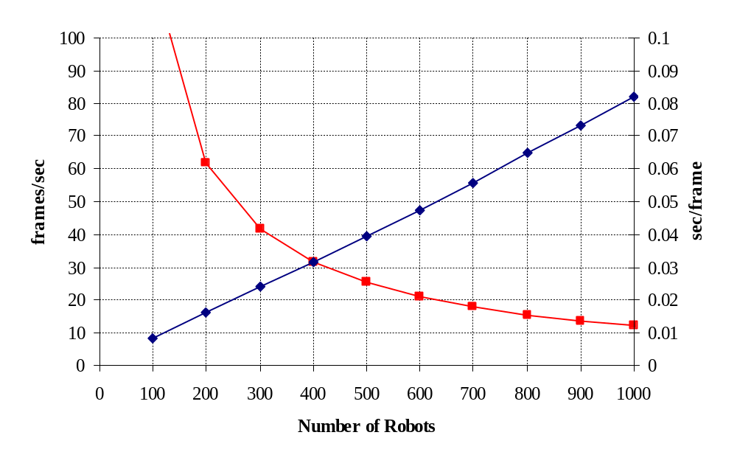
Results
Circle experiment

Slide 38
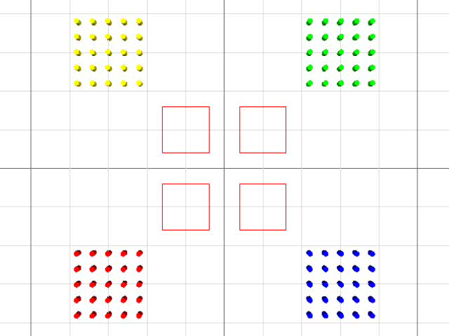
Experiments
Static obstacles: narrow passage

Slide 39
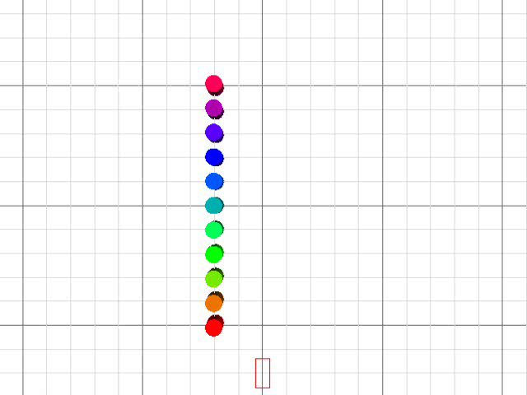
Experiments
(High-speed) moving obstacle: car

Slide 40
Conclusion and Future Work
Conclusion
  Powerful and simple (easy to implement) local collision avoidance technique for multi-agent navigation
Future work
  Model human behavior
    Human dynamics
    Human visibility
    Human characters
  Global path planning
    Roadmap
  Inevitable collision states

