Slide 1
Query session guided multi-document summarization
Thesis presentation by Tal Baumel
Advisor: Prof. Michael Elhadad

Slide 2
Introduction

Slide 3

Information Retrieval
Task
Methods:
Vector Space Model
Probabilistic Models
Evaluation:
$Precusion= \frac{|\left\{relevant docs\right\}∩\{retrived docs\}|}{|\{retrived docs\}|}$
$Recall=\frac{|\{relevant docs\}|∩|\{retrived docs\}|}{|\left\{relevant docs\right\}|}$
$F−measure= \frac{2∗Precision∗Recall}{Precision+Recall}$

Slide 4

Exploratory Search

Slide 5

Exploratory search
Unfamiliar with the domain of his
unsure about the ways to achieve his goals
or even unsure about his goals in the first place

Slide 6

Important Exploratory search system features
Querying and query refinement
Faceted search
Leverage search context

Slide 7
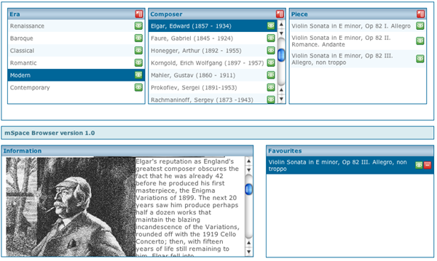
Example: mSpace.fm

Slide 8
Automatic Summarization

Slide 9

Aspects of Automatic Summarization
Informative vs. Indicative summaries
Single vs. Multi-document summaries
Extractive vs. Generative summaries

Slide 10

Difficulties in automatic summarization
Detect Central Topics
Redundancy
Coherence

Slide 11


Advanced Summarization Scenarios
Query Oriented Summarization
Update Summarization

Slide 12

Summarization Evaluation
Manual Evaluation
Questionnaire
Pyramid
Automatic Evaluation
ROUGE:
ROUGE-N$=\frac{\sum_{SεManual Summaries}{\sum_{{gram}_{n}∈S}{{count}_{match}({gram}_{n})}}}{\sum_{S∈Manual Summaries}{\sum_{{gram}_{n}∈S}{count ({gram}_{n})}}}$
ROUGE-S: Skip-Bigram Co-Occurrence

Slide 13
Entailment-Based Exploratory Search and Summarization System For the Medical Domain

Slide 14
Entailment-Based Exploratory Search and Summarization System For the Medical Domain
collaborative effort of both Bar-Ilan and Ben-Gurion universities
a concept graph is generated from a large set documents from the medical domain to explore those concept
Our goal is to add automatic summaries to aid the exploratory search process

Slide 15
Research Objectives

Slide 16
Research Objectives
Can we use automatic summaries to improve the exploratory search process?
Does previous summaries effect the current summary?
Can we use any existing automatic summarization method for our task?
Can we use any existing datasets to evaluate such methods?

Slide 17
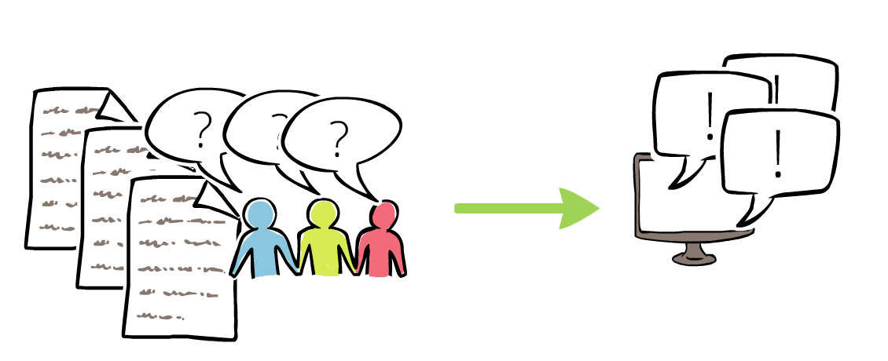
The Query Chain Dataset

Slide 18
Requirements of The Dataset
Capture summaries generated to aid in an exploratory search process
Real word exploratory search processes steps
manually crafted summaries that best describe the information need in those steps
focus on the medical domain

Slide 19
The Dataset Description
Query chains – manually selected from PubMed query logs
Document set – manually selected from various sites to contain relevant information about the query logs
Manual summaries – created for each query some were created within the context of the query chain and some weren’t

Slide 20
The Annotators
Linguistics MSc student
Medical student
Computer science MSc student
Medical public health MSc student
Professional translator with a doctoral degree with experience in translation and scientific editing

Slide 21
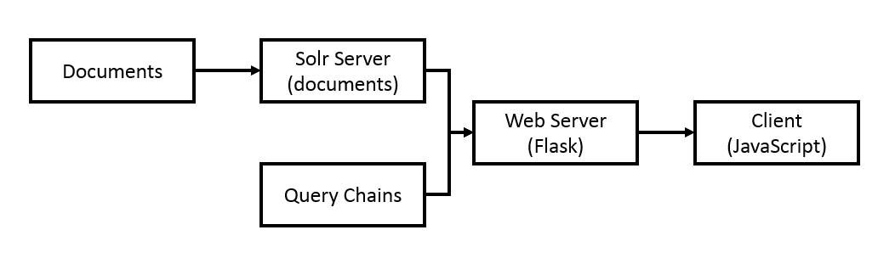
Technology Review

Slide 22
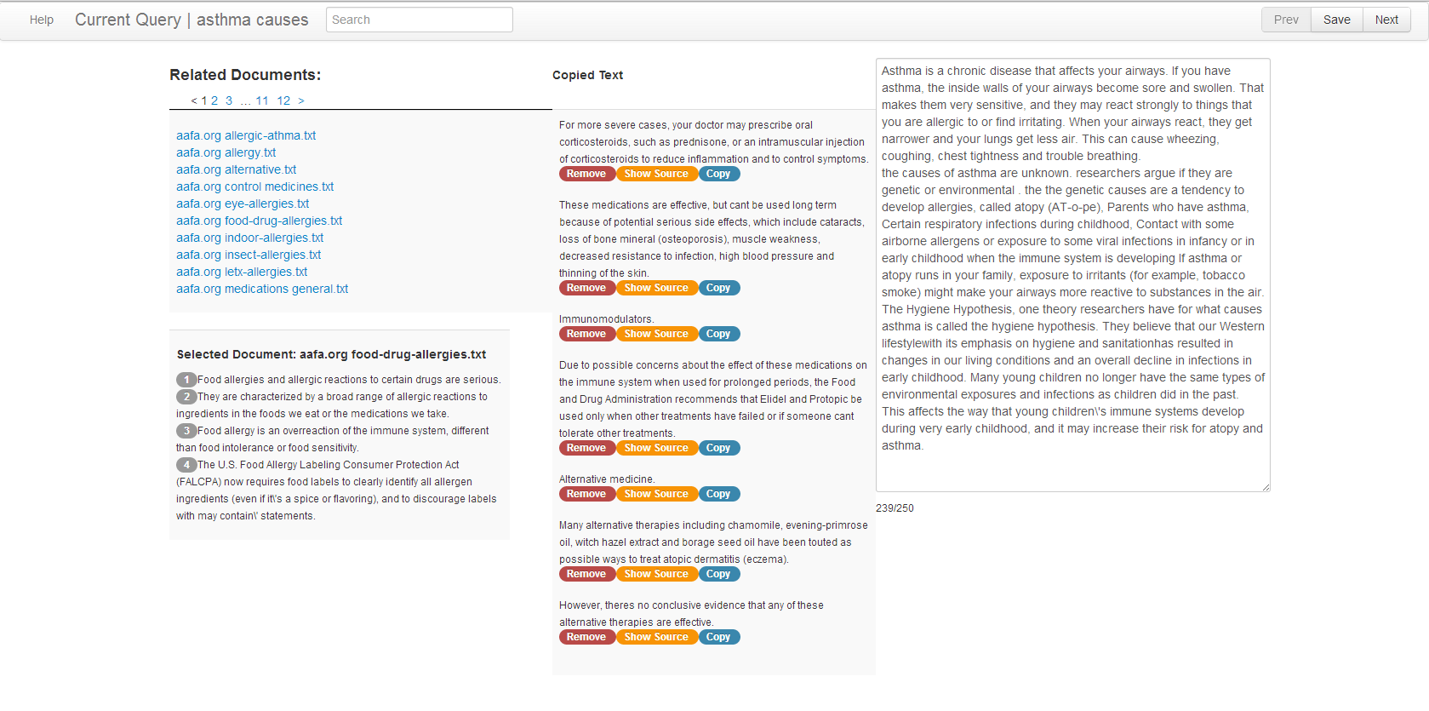

Slide 23
Verifying the Dataset
Using ROUGE we tested mean ROUGE score of manual summaries
With context: r1 = 0.52, r2 = 0.22,rs4 = 0.13
Without context: r1 = 0.49, r2 = 0.22, rs4 = 0.01
Except for the R2 test, results showed statistically significant difference with 95% confidence interval

Slide 24
Dataset Statistics
 | Sentence Count | Word Count | Unique Words
Documents | 3,374 | 37,504 | 3,399
Queries | 33 | 107 | 37
Manual Summaries | 1,212 | 14,636 | 1,701

Slide 25

Methods

Slide 26
Naive Baselines
Presents the document with the best TF/IDF match to the query
Presents the first sentence of the top 10 TF/IDF matching documents to the query

Slide 27
LexRank
The Algorithm creates the following graph:
Each node is a bag of words from a sentence
Each edge is the cosine distance of the bag of words vector
Sentence
Sentence
Sentence
Sentence

Slide 28

LexRank cont.
The sentences are ranked using PageRank
The top sentences are added to the summary in the order of their rank
If a new sentence is too similar to a selected sentence, we discard it
We stop adding sentences when we reach the desired summary length

Slide 29
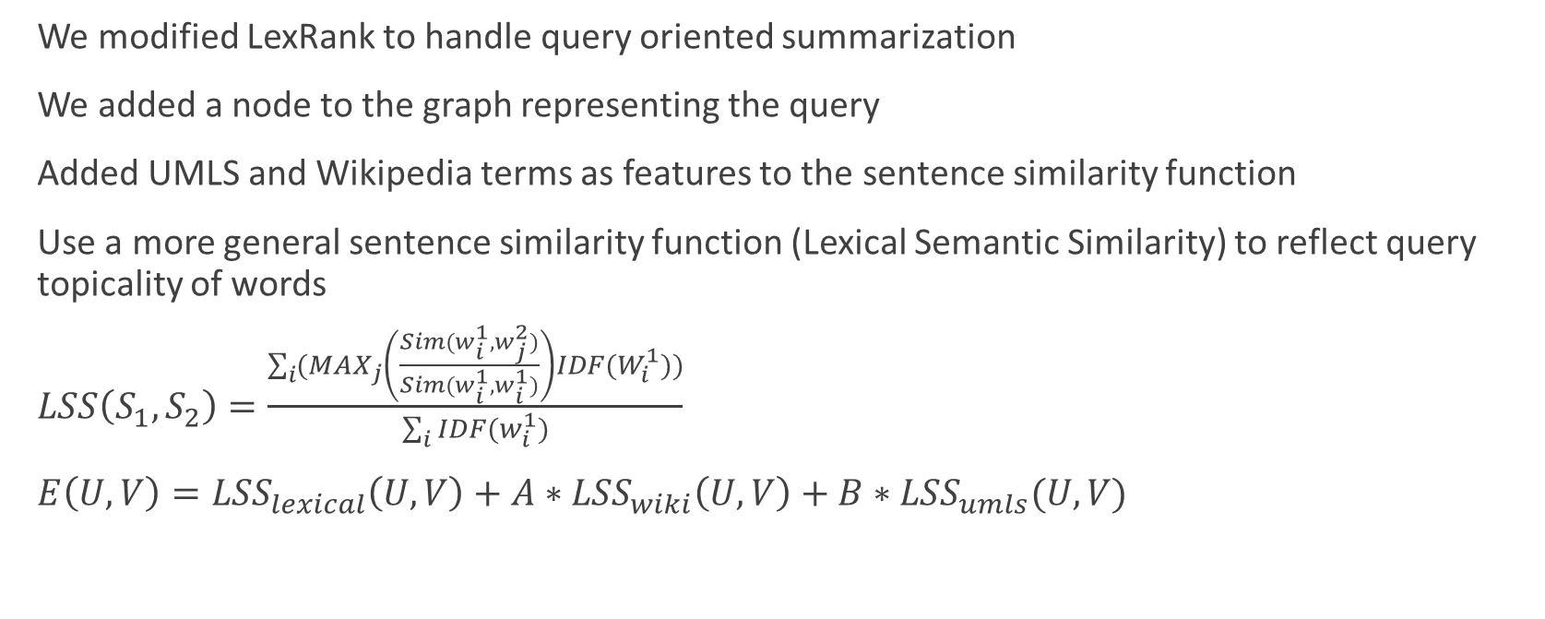
Modification to LexRank
We modified LexRank to handle query oriented summarization
We added a node to the graph representing the query
Added UMLS and Wikipedia terms as features to the sentence similarity function
Use a more general sentence similarity function (Lexical Semantic Similarity) to reflect query topicality of words
$LSS\left(S_{1},S_{2}\right)=\frac{\sum_{i}{({MAX}_{j}\left(\frac{Sim(w_{i}^{1},w_{j}^{2})}{Sim(w_{i}^{1},w_{i}^{1})}\right)IDF(W_{i}^{1}))}}{\sum_{i}{IDF(w_{i}^{1})}}$
$E\left(U,V\right)={LSS}_{lexical}\left(U,V\right)+A∗{LSS}_{wiki}\left(U,V\right)+{B∗LSS}_{umls}(U,V)$

Slide 30
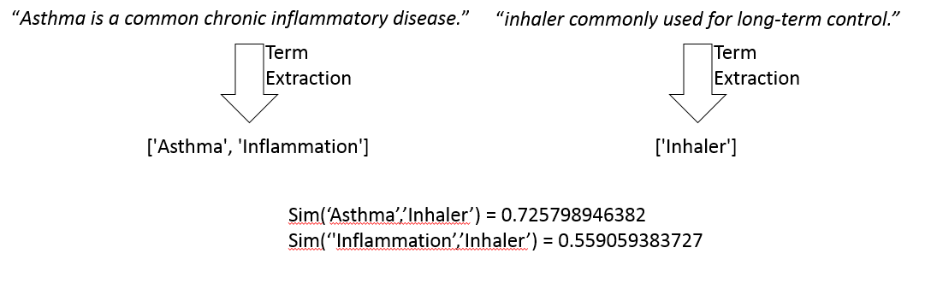
Modifications to LexRank

Slide 31
Modifications to LexRank
In PageRank, the damping factor jumps to a random node in the graph - we allowed the damping factor to only jump back to the query node
instead of simulating a random surf we simulate the probability of reaching a sentence when starting a random walk at the query
After similarity ranking, we choose sentences as in LexRank

Slide 32
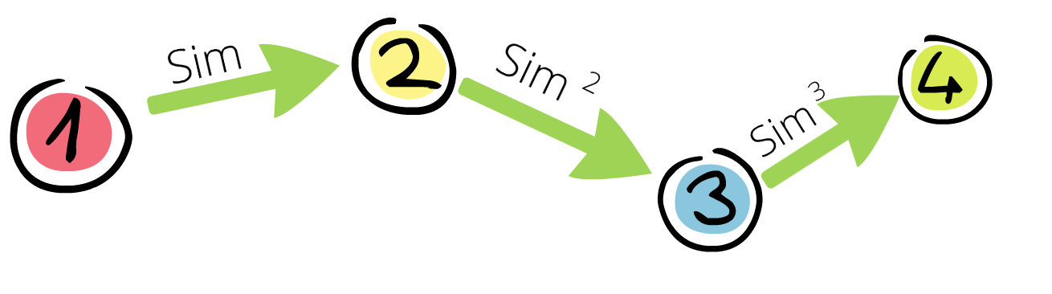
LexRank Update
The algorithm creates the same graph as our modified LexRank
For each new query, gather new documents (ranked by TF/IDF), add new nodes to the sentence graph created from the previous query
Add edges between the new query and the old queries with decreasing cost

Slide 33
LexRank Update
After ranking we selected only sentences that are different from both sentences that are selected for the current summary and previous summaries in the session

Slide 34
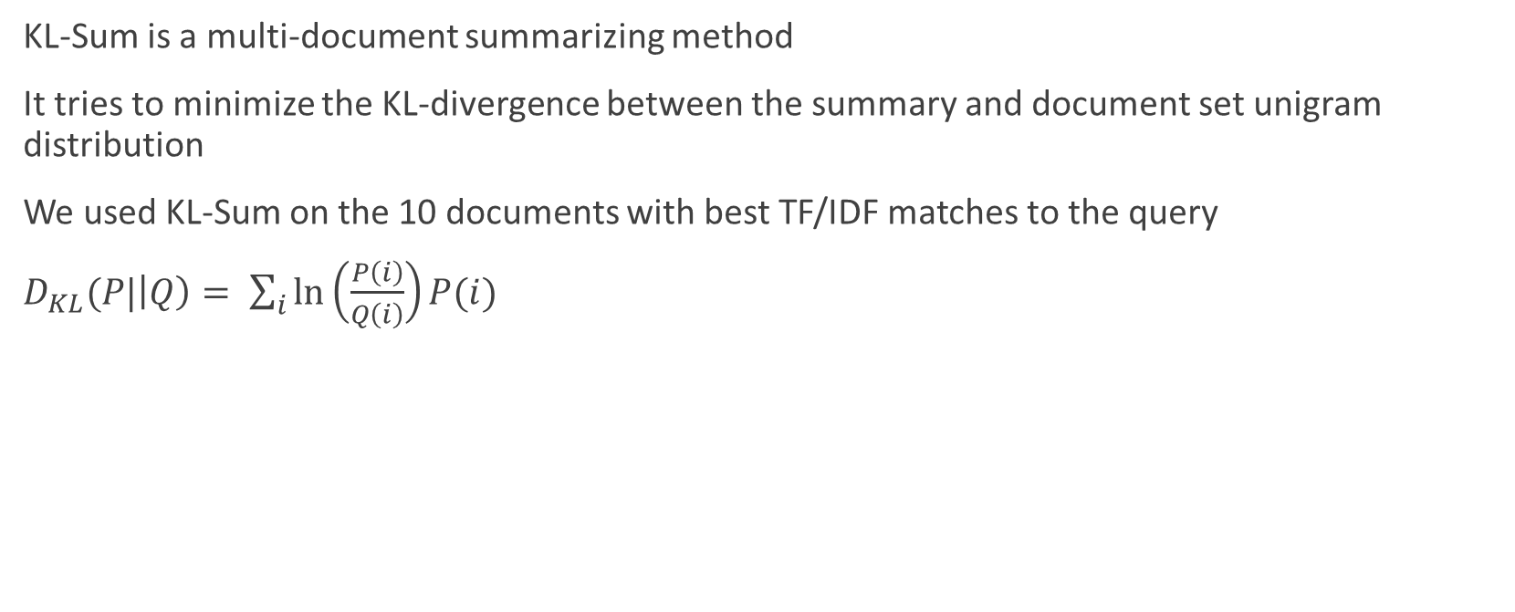
KLSum
KL-Sum is a multi-document summarizing method
It tries to minimize the KL-divergence between the summary and document set unigram distribution
We used KL-Sum on the 10 documents with best TF/IDF matches to the query
$D_{KL}(P|\left|Q\right)= \sum_{i}{\ln\left(\frac{P\left(i\right)}{Q\left(i\right)}\right)}P(i)$

Slide 35
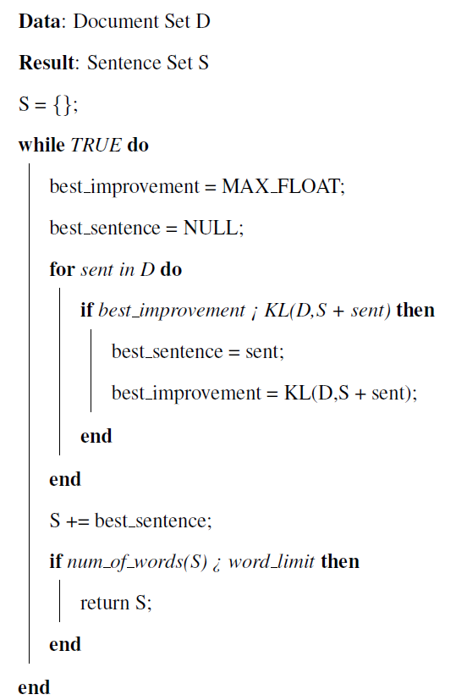

Slide 36
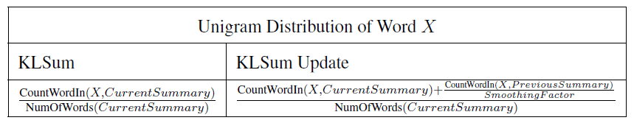

KLSum Update
A variation of KLSum that answers a query chain ($q_{1},q_{2}, …,q_{i},q_{i+1}$)
Try to minimize the KL-divergence of the summary and the top 10 TF/IDF retrieved documents for query $q_{i+1}$
Select sentences for $q_{i+1}$ assuming the smoothed distribution of the previous summary ($q_{1}…q_{i}$) is already part of the summary (eliminates redundancy)

Slide 37
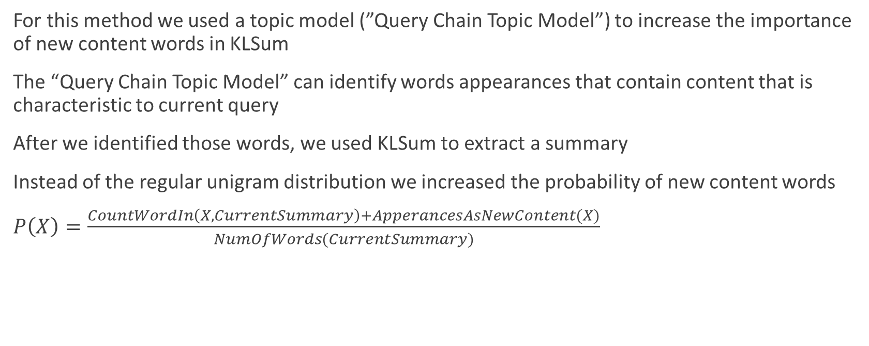
KLSum with LDA
For this method we used a topic model (”Query Chain Topic Model”) to increase the importance of new content words in KLSum
The “Query Chain Topic Model” can identify words appearances that contain content that is characteristic to current query
After we identified those words, we used KLSum to extract a summary
Instead of the regular unigram distribution we increased the probability of new content words
$P\left(X\right)=\frac{CountWordIn\left(X,CurrentSummary\right)+ApperancesAsNewContent(X)}{NumOfWords(CurrentSummary)}$

Slide 38
Latent Dirichlet Allocation (LDA)
A generative model that maps words from a document set into a set of ”abstract topics”
LDA model assumes that each document in the document set is generated as a mixture of topics
The document set is generated as a mixture of topics
Once the topics of document are assigned, words are sampled from each topic to create the document
Learning the probabilities of the topics is a problem of Bayesian inference
Gibbs sampling is commonly used to calculate the posterior distribution

Slide 39
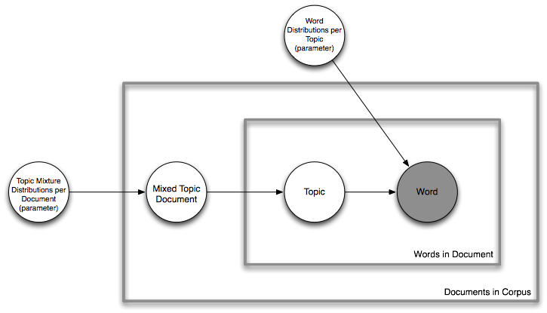
Latent Dirichlet Allocation (LDA)

Slide 40
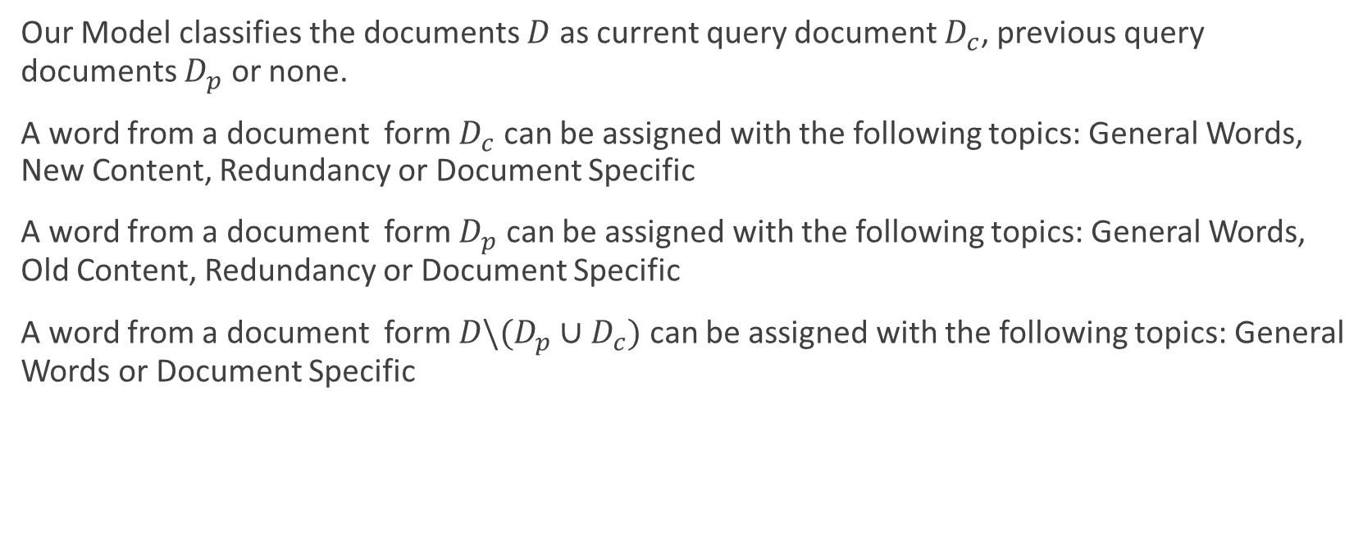
Query Chain Topic Model
Our Model classifies the documents $D$ as current query document $D_{c}$, previous query documents $D_{p}$ or none.
A word from a document form $D_{c}$ can be assigned with the following topics: General Words, New Content, Redundancy or Document Specific
A word from a document form $D_{p}$ can be assigned with the following topics: General Words, Old Content, Redundancy or Document Specific
A word from a document form ${D\backslash (D_{p}∪D}_{c})$ can be assigned with the following topics: General Words or Document Specific

Slide 42
Sentence Ordering
We sorted the sentences by a lexicographical order, we first compared the TF/IDF score between the query and the documents that the sentence were taken from if they were equal, we ordered the sentences by their order in the original document

Slide 43
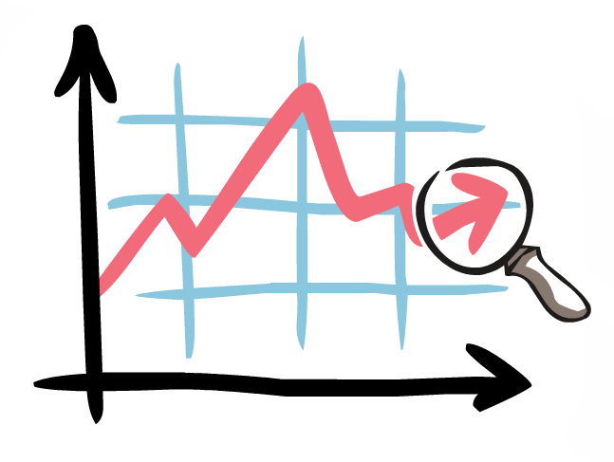
Results Analysis

Slide 44
UMLS and Wiki Coverage
Searched tagging errors by manually searching for tags with low compare scores
Wrong sense error: ’Ventolin (e.p)’ (a song by electronic artist Aphex Twin) instead of ’Salbutamol’ (aka ‘Ventolin’) – manually replaced by the correct sense
Unfixable errors: ’States and territories of Australia’ found in the sentence ”You also can look for asthma-related laws and regulation in each state and territory through the Library of Congress (see Appendix 5).” – manually programed to be discarded

Slide 45
Manual Evaluation
Method | Coverage | Redundancy | Comments
LexRank | medium | some | a lot of lexical appearance of the query but not enough content.
LexRank Update | medium | some | the annotators could not notice the improvement in redundancy.
KLSum | good | noticeable | tendency to prefer longer sentences.
KLSum Update | good | good | tendency to prefer longer sentences.
KLSum + LDA | good | good | low coherence but better than the others.

Slide 46
Automatic Evaloation

Slide 47
Automatic Evaluation

Slide 48

Conclusions and Future Work

Slide 49
Conclusions
Can we use any existing datasets to evaluate such methods?
Can we use any existing automatic summarization method for our task?
Does previous summaries effect the current summary?
Can we use automatic summaries to improve the exploratory search process?

Slide 50
Future Work
improving the coverage and redundancy of our methods
Optimizing run-time performance
Improving coherence

Slide 51

Questions?

