Slide 1
ICG 2021 Spring Homework1 Guidance 2021/03/18
網媒所碩二 聶偲帆

Slide 2
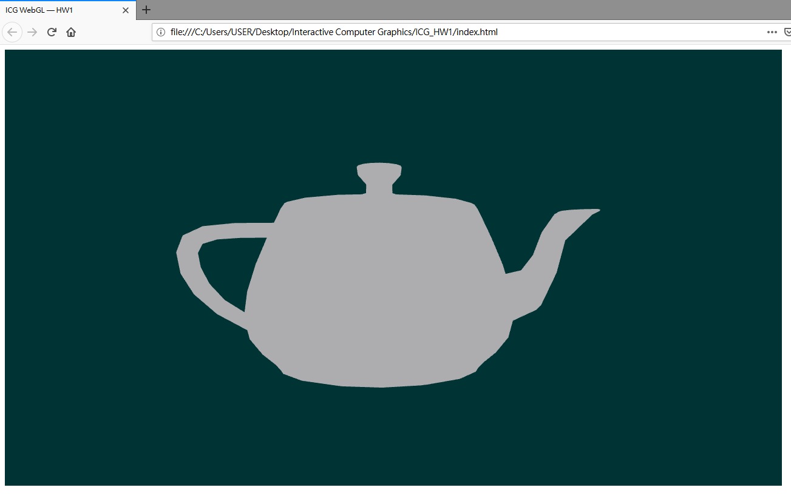
Environment Setup
Download sample code from course website
Follow steps in HW1_Guide.pdf file

Slide 3
Requirements (Due to 2021/05/13)
Implement Flat, Gouraud, and Phong shading with Phong reflection model in shaders.
Enable multiple transformations (four fundamental transformations) on objects in a scene. You are free to use those provided model files and arrange them to form the scene on your own style.
At least 3 objects & at least 3 light sources
Bonus: Special effects on shading / lighting / animation, …
（反正要有三個光源，要很明顯-> 改光源顏色比較明顯）
加分項：卡通渲染 （可以另外寫在另一份code，用不同與言寫也家分
Notes:
上一週期中考

Slide 4
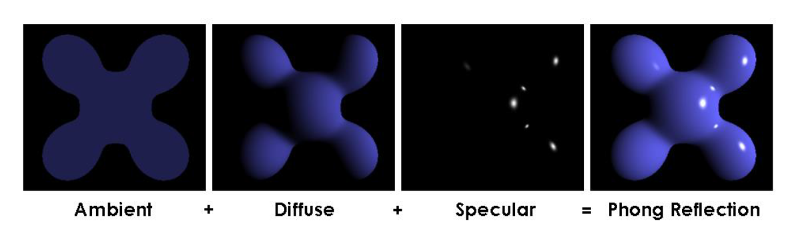
Phong Reflection Model

Slide 5
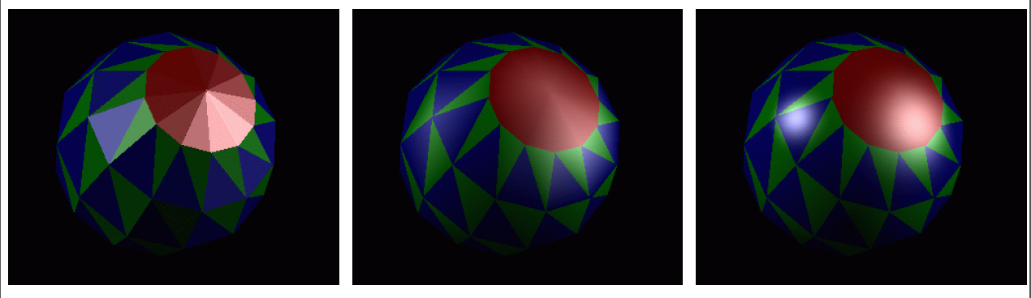
Shading
Flat Shading: Constant normal on the whole surface
Gouraud Shading: Different vertex normal, interpolated vertex color on a fragment
Phong Shading: Different vertex normal, interpolated vertex normal on a fragment

Slide 6
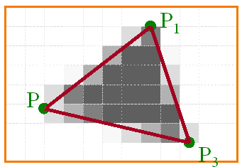
Rendering Pipeline

Slide 7
Graphics API & Shader Language
Graphics API | Shader Language
OpenGL / WebGL | GLSL (OpenGL Shading Language)
DirectX | HLSL (High Level Shading Language)
Vulkan | SPIR-V

Slide 8
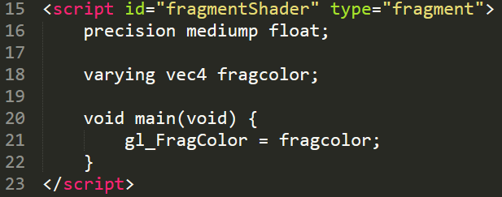
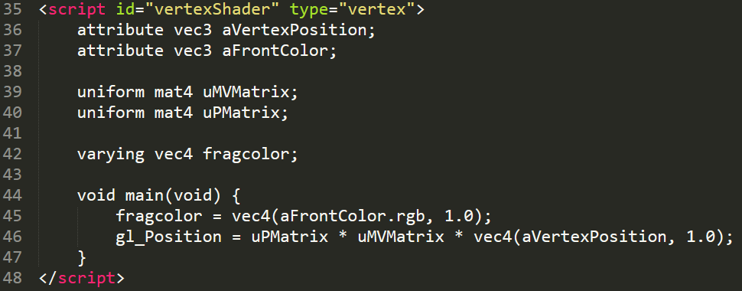
Shader (GLSL)

Slide 9
Shader Data (1/2)

Slide 10
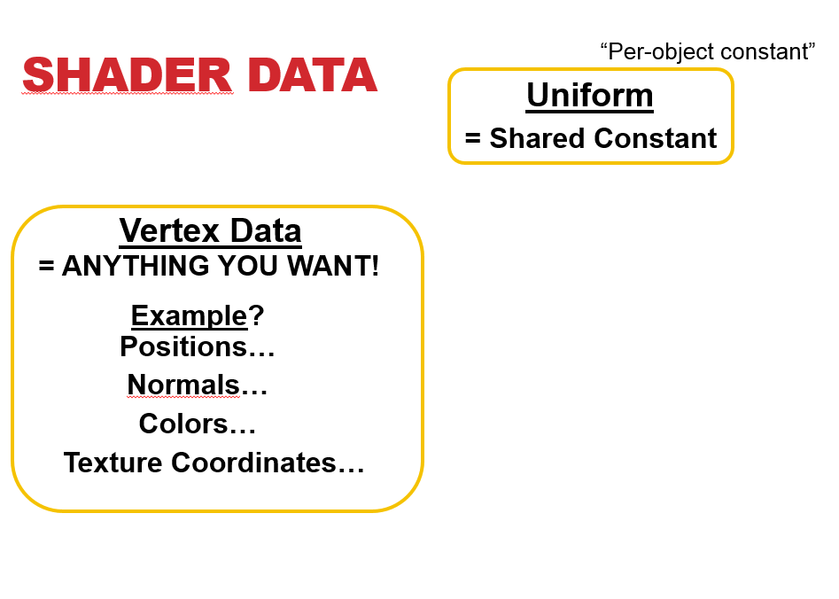
Shader Data (2/2)

Slide 11
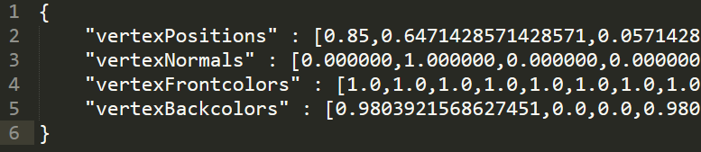
Load Models
已經將大部分課程網的 tri 模型轉成 json 檔
Example Csie.json

Slide 12
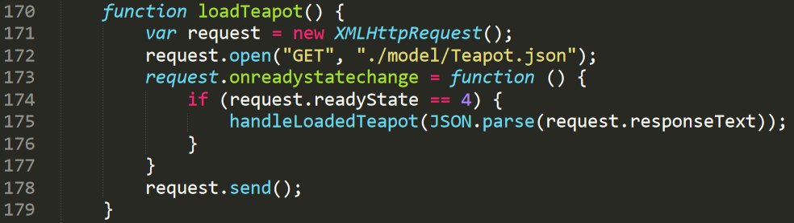
Load Models
將範例code的茶壺路徑替換成其他想要的模型即可。

Slide 13
World transform
y
x
z
Model coordinates

Slide 14
World transform
World coordinates

Slide 15
World transform
Camera coordinates

Slide 16
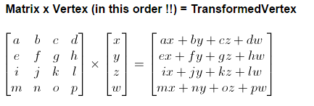
Transformations
Fundamental Transformations:
Translation、Scale、Rotation、Shear
Order of matrix multiplication may affect final result
Homogeneous Coordinates

Slide 17
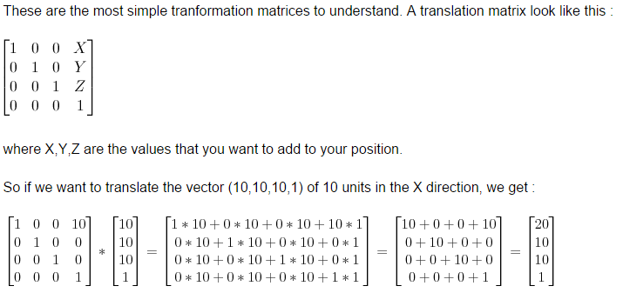
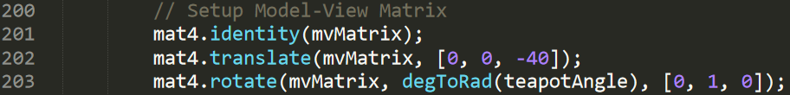
Translation

Slide 18
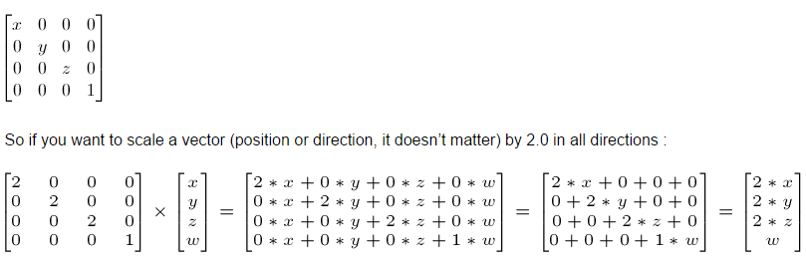
Scale

Slide 19
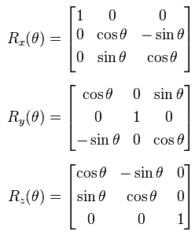
Rotate

Slide 20
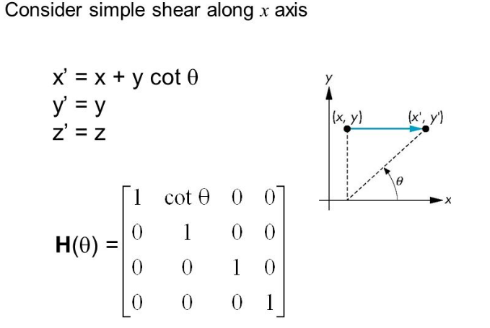
Shear

Slide 21
Requirements Again (Due to 2020/05/13)
Implement Flat, Gouraud, and Phong shading with Phong reflection model in shaders.
Enable multiple transformations (four fundamental transformations) on objects in a scene. You are free to use those provided model files and arrange them to form the scene on your own style.
At least 3 objects & at least 3 light sources
Bonus: Special effects on shading / lighting / animation, …

Slide 22
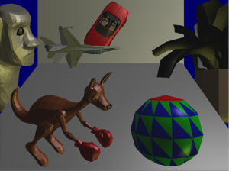
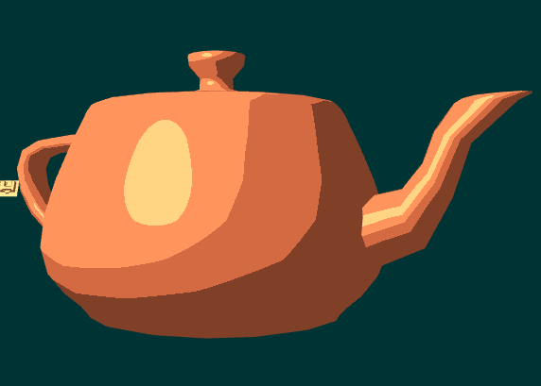
Result Example

Slide 23
Reference
https://webglfundamentals.org/
http://learningwebgl.com/blog/?page_id=1217
https://learnopengl.com/

Slide 24
TA Hours
聶偲帆 (CSIE R505)
r08944017@csie.ntu.edu.tw
Thursday 16:00 ~ 17:00
李建德 (CSIE R505)
r08922180@ntu.edu.tw
Thursday 15:00 ~ 16:00
陳禹樵 (CSIE R505)
sorevan@cmlab.csie.ntu.edu.tw
Tuesday 10:00 ~ 11:00

Slide 25
Q & A

Slide 26
加分
不同的 texture
用不同的語言寫
實作backcolor (因為這次理論上不會用到)
Rotate的方式不同也可以加分
多做幾個物件 幾個光源 放大縮小
（bonus old 6項才會Ａ＋）（新的bonus有原創性加分比較多）
Demo會要你改：
會動，不會動。燈光顏色。之類的一大堆
希望顏色多漂亮一點 設定選單可以多一點特別的東西
自己做model加分 （天竺鼠車車）

Slide 27
老師想要
Clipping的效果，對六個面都clipping一次得到3D clipping 效果

