Slide 1
Discrete mathematics
Spring 2020
Yuan Ze University

Slide 2
Terminologies about graphs

Slide 3
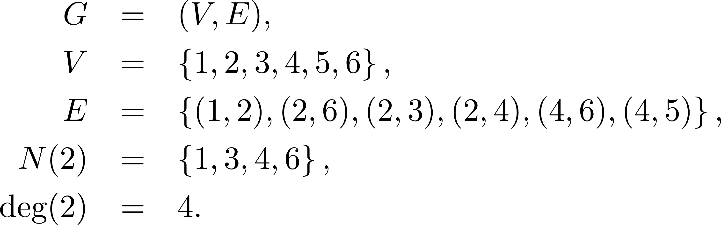
Simple undirected graphs
1
2
5
6
4
3

Slide 4
Terminologies
Graph、圖
Vertex set、set of vertices、點集合
Edge set、set of edges、邊集合
Neighborhood of 2、set of neighbors of 2
Degree of 2

Slide 5
What does “simple” mean?
A graph is simple if it has neither self-loops nor parallel edges.
All graphs in this class are assumed to be simple unless otherwise specified.

Slide 6
Quiz
v₃
How many endpoints does each edge have?
v₁
v₅
v₂
v₄
v₆
v₇
v₈
v₉

Slide 7
Quiz
v₃
Is this a graph?
v₁
v₅
v₂
v₄
v₆
v₈

Slide 8
Degrees
v₆
v₃
1
3
v₇
2
v₁
v₅
2
3
v₉
1
v₂
v₄
2
2
v₈
0

Slide 9
Quiz
v₃
How many vertices have degree 4?
v₁
v₅
v₂
v₄
v₆
v₇
v₈
v₉

Slide 10
Isolated vertices
v₆
v₃
v₇
v₁
v₅
v₉
v₂
v₄
v₈

Slide 11
Paths
v₆
We do not allow repeated vertices on a path
v₃
v₇
v₁
v₅
v₉
v₂
v₄
v₈

Slide 12
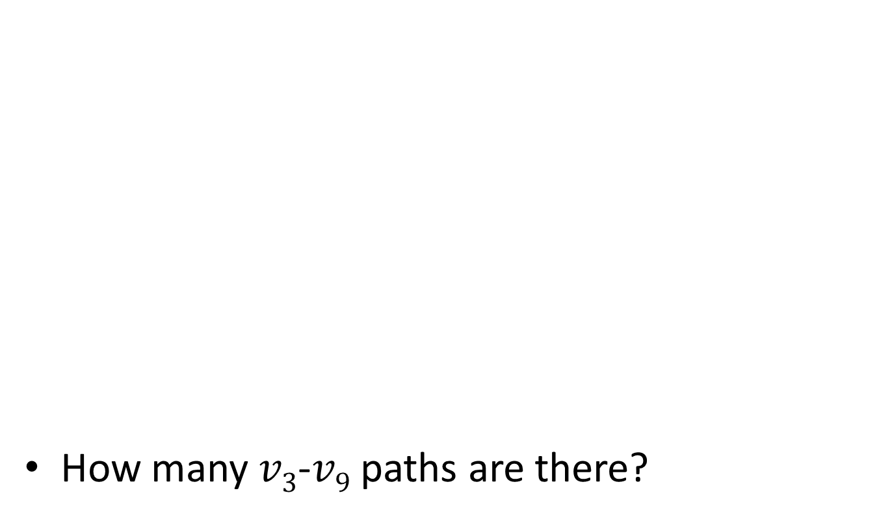
Quiz
v₃
How many $v3$-$v9$ paths are there?
v₁
v₅
v₂
v₄
v₆
v₇
v₈
v₉

Slide 13
Lengths of paths
v₆
The number of edges traversed.
Allow length-zero paths.
v₃
v₇
v₁
v₅
v₉
v₂
v₄
v₈

Slide 14
Cycles
v₆
We allow a cycle to have neither repeated vertices nor repeated edges except that the start and end vertices are the same.
v₃
v₇
v₁
v₅
v₉
v₂
v₄
v₈

Slide 15
Quiz
v₃
How many cycles are there?
v₁
v₅
v₂
v₄
v₆
v₇
v₈
v₉

Slide 16
Subgraphs
v₆
v₃
v₇
v₁
v₅
v₉
v₂
v₄
v₈

Slide 17
Quiz
v₃
Is this graph a subgraph of itself?
v₁
v₅
v₂
v₄
v₆
v₇
v₈
v₉

Slide 18
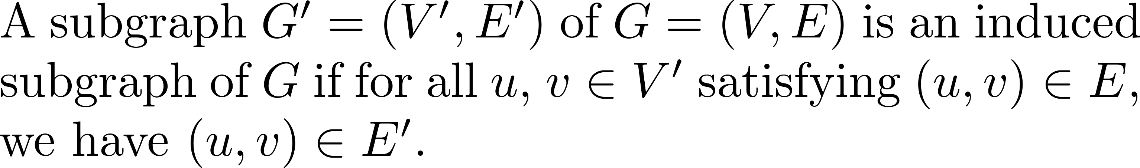
Induced subgraphs
v₆
v₃
v₇
v₁
v₅
v₉
v₂
v₄
v₈

Slide 19
Quiz
Is the graph on the right a subgraph of the one on the left?
v₁
v₁
v₂
v₂
v₈
v₉
v₈

Slide 20
Quiz
Is the graph on the right an induced subgraph of the one on the left?
v₁
v₁
v₂
v₂
v₈
v₉
v₈

Slide 21
Quiz
Does the figure on the right show a subgraph of the graph on the left?
v₁
v₁
v₂
v₈
v₉
v₈

Slide 22
Complete graphs
v₃
v₁
v₅
v₂
v₄

Slide 23
Connected graphs
A graph is connected if there is a path between each pair of vertices.
v₃
v₁
v₅
v₂
v₄

Slide 24
Connected components
v₆
There are 3 connected components.
It is a disconnected graph.
v₃
v₇
v₁
v₅
v₉
v₂
v₄
v₈

Slide 25
Connected components ☺
v₆
v₃
v₇
v₁
v₅
v₉
v₂
v₄
v₈

Slide 26
Quiz
v₃
How many connected components are there?
v₁
v₅
v₂
v₄
v₆
v₇
v₈
v₉

Slide 27
Quiz
v₃
Does the dashed part form a connected component of this graph?
v₁
v₅
v₂
v₄
v₆
v₇
v₈
v₉

Slide 28
Quiz
v₃
Does the dashed part form a connected component of this graph?
v₁
v₅
v₂
v₄
v₆
v₇
v₈
v₉

Slide 29
Quiz
v₃
Does the dashed part form a connected component of this graph?
v₁
v₅
v₂
v₄
v₆
v₇
v₈
v₉

Slide 30
Quiz
v₃
Does the dashed part form a connected component of this graph?
v₁
v₅
v₆
v₂
v₄
v₈
v₉
v₇

Slide 31
Quiz
v₆
How will the number of connected components change if we add to a graph a new vertex and an edge incident to it?
v₃
v₇
v₁
v₅
v₉
v₂
v₄
v₈
☺

Slide 32
Trees
v₃
A tree is a connected acyclic graph.
v₁
v₅
v₂
v₄
v₆
v₇
v₈
v₉

Slide 33
Quiz
Is this a tree?
v₃

Slide 34
Quiz
v₃
In how many ways can you remove an edge from this graph so that it becomes a tree?
v₁
v₅
v₂
v₄
v₆
v₇
v₈
v₉

Slide 35
Representing graphs

Slide 36
Adjacency list representation
1: 2
2: 1, 3, 4
3: 2, 4
4: 2, 3
5:
1
2
5
4
3

Slide 37
Adjacency matrix
1
2
5
 | 1 | 2 | 3 | 4 | 5
1 | 0 | 1 | 0 | 0 | 0
2 | 1 | 0 | 1 | 1 | 0
3 | 0 | 1 | 0 | 1 | 0
4 | 0 | 1 | 1 | 0 | 0
5 | 0 | 0 | 0 | 0 | 0
4
3

Slide 38
Our default choice
Adjacency list representation

Slide 39
Comments?

