Slide 1
Discrete Mathematics
Spring 2020
Yuan Ze University

Slide 2

Course information (1/2)
Discrete Mathematics (CS107/IN106)
Credits: 3
Time: 10:10–12:00, Tuesday, and 9:10–10:00, Wednesday
Place: 70206
Prerequisites: None
Teaching assistants: To be announced
My email: clchang@saturn.yzu.edu.tw
My line ID: clchang1982

Slide 3
Course information (2/2)
Midterm and final exams
A possible programming assignment

Slide 4
Something very important
Do NOT attend any class if you seem to have a cold.
Keep windows open.

Slide 5
Notations

Slide 6
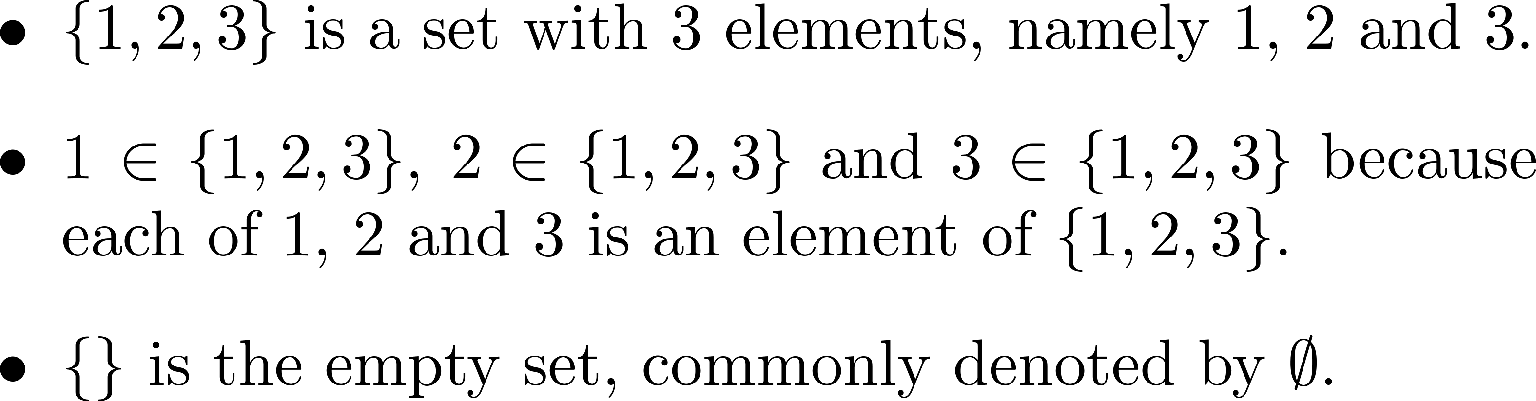
Sets and related notations (1/10)

Slide 7
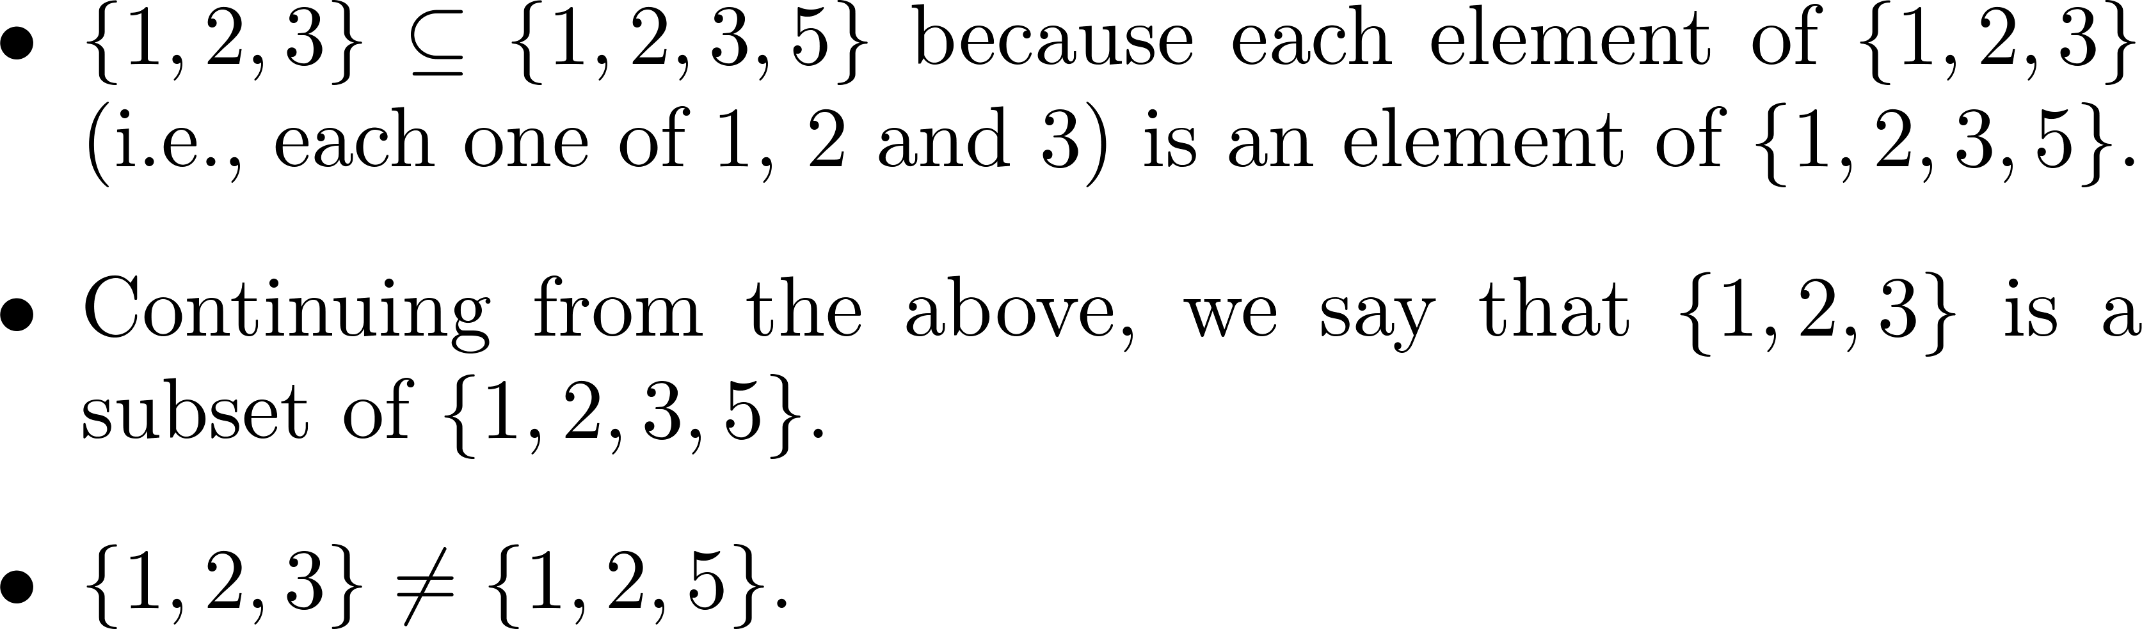
Sets and related notations (2/10)

Slide 8
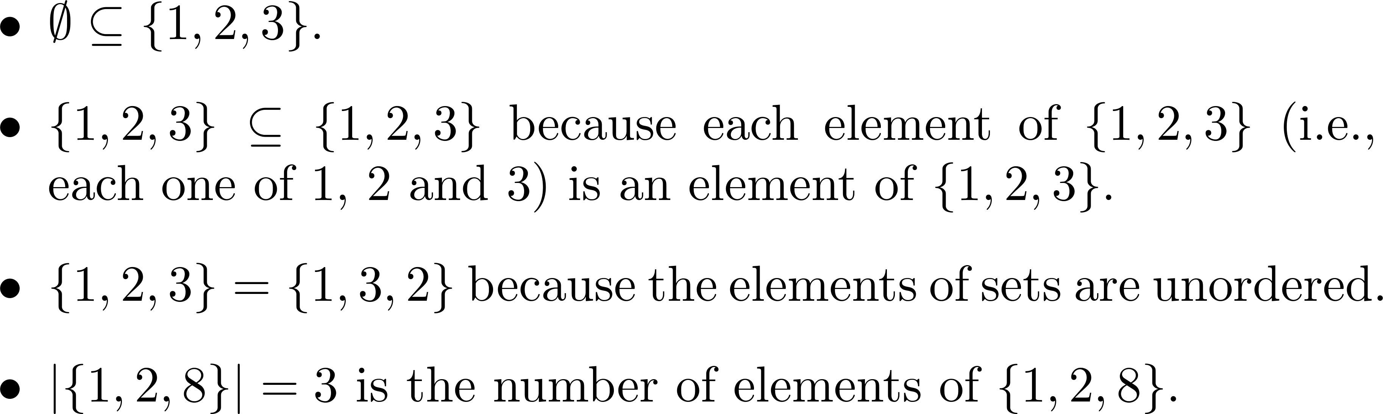
Sets and related notations (3/10)

Slide 9
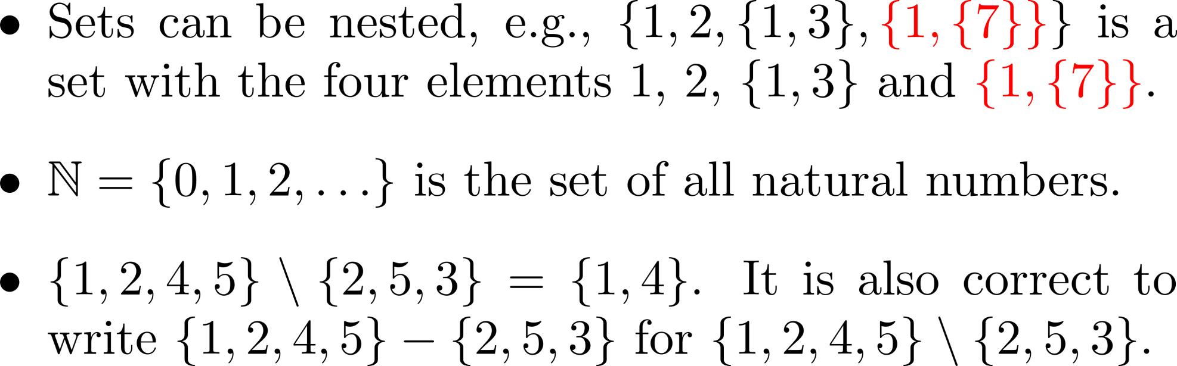
Sets and related notations (4/10)

Slide 10
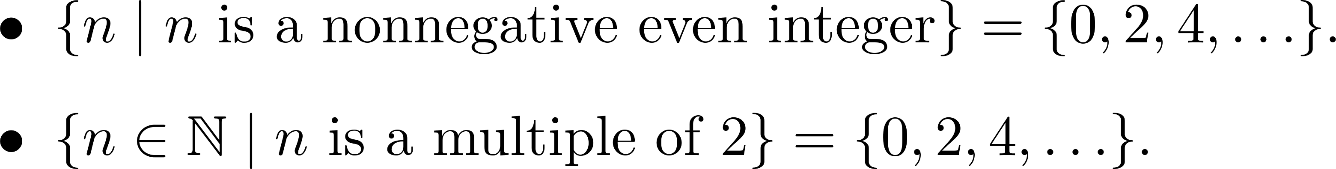
Sets and related notations (5/10)

Slide 11
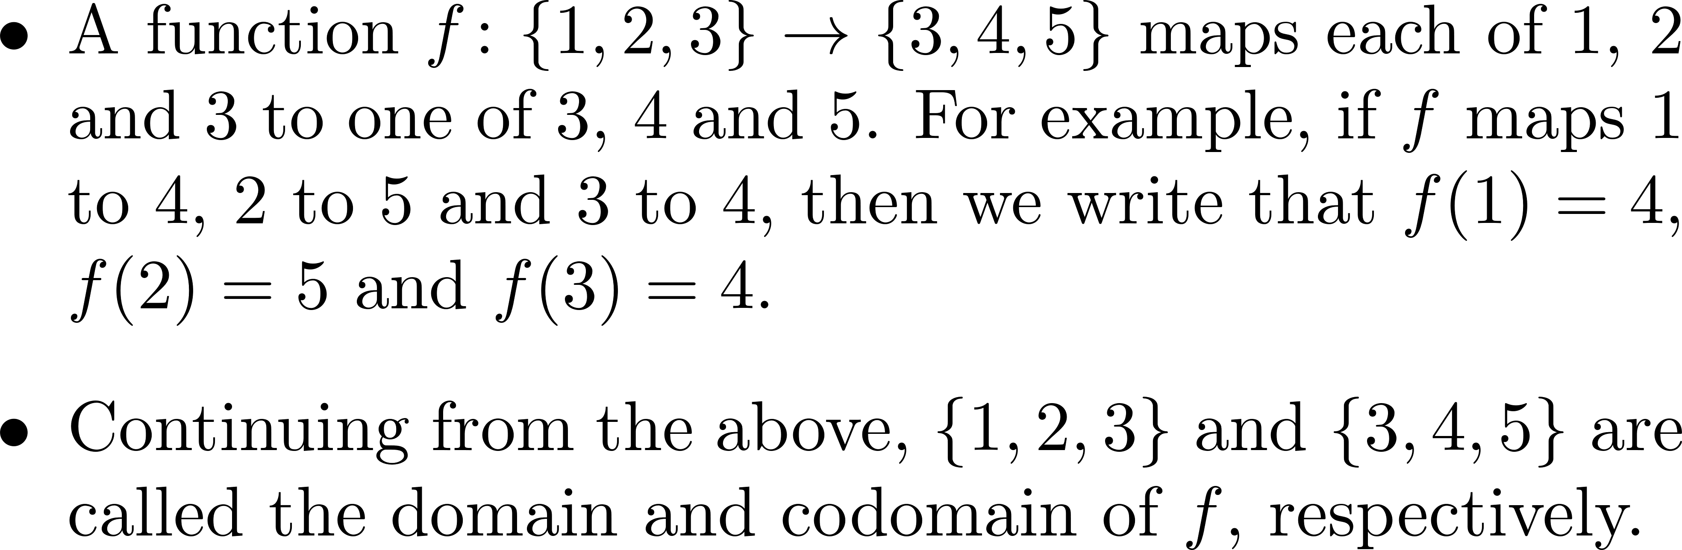
Sets and related notations (6/10)

Slide 12
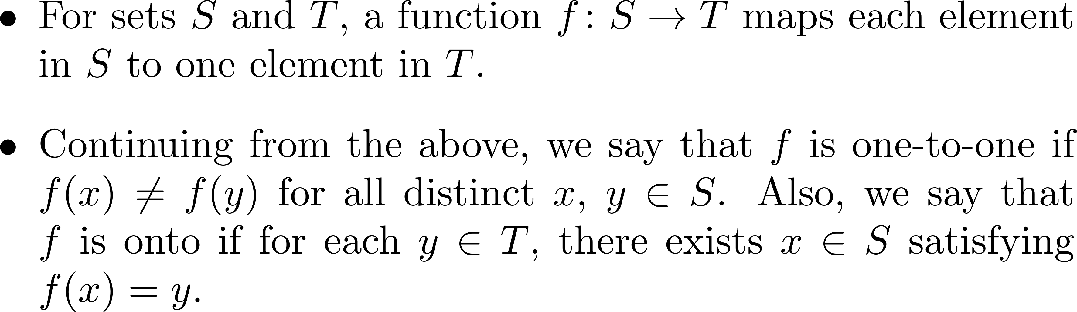
Sets and related notations (7/10)

Slide 13
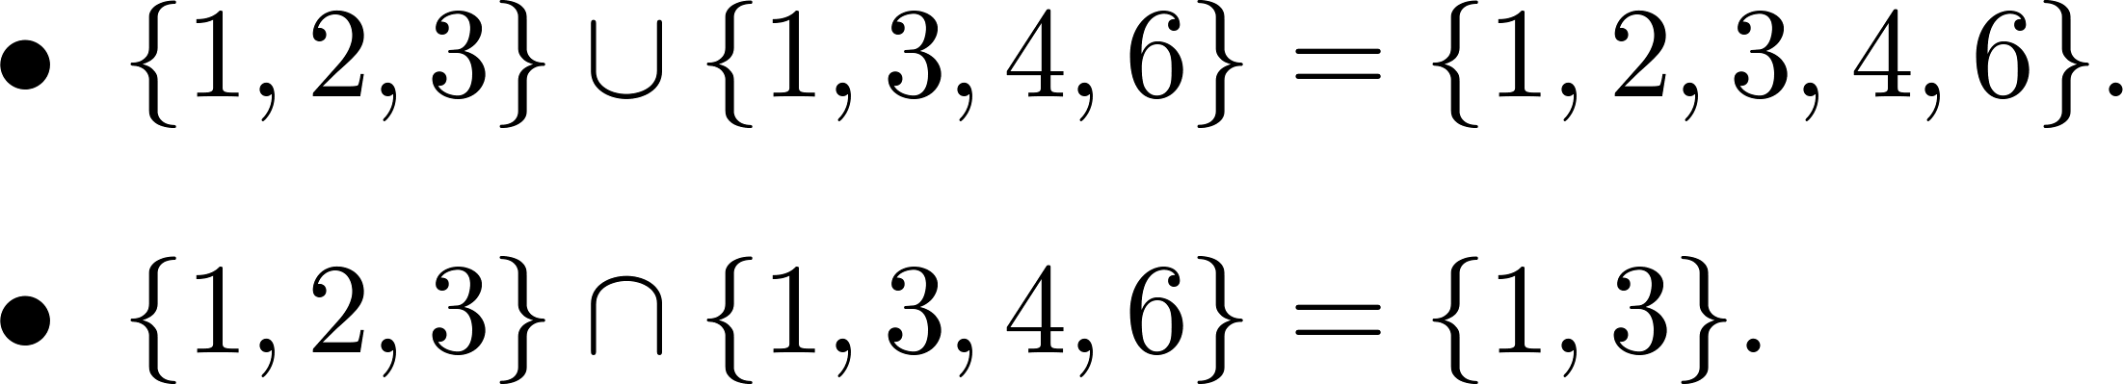

Sets and related notations (8/10)

Slide 14
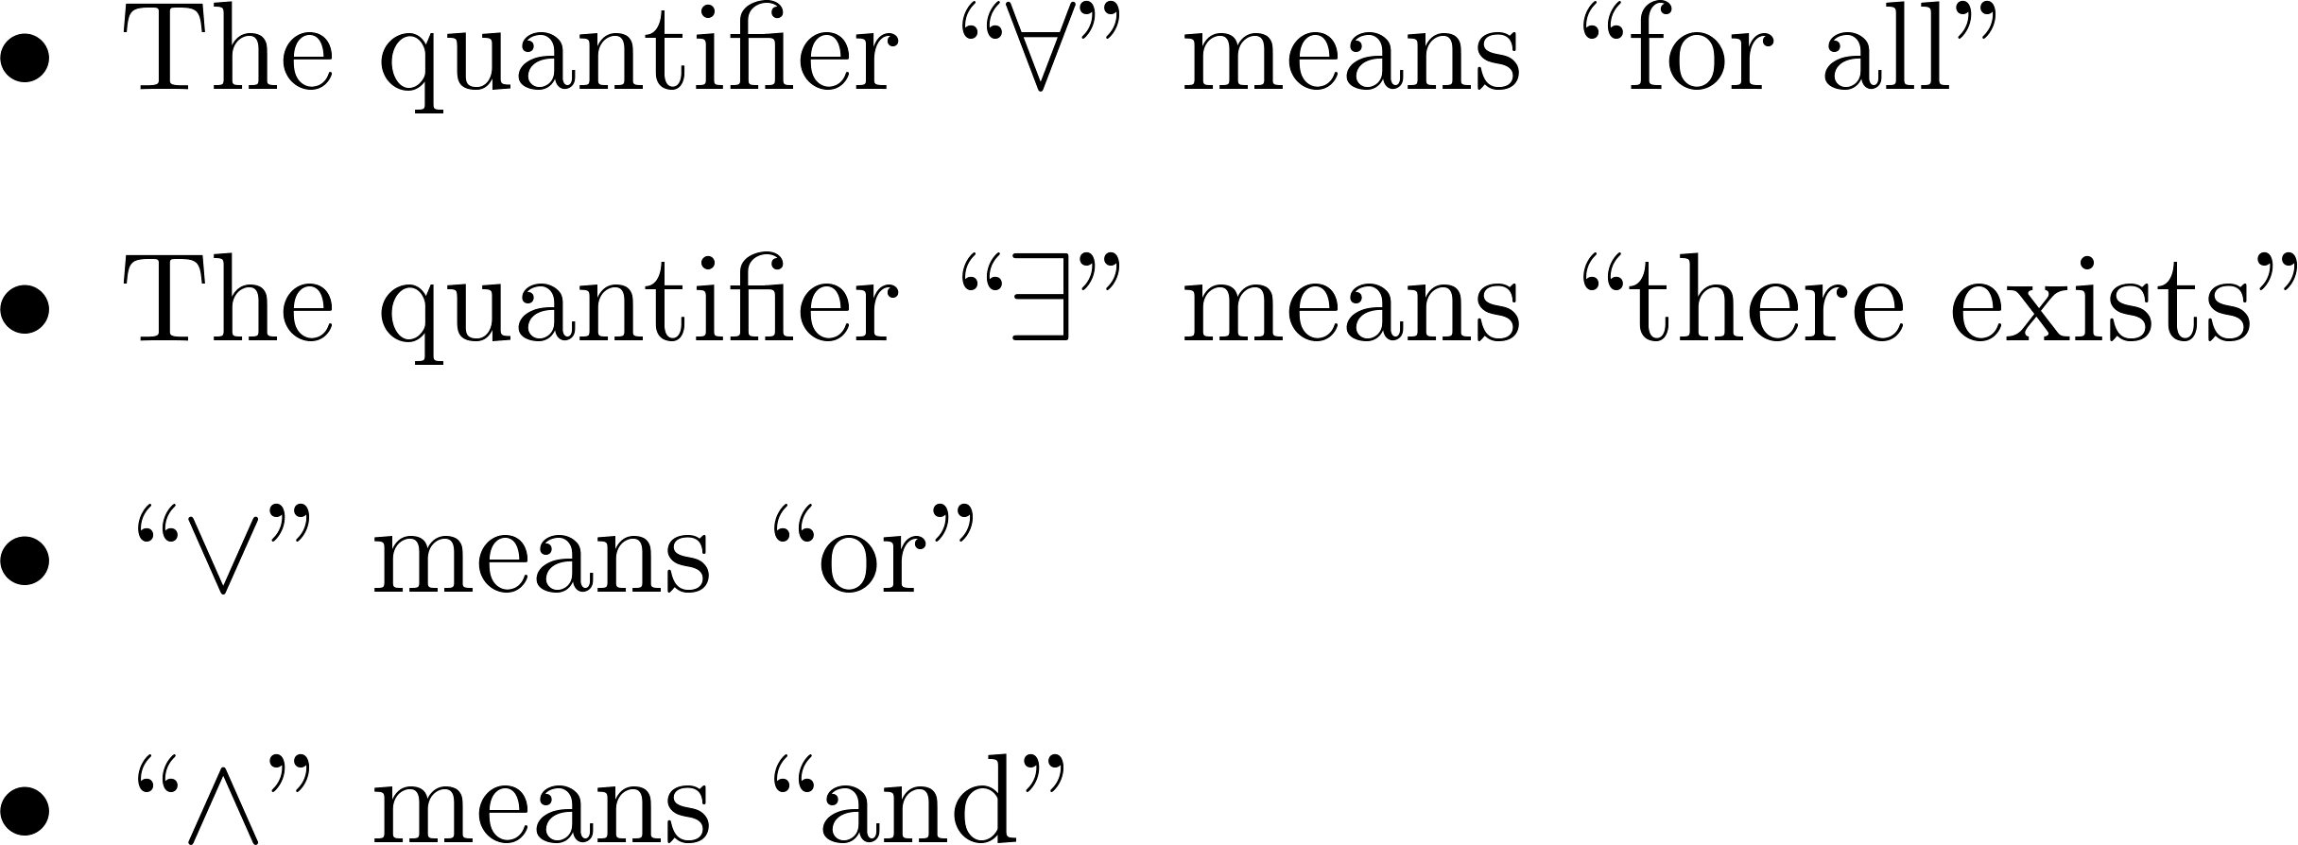
Sets and related notations (9/10)

Slide 15
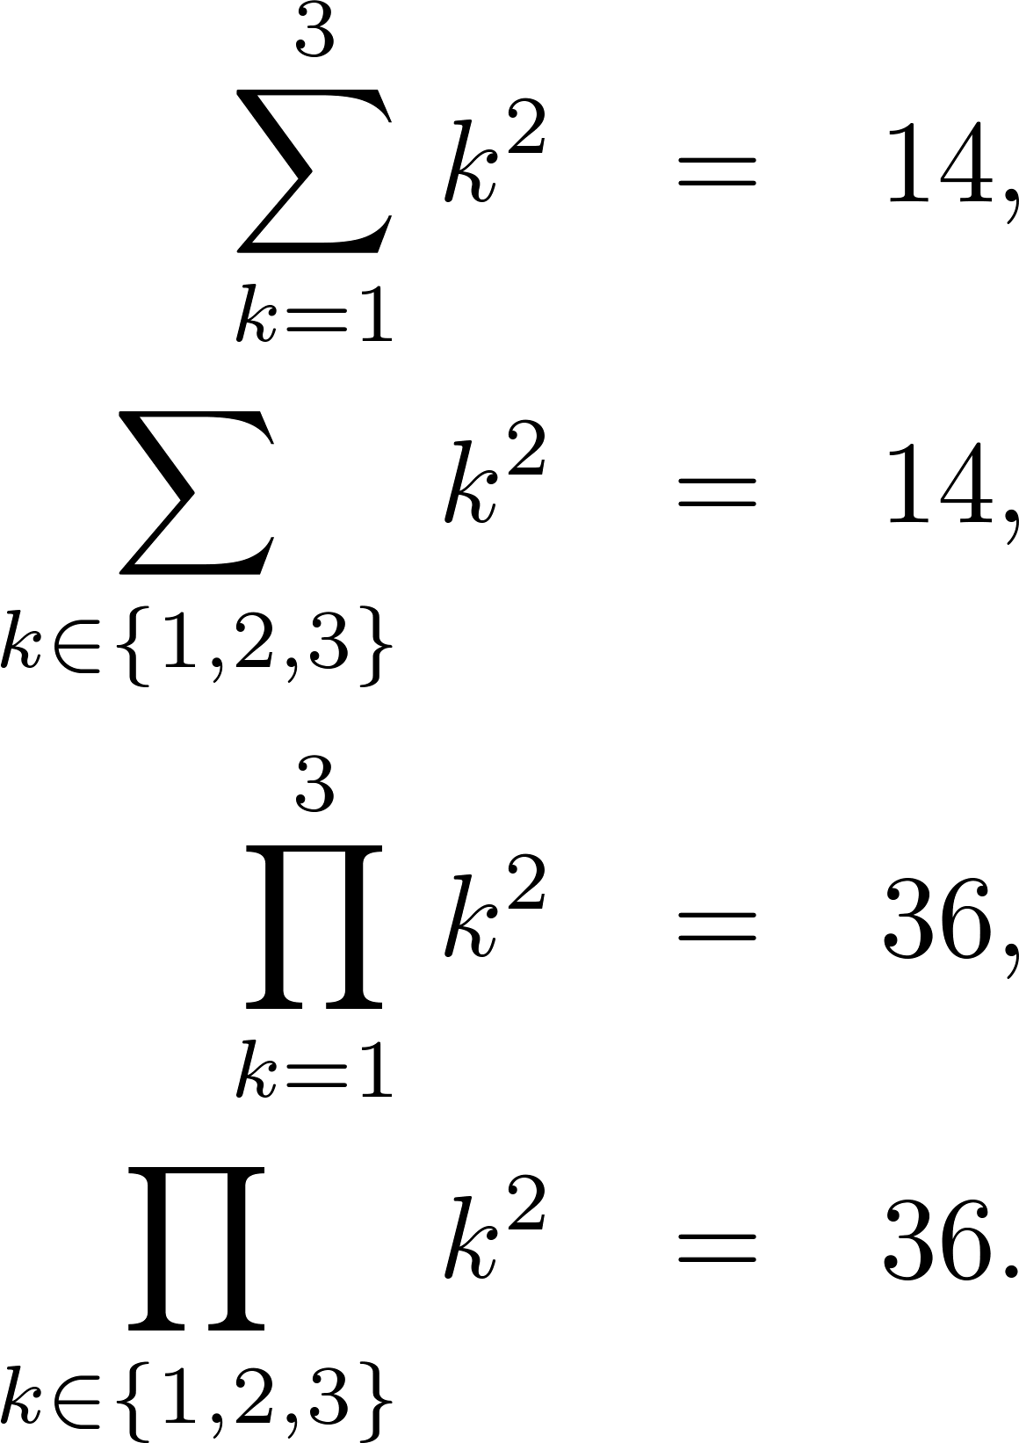
Sets and related notations (10/10)

Slide 16
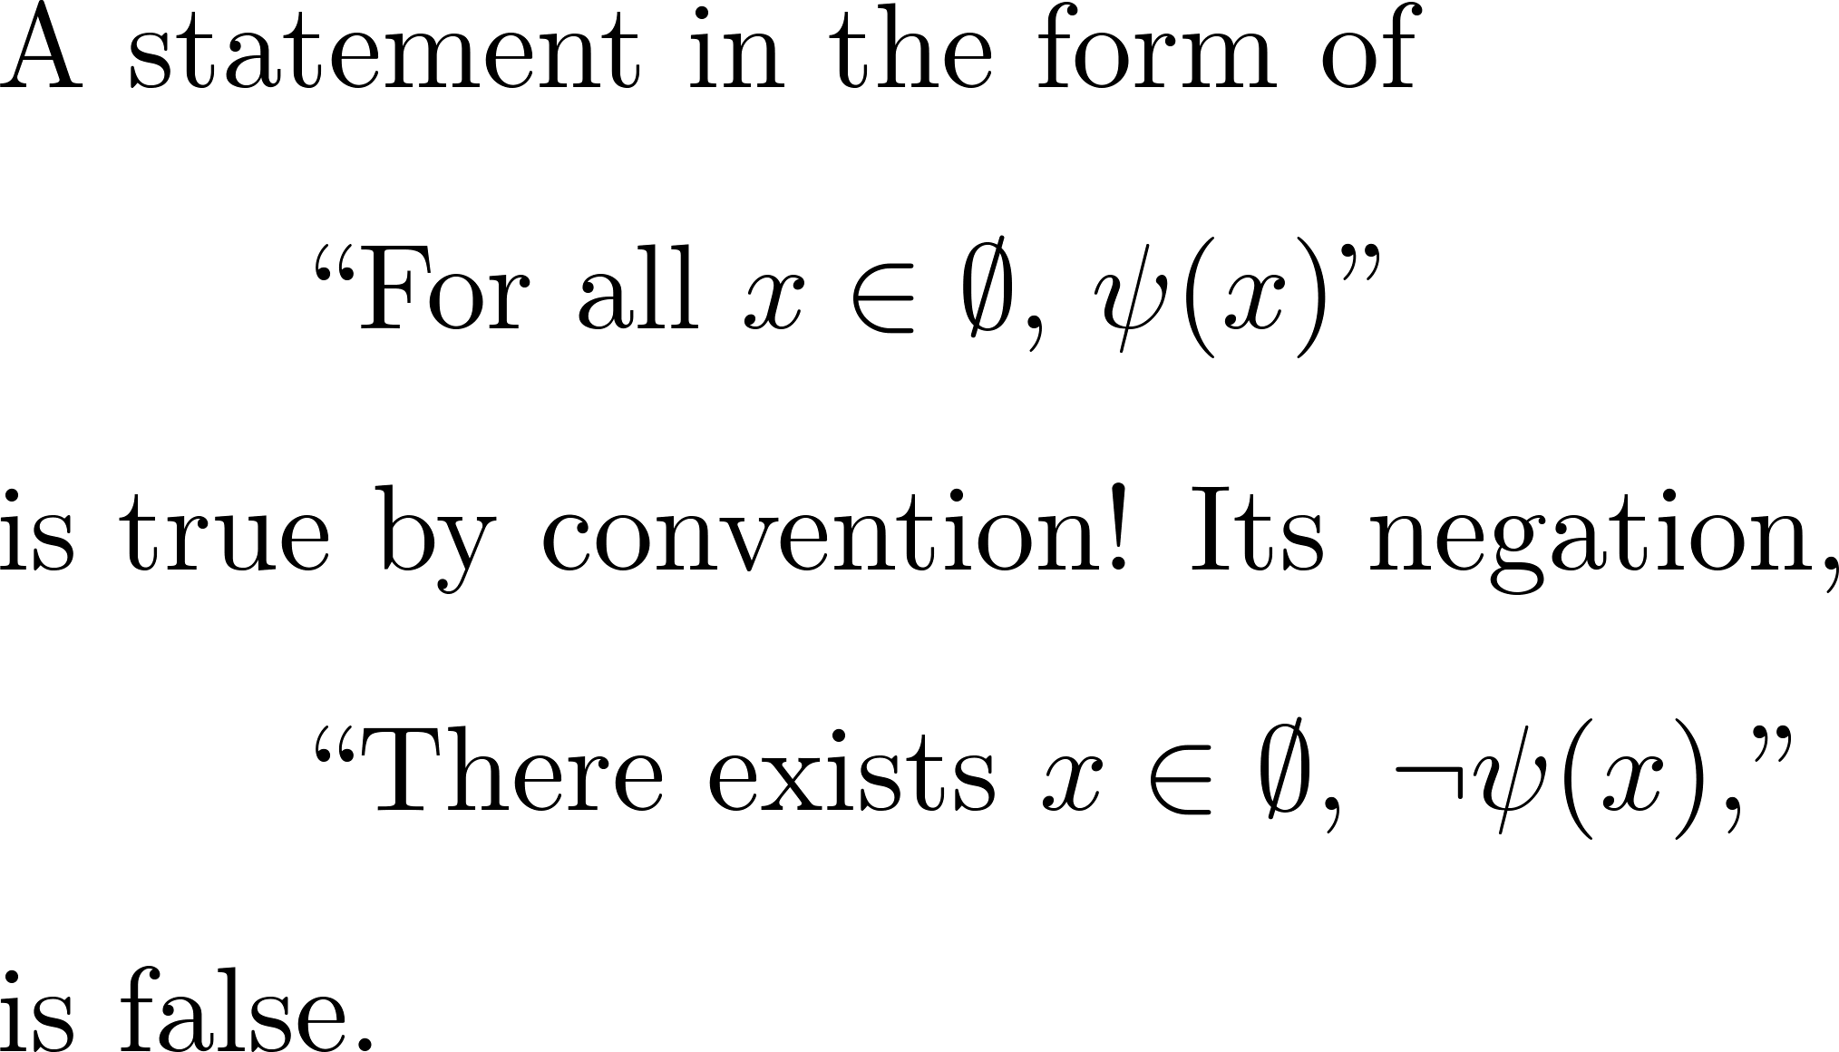
Vacuously true statements

Slide 17
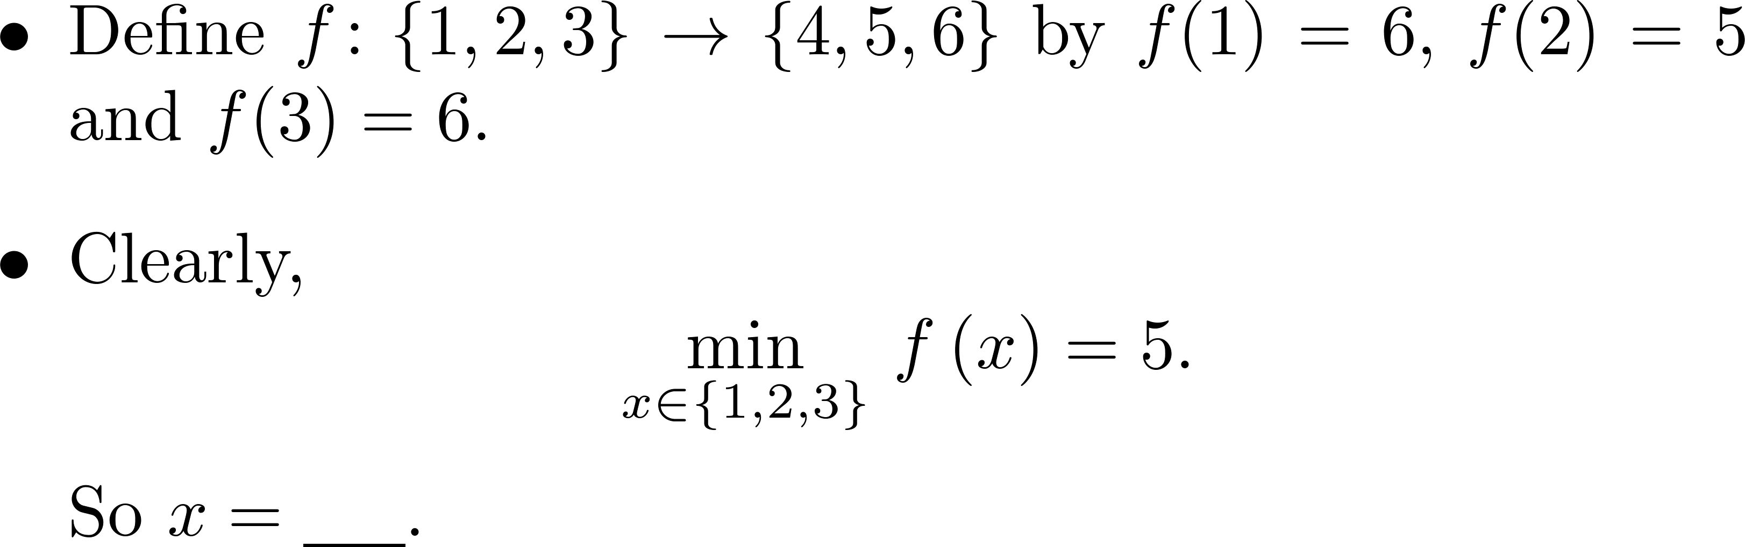
Scopes of variables
An ill-defined question!

Slide 18
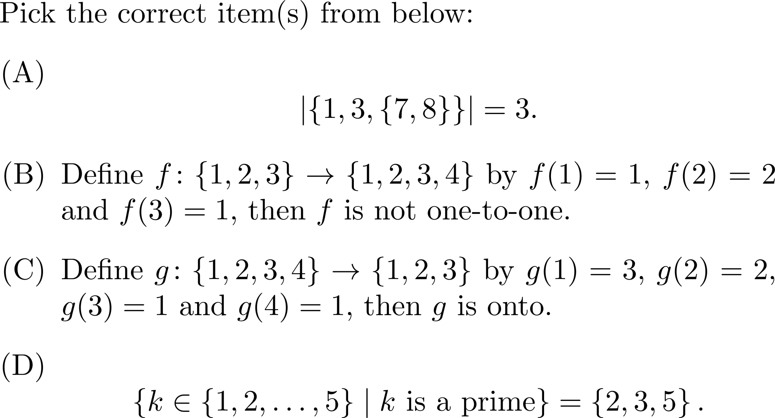
Exercise

Slide 19
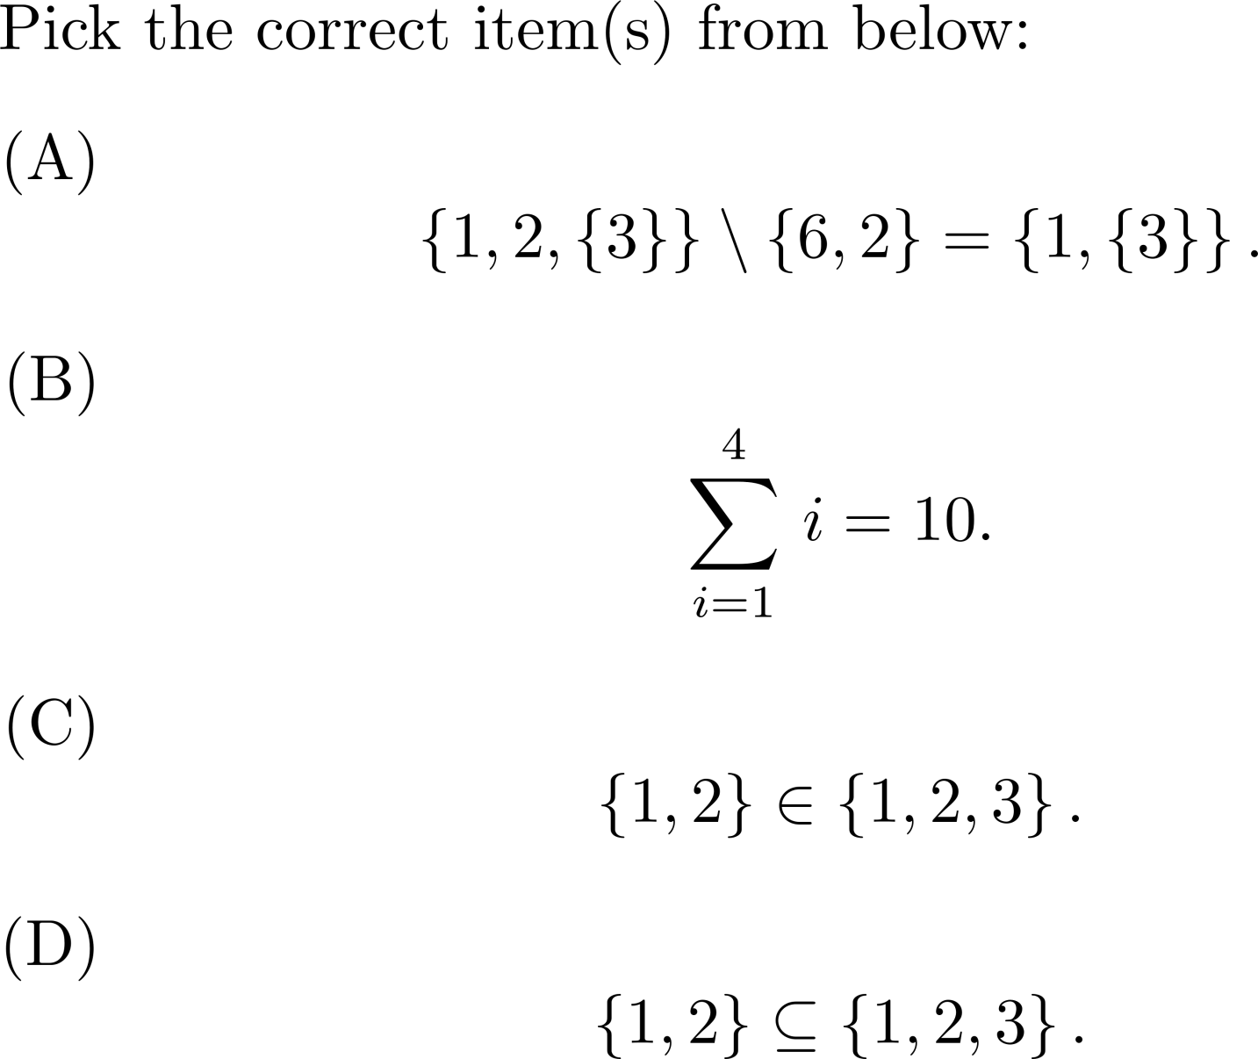
Exercise

Slide 20
Comments?

