Slide 1
Window Programming 10-3
GraphicsPath
AddString
Yuan Ze University

Slide 2
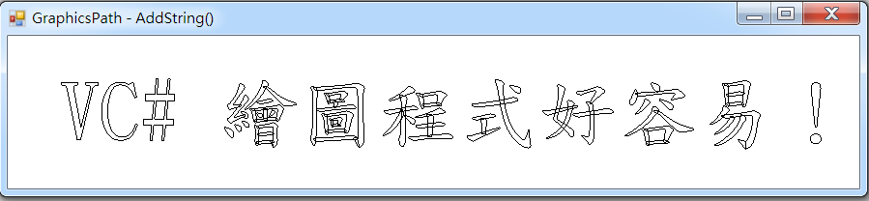
AddString example
AddString描繪出字串的路徑(中空軌跡)
  可用FillPath將內部填色

Slide 3
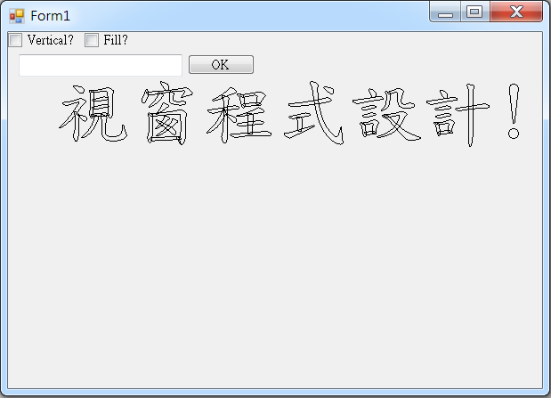
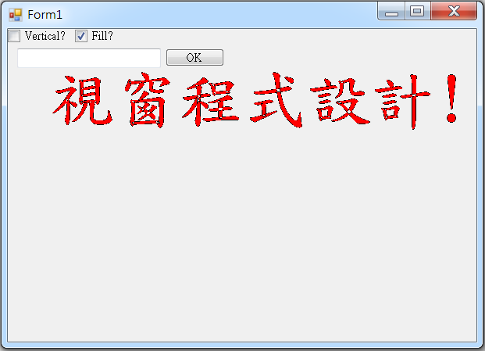
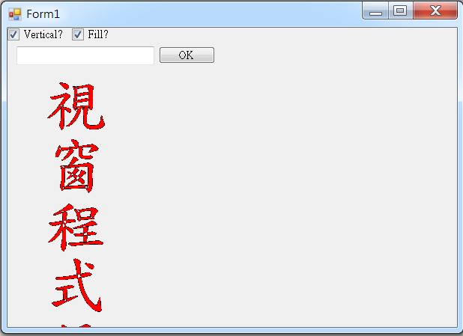
AddString example

Slide 4
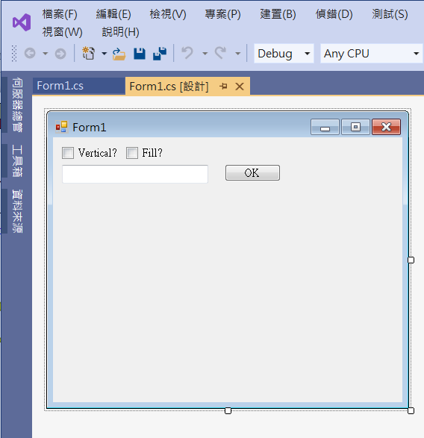
AddString example
checkBox2
button1
checkBox1
textBox1

Slide 5
AddString example
using System;
using System.Collections.Generic;
using System.ComponentModel;
using System.Data;
using System.Drawing;
using System.Linq;
using System.Text;
using System.Threading.Tasks;
using System.Windows.Forms;
using System.Drawing.Drawing2D;

Slide 6
AddString example
public partial class Form1 : Form
{
string text = "視窗程式設計!";
public Form1()
{
InitializeComponent();
ClientSize = new Size(600, 400);
}

Slide 7
AddString example
private void Form1_Resize(object sender, EventArgs e)
{
Invalidate();
}
private void CheckBox1_CheckedChanged(object sender, EventArgs e)
{
Invalidate();
}
private void CheckBox2_CheckedChanged(object sender, EventArgs e)
{
Invalidate();
}

Slide 8
AddString example
private void Form1_Paint(object sender, PaintEventArgs e)
{
GraphicsPath gp = new GraphicsPath(); // GraphicsPath物件
FontFamily family = new FontFamily("標楷體"); //字型
StringFormat format = StringFormat.GenericDefault; // 預設字體設定
if (checkBox1.Checked)
format.FormatFlags = StringFormatFlags.DirectionVertical; // 垂直
else
format.FormatFlags = StringFormatFlags.FitBlackBox; //避免突出，水平

Slide 9
AddString example
gp.AddString(text, // 繪出文字字串
family,
(int)FontStyle.Regular,
80,
new Point(40, 60),
format);
// 將 gp 內的形狀 繪出
e.Graphics.DrawPath(Pens.Black, gp); // 繪出GraphicsPath物件
if (checkBox2.Checked)
e.Graphics.FillPath(new SolidBrush(Color.Red), gp); //填色
}
字型大小
左上角座標

Slide 10
AddString example
private void Button1_Click(object sender, EventArgs e)
{
text=textBox1.Text;
Invalidate();
}

Slide 11
Exercise#10-3

Slide 12
內容來源
  Visual C# 2012 視窗程式設計：繪圖與遊戲專題(鄞永傳/著; 松崗)

