Slide 1
Window Programming 11-1
Bitmap Image
Alpha 透明的畫筆與塗刷
Yuan Ze University

Slide 2
Alpha
Alpha
  0 (完全透明) ~255 (完全不透明)
Pen myPen = new Pen(Color.FromArgb(50, 0, 255, 0), 40);//透明的畫筆 不透明值50
SolidBrush myBrush = new SolidBrush(Color.FromArgb(50, 0, 0, 255)); // 透明的塗刷

Slide 3
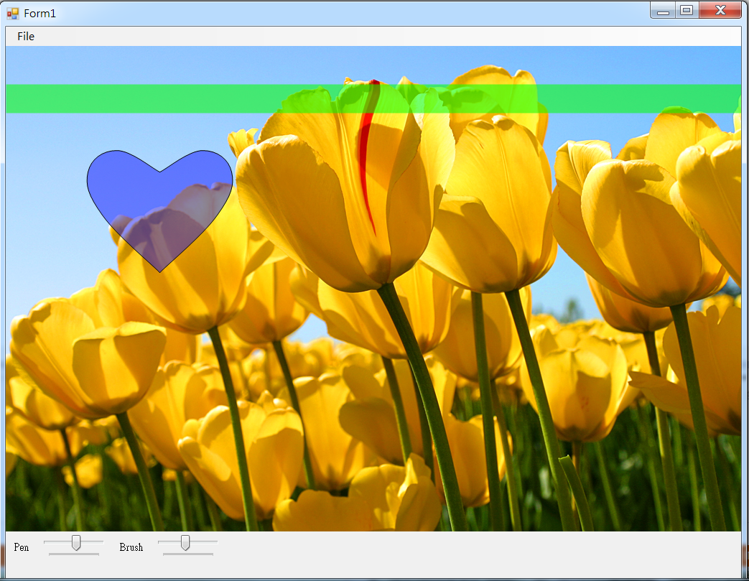
Alpha example

Slide 4
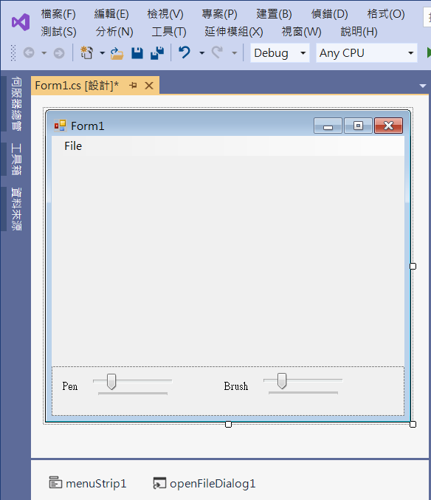
Alpha example
3. trackBar1
Minimum -> 0
Maximum -> 255
Value -> 50
1. panel1
Dock -> bottom
4. label2
2. label1
5. trackBar2
Minimum -> 0
Maximum -> 255
Value -> 50
6. menuStrip1
7. openFileDialog1

Slide 5
Alpha example
using System;
using System.Collections.Generic;
using System.ComponentModel;
using System.Data;
using System.Drawing;
using System.Linq;
using System.Text;
using System.Threading.Tasks;
using System.Windows.Forms;
using System.Drawing.Drawing2D;

Slide 6
Alpha example
public partial class Form1 : Form
{
Image img; // 影像
Point mousePos; // 滑鼠位置
Pen myPen;
SolidBrush myBrush;
int a1;
int a2;
public Form1()
{
InitializeComponent();
DoubleBuffered = true;
}

Slide 7
Alpha example
private void OpenToolStripMenuItem_Click(object sender, EventArgs e)
{
if (openFileDialog1.ShowDialog() == DialogResult.OK) // 開啟影像檔
{
String input = openFileDialog1.FileName;
img = Image.FromFile(input); // 產生一個Image物件
if ((ClientSize.Width < img.Width) || (ClientSize.Height < img.Height))
ClientSize = new Size(img.Width, img.Height);
Invalidate(); // 要求重畫
}
}

Slide 8
Alpha example
private void Form1_Load(object sender, EventArgs e)
{
trackBar1.Value = 50;
trackBar2.Value = 50;
a1 = trackBar1.Value;
a2 = trackBar2.Value;
myPen =
new Pen(Color.FromArgb(a1, 0, 255, 0), 50); // 透明的畫筆
myBrush =
new SolidBrush(Color.FromArgb(a2, 0, 0, 255)); // 透明的塗刷
ClientSize = new Size(400, 400);
}

Slide 9
Alpha example
private void Form1_Paint(object sender, PaintEventArgs e)
{
if (img != null)
{
e.Graphics.SmoothingMode = System.Drawing.Drawing2D.SmoothingMode.AntiAlias;
e.Graphics.DrawImage(img, 0, 0, img.Width, img.Height); // 呈現原圖
GraphicsPath gp = new GraphicsPath(); // GraphicsPath圖形軌跡物件
PointF[] pt1 = new PointF[5]; //心形右邊的曲線
PointF[] pt2 = new PointF[5]; //心形左邊的曲線

Slide 10
Alpha example
GetPointF(mousePos.X, mousePos.Y, 20, pt1, pt2); //計算心形左右邊的曲線
gp.AddCurve(pt1, 0.6f); // 心形曲線 的外框
gp.AddCurve(pt2, 0.6f);
e.Graphics.FillPath(myBrush, gp); //填滿形狀區域 使用影像塗刷 繪出心形
e.Graphics.DrawPath(Pens.Black, gp); // 放大鏡外框
e.Graphics.DrawLine(myPen, 0, 100, img.Width, 100); // 畫出透明的直線
}
}

Slide 11
Alpha example
void GetPointF(int x, int y, int D, PointF[] pt1, PointF[] pt2)
{
//心形右邊的曲線 由上往下
pt1[0] = new PointF(x, y);
pt1[1] = new PointF(x + 3 * D, y - 1.5f * D);
pt1[2] = new PointF(x + 5 * D, y);
pt1[3] = new PointF(x + 4 * D, y + 3 * D);
pt1[4] = new PointF(x, y + 7 * D);
//心形左邊的曲線 順時間方向 由下往上 定義點的座標
pt2[0] = new PointF(x, y + 7 * D);
pt2[1] = new PointF(x - 4 * D, y + 3 * D);
pt2[2] = new PointF(x - 5 * D, y);
pt2[3] = new PointF(x - 3 * D, y - 1.5f * D);
pt2[4] = new PointF(x, y);
}

Slide 12
Alpha example
private void Form1_MouseMove(object sender, MouseEventArgs e)
{
mousePos = e.Location; // 記錄 滑鼠位置
Invalidate(); // 要求更新表單
}
private void TrackBar1_Scroll(object sender, EventArgs e)
{
a1 = trackBar1.Value;
myPen =
new Pen(Color.FromArgb(a1, 0, 255, 0), 40); // 透明的畫筆
Invalidate(); // 要求更新表單
}

Slide 13
Alpha example
private void TrackBar2_Scroll(object sender, EventArgs e)
{
a2 = trackBar2.Value;
myBrush =
new SolidBrush(Color.FromArgb(a2, 0, 0, 255)); // 透明的塗刷
Invalidate(); // 要求更新表單
}

Slide 14
Exercise#11-1

Slide 15
內容來源
  Visual C# 2012 視窗程式設計：繪圖與遊戲專題(鄞永傳/著; 松崗)

