Slide 1
Window Programming 11-7
Region
移動預覽
Yuan Ze University

Slide 2
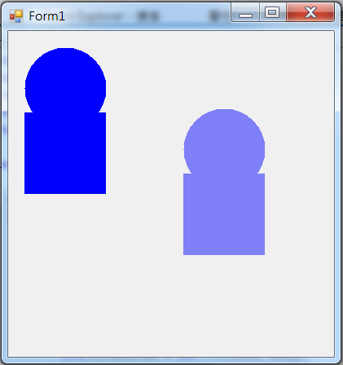
Region example 2

Slide 3
Region example 2
using System;
using System.Collections.Generic;
using System.ComponentModel;
using System.Data;
using System.Drawing;
using System.Linq;
using System.Text;
using System.Threading.Tasks;
using System.Windows.Forms;
using System.Drawing.Drawing2D;

Slide 4
Region example 2
public partial class Form1 : Form
{
int x=0, y=0, x2=0, y2=0, x_d, y_d;
Region r1, r2, r3, r4;
bool inRegion = false;
public Form1()
{
InitializeComponent();
GenerateRegion();
ClientSize = new Size(400, 400);
DoubleBuffered = true;
}

Slide 5
Region example 2
void GenerateRegion()
{
GraphicsPath gp1 = new GraphicsPath(); // 圖形軌跡
gp1.AddEllipse(x + 20, y + 20, 100, 100);
GraphicsPath gp2 = new GraphicsPath(); // 圖形軌跡
gp2.AddRectangle(new Rectangle(x + 20, y + 100, 100, 100));
r1 = new Region(gp1); // Region 區域表面 物件
r2 = new Region(gp2); // Region 區域表面 物件
r1.Union(r2);
}

Slide 6
Region example 2
void GenerateRegion2()
{
GraphicsPath gp1 = new GraphicsPath(); // 圖形軌跡
gp1.AddEllipse(x2 + 20, y2 + 20, 100, 100);
GraphicsPath gp2 = new GraphicsPath(); // 圖形軌跡
gp2.AddRectangle(new Rectangle(x2 + 20, y2 + 100, 100, 100));
r3 = new Region(gp1); // Region 區域表面 物件
r4 = new Region(gp2); // Region 區域表面 物件
r3.Union(r4);
}

Slide 7
Region example 2
private void Form1_Paint(object sender, PaintEventArgs e)
{
e.Graphics.FillRegion(Brushes.Blue, r1);
if (inRegion)
e.Graphics.FillRegion(new SolidBrush(Color.FromArgb(120,0,0,255)), r3);
}

Slide 8
Region example 2
private void Form1_MouseDown(object sender, MouseEventArgs e)
{
if (!inRegion && (r1.IsVisible(e.Location)))
{
inRegion = true;
x_d = e.Location.X - x;
y_d = e.Location.Y - y;
}
}

Slide 9
Region example 2
private void Form1_MouseUp(object sender, MouseEventArgs e)
{
if (inRegion)
{
inRegion = false;
x = e.Location.X - x_d;
y = e.Location.Y - y_d;
GenerateRegion();
Invalidate();
}
}

Slide 10
Region example 2
private void Form1_MouseMove(object sender, MouseEventArgs e)
{
if (inRegion && (e.Button == MouseButtons.Left))
{
x2 = e.Location.X - x_d;
y2 = e.Location.Y - y_d;
GenerateRegion2();
Invalidate();
}
}

Slide 11
Exercise#11-7

Slide 12
內容來源
  Visual C# 2012 視窗程式設計：繪圖與遊戲專題(鄞永傳/著; 松崗)

