Slide 1
Window Programming 12-1
Bitmap Image IV
陽春版小畫家範例
PictureBox載入點陣圖
Yuan Ze University

Slide 2
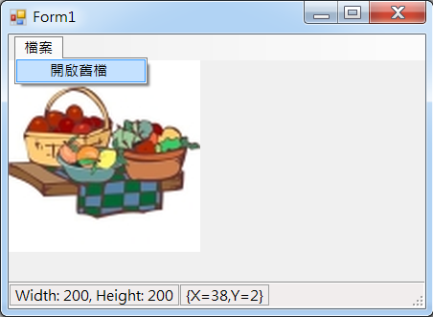
Example

Slide 3
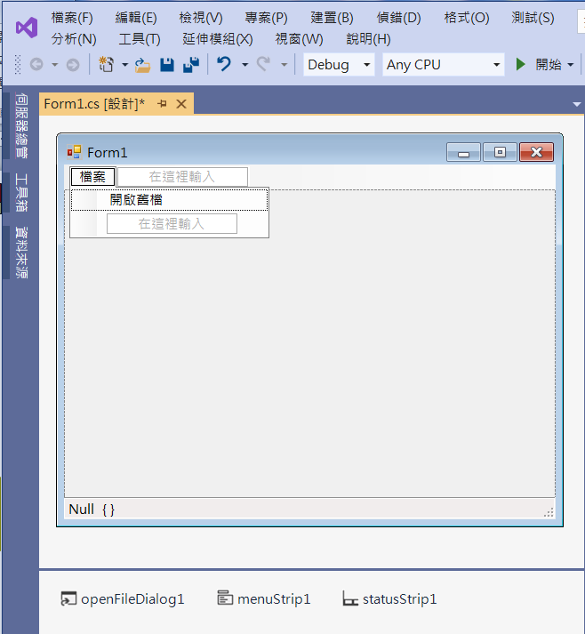
Example
3. Add menuItem
7. pictureBox1
Dock -> Fill
SizeMode -> AutoSize
6. toolStripStatusLabel2
5. toolStripStatusLabel1
2. menuStrip1
4. statusStrip1
1. openFileDialog1

Slide 4
Example
public partial class Form1 : Form
{
int w, h;
Bitmap img1;
public Form1()
{
InitializeComponent();
}

Slide 5
Example
private void 開啟舊檔ToolStripMenuItem_Click(object sender, EventArgs e)
{
if (openFileDialog1.ShowDialog() == DialogResult.OK) // 開啟影像檔
{
String input = openFileDialog1.FileName;
img1 = (Bitmap)Image.FromFile(input); // 產生一個Image物件
w = img1.Width;
h = img1.Height;
if ((ClientSize.Width < w) || (ClientSize.Height < h))
ClientSize = new Size(w, h + 56);
pictureBox1.Image = img1;
pictureBox1.Refresh(); // 要求重畫
toolStripStatusLabel1.Text = "Width: " + w.ToString() + ", Height: " + h.ToString();
}
}

Slide 6
Example
private void PictureBox1_MouseMove(object sender, MouseEventArgs e)
{
if (pictureBox1.Image != null)
{
if ((e.X < w) && (e.Y < h) && (e.X > 0) && (e.Y > 0))
{
toolStripStatusLabel2.Text = e.Location.ToString();
}
else
{
toolStripStatusLabel2.Text = "{,}";
}
}
}

Slide 7
Exercise#12-1

Slide 8
內容來源
  Visual C# 2012 視窗程式設計：繪圖與遊戲專題(鄞永傳/著; 松崗)
  Visual C# 2013視窗程式設計(黃聰明/著; 松崗)
  跟著範例學會Visual C# 2015(張逸中/著; 博碩)

