Slide 1
Window Programming 12-3
陽春版小畫家範例
亮暗調整
Yuan Ze University

Slide 2
Example
增亮
三色均衡地增加
ColorMatrix cm = new ColorMatrix(
new float[][]{ new float[]{ 1.1f, 0, 0, 0, 0},
new float[]{ 0, 1.1f, 0, 0, 0},
new float[]{ 0, 0, 1.1f, 0, 0},
new float[]{ 0, 0, 0, 1, 0},
new float[]{ 0, 0, 0, 0, 1}}); // 色彩調整矩陣

Slide 3
Example
變暗
三色均衡地減少
ColorMatrix cm = new ColorMatrix(
new float[][]{ new float[]{ 0.9f, 0, 0, 0, 0},
new float[]{ 0, 0.9f, 0, 0, 0},
new float[]{ 0, 0, 0.9f, 0, 0},
new float[]{ 0, 0, 0, 1, 0},
new float[]{ 0, 0, 0, 0, 1}}); // 色彩調整矩陣

Slide 4
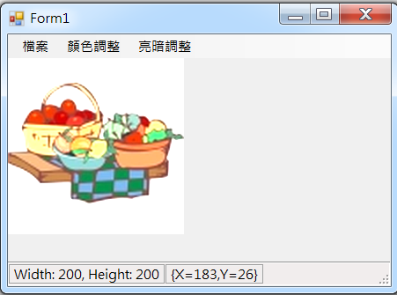
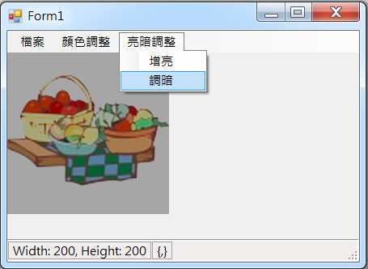
Example

Slide 5
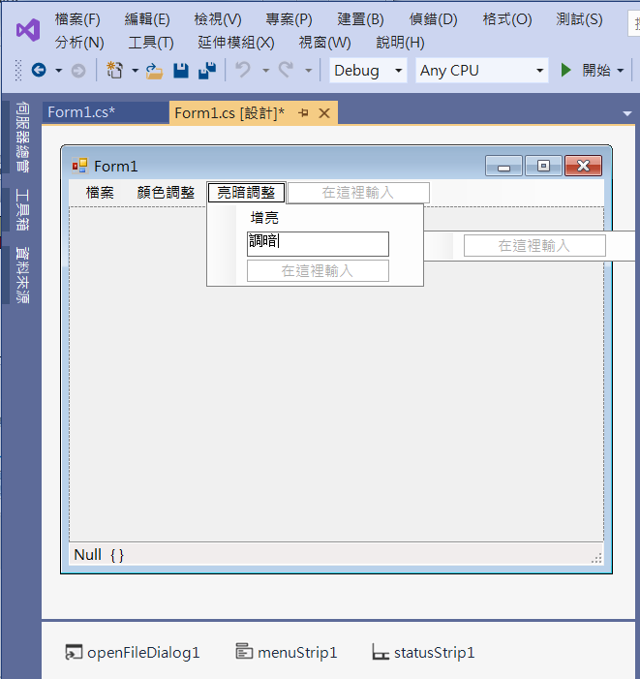
Example
Add menuItems

Slide 6
Example
private void 增亮ToolStripMenuItem_Click(object sender, EventArgs e)
{
if (pictureBox1.Image != null)
{
ColorMatrix cm = new ColorMatrix(
new float[][]{ new float[]{ 1.1f, 0, 0, 0, 0},
new float[]{ 0, 1.1f, 0, 0, 0},
new float[]{ 0, 0, 1.1f, 0, 0},
new float[]{ 0, 0, 0, 1, 0},
new float[]{ 0, 0, 0, 0, 1}});
pictureBox1.Image = ConvertCM(pictureBox1.Image, cm);
}
}

Slide 7
Example
private void 調暗ToolStripMenuItem_Click(object sender, EventArgs e)
{
if (pictureBox1.Image != null)
{
ColorMatrix cm = new ColorMatrix(
new float[][]{ new float[]{ 0.9f, 0, 0, 0, 0},
new float[]{ 0, 0.9f, 0, 0, 0},
new float[]{ 0, 0, 0.9f, 0, 0},
new float[]{ 0, 0, 0, 1, 0},
new float[]{ 0, 0, 0, 0, 1}});
pictureBox1.Image = ConvertCM(pictureBox1.Image, cm);
}
}

Slide 8
Exercise#12-3

Slide 9
內容來源
  Visual C# 2012 視窗程式設計：繪圖與遊戲專題(鄞永傳/著; 松崗)
  Visual C# 2013視窗程式設計(黃聰明/著; 松崗)
  跟著範例學會Visual C# 2015(張逸中/著; 博碩)

