Slide 1
Window Programming 12-5
陽春版小畫家範例
第二個表單
Yuan Ze University

Slide 2
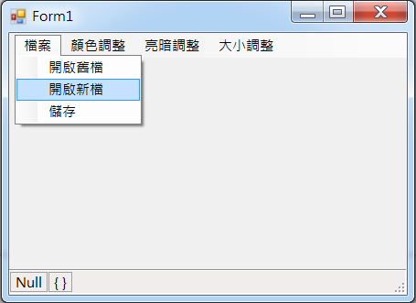
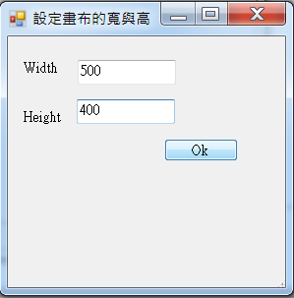
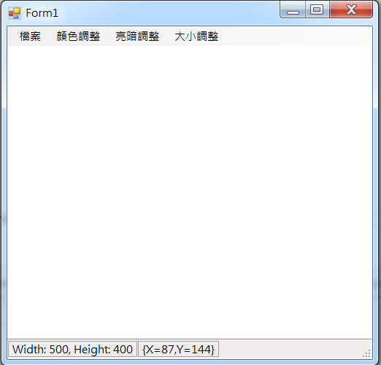
Second Form Example

Slide 3
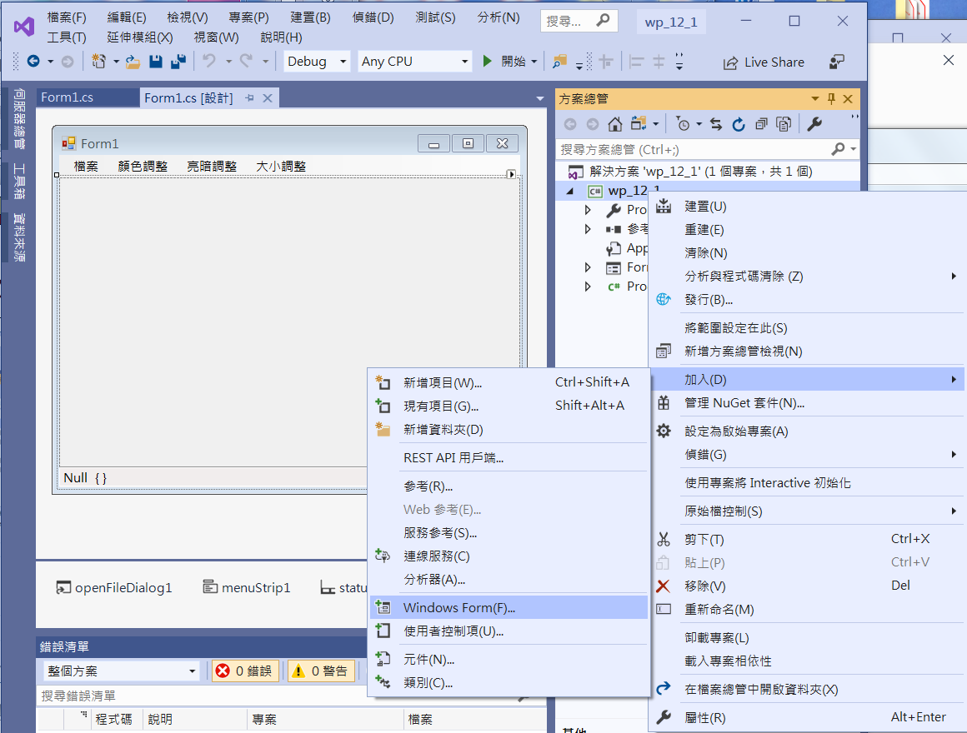
Second Form Example
1. 按右鍵
2. 按”加入”
3. 按”Windows Form”

Slide 4
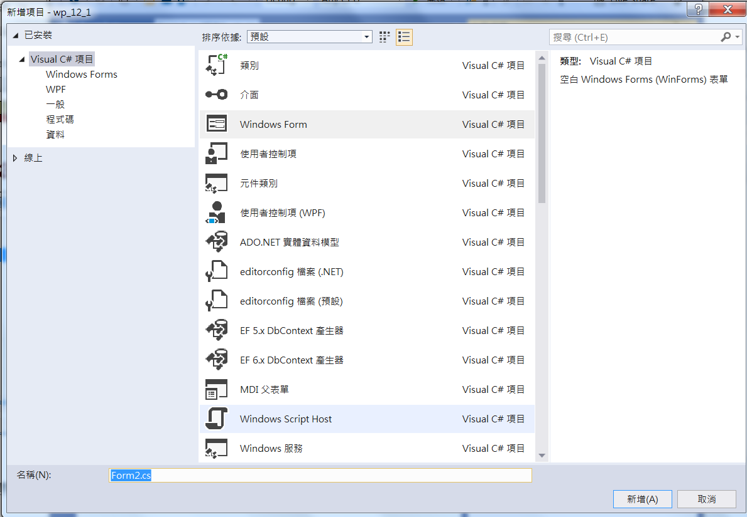
Second Form Example
1. 按Windows Form
2. 按”新增”

Slide 5
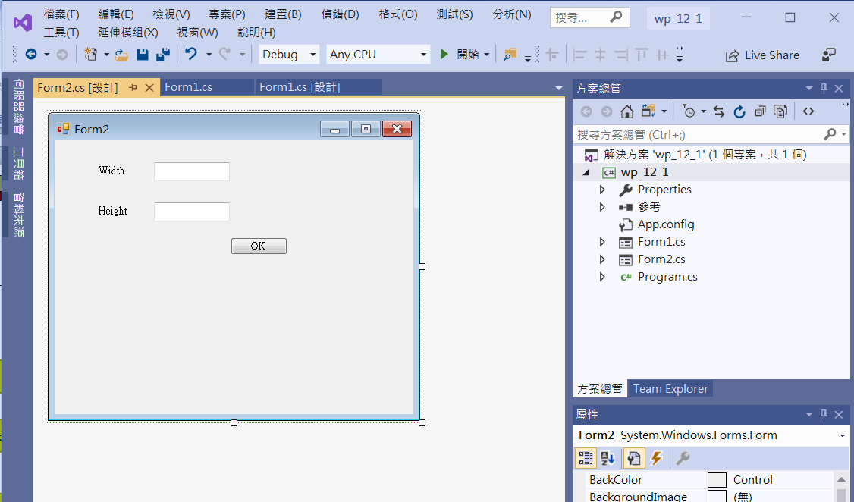
Second Form Example
label1
textbox1
textbox2
label2
button1

Slide 6
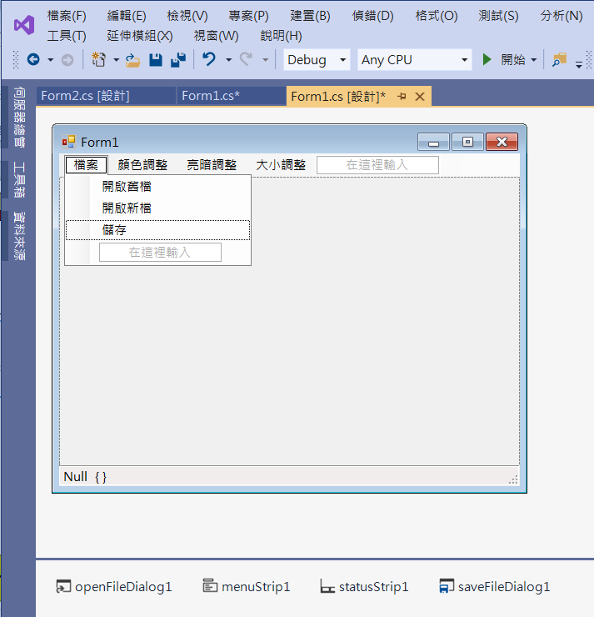
Second Form Example
Add new into menu
Add save into meny
saveFileDialog1

Slide 7
Second Form Example (Form2)
public partial class Form2 : Form
{
private int width = -1, height = -1;
public Form2()
{
InitializeComponent();
}

Slide 8
Second Form Example (Form2)
private void Button1_Click(object sender, EventArgs e)
{
width = int.Parse(textBox1.Text);
height = int.Parse(textBox2.Text);
Close();
}

Slide 9
Second Form Example (Form2)
public int getWidth()
{ //For Form1 to get width
return width;
}
public int getHeight()
{
return height;
}

Slide 10
Second Form Example (Form1)
private void 開啟新檔ToolStripMenuItem_Click(object sender, EventArgs e)
{
Form2 x = new Form2();
x.TopMost = true; //移到最上層
x.Text = "設定畫布的寬與高"; //Form2 的標題
x.ShowDialog(); // Show Form2
w = x.getWidth();
h = x.getHeight();
if (w != -1)
{
img1 = new Bitmap(w, h);
pictureBox1.Image = img1;
Graphics g = Graphics.FromImage(pictureBox1.Image);
g.Clear(Color.White);
pictureBox1.Refresh(); // 要求重畫
if ((ClientSize.Width < w) || (ClientSize.Height < (h + 56)))
ClientSize = new Size(w, h + 56);
toolStripStatusLabel1.Text = "Width: " + w.ToString() + ", Height: " + h.ToString();
}
}

Slide 11
Second Form Example (Form1)
private void 儲存ToolStripMenuItem_Click(object sender, EventArgs e)
{
if (pictureBox1.Image != null)
if (saveFileDialog1.ShowDialog() == DialogResult.OK)
{
String output = saveFileDialog1.FileName;
pictureBox1.Image.Save(output);
img1 = (Bitmap)pictureBox1.Image;
}
}

Slide 12
Exercise#12-5

Slide 13
內容來源
  Visual C# 2012 視窗程式設計：繪圖與遊戲專題(鄞永傳/著; 松崗)
  Visual C# 2013視窗程式設計(黃聰明/著; 松崗)
  跟著範例學會Visual C# 2015(張逸中/著; 博碩)

