Slide 1
Window Programming 12-6
陽春版小畫家範例
塗鴉與ColorDialog
畫線與橡皮筋軌跡
Yuan Ze University

Slide 2
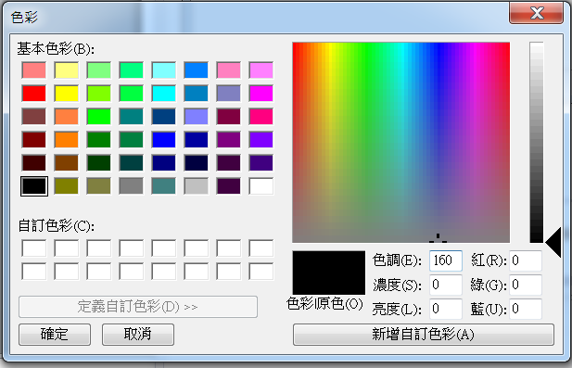
ColorDialog
Message
  ShowDialog()
Attributes
  Color

Slide 3
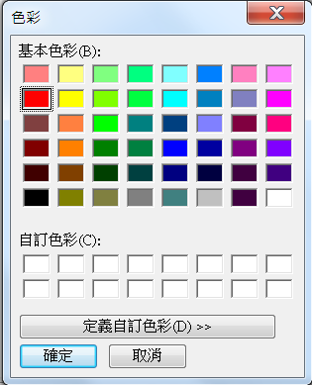
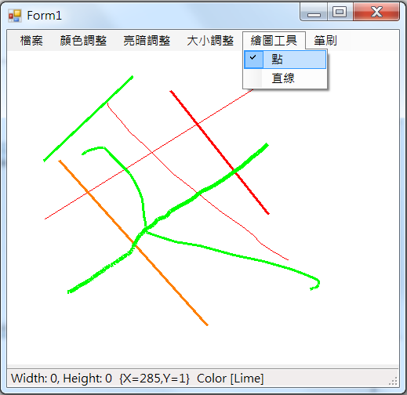
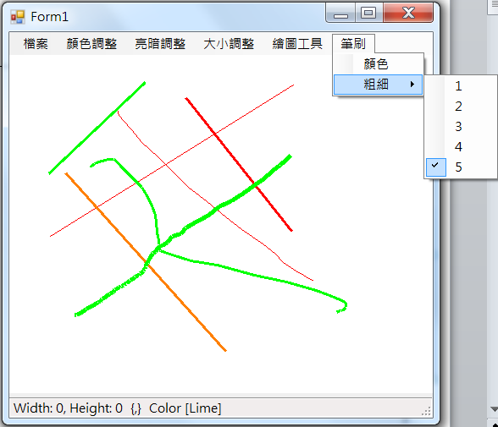
Example

Slide 4
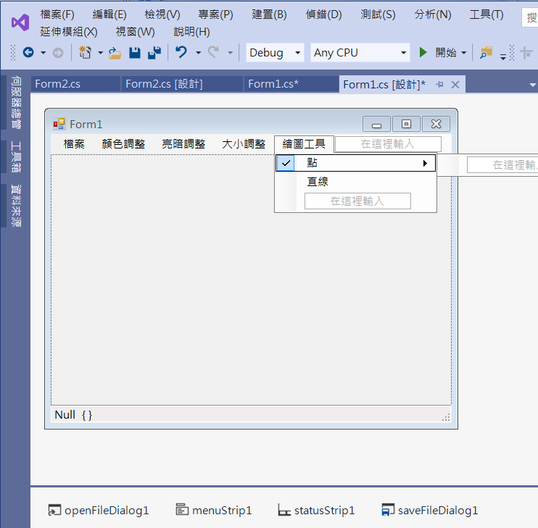
Example
Add menuItems

Slide 5
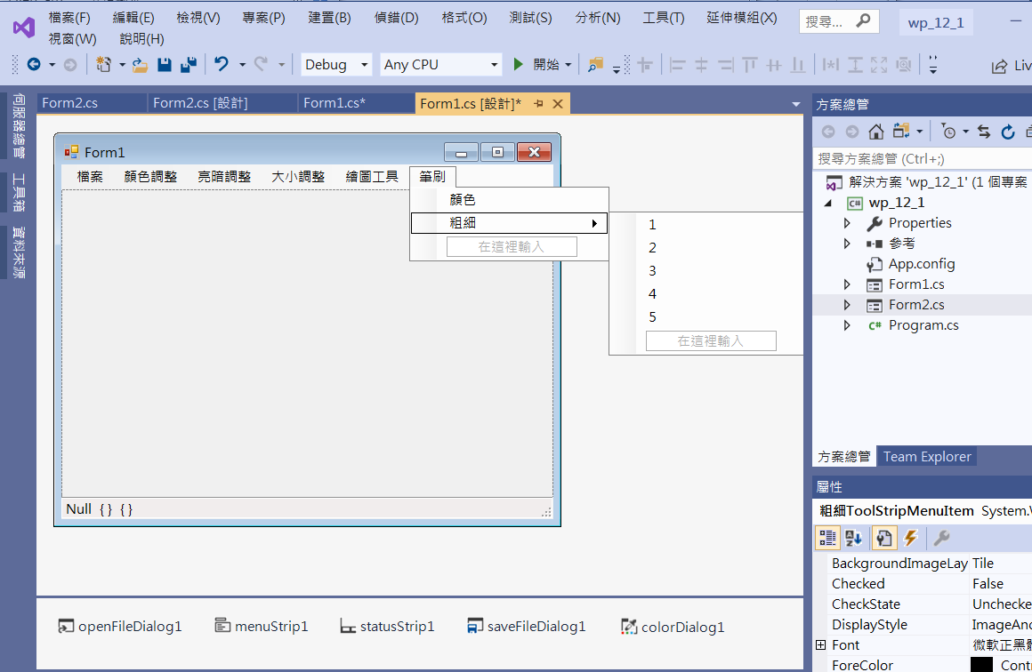
Example
Add menuItems
Add toolStripStatuslabel3
colorDialog1

Slide 6
Example
public partial class Form1 : Form
{
int w, h, x0, y0, pen_width = 1;
Bitmap img1, img2;
Pen p;
int tools = 0;
Color c = Color.Black;

Slide 7
Example
public Form1()
{
InitializeComponent();
DoubleBuffered = true;
p = new Pen(c, pen_width);
toolStripStatusLabel1.Text = "Width: " + w.ToString() + ", Height: " + h.ToString();
toolStripStatusLabel3.Text = c.ToString();
}

Slide 8
Example
private void 顏色ToolStripMenuItem_Click(object sender, EventArgs e)
{
if (colorDialog1.ShowDialog() == DialogResult.OK)
{
c = colorDialog1.Color;
p = new Pen(c, pen_width);
toolStripStatusLabel3.Text = c.ToString();
}
}

Slide 9
Example
private void 點ToolStripMenuItem_Click(object sender, EventArgs e)
{
點ToolStripMenuItem.Checked = true;
直線ToolStripMenuItem.Checked = false;
tools = 0;
}
private void 直線ToolStripMenuItem_Click(object sender, EventArgs e)
{
點ToolStripMenuItem.Checked = false;
直線ToolStripMenuItem.Checked = true;
tools = 1;
}

Slide 10
Example
private void ToolStripMenuItem2_Click(object sender, EventArgs e)
{
pen_width = 1;
toolStripMenuItem2.Checked = true;
toolStripMenuItem3.Checked = false;
toolStripMenuItem4.Checked = false;
toolStripMenuItem5.Checked = false;
toolStripMenuItem6.Checked = false;
p = new Pen(c, pen_width);
}

Slide 11
Example
private void ToolStripMenuItem3_Click(object sender, EventArgs e)
{
pen_width = 2;
toolStripMenuItem2.Checked = false;
toolStripMenuItem3.Checked = true;
toolStripMenuItem4.Checked = false;
toolStripMenuItem5.Checked = false;
toolStripMenuItem6.Checked = false;
p = new Pen(c, pen_width);
}

Slide 12
Example
private void ToolStripMenuItem4_Click(object sender, EventArgs e)
{
pen_width = 3;
toolStripMenuItem2.Checked = false;
toolStripMenuItem3.Checked = false;
toolStripMenuItem4.Checked = true;
toolStripMenuItem5.Checked = false;
toolStripMenuItem6.Checked = false;
p = new Pen(c, pen_width);
}

Slide 13
Example
private void ToolStripMenuItem5_Click(object sender, EventArgs e)
{
pen_width = 4;
toolStripMenuItem2.Checked = false;
toolStripMenuItem3.Checked = false;
toolStripMenuItem4.Checked = false;
toolStripMenuItem5.Checked = true;
toolStripMenuItem6.Checked = false;
p = new Pen(c, pen_width);
}

Slide 14
Example
private void ToolStripMenuItem6_Click(object sender, EventArgs e)
{
pen_width = 5;
toolStripMenuItem2.Checked = false;
toolStripMenuItem3.Checked = false;
toolStripMenuItem4.Checked = false;
toolStripMenuItem5.Checked = false;
toolStripMenuItem6.Checked = true;
p = new Pen(c, pen_width);
}

Slide 15
Example
private void PictureBox1_MouseDown(object sender, MouseEventArgs e)
{
if (pictureBox1.Image!=null)
{
x0 = e.X;
y0 = e.Y;
img2 = (Bitmap)pictureBox1.Image.Clone();
}
}

Slide 16
Example
private void PictureBox1_MouseMove(object sender, MouseEventArgs e)
{
if (pictureBox1.Image != null)
{
if ((e.X < w) && (e.Y < h) && (e.X > 0) && (e.Y > 0))
{
toolStripStatusLabel2.Text = e.Location.ToString();
}
else
{
toolStripStatusLabel2.Text = "{,}";
}

Slide 17
Example
if (e.Button == MouseButtons.Left)
{
if (tools == 0)
{
//Method 1: 直接改pictureBox1的圖
Graphics g = Graphics.FromImage(pictureBox1.Image);
if ((e.X < w) && (e.Y < h) && (e.X > 0) && (e.Y > 0))
{
g.DrawLine(p, x0, y0, e.X, e.Y);
x0 = e.X;
y0 = e.Y;
pictureBox1.Refresh();
}
}

Slide 18
Example
else
if (tools == 1)
{
if ((e.X < w) && (e.Y < h) && (e.X > 0) && (e.Y > 0))
{
//Method 2: 複製一份點陣圖，最後再放回pictureBox1
Bitmap tempImg = (Bitmap)img2.Clone();
Graphics gg = Graphics.FromImage(tempImg);
gg.DrawLine(p, x0, y0, e.X, e.Y);
pictureBox1.Image = tempImg;
pictureBox1.Refresh();
}
}
}
}
}

Slide 19
Exercise#12-6

Slide 20
內容來源
  Visual C# 2012 視窗程式設計：繪圖與遊戲專題(鄞永傳/著; 松崗)
  Visual C# 2013視窗程式設計(黃聰明/著; 松崗)
  跟著範例學會Visual C# 2015(張逸中/著; 博碩)

