Slide 1
Window Programming 13-3
TextBox記事本範例
復原、Stack
Yuan Ze University

Slide 2
Stack
堆疊
Stack s =new Stack();
s.Clear(); //清除
s.Peep(); //預覽
s.Push(); //置入
s.Pop(); //取出
s.Count; //計算個數

Slide 3
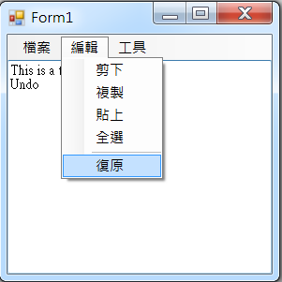
TextBox記事本範例

Slide 4
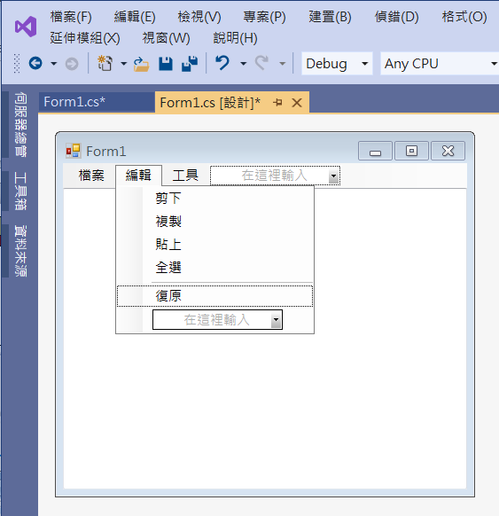
TextBox記事本範例
Add menuItems

Slide 5
TextBox記事本範例
using System;
using System.Collections.Generic;
using System.ComponentModel;
using System.Data;
using System.Drawing;
using System.Linq;
using System.Text;
using System.Threading.Tasks;
using System.Windows.Forms;
using System.IO; //File
using System.Collections; //匯入集合函式庫 Stack

Slide 6
TextBox記事本範例
public partial class Form1 : Form
{
Stack ps = new Stack(); //紀錄復原資訊的堆疊集合
bool fc = false; //是否來自復原控制鍵的文字改變
public Form1()
{
InitializeComponent();
}

Slide 7
TextBox記事本範例
private void 新增ToolStripMenuItem_Click(object sender, EventArgs e)
{
openFileDialog1.FileName = "";
textBox1.Clear();
ps.Clear();
ps.Push(textBox1.Text);
復原ToolStripMenuItem.Enabled = false;
}

Slide 8
TextBox記事本範例
private void 開啟舊檔ToolStripMenuItem_Click(object sender, EventArgs e)
{
if (openFileDialog1.ShowDialog() == DialogResult.OK)
{
textBox1.Text = File.ReadAllText(openFileDialog1.FileName, Encoding.Default);
ps.Clear();
ps.Push(textBox1.Text);
復原ToolStripMenuItem.Enabled = false;
}
}

Slide 9
TextBox記事本範例
private void Form1_Load(object sender, EventArgs e)
{
ps.Clear();
textBox1.Text = "";
ps.Push(textBox1.Text);
復原ToolStripMenuItem.Enabled = false;
openFileDialog1.FileName = "";
openFileDialog1.Filter = "純文字檔案|*.txt";
saveFileDialog1.Filter = "純文字檔案|*.txt";
}

Slide 10
TextBox記事本範例
private void 復原ToolStripMenuItem_Click(object sender, EventArgs e)
{
if (ps.Count > 1)
{
fc = true;
while ((ps.Count > 0) && (textBox1.Text == (String) ps.Peek()))
ps.Pop();
textBox1.Text = (String)ps.Peek();
}
}

Slide 11
TextBox記事本範例
private void TextBox1_TextChanged(object sender, EventArgs e)
{
if (fc == false)
{
ps.Push(textBox1.Text);
}
fc = false;
if (ps.Count > 1)
復原ToolStripMenuItem.Enabled = true;
else
復原ToolStripMenuItem.Enabled = false;
}

Slide 12
Exercise#13-3

Slide 13
內容來源
  跟著範例學會Visual C# 2015(張逸中/著; 博碩)
  Visual C# 2013視窗程式設計(黃聰明/著; 松崗)

