Slide 1
Window Programming 13-6
RichTextBox記事本範例
編輯、顏色、字型、復原
Yuan Ze University

Slide 2
RichTextBox
richTextBox1.SelectionFont 選取範圍之字型
richTextBox1.SelectionColor 選取範圍之字型顏色

Slide 3
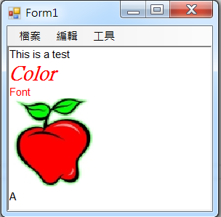
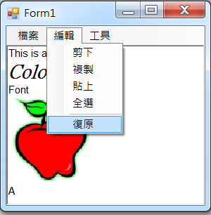
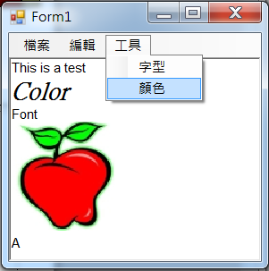
RichTextBox記事本範例

Slide 4
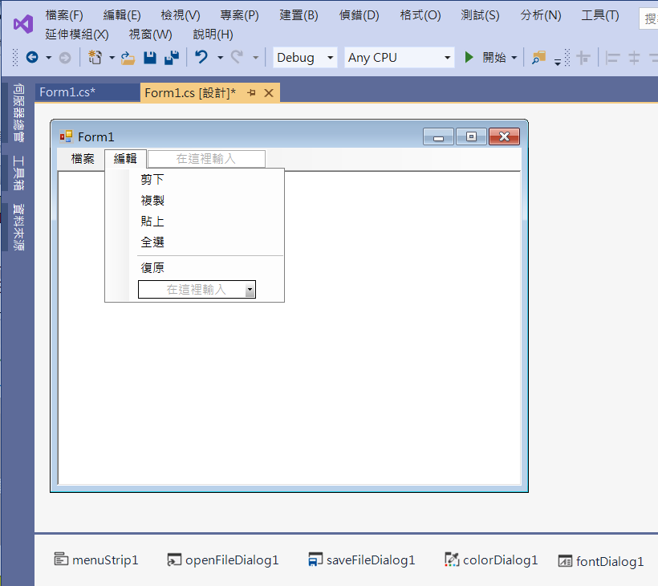
RichTextBox記事本範例
Add menuItems
colorDialog1
fontDialog1

Slide 5
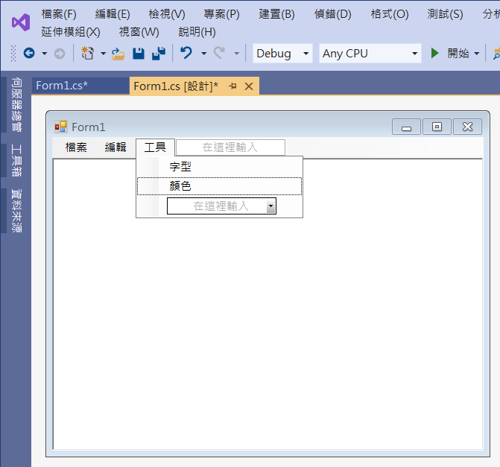
RichTextBox記事本範例
Add menuItems

Slide 6
RichTextBox記事本範例
using System;
using System.Collections.Generic;
using System.ComponentModel;
using System.Data;
using System.Drawing;
using System.Linq;
using System.Text;
using System.Threading.Tasks;
using System.Windows.Forms;
using System.IO; //File
using System.Collections; //匯入集合函式庫 Stack

Slide 7
RichTextBox記事本範例
public partial class Form1 : Form
{
Stack ps = new Stack(); //紀錄復原資訊的堆疊集合
public Form1()
{
InitializeComponent();
}

Slide 8
RichTextBox記事本範例
private void 新增ToolStripMenuItem_Click(object sender, EventArgs e)
{
openFileDialog1.FileName = "";
richTextBox1.Clear();
ps.Clear();
ps.Push(richTextBox1.Rtf);
復原ToolStripMenuItem.Enabled = false;
}

Slide 9
RichTextBox記事本範例
private void 開啟舊檔ToolStripMenuItem_Click(object sender, EventArgs e)
{
if (openFileDialog1.ShowDialog() == DialogResult.OK)
{
if (Path.GetExtension(openFileDialog1.FileName) == ".txt")
richTextBox1.LoadFile(openFileDialog1.FileName, RichTextBoxStreamType.PlainText);
else
richTextBox1.LoadFile(openFileDialog1.FileName); ps.Clear();
ps.Push(richTextBox1.Rtf);
復原ToolStripMenuItem.Enabled = false;
}
}

Slide 10
RichTextBox記事本範例
private void Form1_Load(object sender, EventArgs e)
{
richTextBox1.Rtf = "";
ps.Clear();
ps.Push(richTextBox1.Rtf); //先放空字串入Stack
復原ToolStripMenuItem.Enabled = false;
openFileDialog1.FileName = "";
openFileDialog1.Filter = "RTF檔案(*.rtf); 純文字檔案(*.txt)|*.rtf;*.txt";
saveFileDialog1.Filter = "RTF檔案|*.rtf";
}

Slide 11
RichTextBox記事本範例
private void 剪下ToolStripMenuItem_Click(object sender, EventArgs e)
{
richTextBox1.Cut();
}
private void 複製ToolStripMenuItem_Click(object sender, EventArgs e)
{
richTextBox1.Copy();
}

Slide 12
RichTextBox記事本範例
private void 貼上ToolStripMenuItem_Click(object sender, EventArgs e)
{
richTextBox1.Paste();
}
private void 全選ToolStripMenuItem_Click(object sender, EventArgs e)
{
richTextBox1.SelectAll();
}

Slide 13
RichTextBox記事本範例
private void 字型ToolStripMenuItem_Click(object sender, EventArgs e)
{
if (fontDialog1.ShowDialog() == DialogResult.OK)
richTextBox1.SelectionFont = fontDialog1.Font;
}
private void 顏色ToolStripMenuItem_Click(object sender, EventArgs e)
{
if (colorDialog1.ShowDialog() == DialogResult.OK)
richTextBox1.SelectionColor = colorDialog1.Color;
}

Slide 14
RichTextBox記事本範例
private void 復原ToolStripMenuItem_Click(object sender, EventArgs e)
{
if (ps.Count > 1)
{
while ((ps.Count > 0) && (richTextBox1.Rtf == (String)ps.Peek()))
ps.Pop();
//暫時取消richTextBox1_TextChanged，以免復原的動作又被存入Stack
richTextBox1.TextChanged -= new System.EventHandler(RichTextBox1_TextChanged);
richTextBox1.Rtf = (String)ps.Peek(); //復原
//加回 richTextBox1_TextChanged
richTextBox1.TextChanged += new System.EventHandler(RichTextBox1_TextChanged);
}
if (ps.Count==1) //Stack內是一開始存的空字串
復原ToolStripMenuItem.Enabled = false;
}

Slide 15
RichTextBox記事本範例
private void RichTextBox1_TextChanged(object sender, EventArgs e)
{
ps.Push(richTextBox1.Rtf); //變動存入Stack
if (ps.Count > 1)
復原ToolStripMenuItem.Enabled = true;
else
復原ToolStripMenuItem.Enabled = false;
}

Slide 16
Exercise#13-6

Slide 17
內容來源
  跟著範例學會Visual C# 2015(張逸中/著; 博碩)
  Visual C# 2013視窗程式設計(黃聰明/著; 松崗)

