Slide 1
Window Programming 14-4
ScreenSaver II (Passwd)
Yuan Ze University

Slide 2
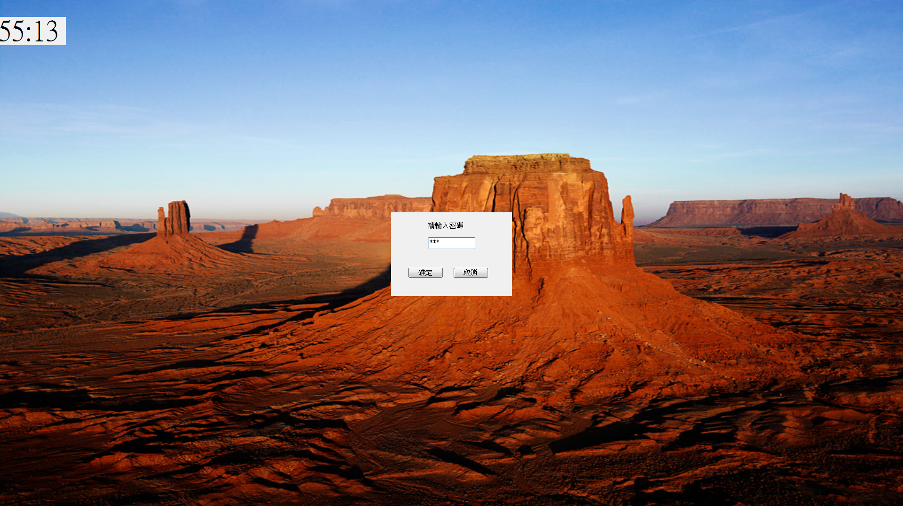
ScreenSaver II

Slide 3
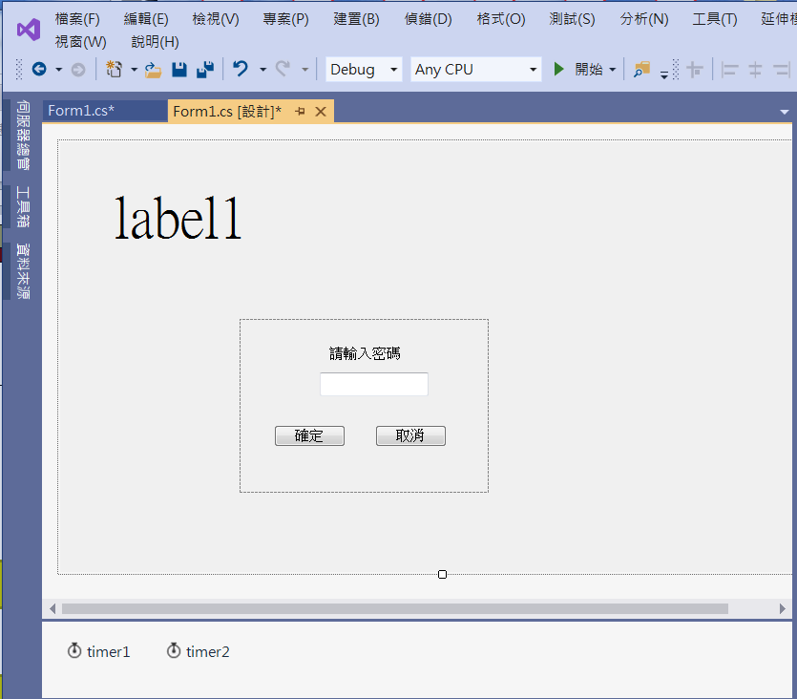
ScreenSaver II
1. panel1
3. testbox1
PasswdChar -> *
2. label2
4. button1
5. button2

Slide 4
ScreenSaver II
private void Form1_Load(object sender, EventArgs e)
{
label1.Text = DateTime.Now.ToString();
BackgroundImageLayout = ImageLayout.Stretch;
panel1.Visible = false;
}
private void Form1_Click(object sender, EventArgs e)
{
//Application.Exit();
panel1.Left = (Width - panel1.Width) / 2;
panel1.Top = (Height - panel1.Height) / 2;
panel1.Visible = true;
}

Slide 5
ScreenSaver II
private void Button1_Click(object sender, EventArgs e)
{
if (textBox1.Text == "yzu")
Application.Exit();
else
MessageBox.Show("密碼錯誤!");
}
private void Button2_Click(object sender, EventArgs e)
{
panel1.Visible = false;
}

Slide 6

Exercise#14-4

Slide 7
內容來源
  Visual C# 2012 視窗程式設計：繪圖與遊戲專題(鄞永傳/著; 松崗)
  跟著範例學會Visual C# 2015(張逸中/著; 博碩)
  Visual C# 2013視窗程式設計(黃聰明/著; 松崗)

