Slide 1
Window Programming 14-5
Digital Clock
Yuan Ze University

Slide 2
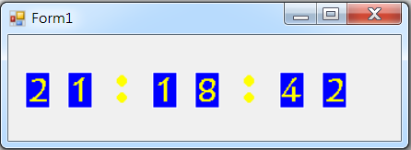
Digital Clock

Slide 3











Digital Clock
icon0 icon6
icon1 icon7
icon2 icon8
icon3 icon9
icon4 icon10
icon5

Slide 4
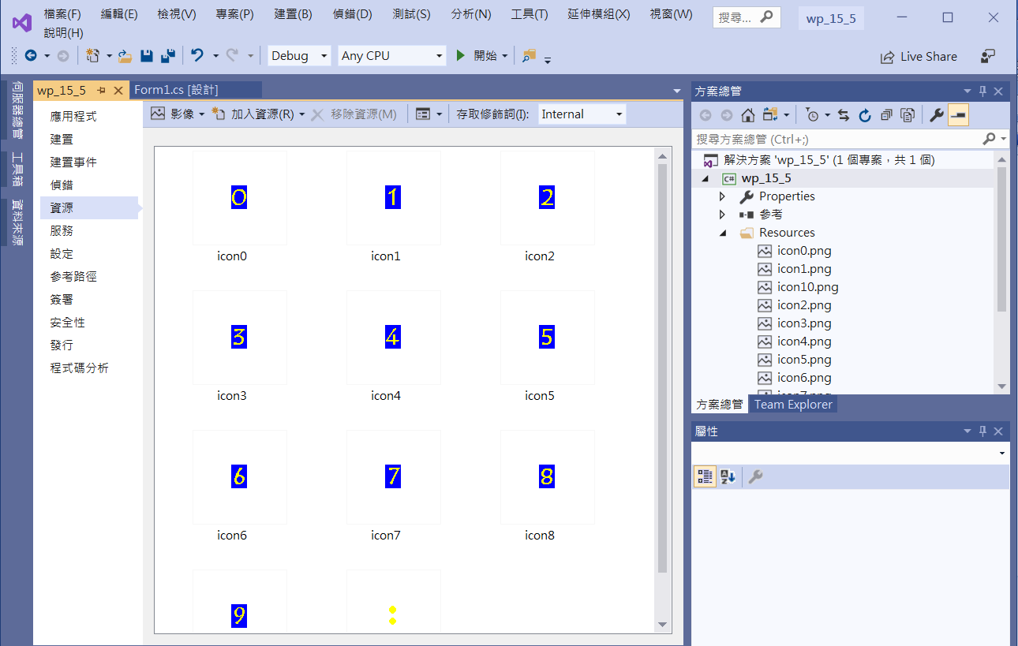
Digital Clock
Add Bitmap resources

Slide 5
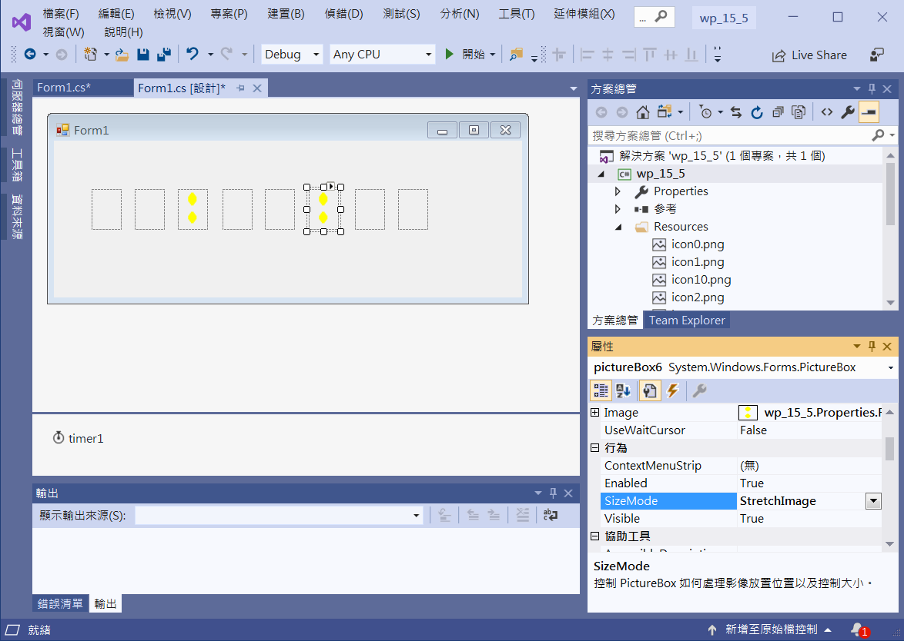
Digital Clock
Add pictureBox1~8
pictureBox3 & 6
Image 設成 icon10
pictureBox1~8
SizeMode = StretchImage
Timer1
Interval=1000

Slide 6
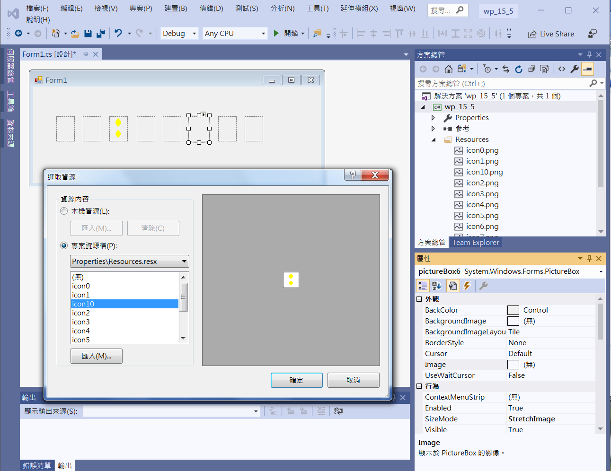
Digital Clock
pictureBox3 & 6
Image 設成 icon10

Slide 7
Digital Clock
public partial class Form1 : Form
{
Bitmap bg0 = new Bitmap(Properties.Resources.icon0);
Bitmap bg1 = new Bitmap(Properties.Resources.icon1);
Bitmap bg2 = new Bitmap(Properties.Resources.icon2);
Bitmap bg3 = new Bitmap(Properties.Resources.icon3);
Bitmap bg4 = new Bitmap(Properties.Resources.icon4);
Bitmap bg5 = new Bitmap(Properties.Resources.icon5);
Bitmap bg6 = new Bitmap(Properties.Resources.icon6);
Bitmap bg7 = new Bitmap(Properties.Resources.icon7);
Bitmap bg8 = new Bitmap(Properties.Resources.icon8);
Bitmap bg9 = new Bitmap(Properties.Resources.icon9);
Bitmap bg10 = new Bitmap(Properties.Resources.icon10);

Slide 8
Digital Clock
private void TimeRefresh() //更新時間數字
{
DateTime t = DateTime.Now; // 目前的時間
pictureBox1.Image = selectBitmap(t.Hour / 10);
pictureBox2.Image = selectBitmap(t.Hour % 10);
pictureBox4.Image = selectBitmap(t.Minute / 10);
pictureBox5.Image = selectBitmap(t.Minute % 10);
pictureBox7.Image = selectBitmap(t.Second / 10);
pictureBox8.Image = selectBitmap(t.Second % 10);
}

Slide 9
Digital Clock
private Bitmap selectBitmap(int n)
{
//回傳相對應點陣圖
switch (n)
{
case 1: return bg1;
case 2: return bg2;
case 3: return bg3;
case 4: return bg4;
case 5: return bg5;
case 6: return bg6;
case 7: return bg7;
case 8: return bg8;
case 9: return bg9;
}
return bg0; // when n==0
}

Slide 10
Digital Clock
public Form1()
{
InitializeComponent();
timer1.Interval = 1000;
timer1.Enabled = true;
TimeRefresh();
}
private void Timer1_Tick(object sender, EventArgs e)
{
TimeRefresh();
}

Slide 11
Exercise#14-5

Slide 12
內容來源
  Visual C# 2012 視窗程式設計：繪圖與遊戲專題(鄞永傳/著; 松崗)
  跟著範例學會Visual C# 2015(張逸中/著; 博碩)
  Visual C# 2013視窗程式設計(黃聰明/著; 松崗)

