Slide 1
Window Programming 14-6
數字拼盤遊戲
Yuan Ze University

Slide 2
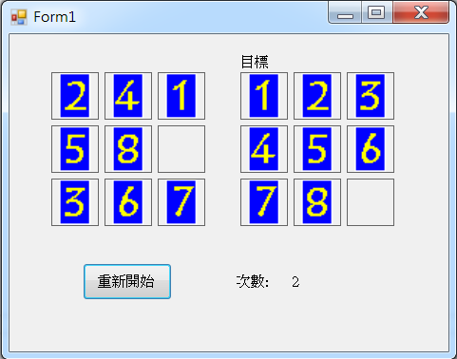
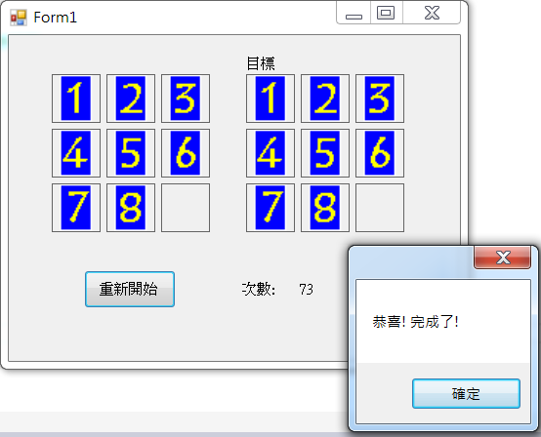
數字拼盤遊戲

Slide 3
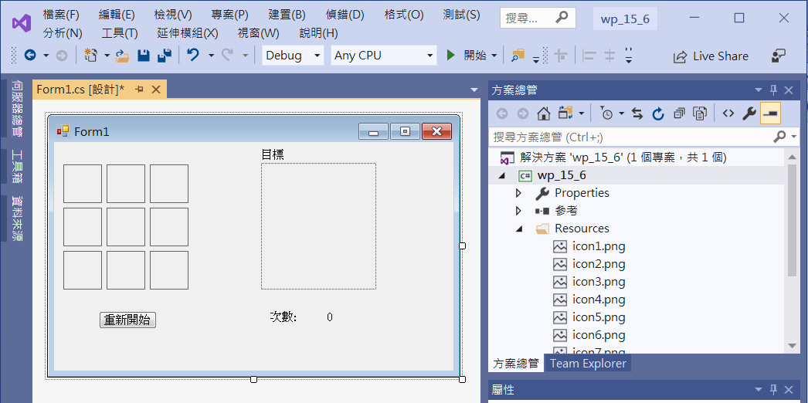
數字拼盤遊戲
Add pictureBox1~9
Size = 50,50
BorderStyle = FixedSingle
SizeMode = StretchImage
label1
pictureBox10
SizeMode = AutoSize
button1
label2
label3

Slide 4
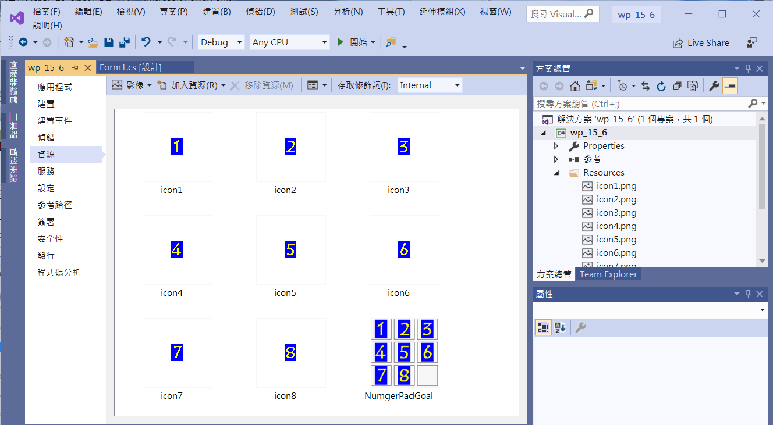
數字拼盤遊戲
Add Image Resources

Slide 5
數字拼盤遊戲
public partial class Form1 : Form
{
Image[] image = new Image[9];
PictureBox[] pb = new PictureBox[9];
Random rd = new Random(DateTime.Now.Minute + DateTime.Now.Second);
// 0 1 2
// 3 4 5
// 6 7 8
Point[] LegalMove = new Point[] //合法移動的方式 Point(從,到)
{ new Point(0,1), new Point(0,3),
new Point(1,0), new Point(1,4), new Point(1,2),
new Point(2,1), new Point(2,5),
new Point(3,0), new Point(3,4), new Point(3,6),
new Point(4,1), new Point(4,3), new Point(4,7), new Point(4,5),
new Point(5,2), new Point(5,4), new Point(5,8),
new Point(6,3), new Point(6,7),
new Point(7,4), new Point(7,6), new Point(7,8),
new Point(8,5), new Point(8,7),
};
int Count = 0; //用了幾步
bool restart=false; //是否重置狀態

Slide 6
數字拼盤遊戲
public Form1()
{
InitializeComponent();
image[0] = null;
image[1] = new Bitmap(Properties.Resources.icon1);
image[2] = new Bitmap(Properties.Resources.icon2);
image[3] = new Bitmap(Properties.Resources.icon3);
image[4] = new Bitmap(Properties.Resources.icon4);
image[5] = new Bitmap(Properties.Resources.icon5);
image[6] = new Bitmap(Properties.Resources.icon6);
image[7] = new Bitmap(Properties.Resources.icon7);
image[8] = new Bitmap(Properties.Resources.icon8);
pictureBox10.Image= new Bitmap(Properties.Resources.NumgerPadGoal);

Slide 7
數字拼盤遊戲
pb[0] = pictureBox1;
pb[1] = pictureBox2;
pb[2] = pictureBox3;
pb[3] = pictureBox4;
pb[4] = pictureBox5;
pb[5] = pictureBox6;
pb[6] = pictureBox7;
pb[7] = pictureBox8;
pb[8] = pictureBox9;
Button1_Click(this, null); //起始
}

Slide 8
數字拼盤遊戲
private void Button1_Click(object sender, EventArgs e)
{
for (int i = 0; i < 9; i++)
{
pb[i].Tag = (i+1) % 9; //利用Tag屬性儲存位置資料，照順序排列: 1 2 3 4 5 6 7 8 0
pb[i].Enabled = true;
}
for (int i=0; i < 9; i++)
pb[i].Image = image[(int)pb[i].Tag]; //指定點陣圖
//亂數重置數字拼盤
restart = true;
for (int i=0; i <1000; i++)
{
PictureBox1_Click(pb[rd.Next(9)], null);
}
restart = false;

Slide 9
數字拼盤遊戲
Count = 0;
label3.Text = Count.ToString();
}

Slide 10
數字拼盤遊戲
//pcitureBox1~pcitureBox9 都用同一個事件函數
private void PictureBox1_Click(object sender, EventArgs e)
{
PictureBox x=(PictureBox)sender;
int SelectedNo = 0;
for (int i=0;i < 9;i++)
{
if (pb[i]==x)
{
SelectedNo = i; //點選位置
break;
}
}

Slide 11
數字拼盤遊戲
int EmptyNo = 0;
for (int i = 0; i < 9; i++)
{
if ((int)pb[i].Tag == 0)
{
EmptyNo = i; //空格位置
break;
}
}

Slide 12
數字拼盤遊戲
//移動
for (int i=0;i < 24; i++)
{
if (LegalMove[i].X == SelectedNo && LegalMove[i].Y == EmptyNo)
{
Count++;
label3.Text = Count.ToString();
pb[EmptyNo].Tag=pb[SelectedNo].Tag; //對調數字
pb[SelectedNo].Tag = 0;
pb[EmptyNo].Image = image[(int)pb[EmptyNo].Tag]; //對調圖片
pb[SelectedNo].Image = null;
break;
}
}

Slide 13
數字拼盤遊戲
//檢查是否完成
if (restart == false)
if ((int)pb[0].Tag==1 && (int)pb[1].Tag == 2 && (int)pb[2].Tag == 3 &&
(int)pb[3].Tag == 4 && (int)pb[4].Tag == 5 && (int)pb[5].Tag == 6 &&
(int)pb[6].Tag == 7 && (int)pb[7].Tag == 8 && (int)pb[8].Tag == 0 )
{
for (int i = 0; i < 9; i++)
pb[i].Enabled = false;
MessageBox.Show("恭喜! 完成了!");
}
}

Slide 14
Exercise#14-6

Slide 15
內容來源
  Visual C# 2012 視窗程式設計：繪圖與遊戲專題(鄞永傳/著; 松崗)
  跟著範例學會Visual C# 2015(張逸中/著; 博碩)
  Visual C# 2013視窗程式設計(黃聰明/著; 松崗)

