Slide 1
Window Programming 3-5
Drawing I
DrawPie
Yuan Ze University

Slide 2
DrawPie()
int Cx=200, Cy=200; // 圓心
int D = 100; // 半徑
e.Graphics.DrawPie(Pens.Black, Cx - D, Cy - D, 2 * D, 2 * D, 0, 180);

Slide 3
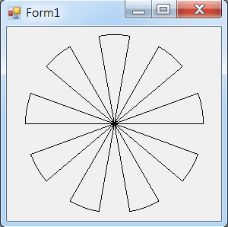
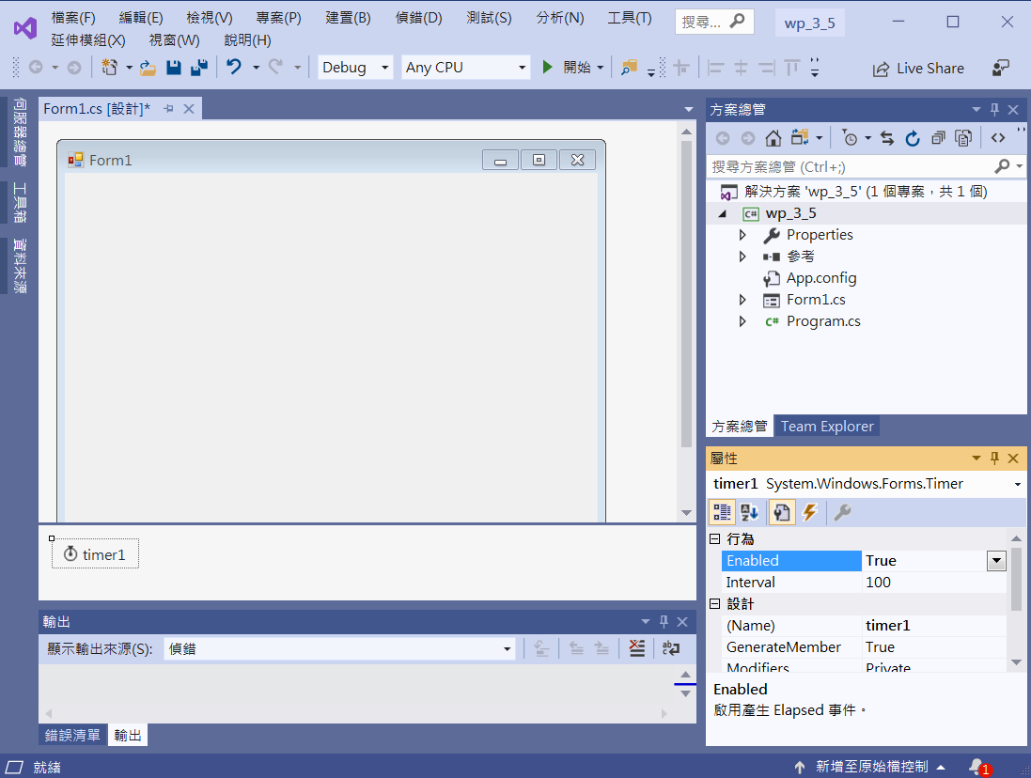
DrawPie()
Enabled -> True
timer1
Interval -> 100

Slide 4
DrawPie()
public partial class Form1 : Form
{
int startAngle = -10; // 開始的角度
public Form1()
{
InitializeComponent();
}
private void Form1_Paint(object sender, PaintEventArgs e)
{
int Cx = this.ClientSize.Width / 2; //找中心點
int Cy = this.ClientSize.Height / 2; //找中心點
int D = (int)(Math.Min(this.ClientSize.Width, this.ClientSize.Height) / 2) - 10; //半徑
for (int i = 0; i < 18; i++)
{
if (i %2 ==0) // 偶數才要繪出
e.Graphics.DrawPie(Pens.Black, Cx - D, Cy - D, 2 * D, 2 * D, startAngle + i * 20, 20);
// 繪出派形
}
}

Slide 5
DrawPie()
private void Timer1_Tick(object sender, EventArgs e)
{
startAngle = startAngle + 1; // 更新開始的角度
Invalidate();
}

Slide 6
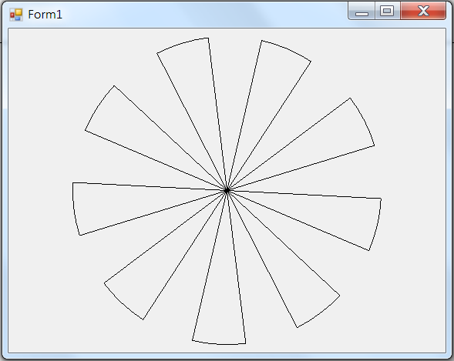
Exercise#3-5

Slide 7
內容來源
  Visual C# 2012 視窗程式設計：繪圖與遊戲專題(鄞永傳/著; 松崗)
  Visual C# 2013視窗程式設計(黃聰明/著; 松崗)
  跟著範例學會Visual C# 2015(張逸中/著; 博碩)

