Slide 1
Window Programming 3-7
Drawing I
Integrated Example 1
Yuan Ze University

Slide 2
Integrated Example 1
public partial class Form1 : Form
{
Rectangle rec1 = new Rectangle(0, 0, 150, 150);
Rectangle rec2 = new Rectangle(0, 150, 150, 150);
Brush b1 = new SolidBrush(Color.Red);
Brush b2 = new SolidBrush(Color.Blue);
public Form1()
{
InitializeComponent();
}
}

Slide 3
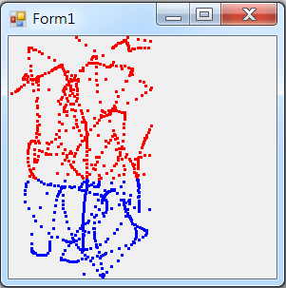
Integrated Example 1
private void Form1_MouseMove(object sender, MouseEventArgs e)
{
if (rec1.Contains(e.Location))
{
Graphics g = this.CreateGraphics();
g.FillRectangle(b1,e.X, e.Y, 3, 3);
}
if (rec2.Contains(e.Location))
{
Graphics g = this.CreateGraphics();
g.FillRectangle(b2, e.X, e.Y, 3, 3);
}
}

Slide 4
Exercise#3-7

Slide 5
內容來源
  Visual C# 2012 視窗程式設計：繪圖與遊戲專題(鄞永傳/著; 松崗)
  Visual C# 2013視窗程式設計(黃聰明/著; 松崗)
  跟著範例學會Visual C# 2015(張逸中/著; 博碩)

