Slide 1
Window Programming 4-4
Menu
MenuStrip (I)
Yuan Ze University

Slide 2
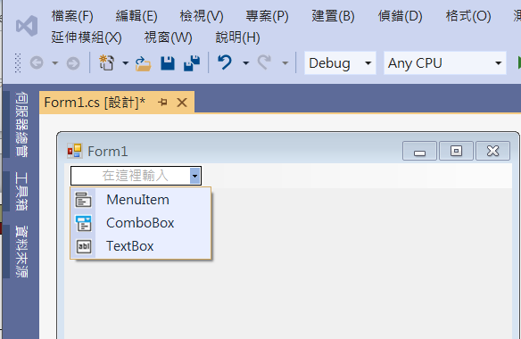
MenuStrip
Menu containing
  MenuItem
    Attribute: Checked
    Event: Click
  ComboBox
    Attribute: SelectedIndex
    Event: SelectedIndexChanged
  TextBox

Slide 3
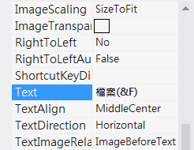

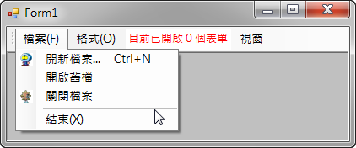
MenuStrip
MenuItem
  便捷鍵：是指功能表或功能表項目中可與Alt鍵搭配使用的加底線字母。只要在輸入給Text屬性中的地方，把想當做便捷鍵使用的字母之前輸入連字號(&)，即表示以該字母做為便捷鍵，例如，下圖左是設定的方式，而下圖右是執行時，若按Alt+F就會展開檔案功能表

Slide 4
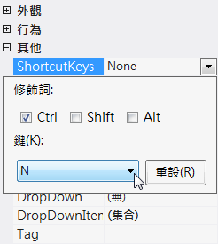
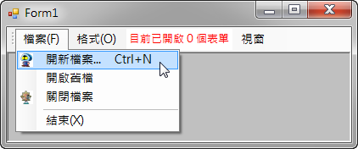
MenuStrip
MenuItem
  ShortcutKeys：取得或設定與ToolStripMenuItem關聯的快速鍵，例如，下圖左是設定修飾詞為Ctrl，而鍵為N，因此，就構成了Ctrl+N。下圖右則是程式執行時，其外觀：

Slide 5
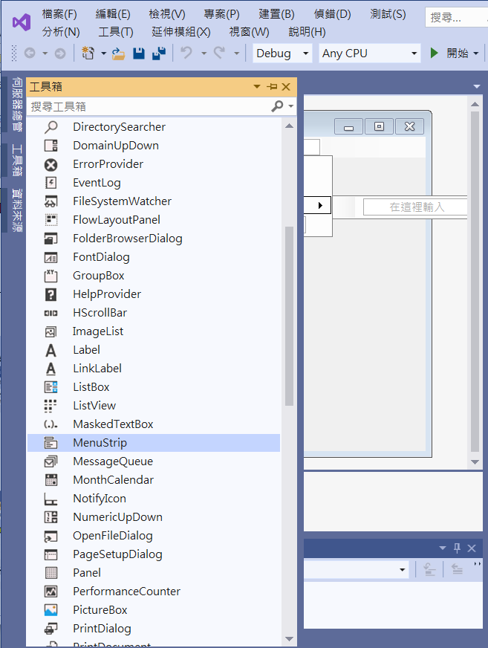
Example I of MenuStrip
Add MenuItems in MenuStrip
Choose MenuStrip from toolbox

Slide 6
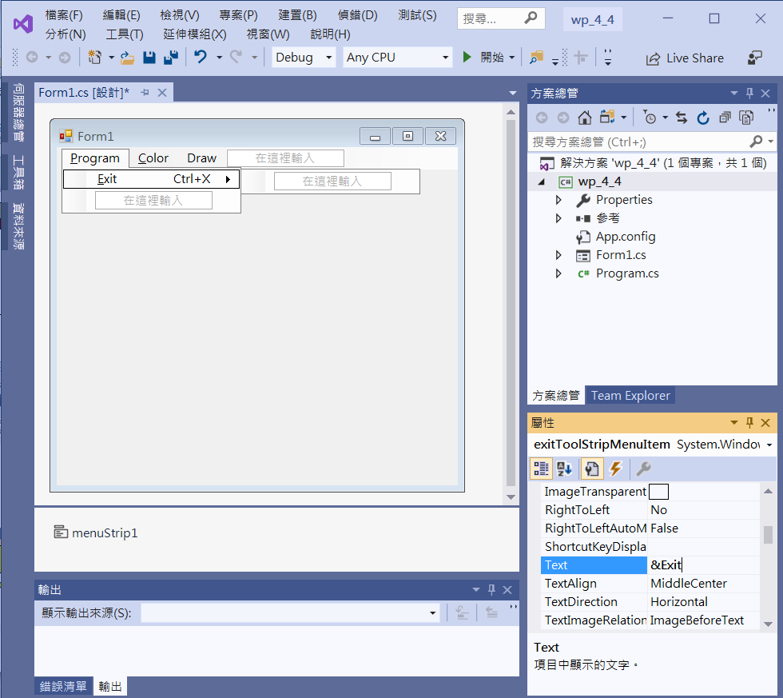
Example I of MenuStrip
Add MenuItems in MenuStrip & Add 便捷鍵
2. Edit MenuItem
1. Click menuStrip1
3. Set Text &Exit

Slide 7
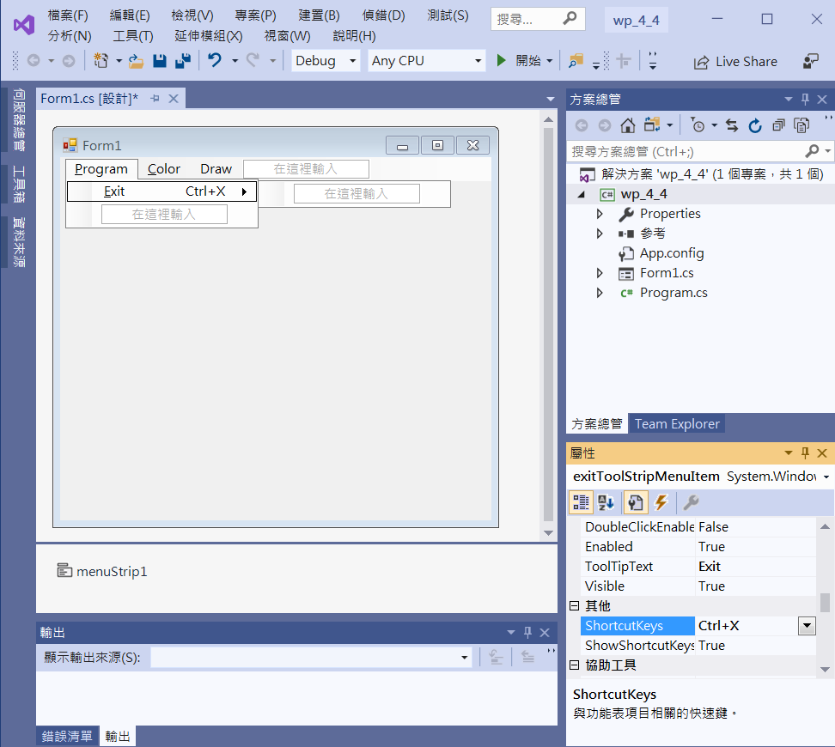
Example I of MenuStrip
Add ToolTipText
Set ToolTipText-> Exit

Slide 8
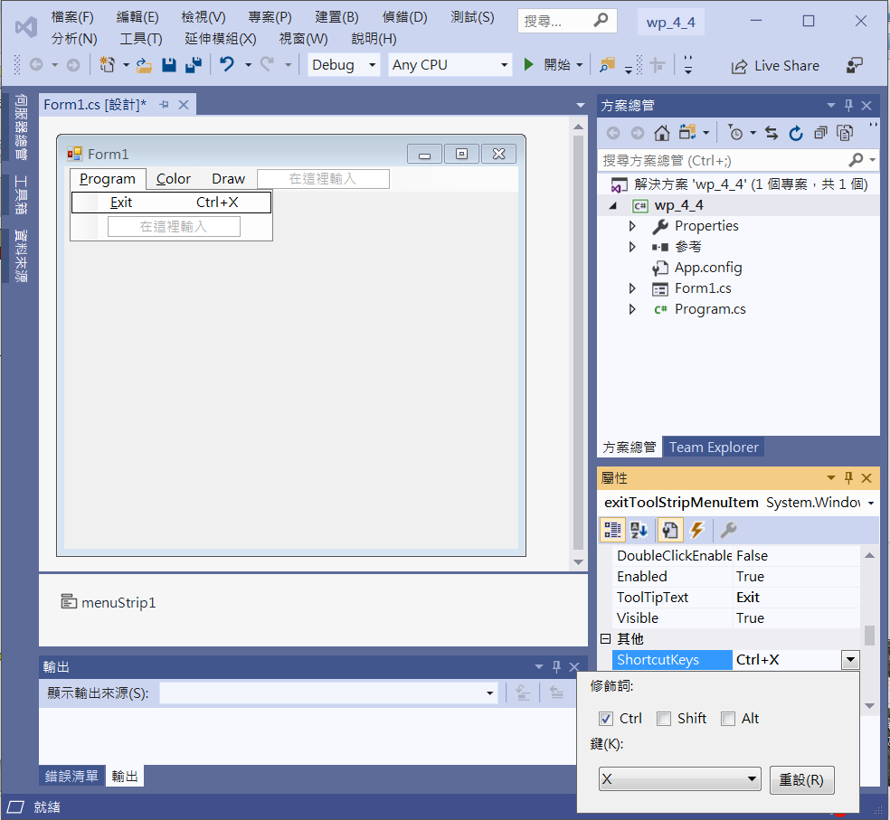
Example I of MenuStrip
Add ShortcutKeys
Set ShortcutKeys-> Ctrl+X

Slide 9
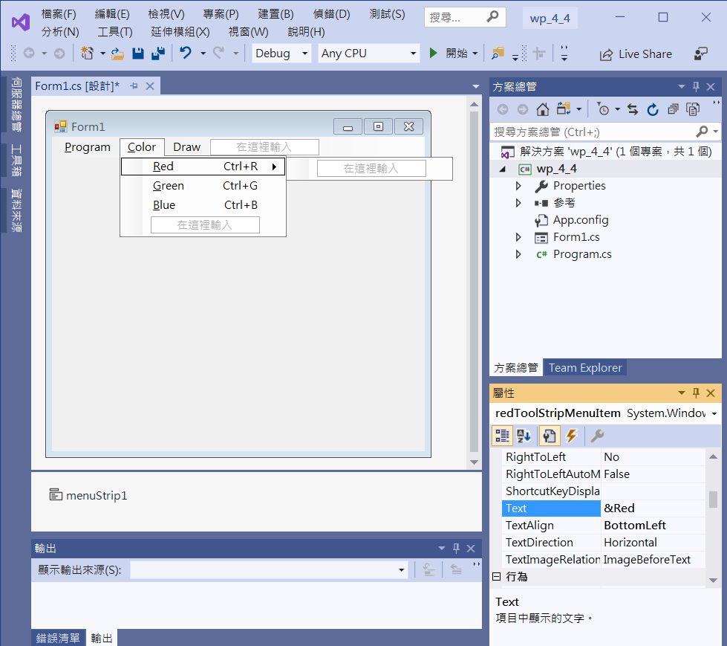
Example I of MenuStrip
Add 便捷鍵
Text-> &Red

Slide 10
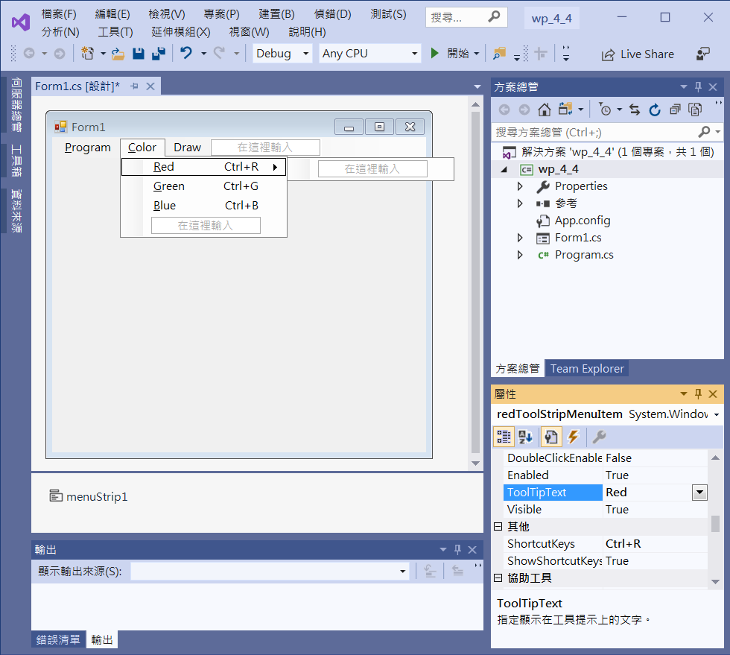
Example I of MenuStrip
Add ToolTipText
ToolTipText-> Red

Slide 11
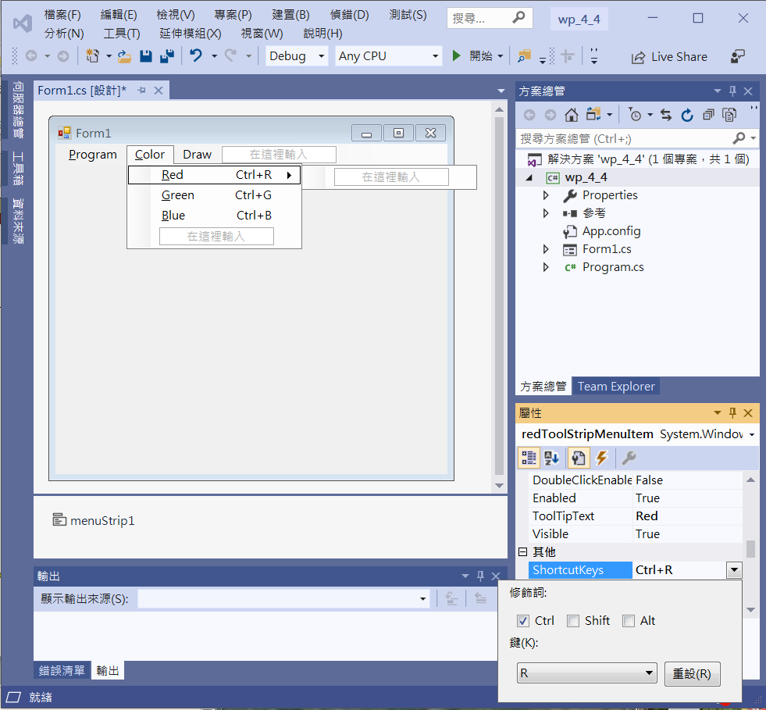
Example I of MenuStrip
Add ShortcutKeys
ShortcutKeys-> Ctrl+R

Slide 12
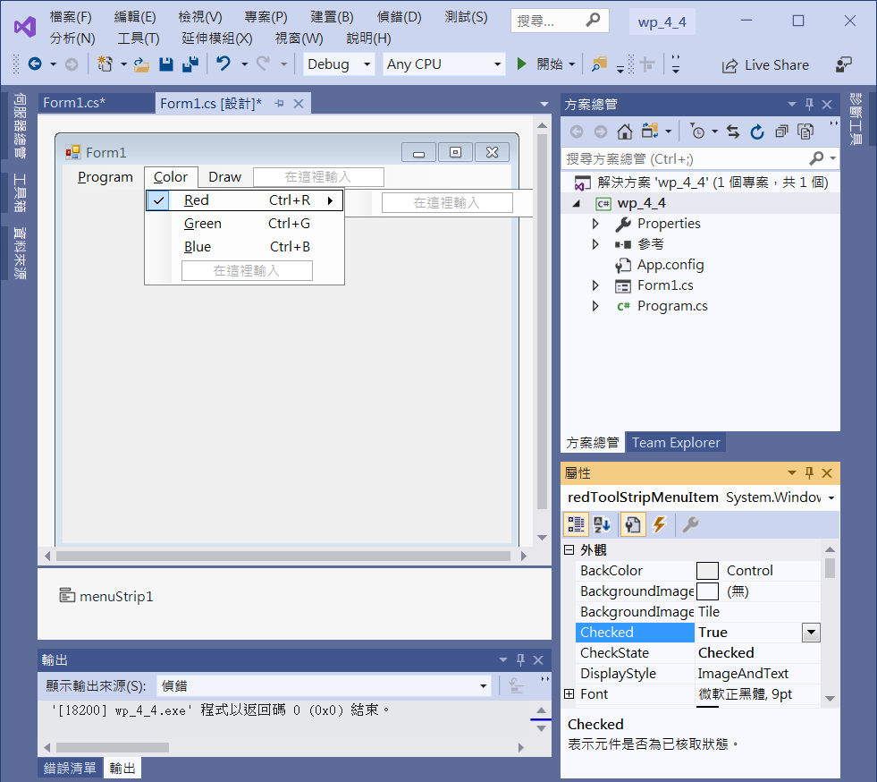
Example I of MenuStrip
Set Red Checked True
Checked -> True

Slide 13
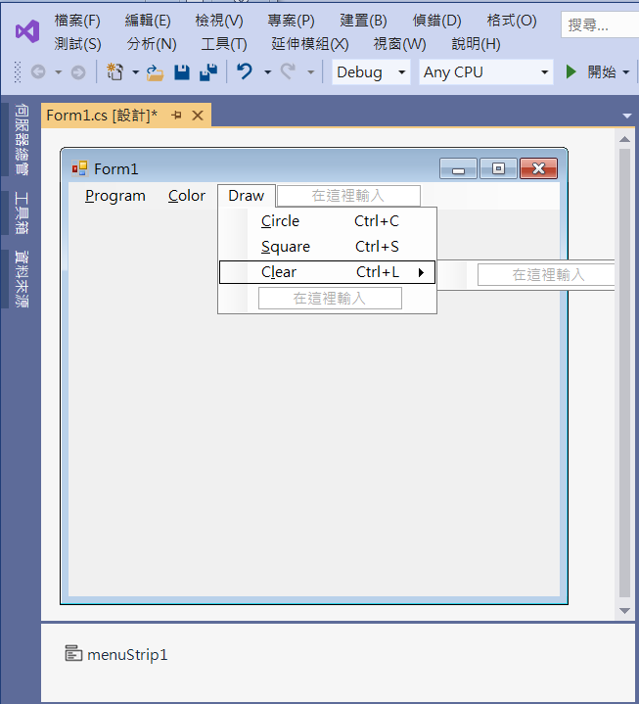
Example I of MenuStrip
Add MenuItems in MenuStrip

Slide 14
Example I of MenuStrip
public partial class Form1 : Form
{
Color c = Color.Red;
public Form1()
{
InitializeComponent();
}
private void ExitToolStripMenuItem_Click(object sender, EventArgs e)
{
Application.Exit(); //exit the program
}

Slide 15
Example I of MenuStrip
private void RedToolStripMenuItem_Click(object sender, EventArgs e)
{
c = Color.Red;
redToolStripMenuItem.Checked = true;
greenToolStripMenuItem.Checked = false;
blueToolStripMenuItem.Checked = false;
}
private void GreenToolStripMenuItem_Click(object sender, EventArgs e)
{
c = Color.Green;
redToolStripMenuItem.Checked = false;
greenToolStripMenuItem.Checked = true;
blueToolStripMenuItem.Checked = false;
}

Slide 16
Example I of MenuStrip
private void BlueToolStripMenuItem_Click(object sender, EventArgs e)
{
c = Color.Blue;
redToolStripMenuItem.Checked = false;
greenToolStripMenuItem.Checked = false;
blueToolStripMenuItem.Checked = true;
}
private void CircleToolStripMenuItem_Click(object sender, EventArgs e)
{
Graphics g1 = this.CreateGraphics();
g1.DrawEllipse(new Pen(c), 20, 40, 100, 100);
}

Slide 17
Example I of MenuStrip
private void SquareToolStripMenuItem_Click(object sender, EventArgs e)
{
Graphics g1 = this.CreateGraphics();
g1.DrawRectangle(new Pen(c), 140, 40, 100, 100);
}
private void ClearToolStripMenuItem_Click(object sender, EventArgs e)
{
Graphics g1 = this.CreateGraphics();
g1.Clear(this.BackColor);
}

Slide 18
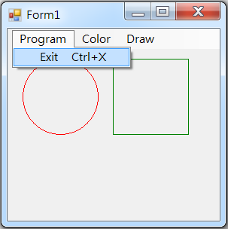
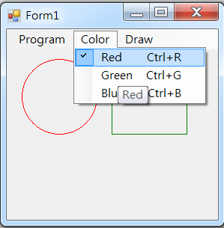
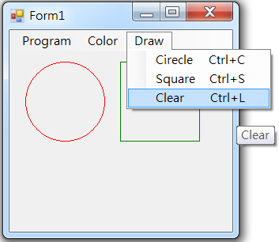
Exercise#4-4

Slide 19
內容來源
  Visual C# 2012 視窗程式設計：繪圖與遊戲專題(鄞永傳/著; 松崗)
  Visual C# 2013視窗程式設計(黃聰明/著; 松崗)
  跟著範例學會Visual C# 2015(張逸中/著; 博碩)

