Slide 1
Window Programming 4-5
Menu
MenuStrip (II)
Yuan Ze University

Slide 2
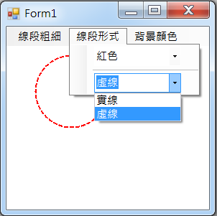
Example II of MenuStrip
ComboBox in MenuStrip

Slide 3
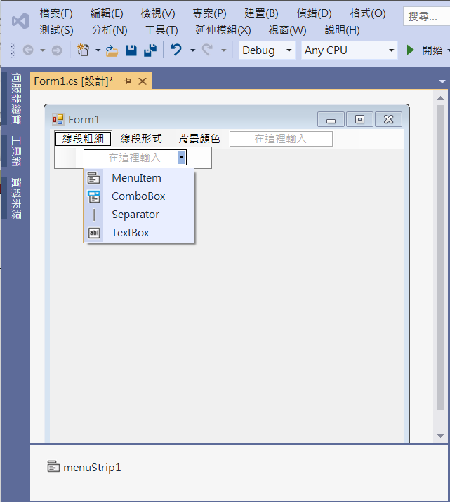
Example II of MenuStrip
Add a ComboBox for 線段粗細
1. Click at Arrow
2. Add a ComboBox

Slide 4
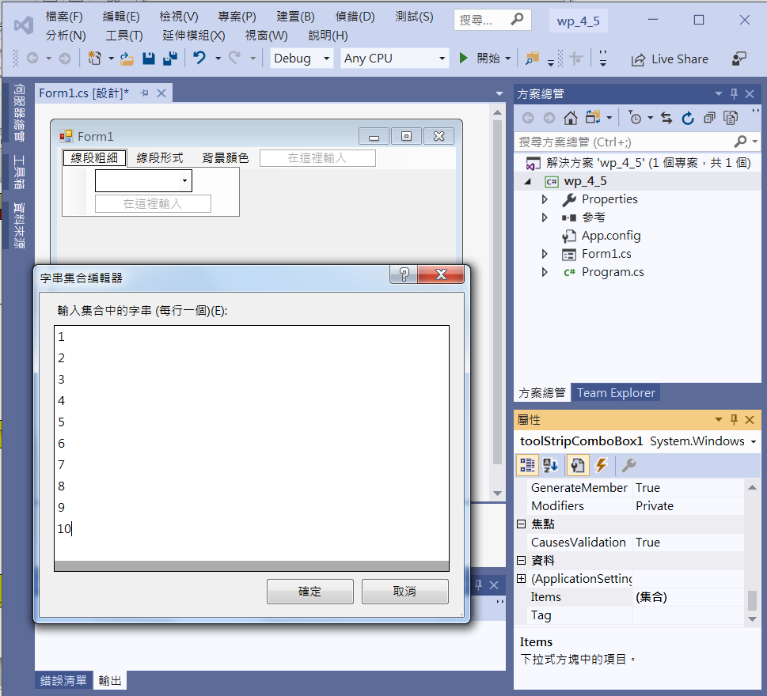
Example II of MenuStrip
Add a ComboBox for 線段粗細
2. Edit Items
1. Click Items

Slide 5
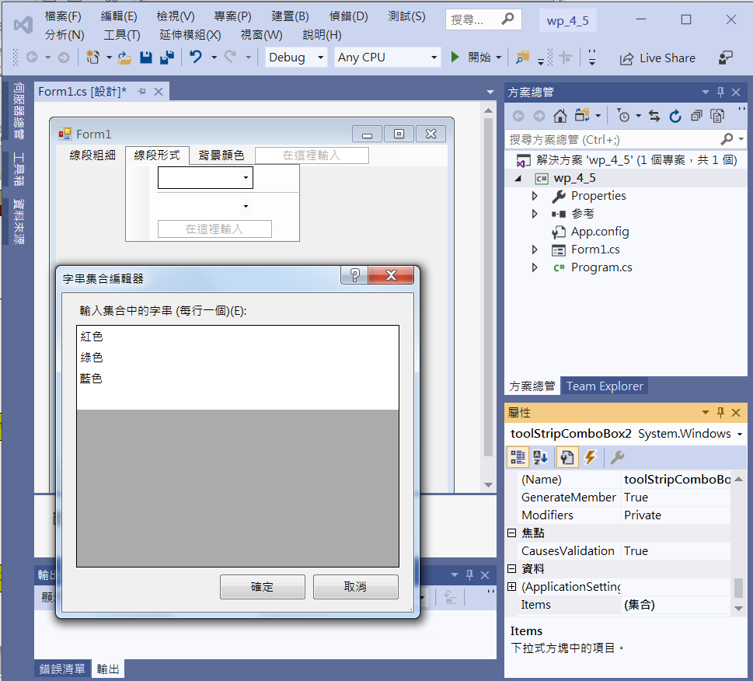
Example II of MenuStrip
Add a ComboBox for 顏色
1. Add a ComboBox
3. Edit Items
2. Click Items

Slide 6
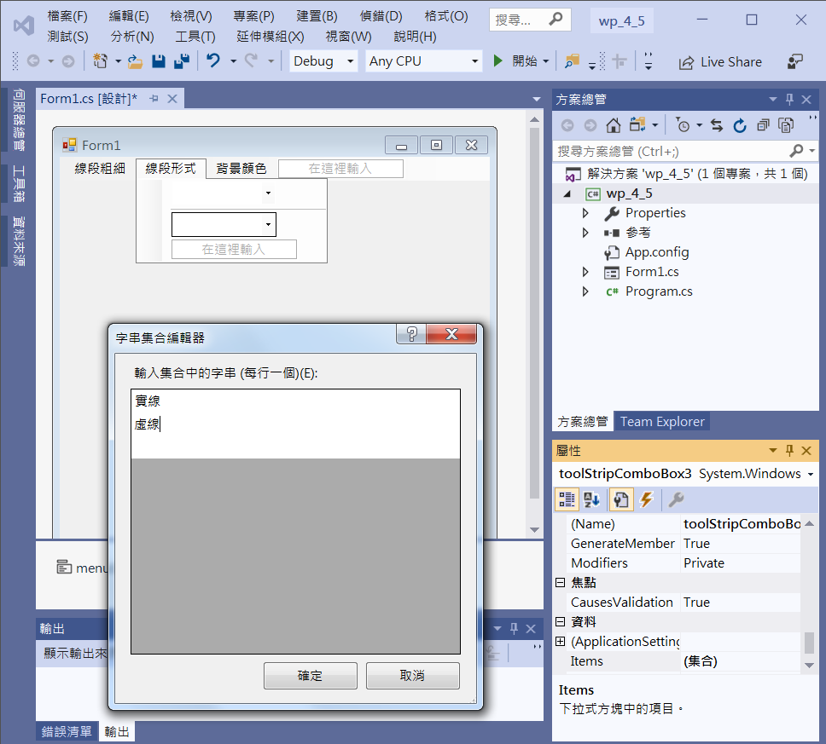
Example II of MenuStrip
Add a ComboBox for 實線或虛線
1. Add a Separator
2. Add a ComboBox
4. Edit Items
3. Click Items

Slide 7
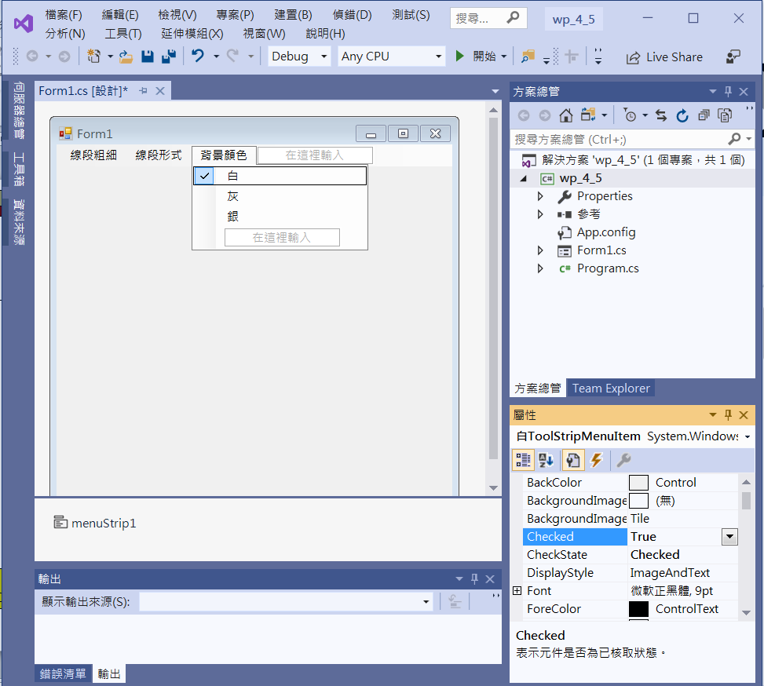
Example II of MenuStrip
Add 3 MenuItems for 背景顏色
1. Add 3 MenuItems
2. 白
Checked -> true

Slide 8
Example II of MenuStrip
using System;
using System.Collections.Generic;
using System.ComponentModel;
using System.Data;
using System.Drawing;
using System.Linq;
using System.Text;
using System.Threading.Tasks;
using System.Windows.Forms;
using System.Drawing.Drawing2D; //DashStyle

Slide 9
Example II of MenuStrip
public partial class Form1 : Form
{
Color bgcolor=Color.White;
int lineWidth=1;
Color lineColor = Color.Red;
bool lineSolid = true;
public Form1()
{
InitializeComponent();
}

Slide 10
Example II of MenuStrip
private void Form1_Load(object sender, EventArgs e)
{
this.BackColor = bgcolor;
toolStripComboBox1.SelectedIndex = 0;
toolStripComboBox2.SelectedIndex = 0;
toolStripComboBox3.SelectedIndex = 0;
白ToolStripMenuItem.Checked = true;
灰ToolStripMenuItem.Checked = false;
銀ToolStripMenuItem.Checked = false;
}

Slide 11
Example II of MenuStrip
private void 白ToolStripMenuItem_Click(object sender, EventArgs e)
{
bgcolor=Color.White;
this.BackColor = bgcolor;
白ToolStripMenuItem.Checked = true;
灰ToolStripMenuItem.Checked = false;
銀ToolStripMenuItem.Checked = false;
Invalidate();
}

Slide 12
Example II of MenuStrip
private void 灰ToolStripMenuItem_Click(object sender, EventArgs e)
{
bgcolor = Color.Gray;
this.BackColor = bgcolor;
白ToolStripMenuItem.Checked = false;
灰ToolStripMenuItem.Checked = true;
銀ToolStripMenuItem.Checked = false;
Invalidate();
}

Slide 13
Example II of MenuStrip
private void 銀ToolStripMenuItem_Click(object sender, EventArgs e)
{
bgcolor = Color.Silver;
this.BackColor = bgcolor;
白ToolStripMenuItem.Checked = false;
灰ToolStripMenuItem.Checked = false;
銀ToolStripMenuItem.Checked = true;
Invalidate();
}

Slide 14
Example II of MenuStrip
private void ToolStripComboBox1_SelectedIndexChanged(object sender, EventArgs e)
{
lineWidth = toolStripComboBox1.SelectedIndex+1;
Invalidate();
}

Slide 15
Example II of MenuStrip
private void ToolStripComboBox2_SelectedIndexChanged(object sender, EventArgs e)
{
switch (toolStripComboBox2.SelectedIndex)
{
case 0:
lineColor = Color.Red;
break;
case 1:
lineColor = Color.Green;
break;
case 2:
lineColor = Color.Blue;
break;
}
Invalidate();
}

Slide 16
Example II of MenuStrip
private void ToolStripComboBox3_SelectedIndexChanged(object sender, EventArgs e)
{
switch (toolStripComboBox3.SelectedIndex)
{
case 0:
lineSolid = true;
break;
case 1:
lineSolid = false;
break;
}
Invalidate();
}

Slide 17
Example II of MenuStrip
private void Form1_Paint(object sender, PaintEventArgs e)
{
Pen p1 = new Pen(lineColor, lineWidth);
if (lineSolid)
p1.DashStyle = DashStyle.Solid;
else
p1.DashStyle = DashStyle.Dash;
Graphics g1 = e.Graphics;
g1.DrawEllipse(p1, 40, 40, 100, 100);
}

Slide 18
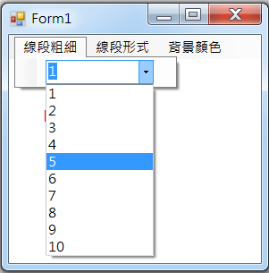
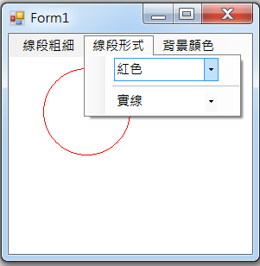
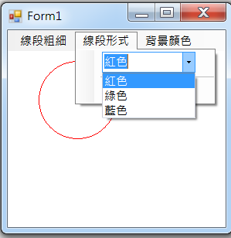
Exercise#4-5

Slide 19
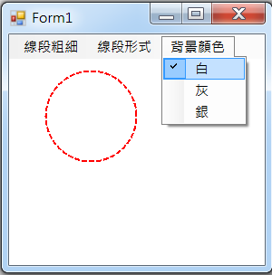
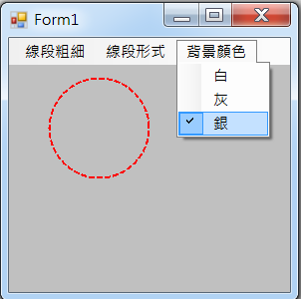
Exercise#4-5

Slide 20
內容來源
  Visual C# 2012 視窗程式設計：繪圖與遊戲專題(鄞永傳/著; 松崗)
  Visual C# 2013視窗程式設計(黃聰明/著; 松崗)
  跟著範例學會Visual C# 2015(張逸中/著; 博碩)

