Slide 1
Window Programming 5-2
A example of network picture
Yuan Ze University

Slide 2
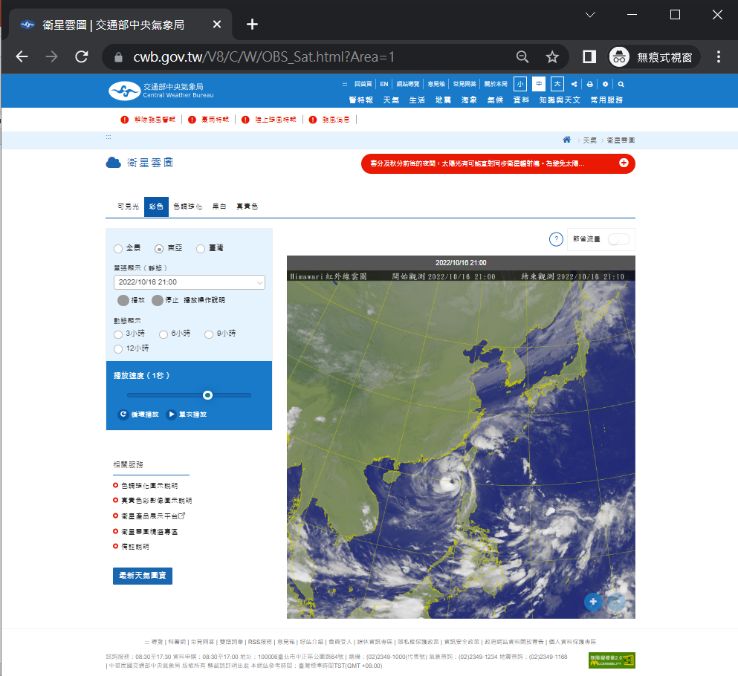
Network picture (衛星雲圖)
Chrome
Click right button at the picture to see the URL

Slide 3
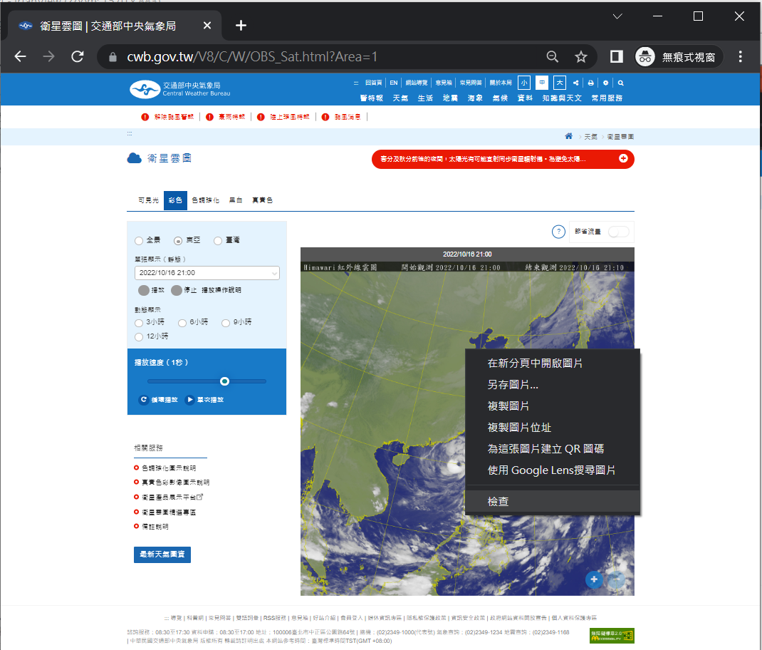
Network picture (衛星雲圖)
Chrome
Click right button at the picture to see the URL

Slide 4
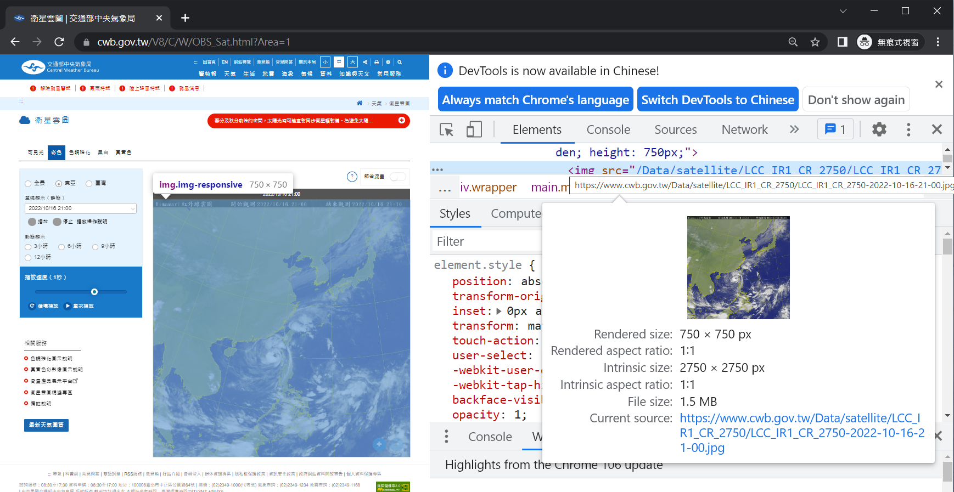
Network picture (衛星雲圖)
URL

Slide 5
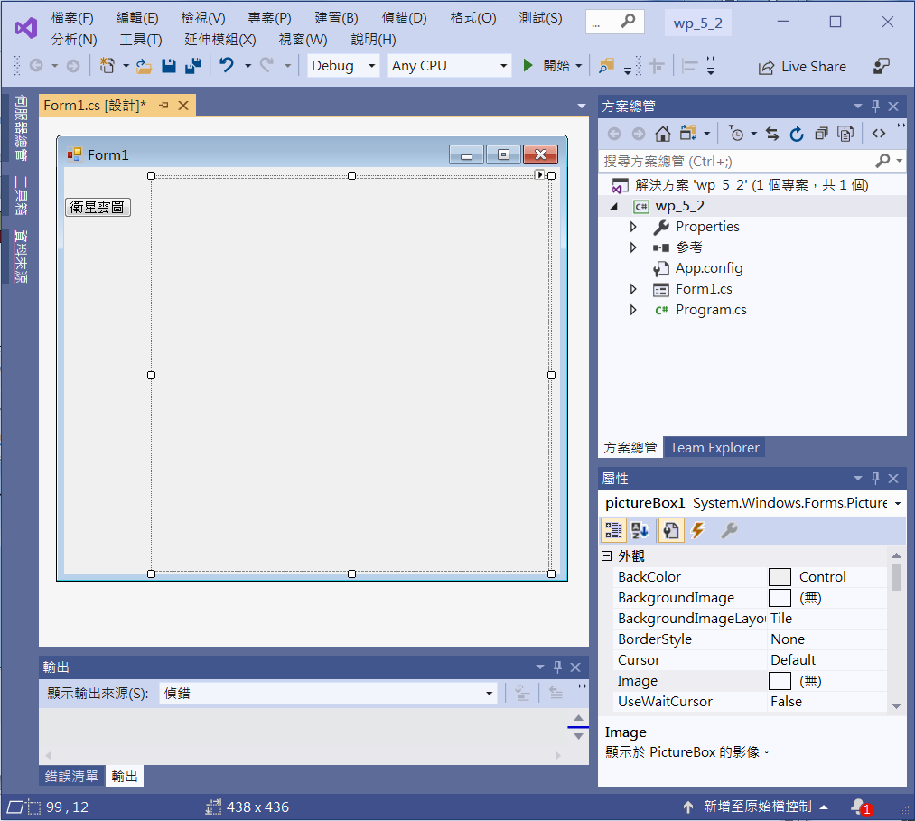
Network picture (衛星雲圖)
button1
pictureBox1

Slide 6
Network picture (衛星雲圖)
using System;
using System.Collections.Generic;
using System.ComponentModel;
using System.Data;
using System.Drawing;
using System.Linq;
using System.Text;
using System.Threading.Tasks;
using System.Windows.Forms;
using System.Net; // 處理https 安全協定

Slide 7
Network picture (衛星雲圖)
private void Button1_Click(object sender, EventArgs e)
{
System.Net.ServicePointManager.ServerCertificateValidationCallback = delegate { return true; };
System.Net.ServicePointManager.SecurityProtocol = SecurityProtocolType.Tls12 | SecurityProtocolType.Ssl3 | SecurityProtocolType.Tls;
string strMinute = "";
if (DateTime.Now.Minute > 50) strMinute = "50";
else
if (DateTime.Now.Minute > 40) strMinute = "40";
else
if (DateTime.Now.Minute > 30) strMinute = "30";
else
if (DateTime.Now.Minute > 20) strMinute = "20";
else
if (DateTime.Now.Minute > 10) strMinute = "10";
else
strMinute = "00";

Slide 8
Network picture (衛星雲圖)
string mapURL = String.Format(
"https://www.cwb.gov.tw/Data/satellite/LCC_IR1_CR_2750/LCC_IR1_CR_2750-{0}-{1}-{2}-{3}-{4}.jpg",
DateTime.Now.Year,
DateTime.Now.Month.ToString("00"),
DateTime.Now.Day.ToString("00"),
(DateTime.Now.Hour - 1).ToString("00"),
strMinute);
pictureBox1.ImageLocation = mapURL;
pictureBox1.ClientSize = new Size(400, 430);
}

Slide 9
Network picture (衛星雲圖)
private void Form1_Load(object sender, EventArgs e)
{
this.AutoSize = true;
this.AutoSizeMode = AutoSizeMode.GrowAndShrink; //表單自動縮放
pictureBox1.SizeMode = PictureBoxSizeMode.Zoom; //縮小圖的大小
//pictureBox1.SizeMode = PictureBoxSizeMode.AutoSize; //實際圖大小
}

Slide 10
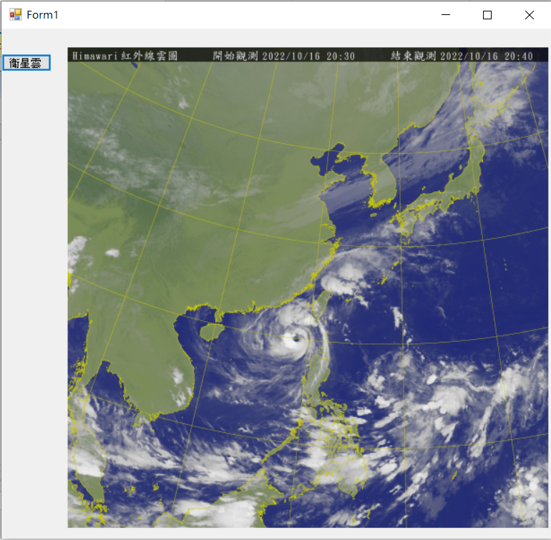

Exercise#5-2

Slide 11
內容來源
  Visual C# 2012 視窗程式設計：繪圖與遊戲專題(鄞永傳/著; 松崗)
  Visual C# 2013視窗程式設計(黃聰明/著; 松崗)
  跟著範例學會Visual C# 2015(張逸中/著; 博碩)

