Slide 1
Window Programming 5-3
OpenFileDialog
Yuan Ze University

Slide 2
OpenFileDialog
A dialog for opening a file
Attribute
  Title
  FileName
  DefaultExt
  Filter
Event
  ShowDialog
    DialogResult.OK

Slide 3
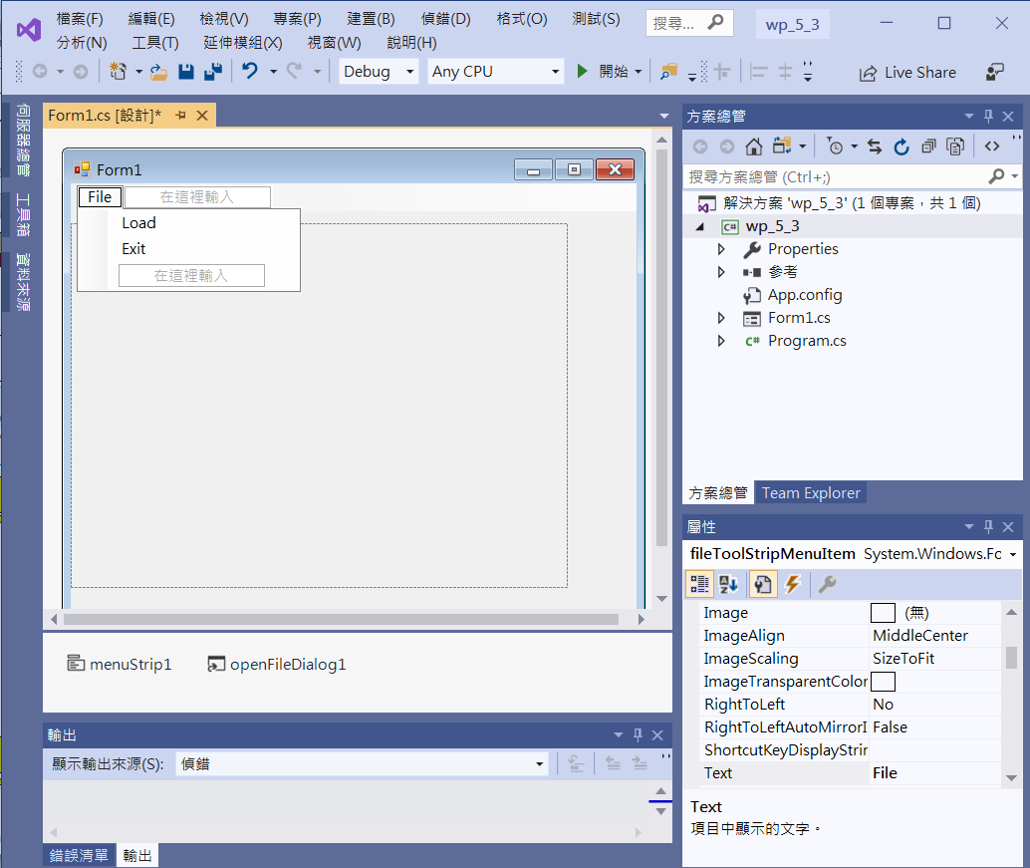
OpenFileDialog & PictureBox
Edit
Menu
pictureBox1
openFileDialog1
menuStrip1

Slide 4
OpenFileDialog & PictureBox
private void Form1_Load(object sender, EventArgs e)
{
this.AutoSize = true;
this.AutoSizeMode = AutoSizeMode.GrowAndShrink;
pictureBox1.SizeMode = PictureBoxSizeMode.AutoSize;
openFileDialog1.Filter = "圖檔(*.BMP,*.JPG,*.GIF)|*.BMP;*.JPG;*.GIF|所有檔案(*.*)|*.*";
}

Slide 5
OpenFileDialog & PictureBox
private void LoadToolStripMenuItem_Click(object sender, EventArgs e)
{
if (openFileDialog1.ShowDialog() == DialogResult.OK)
{
String s=openFileDialog1.FileName;
pictureBox1.Image = new Bitmap(s);
}
}

Slide 6
OpenFileDialog & PictureBox
private void ExitToolStripMenuItem_Click(object sender, EventArgs e)
{
Application.Exit();
}

Slide 7
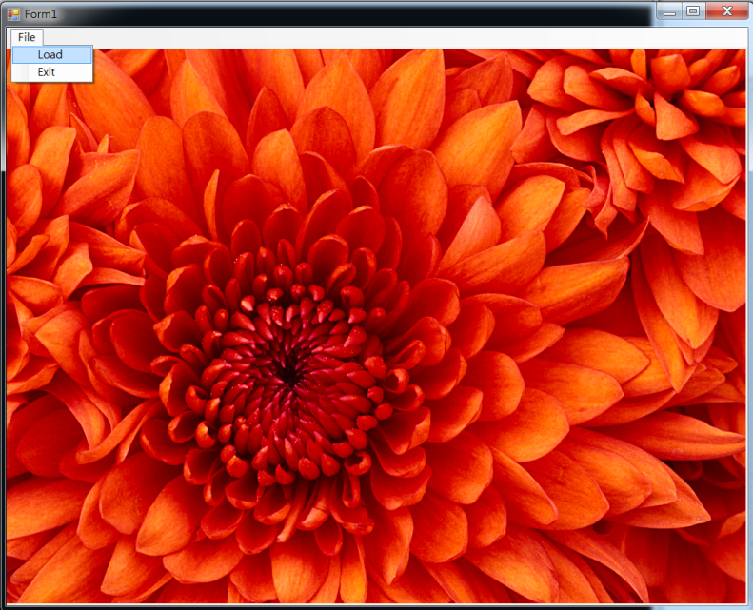
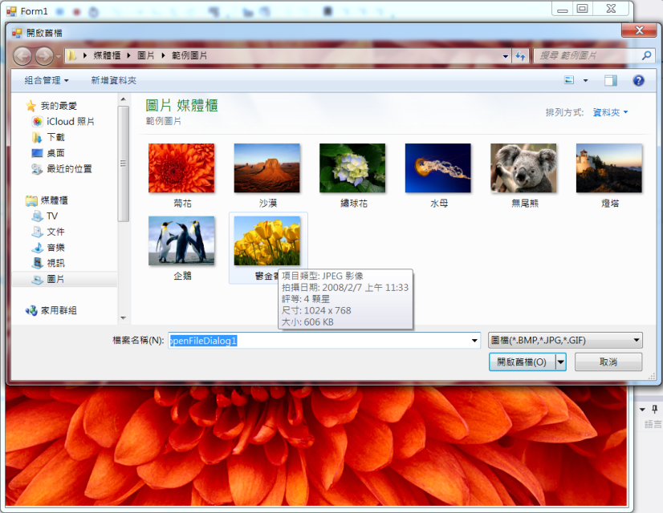

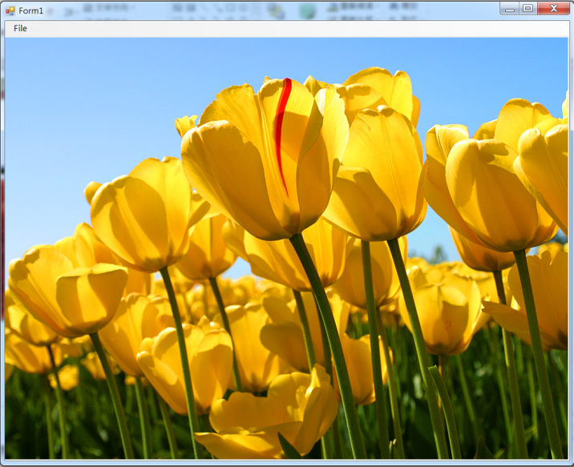
Exercise#5-3

Slide 8
內容來源
  Visual C# 2012 視窗程式設計：繪圖與遊戲專題(鄞永傳/著; 松崗)
  Visual C# 2013視窗程式設計(黃聰明/著; 松崗)
  跟著範例學會Visual C# 2015(張逸中/著; 博碩)

