Slide 1
Window Programming 5-4
SaveFileDialog, StreamReader, StreamWriter
Yuan Ze University

Slide 2
SaveFileDialog
A dialog for saving a file
Attribute
  Title
  FileName
  DefaultExt
  Filter
Event
  ShowDialog
    DialogResult.OK

Slide 3
StreamReader
Load a text file
  Using System.IO
  StreamReader s = new StreamReader(“A1.txt”);
Event
  ReadLine
  ReadToEnd
  Close

Slide 4
StreamWriter
Save a text file
  Using System.IO
  StreamWriter s = new StreamWriter(“A1.txt”);
  StreamWriter s = new StreamWriter(“A1.txt”, true); // append
Event
  Write
  WriteLine

Slide 5
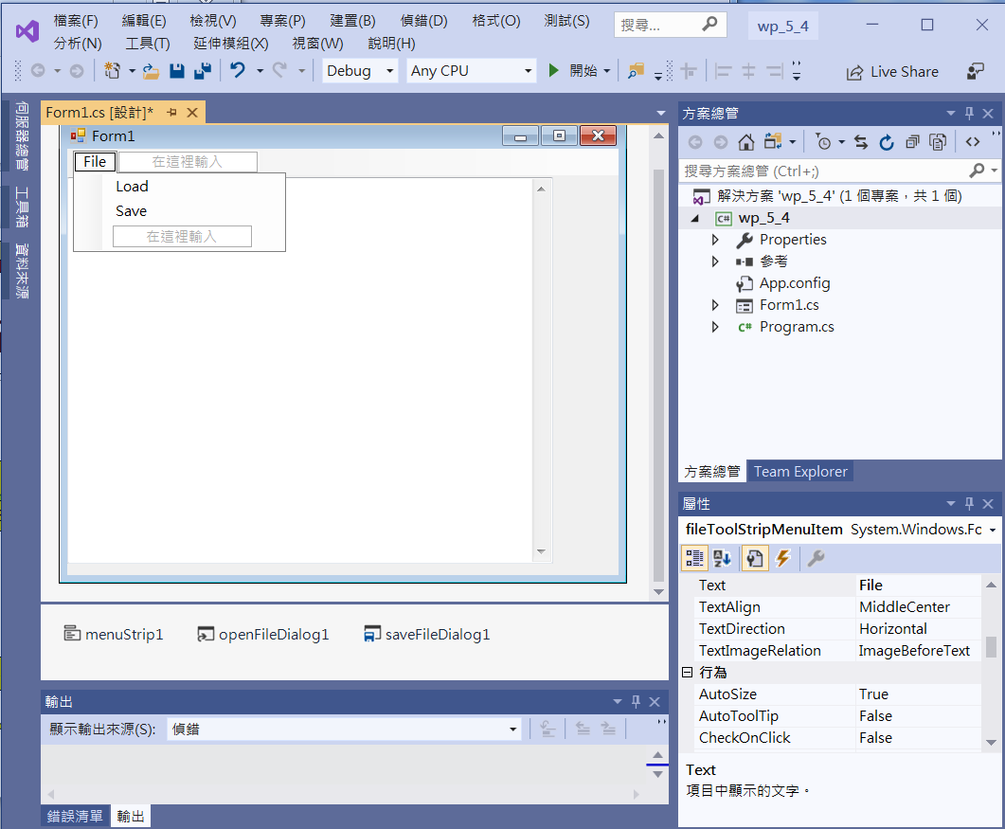
StreamReader & StreamWriter
Edit
Menu
textBox1
Multiline-> true
ScrollBars ->Both
openFileDialog1
saveFileDialog1
menuStrip1

Slide 6
StreamReader & StreamWriter
using System;
using System.Collections.Generic;
using System.ComponentModel;
using System.Data;
using System.Drawing;
using System.Linq;
using System.Text;
using System.Threading.Tasks;
using System.Windows.Forms;
using System.IO;
Add using System.IO;

Slide 7
StreamReader & StreamWriter
private void LoadToolStripMenuItem_Click(object sender, EventArgs e)
{
if (openFileDialog1.ShowDialog() == DialogResult.OK)
{
StreamReader inFile = new StreamReader(openFileDialog1.FileName);
textBox1.Text = inFile.ReadToEnd();
inFile.Close();
}
}

Slide 8
StreamReader & StreamWriter
private void SaveToolStripMenuItem_Click(object sender, EventArgs e)
{
if (saveFileDialog1.ShowDialog() == DialogResult.OK)
{
StreamWriter outFile = new StreamWriter(saveFileDialog1.FileName);
outFile.Write(textBox1.Text);
outFile.Close();
}
}

Slide 9
StreamReader & StreamWriter
private void Form1_Load(object sender, EventArgs e)
{
openFileDialog1.Filter = "文字檔(*.txt)|*.txt";
saveFileDialog1.Filter = "文字檔(*.txt)|*.txt";
}

Slide 10
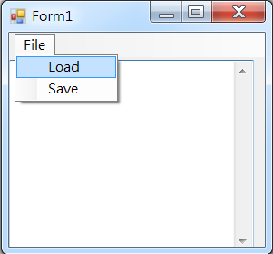
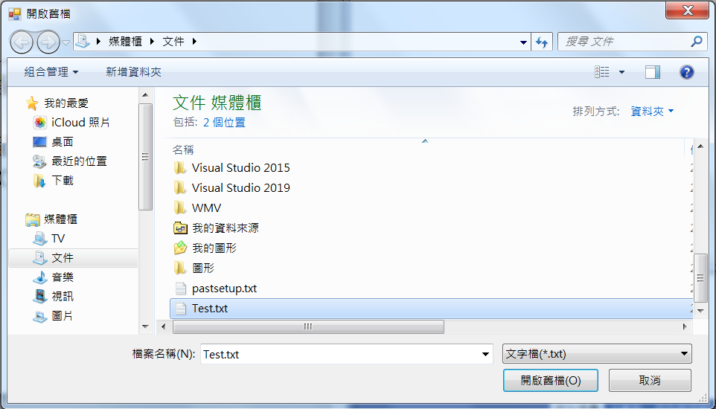
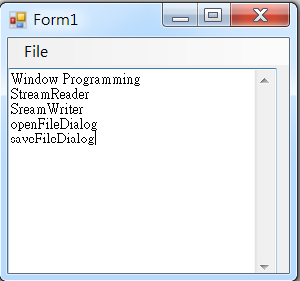
Exercise#5-4

Slide 11
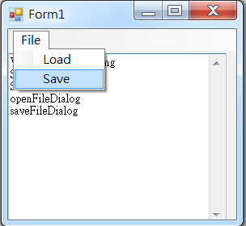
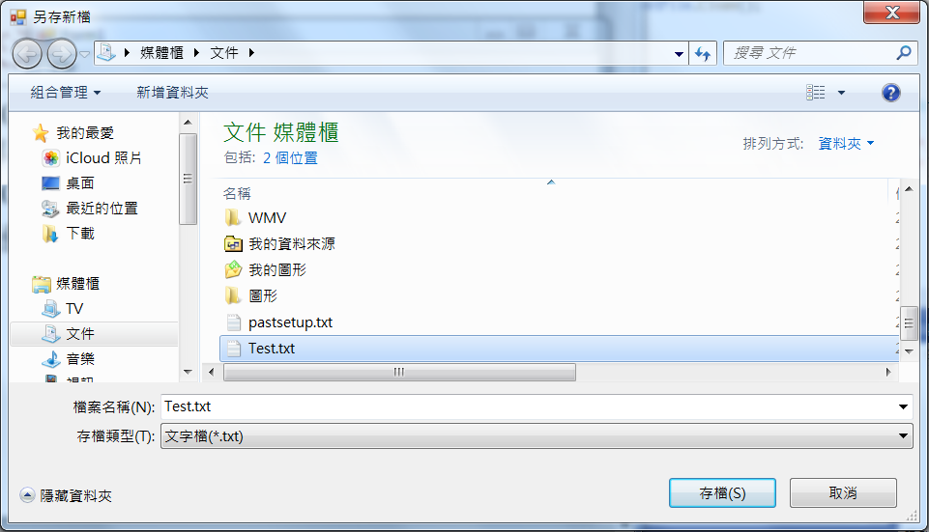
Exercise#5-4

Slide 12
內容來源
  Visual C# 2012 視窗程式設計：繪圖與遊戲專題(鄞永傳/著; 松崗)
  Visual C# 2013視窗程式設計(黃聰明/著; 松崗)
  跟著範例學會Visual C# 2015(張逸中/著; 博碩)

