Slide 1
Window Programming 5-5
DrawString, BinaryWriter
BinaryReader, List
Yuan Ze University

Slide 2
DrawString
Draw a string
  e.Graphics.DrawString("a string" , this.Font, new SolidBrush(Color.Blue), point.X, point.Y);

Slide 3
BinaryReader
Load a binary file
  Using System.IO
  BinaryReader s = new BinaryReader(File.Open("A1", FileMode.Open));
Event
  ReadInt32
  ReadString
  ReadBoolean
  Close

Slide 4
BinaryWriter
Write a binary file
  Using System.IO
  BinaryWriter s = new BinaryWriter(File.Open("A1", FileMode.Create));
  BinaryWriter s = new BinaryWriter(File.Open("A1", FileMode.Append));
Event
  Write
  Close

Slide 5
List
Dynamic array
  List<Point> pt = new List<Point>();
  pt.Add(new Point(100,200));
  pt[0];
  pt.Count();
  pt.RemoveAt(k-1);
  pt.Clear();

Slide 6
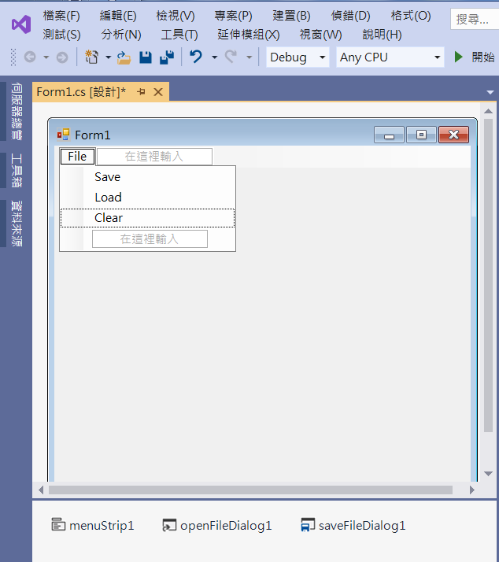
An Example of Saving Points
Edit
Menu
menuStrip1
openFileDialog1
saveFileDialog1

Slide 7
An Example of Saving Points
using System;
using System.Collections.Generic;
using System.ComponentModel;
using System.Data;
using System.Drawing;
using System.Linq;
using System.Text;
using System.Threading.Tasks;
using System.Windows.Forms;
using System.IO;

Slide 8
An Example of Saving Points
namespace wp_5_5
{
public partial class Form1 : Form
{
List<Point> Pt = new List<Point>();
public Form1()
{
InitializeComponent();
}

Slide 9
An Example of Saving Points
private void Form1_Load(object sender, EventArgs e)
{
openFileDialog1.Filter = "點座標檔(*.ptf)|*.ptf";
saveFileDialog1.Filter = "點座標檔(*.ptf)|*.ptf";
}
private void Form1_MouseDown(object sender, MouseEventArgs e)
{
Pt.Add(e.Location);
Invalidate();
}

Slide 10
An Example of Saving Points
private void Form1_Paint(object sender, PaintEventArgs e)
{
for (int i=0; i < Pt.Count(); i++)
{
e.Graphics.DrawString("(" + Pt[i].X.ToString() + "," + Pt[i].Y.ToString() + ")", this.Font, new SolidBrush(Color.Blue), Pt[i].X, Pt[i].Y);
}
}

Slide 11
An Example of Saving Points
private void SaveToolStripMenuItem_Click(object sender, EventArgs e)
{
if (saveFileDialog1.ShowDialog()== DialogResult.OK)
{
String s = saveFileDialog1.FileName;
BinaryWriter outFile = new BinaryWriter(File.Open(s, FileMode.Create));
outFile.Write(Pt.Count());
for (int i=0; i< Pt.Count(); i++)
{
outFile.Write(Pt[i].X);
outFile.Write(Pt[i].Y);
}
outFile.Close();
}
}

Slide 12
An Example of Saving Points
private void LoadToolStripMenuItem_Click(object sender, EventArgs e)
{
if (openFileDialog1.ShowDialog() == DialogResult.OK)
{
String s = openFileDialog1.FileName;
if (!File.Exists(s)) return; // Check whether the file exists
BinaryReader inFile = new BinaryReader(File.Open(s, FileMode.Open));
Pt.Clear();
int n = inFile.ReadInt32();
for (int i = 0; i < n; i++)
Pt.Add(new Point(inFile.ReadInt32(), inFile.ReadInt32()));
Invalidate();
inFile.Close();
}
}

Slide 13
An Example of Saving Points
private void ClearToolStripMenuItem_Click(object sender, EventArgs e)
{
Pt.Clear();
Invalidate();
}

Slide 14
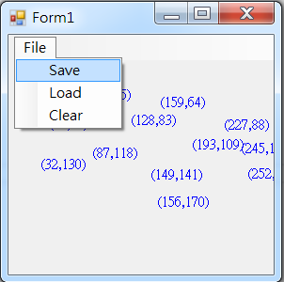
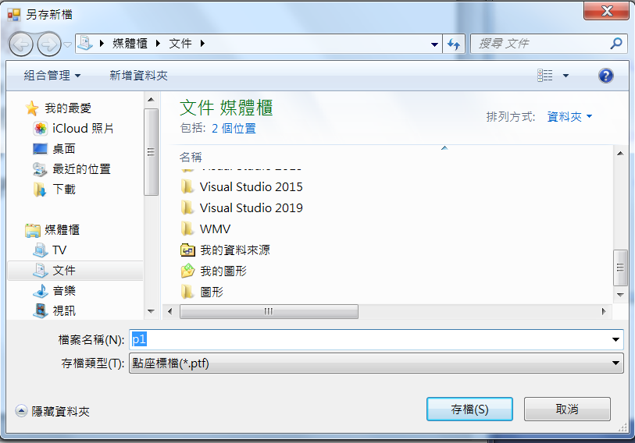
Exercise#5-5

Slide 15
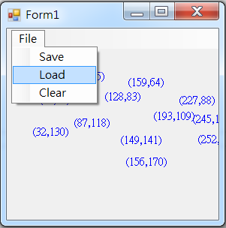
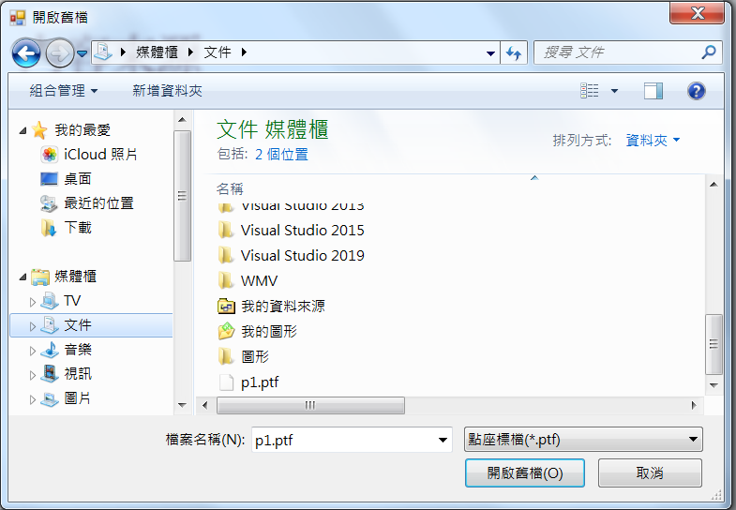
Exercise#5-5

Slide 16
內容來源
  Visual C# 2012 視窗程式設計：繪圖與遊戲專題(鄞永傳/著; 松崗)
  Visual C# 2013視窗程式設計(黃聰明/著; 松崗)
  跟著範例學會Visual C# 2015(張逸中/著; 博碩)

