Slide 1
Window Programming 6-5
An Example of ToolStrip & StatusStrip
Yuan Ze University

Slide 2
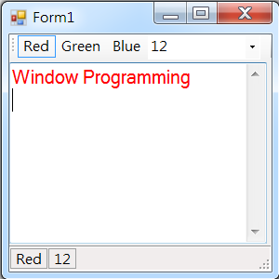
An Example of ToolStrip & StatusStrip

Slide 3
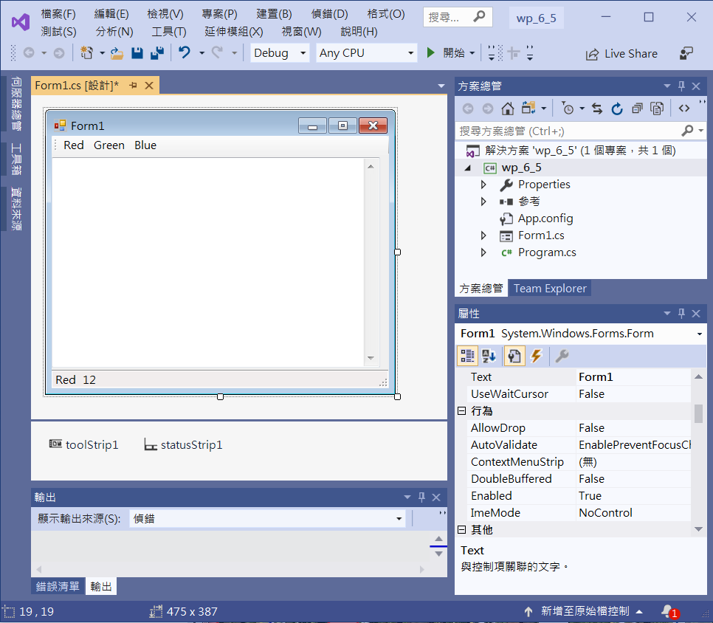
An Example of ToolStrip & StatusStrip
2. Add 3 toolStripButton
5. Add textBoxl
Multiline -> True
ScrollBars -> Vertical
4. Add 2 statusStripLabel
1. Add toolStrip1
3. Add statusStrip1

Slide 4
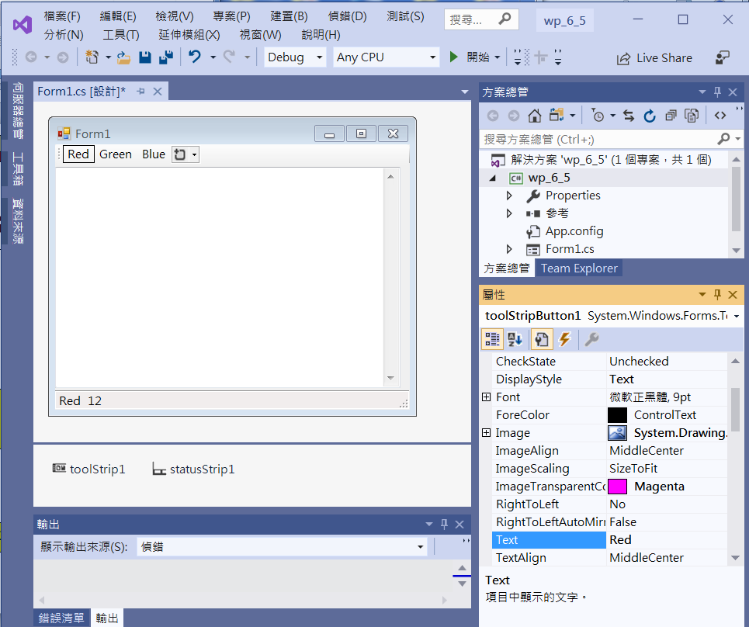
An Example of ToolStrip & StatusStrip
1. toolStripButton1
2. DisplayStyle -> Text
3. Text -> Red

Slide 5
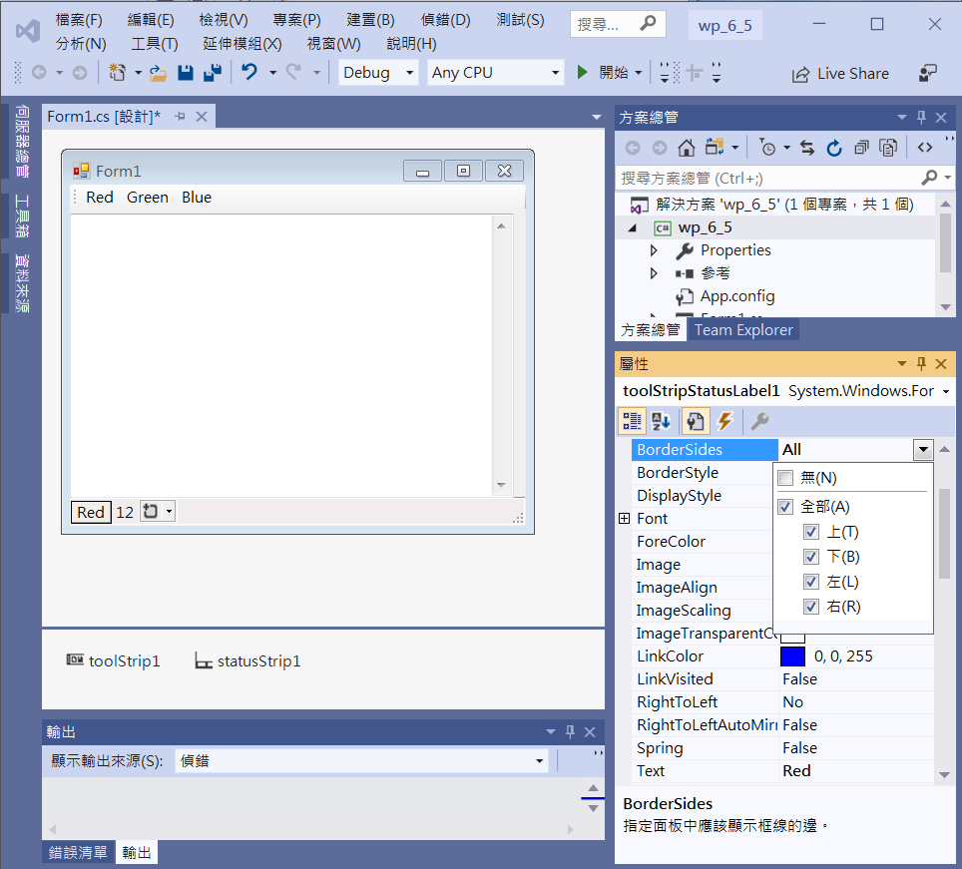
An Example of ToolStrip & StatusStrip
2. BorderSides -> All
1. toolStripStatusLabel1
3. Text -> Red

Slide 6
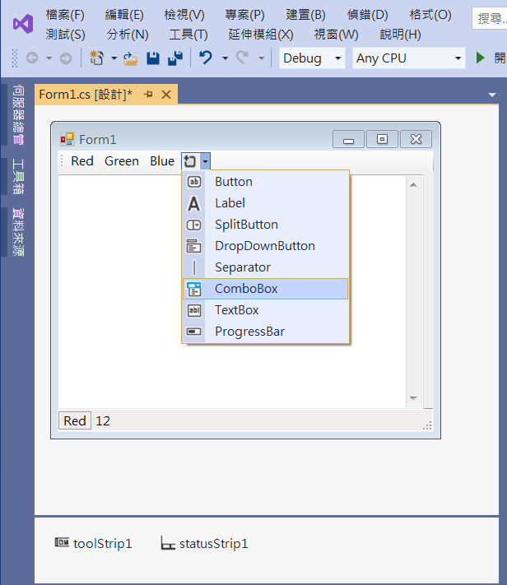
An Example of ToolStrip & StatusStrip
Add a comboBox into toolStrip1

Slide 7
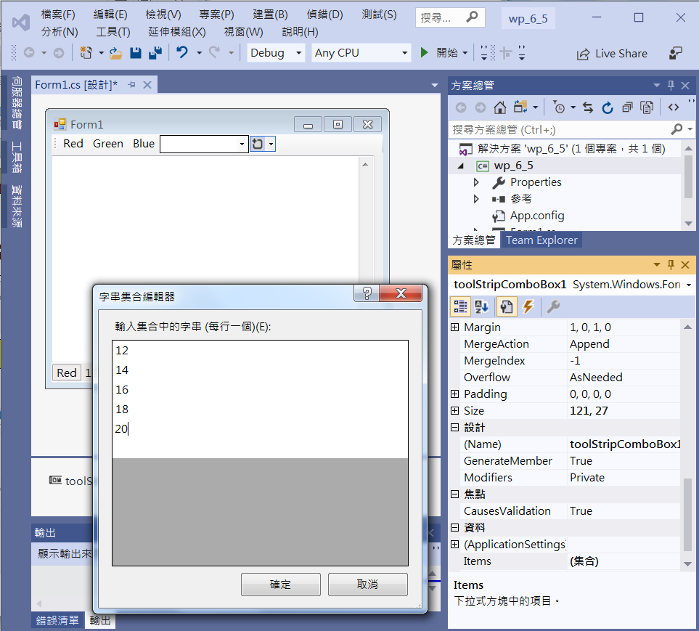
An Example of ToolStrip & StatusStrip
1. toolStripcomboBox1
3. Add Items
2. Click Items

Slide 8
An Example of ToolStrip & StatusStrip
private void Form1_Load(object sender, EventArgs e)
{
toolStripStatusLabel1.Text = "Red";
toolStripStatusLabel2.Text = "12";
textBox1.ForeColor = Color.Red;
textBox1.Font = new Font("Ariel", 12);
textBox1.Text = "Window Programming\n";
toolStripComboBox1.SelectedIndex = 0;
toolStripButton1.Checked = true;
}

Slide 9
An Example of ToolStrip & StatusStrip
private void ToolStripButton1_Click(object sender, EventArgs e)
{
toolStripStatusLabel1.Text = "Red";
toolStripButton1.Checked = true;
toolStripButton2.Checked = false;
toolStripButton3.Checked = false;
textBox1.ForeColor = Color.Red;
}

Slide 10
An Example of ToolStrip & StatusStrip
private void ToolStripButton2_Click(object sender, EventArgs e)
{
toolStripStatusLabel1.Text = "Green";
toolStripButton1.Checked = false;
toolStripButton2.Checked = true;
toolStripButton3.Checked = false;
textBox1.ForeColor = Color.Green;
}

Slide 11
An Example of ToolStrip & StatusStrip
private void ToolStripButton3_Click(object sender, EventArgs e)
{
toolStripStatusLabel1.Text = "Blue";
toolStripButton1.Checked = false;
toolStripButton2.Checked = false;
toolStripButton3.Checked = true;
textBox1.ForeColor = Color.Blue;
}

Slide 12
An Example of ToolStrip & StatusStrip
private void ToolStripComboBox1_SelectedIndexChanged(object sender, EventArgs e)
{
switch (toolStripComboBox1.SelectedIndex)
{
case 0:
textBox1.Font = new Font("Ariel", 12);
toolStripStatusLabel2.Text = "12";
break;
case 1:
textBox1.Font = new Font("Ariel", 14);
toolStripStatusLabel2.Text = "14";
break;
case 2:
textBox1.Font = new Font("Ariel", 16);
toolStripStatusLabel2.Text = "16";
break;

Slide 13
An Example of ToolStrip & StatusStrip
case 3:
textBox1.Font = new Font("Ariel", 18);
toolStripStatusLabel2.Text = "18";
break;
case 4:
textBox1.Font = new Font("Ariel", 20);
toolStripStatusLabel2.Text = "20";
break;
}
}

Slide 14
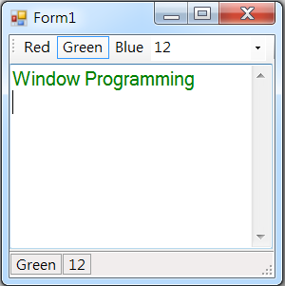
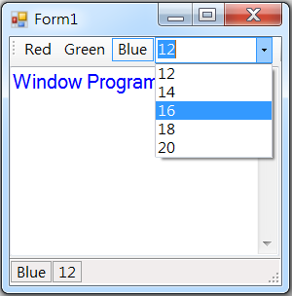
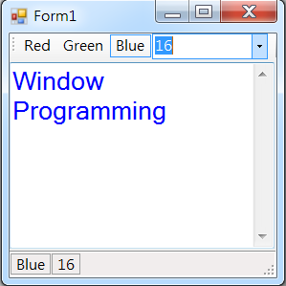
Exercise#6-5

Slide 15
內容來源
  Visual C# 2012 視窗程式設計：繪圖與遊戲專題(鄞永傳/著; 松崗)
  Visual C# 2013視窗程式設計(黃聰明/著; 松崗)
  跟著範例學會Visual C# 2015(張逸中/著; 博碩)

