Slide 1
Window Programming 7-4
TextureBrush
Yuan Ze University

Slide 2
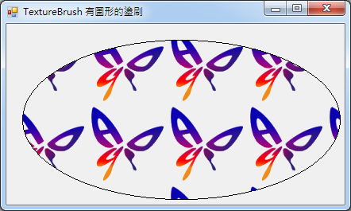
TextureBrush(圖形塗刷)
Bitmap bm = new Bitmap(Properties.Resources.Butterfly);
...
private void Form1_Paint(object sender, PaintEventArgs e)
{
TextureBrush Mybrush = new TextureBrush(bm); // 使用的影像
e.Graphics.FillEllipse(Mybrush, 20, 20, 400, 200); //塗刷填滿橢圓形區域
e.Graphics.DrawEllipse(Pens.Black, 20, 20, 400, 200); //畫出橢圓形外框
}

Slide 3
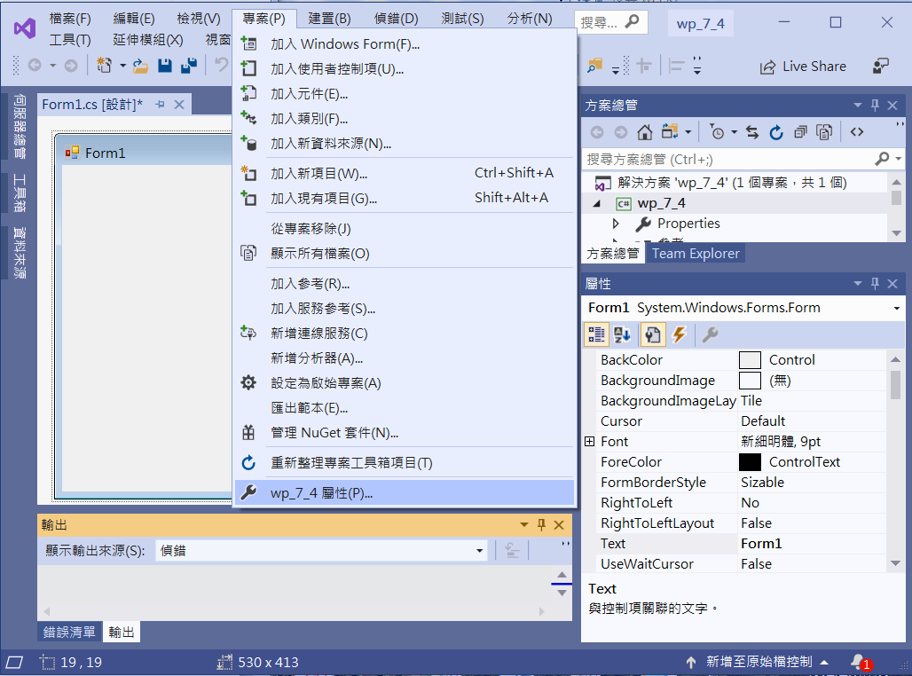
An example of TextureBrush
Add Bitmap to resource
1. Click project
2. Click Property

Slide 4
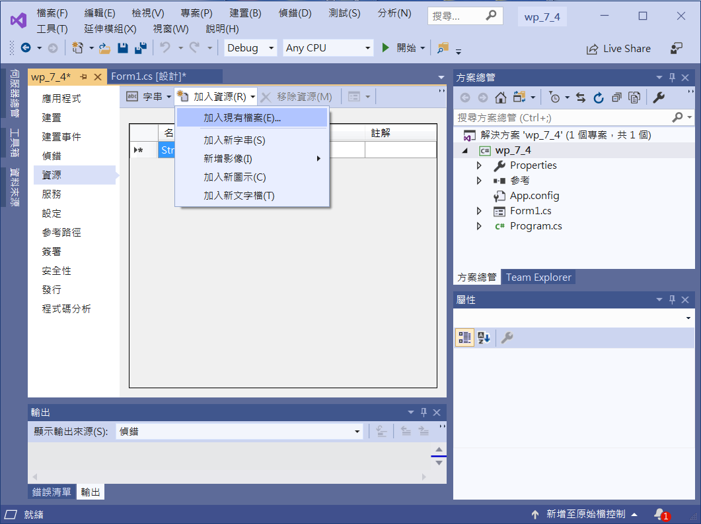
An example of TextureBrush
2. Click
Add a File
1. Click resource

Slide 5
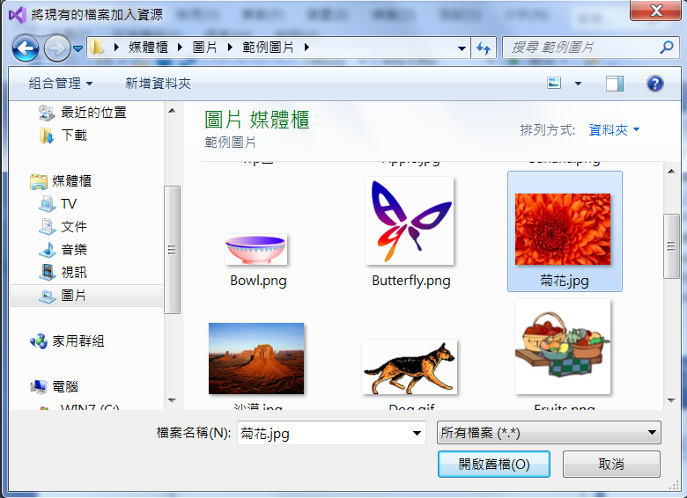
An example of TextureBrush
1. Click a file
2. Click
open the File

Slide 6
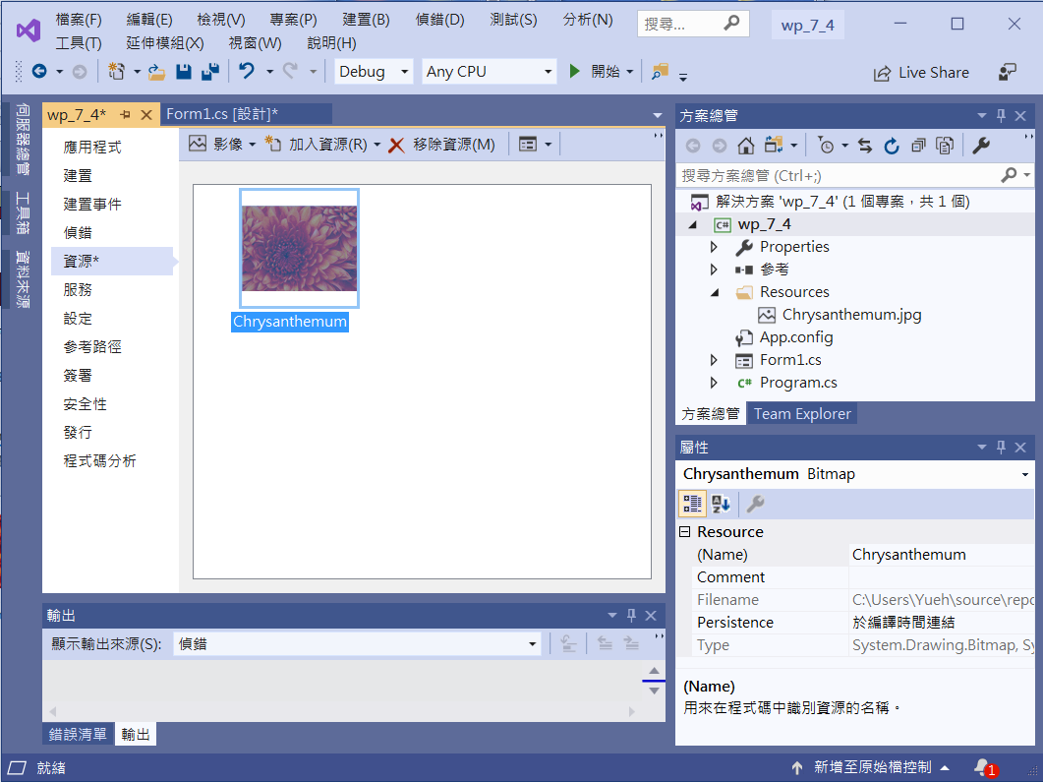
An example of TextureBrush

Slide 7
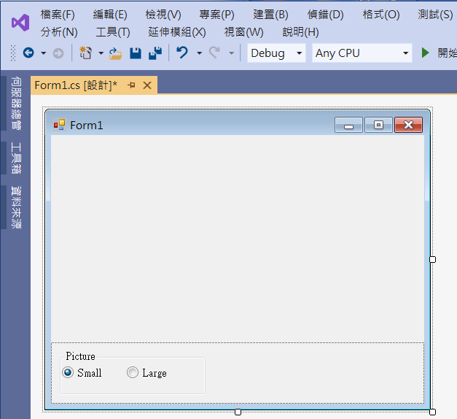
An example of TextureBrush
1. panel1
Dock ->Bottom
2. groupBox1
4. radioButton2
3. radioButton1
Checked -> true

Slide 8
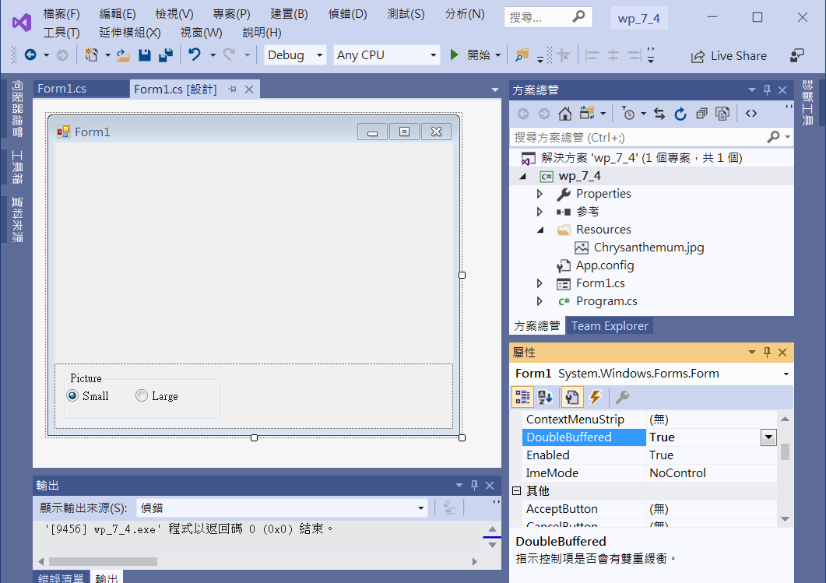
Form1 DoubleBuffered for avoiding flash
1. Form1
2. DoubleBuffered -> True

Slide 9
An example of TextureBrush
public partial class Form1 : Form
{
Bitmap bm = new Bitmap(Properties.Resources.Chrysanthemum);
Boolean small = true;
public Form1()
{
InitializeComponent();
}

Slide 10
An example of TextureBrush
private void Form1_Paint(object sender, PaintEventArgs e)
{
TextureBrush myBrush;
if (small)
{
Rectangle rect = new Rectangle(0, 0, 100, 100);
myBrush = new TextureBrush(bm, rect);
}
else
myBrush = new TextureBrush(bm);
e.Graphics.FillEllipse(myBrush, 20, 20, this.ClientSize.Width-40, this.ClientSize.Height-100);
}

Slide 11
An example of TextureBrush
private void RadioButton1_CheckedChanged(object sender, EventArgs e)
{
small = true;
Invalidate();
}
private void RadioButton2_CheckedChanged(object sender, EventArgs e)
{
small = false;
Invalidate();
}

Slide 12
An example of TextureBrush
private void Form1_Resize(object sender, EventArgs e)
{
Invalidate();
}

Slide 13
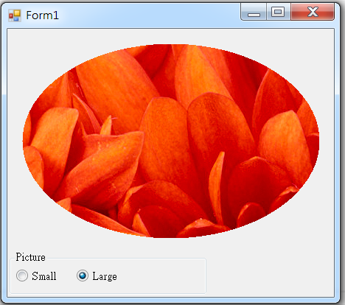
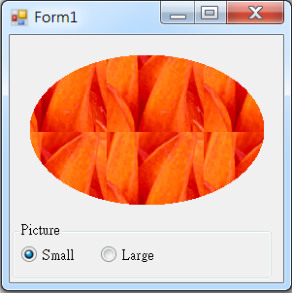
Exercise#7-4

Slide 14
內容來源
  Visual C# 2012 視窗程式設計：繪圖與遊戲專題(鄞永傳/著; 松崗)
  Visual C# 2013視窗程式設計(黃聰明/著; 松崗)
  跟著範例學會Visual C# 2015(張逸中/著; 博碩)

