Slide 1
Window Programming 7-7
RotateTransform
Yuan Ze University

Slide 2
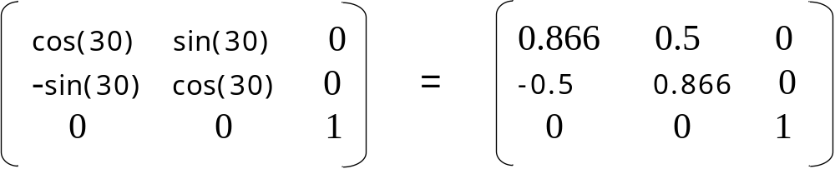
Rotate
Matrix矩陣的旋轉
Matrix myMatrix = new Matrix();
A.Rotate(30); // 一個旋轉矩陣

Slide 3
RotateTransform
e.Graphics. RotateTransform(30);
//畫布的轉換矩陣 x 旋轉矩陣 (旋轉30度)
e.Graphics. RotateTransform(30, MatrixOrder.Append);
// 旋轉矩陣x畫布的轉換矩陣

Slide 4
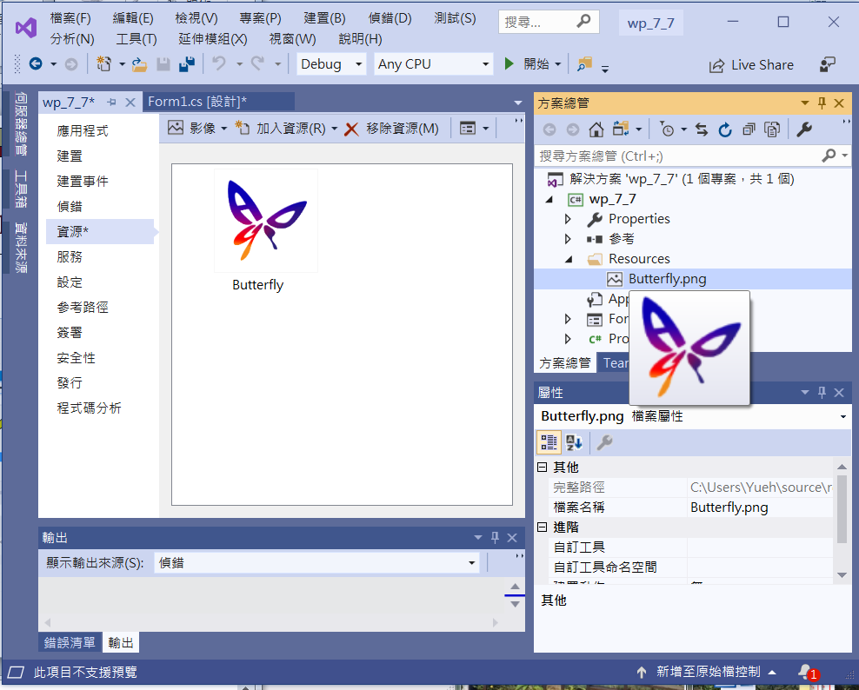
An example of RotateTransform
Add file to resource

Slide 5
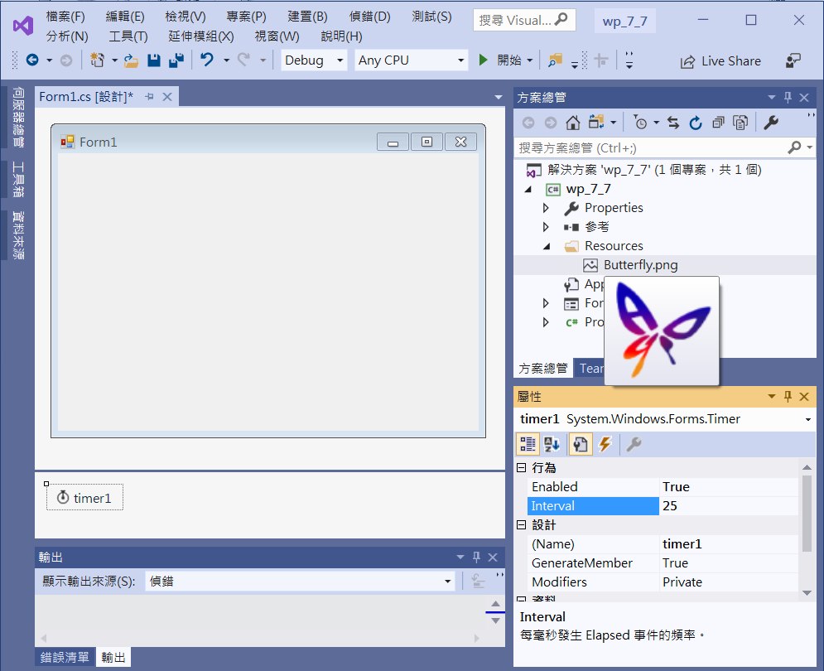
An example of RotateTransform
resource
1. timer1
Interval -> 25
Enabled -> true

Slide 6
An example of RotateTransform
using System;
using System.Collections.Generic;
using System.ComponentModel;
using System.Data;
using System.Drawing;
using System.Linq;
using System.Text;
using System.Threading.Tasks;
using System.Windows.Forms;
using System.Drawing.Drawing2D;

Slide 7
An example of RotateTransform
public partial class Form1 : Form
{
Bitmap bm = new Bitmap(Properties.Resources.Butterfly);
float theta = 0; // 旋轉角度
public Form1()
{
InitializeComponent();
}

Slide 8
An example of RotateTransform
private void Form1_Paint(object sender, PaintEventArgs e)
{
int Cx = this.ClientSize.Width / 2; // 視窗客戶區正中心點
int Cy = this.ClientSize.Height / 2;//
e.Graphics.ResetTransform(); // 畫布的矩陣 = 單位矩陣
e.Graphics.TranslateTransform(-bm.Width / 2, -bm.Height / 2, MatrixOrder.Append); //位移到圖中心
e.Graphics.RotateTransform(theta, MatrixOrder.Append);
// 乘上 旋轉矩陣
e.Graphics.TranslateTransform(Cx, Cy, MatrixOrder.Append);
// 再搬到視窗客戶區正中心點
TextureBrush tb = new TextureBrush(bm);
e.Graphics.FillRectangle(tb, 0, 0, 100,100); // 繪出圖形
}

Slide 9
An example of RotateTransform
private void Timer1_Tick(object sender, EventArgs e)
{
theta = theta + 2; // 旋轉角度 遞增
Invalidate();
}

Slide 10
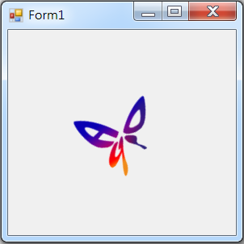
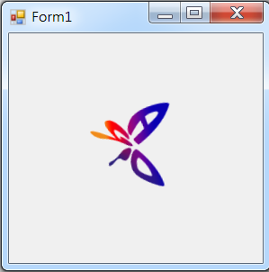
Exercise#7-7

Slide 11
內容來源
  Visual C# 2012 視窗程式設計：繪圖與遊戲專題(鄞永傳/著; 松崗)
  Visual C# 2013視窗程式設計(黃聰明/著; 松崗)
  跟著範例學會Visual C# 2015(張逸中/著; 博碩)

