Slide 1
Window Programming 8-5
Drawing III
TrackBar example
Yuan Ze University

Slide 2
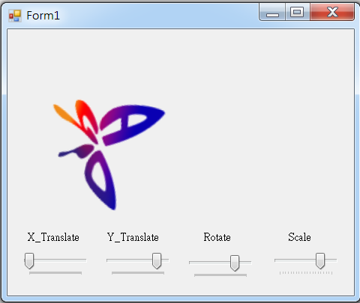
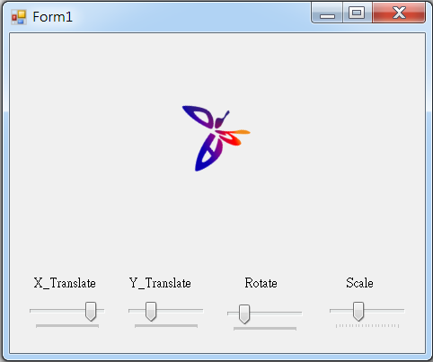
TrackBar example

Slide 3
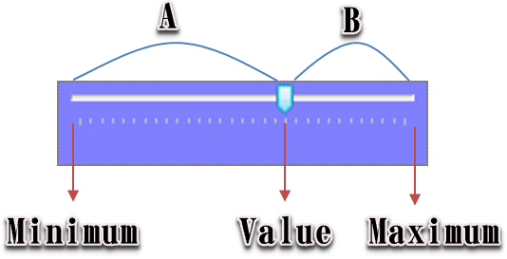
TrackBar
Scrollable item
Attributes
  Minimun
  Maximun
  Value
Event
  Scorll
  ValueChanged

Slide 4
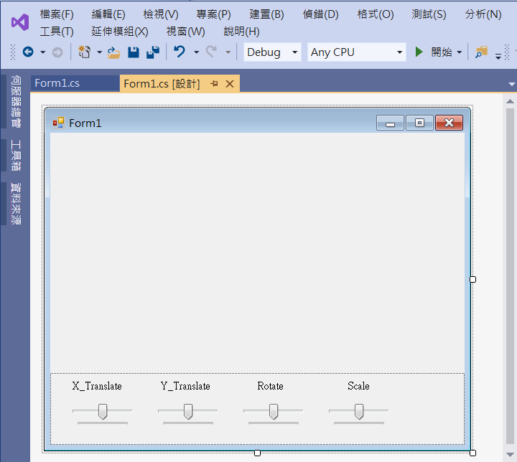
TrackBar example
1. Panel1
Dock -> bottom
2. trackBar1
Minimum -> 0
Maximum -> 100
Value -> 50
label1
label2
label3
label4
5. trackBar4
Minimum -> 1
Maximum -> 20
Value -> 10
3. trackBar2
Minimum -> 0
Maximum -> 100
Value -> 50
4. trackBar3
Minimum -> 0
Maximum -> 360
Value -> 180

Slide 5
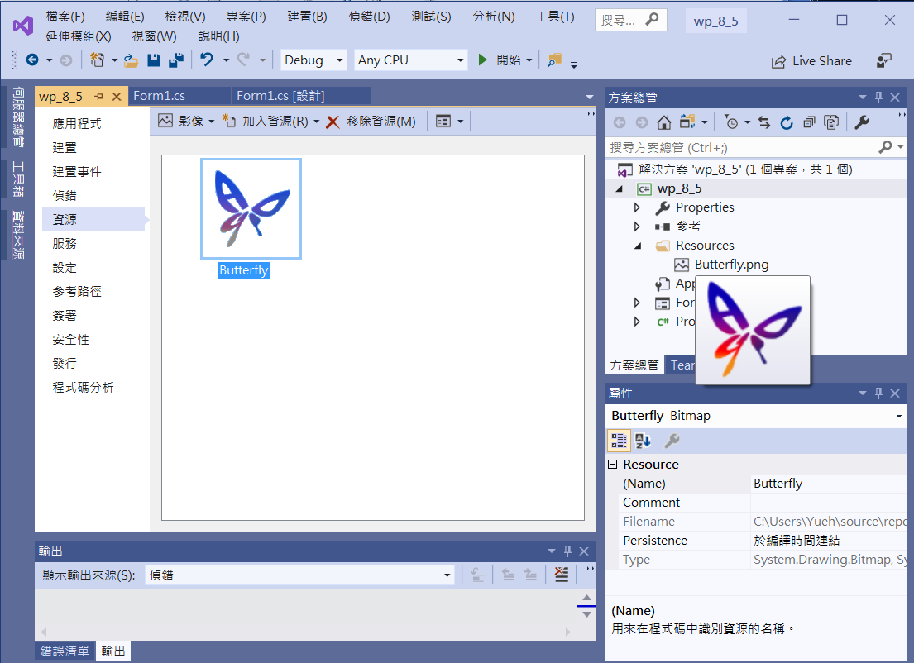
TrackBar example
Add file to resource

Slide 6
TrackBar example
using System;
using System.Collections.Generic;
using System.ComponentModel;
using System.Data;
using System.Drawing;
using System.Linq;
using System.Text;
using System.Threading.Tasks;
using System.Windows.Forms;
using System.Drawing.Drawing2D;

Slide 7
TrackBar example
public partial class Form1 : Form
{
Bitmap bm = new Bitmap(Properties.Resources.Butterfly);
int translateX=0, translateY=0, rotate=0;
double scale=1;
int Cx, Cy;

Slide 8
TrackBar example
public Form1()
{
InitializeComponent();
Cx = this.ClientSize.Width / 2; // 視窗客戶區正中心點
Cy = this.ClientSize.Height / 2;//
trackBar1.Value = 50;
trackBar2.Value = 50;
trackBar3.Value = 180;
trackBar4.Value = 10;
translateX = (int)((double)(trackBar1.Value - 50) / 200 * Cx) - (bm.Width / 2);
translateY = (int)((double)(trackBar2.Value - 50) / 200 * Cy) - (bm.Height / 2);
}

Slide 9
TrackBar example
private void Form1_Paint(object sender, PaintEventArgs e)
{
e.Graphics.ResetTransform(); // 畫布的矩陣 = 單位矩陣
e.Graphics.TranslateTransform(-bm.Width / 2, -bm.Height / 2, MatrixOrder.Append);
e.Graphics.RotateTransform(rotate, MatrixOrder.Append);
e.Graphics.ScaleTransform((float)scale, (float)scale, MatrixOrder.Append);
e.Graphics.TranslateTransform(Cx + translateX, Cy + translateY, MatrixOrder.Append);
TextureBrush tb = new TextureBrush(bm);
e.Graphics.FillRectangle(tb, 0, 0, 100, 100); // 繪出圖形
}

Slide 10
TrackBar example
private void trackBar1_Scroll(object sender, EventArgs e)
{
translateX = (int) ((double)(trackBar1.Value - 50) / 200 * Cx) - (bm.Width / 2);
translateY = (int)((double)(trackBar2.Value - 50) / 200 * Cy) - (bm.Height / 2);
rotate = trackBar3.Value - 180;
scale = (double) trackBar4.Value / 10;
Invalidate();
}

Slide 11
TrackBar example
private void Form1_Resize(object sender, EventArgs e)
{
Cx = this.ClientSize.Width / 2; // 視窗客戶區正中心點
Cy = this.ClientSize.Height / 2;//
Invalidate();
}

Slide 12
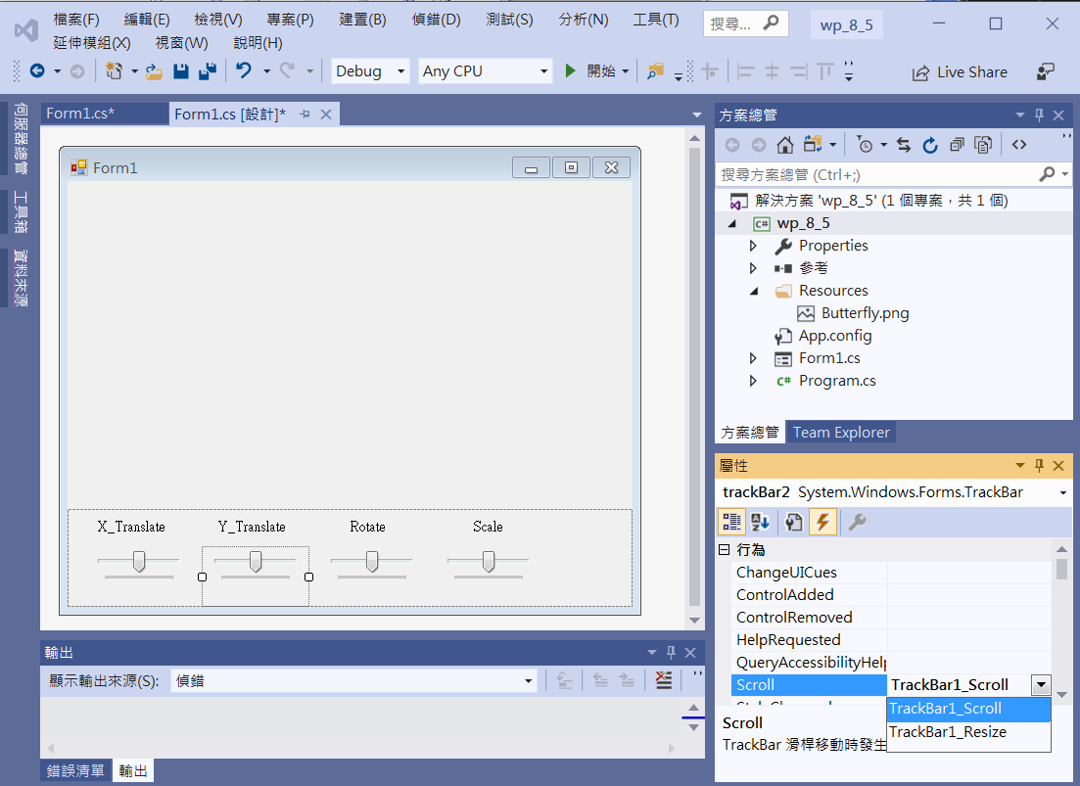
TrackBar example
trackBar1~4
Scroll -> trackBar11_Scroll

Slide 13
Exercise#8-5

Slide 14
內容來源
  Visual C# 2012 視窗程式設計：繪圖與遊戲專題(鄞永傳/著; 松崗)
  Visual C# 2013視窗程式設計(黃聰明/著; 松崗)
  跟著範例學會Visual C# 2015(張逸中/著; 博碩)

