Slide 1
Window Programming 8-6
Drawing III
Flag example
Yuan Ze University

Slide 2
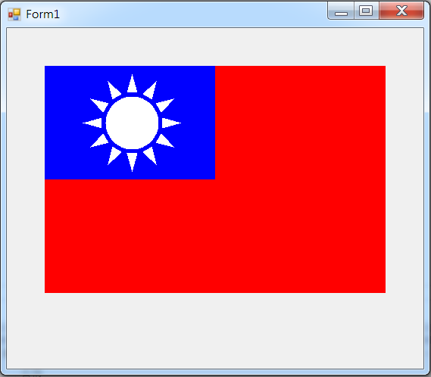
Flag example

Slide 3
Flag example
public partial class Form1 : Form
{
Point[] pt = new Point[3];
public Form1()
{
InitializeComponent();
ClientSize = new Size(550, 450);
pt[0] = new Point(-7, -40);
pt[1] = new Point(0, -65);
pt[2] = new Point(7, -40);
}

Slide 4
Flag example
private void Form1_Paint(object sender, PaintEventArgs e)
{
e.Graphics.FillRectangle(new SolidBrush(Color.Red), 50, 50, 450, 300);
e.Graphics.FillRectangle(new SolidBrush(Color.Blue), 50, 50, 225, 150);
e.Graphics.FillEllipse(new SolidBrush(Color.White), 130, 90, 70, 70);
e.Graphics.TranslateTransform(165, 125);
for (int i=0;i<12;i++)
{
e.Graphics.FillPolygon(new SolidBrush(Color.White), pt);
e.Graphics.RotateTransform(30);
}
}

Slide 5
Exercise#8-6

Slide 6
內容來源
  Visual C# 2012 視窗程式設計：繪圖與遊戲專題(鄞永傳/著; 松崗)
  Visual C# 2013視窗程式設計(黃聰明/著; 松崗)
  跟著範例學會Visual C# 2015(張逸中/著; 博碩)

