Slide 1
Window Programming 9-3
PictureBox
Yuan Ze University

Slide 2
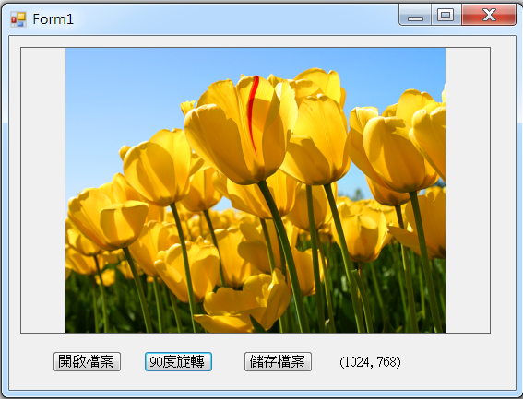
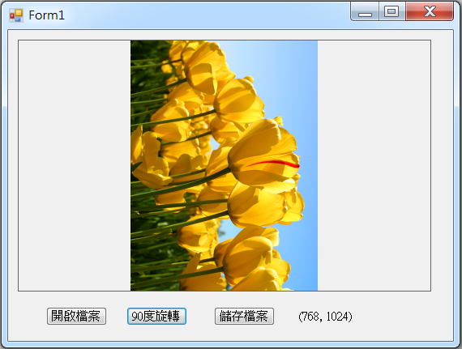
PictureBox example

Slide 3
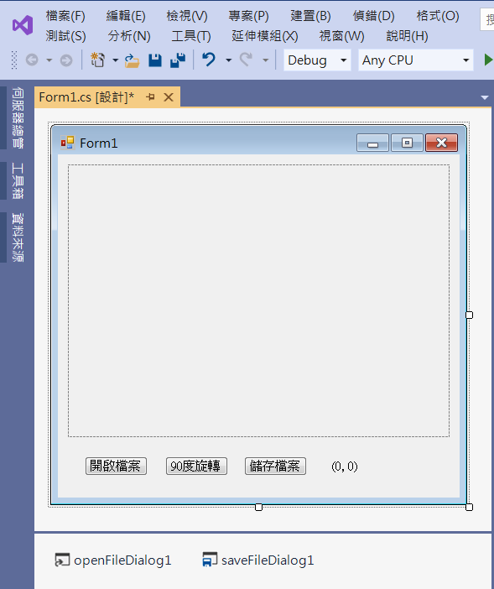
PictureBox example
pictueBox1
button2
button3
label1
button1
openFileDialog1
saveFileDialog1

Slide 4
PictureBox example
public partial class Form1 : Form
{
Image img; // Image 影像
public Form1()
{
InitializeComponent();
pictureBox1.SizeMode = PictureBoxSizeMode.Zoom; // 設定影像縮放模式
pictureBox1.BorderStyle = BorderStyle.FixedSingle; //設定邊線
}

Slide 5
PictureBox example
private void Button1_Click(object sender, EventArgs e)
{
if (openFileDialog1.ShowDialog() == DialogResult.OK) // 開啟影像檔
{
String input = openFileDialog1.FileName;
img = Image.FromFile(input); // 產生一個Image物件
pictureBox1.Image = img;
// 呈現 影像 的寬高資訊
label1.Text = "(" + img.Width.ToString() + ", " + img.Height.ToString() + ")";
}
}

Slide 6
PictureBox example
private void Button2_Click(object sender, EventArgs e)
{
img.RotateFlip(RotateFlipType.Rotate90FlipNone); // 影像旋轉90度
label1.Text = "(" + img.Width.ToString() + ", " + img.Height.ToString() + ")";
pictureBox1.Image = img;
pictureBox1.Refresh(); // pictureBox1 重畫
}

Slide 7
PictureBox example
private void Button3_Click(object sender, EventArgs e)
{
if (saveFileDialog1.ShowDialog() == DialogResult.OK) // 儲存影像檔
{
String output = saveFileDialog1.FileName;
img.Save(output);
}
}

Slide 8
Exercise#9-3

Slide 9
內容來源
  Visual C# 2012 視窗程式設計：繪圖與遊戲專題(鄞永傳/著; 松崗)
  跟著範例學會Visual C# 2015(張逸中/著; 博碩)

