Slide 1
Window Programming 9-6
DrawImage
Distort
Yuan Ze University

Slide 2
DrawImage distort example
Point[] pt = new Point[3]; // 三個點座標 定義一個平形四邊形
pt[0] = new Point(MousePos.X - img.Width / 2, MousePos.Y); // 左上
pt[1] = new Point(MousePos.X + img.Width / 2, MousePos.Y); // 右上
pt[2] = new Point(Cx - img.Width / 2, Cy + img.Height / 2); // 左下
e.Graphics.DrawImage(img, pt); // 呈現圖型

Slide 3
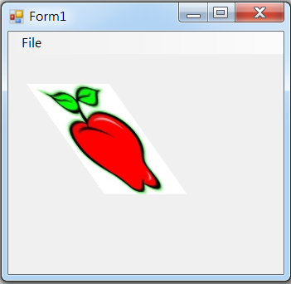
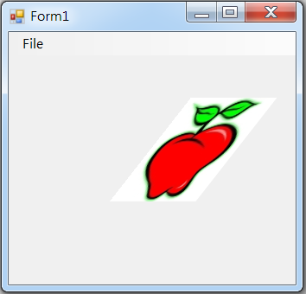
DrawImage distort example

Slide 4
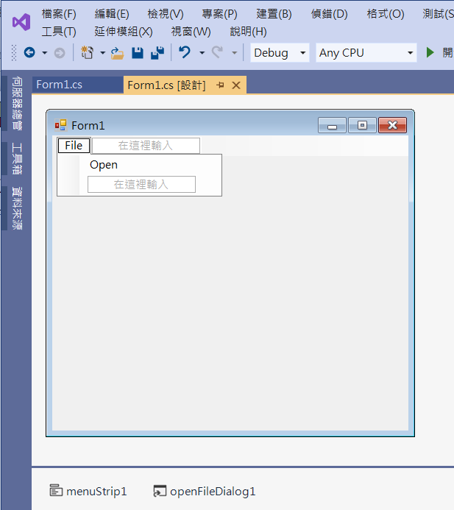
DrawImage distort example
2. Edit menuStrip1
3. Add openFileDialog1
1. Add menuStrip1

Slide 5
DrawImage distort example
public partial class Form1 : Form
{
Image img;
Point MousePos = new Point(); //滑鼠位置
public Form1()
{
InitializeComponent();
}

Slide 6
DrawImage distort example
private void OpenToolStripMenuItem_Click(object sender, EventArgs e)
{
if (openFileDialog1.ShowDialog() == DialogResult.OK) // 開啟影像檔
{
String input = openFileDialog1.FileName;
img = Image.FromFile(input); // 產生一個Image物件
if ((ClientSize.Width < img.Width) || (ClientSize.Height < img.Height))
ClientSize = new Size(img.Width, img.Height);
Invalidate(); // 要求重畫
}
}

Slide 7
DrawImage distort example
private void Form1_Paint(object sender, PaintEventArgs e)
{
if (img!=null)
{
int Cx = ClientSize.Width / 2; // 視窗客戶區 正中心
int Cy = ClientSize.Height / 2;
Point[] pt = new Point[3]; // 三個點座標 定義一個平形四邊形
pt[0] = new Point(MousePos.X - img.Width / 2, MousePos.Y); // 左上
pt[1] = new Point(MousePos.X + img.Width / 2, MousePos.Y); // 右上
pt[2] = new Point(Cx - img.Width / 2, Cy + img.Height / 2); // 左下
e.Graphics.DrawImage(img, pt); // 呈現圖型
}
}

Slide 8
DrawImage distort example
private void Form1_MouseMove(object sender, MouseEventArgs e)
{
if (e.Button == MouseButtons.Left)
{
MousePos = e.Location; // 記錄滑鼠位置
Invalidate(); // 要求表單重畫
}
}

Slide 9
DrawImage distort example
private void Form1_Resize(object sender, EventArgs e)
{
Invalidate();
}

Slide 10
Exercise#9-6

Slide 11
內容來源
  Visual C# 2012 視窗程式設計：繪圖與遊戲專題(鄞永傳/著; 松崗)
  跟著範例學會Visual C# 2015(張逸中/著; 博碩)

