Slide 1

Data-Intensive Distributed Computing
CS 451/651 431/631 (Winter 2018)
Part 3: Analyzing Text (2/2)
January 30, 2018
Jimmy Lin
David R. Cheriton School of Computer Science
University of Waterloo
These slides are available at http://lintool.github.io/bigdata-2018w/
This work is licensed under a Creative Commons Attribution-Noncommercial-Share Alike 3.0 United States See http://creativecommons.org/licenses/by-nc-sa/3.0/us/ for details

Slide 2

Search!
Source: http://www.flickr.com/photos/guvnah/7861418602/

Slide 3
Abstract IR Architecture
Documents
Query
online
offline
Representation
Function
Representation
Function
Query Representation
Document Representation
Retrieval
Index
Comparison
Function
Indexing
Hits

Slide 4
Doc 1
Doc 2
Doc 3
Doc 4
one fish, two fish
red fish, blue fish
cat in the hat
green eggs and ham
1
2
3
4
What goes in each cell?
blue
1
cat
1
boolean
count
egg
1
positions
fish
1
1
green
1
ham
1
hat
1
one
1
red
1
two
1

Slide 5
Doc 1
Doc 2
Doc 3
Doc 4
one fish, two fish
red fish, blue fish
cat in the hat
green eggs and ham
1
2
3
4
blue
1
Indexing: building this structure
cat
1
Retrieval: manipulating this structure
egg
1
fish
1
1
green
1
ham
1
hat
1
one
1
red
1
two
1

Slide 6
Doc 1
Doc 2
Doc 3
Doc 4
one fish, two fish
red fish, blue fish
cat in the hat
green eggs and ham
1
2
3
4
blue
1
blue
2
cat
1
cat
3
egg
1
egg
4
fish
1
1
fish
1
2
green
1
green
4
ham
1
ham
4
hat
1
hat
3
one
1
one
1
red
1
red
2
two
1
two
1
postings lists
(always in sorted order)

Slide 7
Doc 1
Doc 2
Doc 3
Doc 4
one fish, two fish
red fish, blue fish
cat in the hat
green eggs and ham
tf
1
2
3
4
df
blue
1
1
blue
1
2
1
cat
1
1
cat
1
3
1
egg
1
1
egg
1
4
1
fish
2
2
2
fish
2
1
2
2
2
green
1
1
green
1
4
1
ham
1
1
ham
1
4
1
hat
1
1
hat
1
3
1
one
1
1
one
1
1
1
red
1
1
red
1
2
1
two
1
1
two
1
1
1

Slide 8
Doc 1
Doc 2
Doc 3
Doc 4
one fish, two fish
red fish, blue fish
cat in the hat
green eggs and ham
tf
1
2
3
4
df
blue
1
1
blue
1
2
1
[3]
cat
1
1
cat
1
3
1
[1]
egg
1
1
egg
1
4
1
[2]
fish
2
2
2
fish
2
1
2
[2,4]
2
2
[2,4]
green
1
1
green
1
4
1
[1]
ham
1
1
ham
1
4
1
[3]
hat
1
1
hat
1
3
1
[2]
one
1
1
one
1
1
1
[1]
red
1
1
red
1
2
1
[1]
two
1
1
two
1
1
1
[3]

Slide 9
Inverted Indexing with MapReduce
Doc 1
Doc 2
Doc 3
one fish, two fish
red fish, blue fish
cat in the hat
one
1
1
red
2
1
cat
3
1
Map
two
blue
hat
1
1
2
1
3
1
fish
1
2
fish
2
2
Shuffle and Sort: aggregate values by keys
cat
3
1
Reduce
blue
2
1
fish
1
2
2
2
hat
3
1
one
1
1
two
1
1
red
2
1

Slide 10
Inverted Indexing: Pseudo-Code
class Mapper {
def map(docid: Long, doc: String) = {
val counts = new Map()
for (term <- tokenize(doc)) {
counts(term) += 1
}
for ((term, tf) <- counts) {
emit(term, (docid, tf))
}
}
}
class Reducer {
def reduce(term: String, postings: Iterable[(docid, tf)]) = {
val p = new List()
for ((docid, tf) <- postings) {
p.append((docid, tf))
}
p.sort()
emit(term, p)
}
}

Slide 11
Positional Indexes
Doc 1
Doc 2
Doc 3
one fish, two fish
red fish, blue fish
cat in the hat
one
1
1
[1]
red
2
1
[1]
cat
3
1
[1]
Map
two
blue
hat
1
1
[3]
2
1
[3]
3
1
[2]
fish
1
2
[2,4]
fish
2
2
[2,4]
Shuffle and Sort: aggregate values by keys
cat
3
1
[1]
Reduce
blue
2
1
[3]
fish
1
2
[2,4]
2
2
[2,4]
hat
3
1
[2]
one
1
1
[1]
two
1
1
[3]
red
2
1
[1]

Slide 12
Inverted Indexing: Pseudo-Code
class Mapper {
def map(docid: Long, doc: String) = {
val counts = new Map()
for (term <- tokenize(doc)) {
counts(term) += 1
}
for ((term, tf) <- counts) {
emit(term, (docid, tf))
}
}
}
class Reducer {
def reduce(term: String, postings: Iterable[(docid, tf)]) = {
val p = new List()
for ((docid, tf) <- postings) {
p.append((docid, tf))
}
p.sort()
emit(term, p)
}
}
What’s the problem?

Slide 13
Another Try…
(key)
(values)
(keys)
(values)
fish
1
2
fish
1
2
34
1
fish
9
1
21
3
fish
21
3
35
2
fish
34
2
80
3
fish
35
3
9
1
fish
80
1
How is this different?
Let the framework do the sorting!
Where have we seen this before?

Slide 14
Inverted Indexing: Pseudo-Code
class Mapper {
def map(docid: Long, doc: String) = {
val counts = new Map()
for (term <- tokenize(doc)) {
counts(term) += 1
}
for ((term, tf) <- counts) {
emit((term, docid), tf)
}
}
}
class Reducer {
var prev = null
val postings = new PostingsList()
def reduce(key: Pair, tf: Iterable[Int]) = {
if key.term != prev and prev != null {
emit(prev, postings)
postings.reset()
}
postings.append(key.docid, tf.first)
prev = key.term
}
def cleanup() = {
emit(prev, postings)
}
}
Wait, how’s this any better?
What else do we need to do?

Slide 15
Postings Encoding
Conceptually:
fish
1
2
9
1
21
3
34
1
35
2
80
3
…
In Practice:
Don’t encode docids, encode gaps (or d-gaps)
But it’s not obvious that this save space…
fish
1
2
8
1
12
3
13
1
1
2
45
3
…
= delta encoding, delta compression, gap compression

Slide 16
Overview of Integer Compression
Byte-aligned technique
VByte
Bit-aligned
Unary codes
γ/δ codes
Golomb codes (local Bernoulli model)
Word-aligned
Simple family
Bit packing family (PForDelta, etc.)

Slide 17
VByte
Simple idea: use only as many bytes as needed
Need to reserve one bit per byte as the “continuation bit”
Use remaining bits for encoding value
7 bits
0
14 bits
1
0
21 bits
1
1
0
Works okay, easy to implement…
Beware of branch mispredicts!

Slide 18
Simple-9
How many different ways can we divide up 28 bits?
28 1-bit numbers
14 2-bit numbers
9 3-bit numbers
7 4-bit numbers
“selectors”
(9 total ways)
Efficient decompression with hard-coded decoders
Simple Family – general idea applies to 64-bit words, etc.
Beware of branch mispredicts?

Slide 19
Bit Packing
What’s the smallest number of bits we need to code a block (=128) of integers?
3
…
4
…
5
…
Efficient decompression with hard-coded decoders
PForDelta – bit packing + separate storage of “overflow” bits
Beware of branch mispredicts?

Slide 20
Golomb Codes
x ≥ 1, parameter b:
q + 1 in unary, where q = ⎣( x - 1 ) / b⎦
r in binary, where r = x - qb - 1, in ⎣log b⎦ or ⎡log b⎤ bits
Example:
b = 3, r = 0, 1, 2 (0, 10, 11)
b = 6, r = 0, 1, 2, 3, 4, 5 (00, 01, 100, 101, 110, 111)
x = 9, b = 3: q = 2, r = 2, code = 110:11
x = 9, b = 6: q = 1, r = 2, code = 10:100
Punch line: optimal b ~ 0.69 (N/df)
Different b for every term!

Slide 21
Inverted Indexing: Pseudo-Code
class Mapper {
def map(docid: Long, doc: String) = {
val counts = new Map()
for (term <- tokenize(doc)) {
counts(term) += 1
}
for ((term, tf) <- counts) {
emit((term, docid), tf)
}
}
}
class Reducer {
var prev = null
val postings = new PostingsList()
def reduce(key: Pair, tf: Iterable[Int]) = {
if key.term != prev and prev != null {
emit(prev, postings)
postings.reset()
}
postings.append(key.docid, tf.first)
prev = key.term
}
def cleanup() = {
emit(prev, postings)
}
}
Ah, now we know why this is different!

Slide 22
Chicken and Egg?
(key)
(value)
fish
1
2
But wait! How do we set the Golomb parameter b?
fish
9
1
fish
21
3
Recall: optimal b ~ 0.69 (N/df)
fish
34
2
We need the df to set b…
fish
35
3
But we don’t know the df until we’ve seen all postings!
fish
80
1
…
Write postings compressed
Sound familiar?

Slide 23
Getting the df
In the mapper:
Emit “special” key-value pairs to keep track of df
In the reducer:
Make sure “special” key-value pairs come first: process them to determine df
Remember: proper partitioning!

Slide 24
Getting the df: Modified Mapper
Doc 1
one fish, two fish
Input document…
(key)
(value)
fish
1
2
Emit normal key-value pairs…
one
1
1
two
1
1
fish
★
1
Emit “special” key-value pairs to keep track of df…
one
★
1
two
★
1

Slide 25
Getting the df: Modified Reducer
(key)
(value)
fish
★
1
1
1
…
First, compute the df by summing contributions from all “special” key-value pair…
Compute b from df
fish
1
2
fish
9
1
fish
21
3
Important: properly define sort order to make sure “special” key-value pairs come first!
fish
34
2
fish
35
3
fish
80
1
Write postings compressed
…
Where have we seen this before?

Slide 26
But I don’t care about Golomb Codes!
tf
1
2
3
4
df
blue
1
1
blue
1
2
1
cat
1
1
cat
1
3
1
egg
1
1
egg
1
4
1
fish
2
2
2
fish
2
1
2
2
2
green
1
1
green
1
4
1
ham
1
1
ham
1
4
1
hat
1
1
hat
1
3
1
one
1
1
one
1
1
1
red
1
1
red
1
2
1
two
1
1
two
1
1
1

Slide 27
Basic Inverted Indexer: Reducer
(key)
(value)
fish
★
1
1
1
…
Compute the df by summing contributions from all “special” key-value pair…
Write the df
fish
1
2
fish
9
1
fish
21
3
fish
34
2
fish
35
3
fish
80
1
Write postings compressed
…

Slide 28
Inverted Indexing: IP (~Pairs)
class Mapper {
def map(docid: Long, doc: String) = {
val counts = new Map()
for (term <- tokenize(doc)) {
counts(term) += 1
}
for ((term, tf) <- counts) {
emit((term, docid), tf)
}
}
}
class Reducer {
var prev = null
val postings = new PostingsList()
def reduce(key: Pair, tf: Iterable[Int]) = {
if key.term != prev and prev != null {
emit(key.term, postings)
postings.reset()
}
postings.append(key.docid, tf.first)
prev = key.term
}
def cleanup() = {
emit(prev, postings)
}
}
What’s the assumption?
Is it okay?

Slide 29
Merging Postings
Let’s define an operation ⊕ on postings lists P:
Postings(1, 15, 22, 39, 54) ⊕ Postings(2, 46)
= Postings(1, 2, 15, 22, 39, 46, 54)
What exactly is this operation? What have we created?
Then we can rewrite our indexing algorithm!
flatMap: emit singleton postings
reduceByKey: ⊕

Slide 30
What’s the issue?
Postings₁ ⊕ Postings₂ = Postings_{M}
Solution: apply compression as needed!

Slide 31
Inverted Indexing: LP (~Stripes)
Slightly less elegant implementation… but uses same idea
class Mapper {
val m = new Map()
def map(docid: Long, doc: String) = {
val counts = new Map()
for (term <- tokenize(doc)) {
counts(term) += 1
}
for ((term, tf) <- counts) {
m(term).append((docid, tf))
}
if memoryFull()
flush()
}
def cleanup() = {
flush()
}
def flush() = {
for (term <- m.keys) {
emit(term, new PostingsList(m(term)))
}
m.clear()
}
}
What’s happening here?

Slide 32
Inverted Indexing: LP (~Stripes)
class Reducer {
def reduce(term: String, lists: Iterable[PostingsList]) = {
var f = new PostingsList()
for (list <- lists) {
f = f + list
}
emit(term, f)
}
}
What’s happening here?

Slide 33
LP vs. IP?
Experiments on ClueWeb09 collection: segments 1 + 2
101.8m documents (472 GB compressed, 2.97 TB uncompressed)
From: Elsayed et al., Brute-Force Approaches to Batch Retrieval: Scalable Indexing with MapReduce, or Why Bother? 2010

Slide 34
Another Look at LP
class Mapper {
val m = new Map()
def map(docid: Long, doc: String) = {
val counts = new Map()
for (term <- tokenize(doc)) {
counts(term) += 1
}
for ((term, tf) <- counts) {
m(term).append((docid, tf))
}
if memoryFull()
flush()
}
def cleanup() = {
flush()
}
def flush() = {
for (term <- m.keys) {
emit(term, new PostingsList(m(term)))
}
m.clear()
}
}
class Reducer {
def reduce(term: String, lists: Iterable[PostingsList]) = {
val f = new PostingsList()
for (list <- lists) {
f = f + list
}
emit(term, f)
}
}
flatMap: emit singleton postings
reduceByKey: ⊕
Remind you of anything in Spark?
RDD[(K, V)]
aggregateByKey
seqOp: (U, V) ⇒ U, combOp: (U, U) ⇒ U
RDD[(K, U)]

Slide 35
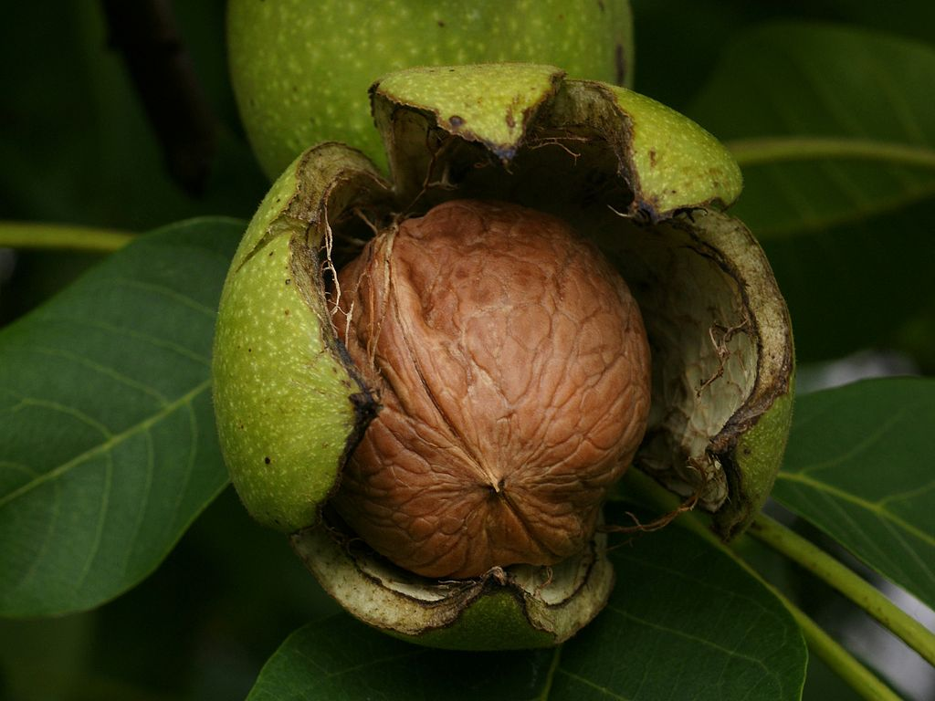
Algorithm design in a nutshell…
Exploit associativity and commutativity via commutative monoids (if you can)
Exploit framework-based sorting to sequence computations (if you can’t)
Source: Wikipedia (Walnut)

Slide 36
Abstract IR Architecture
Documents
Query
online
offline
Representation
Function
Representation
Function
Query Representation
Document Representation
Retrieval
Index
Comparison
Function
Indexing
Hits

Slide 37
MapReduce it?
Perfect for MapReduce!
The indexing problem
Scalability is critical
Must be relatively fast, but need not be real time
Fundamentally a batch operation
Incremental updates may or may not be important
For the web, crawling is a challenge in itself
The retrieval problem
Must have sub-second response time
For the web, only need relatively few results
Uh… not so good…

Slide 38
Assume everything fits in memory on a single machine…
(For now)

Slide 39
Boolean Retrieval
Users express queries as a Boolean expression
AND, OR, NOT
Can be arbitrarily nested
Retrieval is based on the notion of sets
Any query divides the collection into two sets: retrieved, not-retrieved
Pure Boolean systems do not define an ordering of the results

Slide 40
Boolean Retrieval
To execute a Boolean query:
OR
Build query syntax tree
( blue AND fish ) OR ham
ham
AND
blue
fish
For each clause, look up postings
blue
2
5
9
fish
1
2
3
5
6
7
8
9
ham
1
3
4
5
Traverse postings and apply Boolean operator

Slide 41
Term-at-a-Time
OR
blue
2
5
9
ham
AND
fish
1
2
3
5
6
7
8
9
ham
1
3
4
5
blue
fish
AND
2
5
9
blue
fish
Efficiency analysis?
OR
1
2
3
4
5
9
ham
AND
blue
fish
What’s RPN?

Slide 42
Document-at-a-Time
OR
blue
2
5
9
ham
AND
fish
1
2
3
5
6
7
8
9
ham
1
3
4
5
blue
fish
blue
2
5
9
fish
1
2
3
5
6
7
8
9
ham
1
3
4
5
Tradeoffs?
Efficiency analysis?

Slide 43
Boolean Retrieval
Users express queries as a Boolean expression
AND, OR, NOT
Can be arbitrarily nested
Retrieval is based on the notion of sets
Any query divides the collection into two sets: retrieved, not-retrieved
Pure Boolean systems do not define an ordering of the results
What’s the issue?

Slide 44
Ranked Retrieval
Order documents by how likely they are to be relevant
Estimate relevance(q, d_{i})
Sort documents by relevance
How do we estimate relevance?
Take “similarity” as a proxy for relevance

Slide 45
Vector Space Model
t₃
d₂
d₃
d₁
θ
φ
t₁
d₅
t₂
d₄
Assumption: Documents that are “close together” in vector space “talk about” the same things
Therefore, retrieve documents based on how close the document is to the query (i.e., similarity ~ “closeness”)

Slide 46
Similarity Metric
Use “angle” between the vectors:
Or, more generally, inner products:

Slide 47
Term Weighting
Term weights consist of two components
Local: how important is the term in this document?
Global: how important is the term in the collection?
Here’s the intuition:
Terms that appear often in a document should get high weights
Terms that appear in many documents should get low weights
How do we capture this mathematically?
Term frequency (local)
Inverse document frequency (global)

Slide 48
TF.IDF Term Weighting
weight assigned to term i in document j
number of occurrence of term i in document j
number of documents in entire collection
number of documents with term i

Slide 49
Retrieval in a Nutshell
Look up postings lists corresponding to query terms
Traverse postings for each query term
Store partial query-document scores in accumulators
Select top k results to return

Slide 50
Retrieval: Document-at-a-Time
Evaluate documents one at a time (score all query terms)
blue
9
2
21
1
35
1
…
fish
1
2
9
1
21
3
34
1
35
2
80
3
…
Accumulators
(e.g. min heap)
Document score in top k?
Yes: Insert document score, extract-min if heap too large
No: Do nothing
Tradeoffs:
Small memory footprint (good)
Skipping possible to avoid reading all postings (good)
More seeks and irregular data accesses (bad)

Slide 51
Retrieval: Term-At-A-Time
Evaluate documents one query term at a time
Usually, starting from most rare term (often with tf-sorted postings)
blue
9
2
21
1
35
1
…
Accumulators (e.g., hash)
Score_{{q=x}}(doc n) = s
fish
1
2
9
1
21
3
34
1
35
2
80
3
…
Tradeoffs:
Early termination heuristics (good)
Large memory footprint (bad), but filtering heuristics possible

Slide 52
Why store df as part of postings?
tf
1
2
3
4
df
blue
1
1
blue
1
2
1
cat
1
1
cat
1
3
1
egg
1
1
egg
1
4
1
fish
2
2
2
fish
2
1
2
2
2
green
1
1
green
1
4
1
ham
1
1
ham
1
4
1
hat
1
1
hat
1
3
1
one
1
1
one
1
1
1
red
1
1
red
1
2
1
two
1
1
two
1
1
1

Slide 53
Assume everything fits in memory on a single machine…
Okay, let’s relax this assumption now

Slide 54
Important Ideas
Partitioning (for scalability)
Replication (for redundancy)
Caching (for speed)
Routing (for load balancing)
The rest is just details!

Slide 55
Term vs. Document Partitioning
D
T₁
D
T₂
Term Partitioning
…
T₃
T
Document Partitioning
…
T
D₁
D₂
D₃

Slide 56
FE
brokers
partitions
…
…
cache
replicas
…
…
…
…
…
…

Slide 57
Datacenter
Datacenter
Datacenter
brokers
brokers
brokers
partitions
partitions
partitions
…
…
…
Tier
…
Tier
…
Tier
…
cache
cache
cache
replicas
replicas
replicas
…
…
…
…
…
…
…
…
…
…
…
…
…
…
…
…
…
…
partitions
partitions
partitions
…
…
…
Tier
…
Tier
…
Tier
…
cache
cache
cache
replicas
replicas
replicas
…
…
…
…
…
…
…
…
…
…
…
…
…
…
…
…
…
…
partitions
partitions
partitions
…
…
…
Tier
…
Tier
…
Tier
…
cache
cache
cache
replicas
replicas
replicas
…
…
…
…
…
…
…
…
…
…
…
…
…
…
…
…
…
…

Slide 58
Important Ideas
Partitioning (for scalability)
Replication (for redundancy)
Caching (for speed)
Routing (for load balancing)

Slide 59

Questions?
Source: Wikipedia (Japanese rock garden)

