Slide 1

Pseudocode and comments
Peter Wad Sackett

Slide 2
Formal explanation of pseudocode
Pseudocode is an informal high-level description of the operating principle of a computer program or other algorithm.
It uses the structural conventions of a normal programming language, but is intended for human reading rather than machine reading. Pseudocode typically omits details that are essential for machine understanding of the algorithm, such as variable declarations, system-specific code and some subroutines. The programming language is augmented with natural language description details, where convenient, or with compact mathematical notation.
The purpose of using pseudocode is that it is easier for people to understand than conventional programming language code, and that it is an efficient and environment-independent description of the key principles of an algorithm.
It is commonly used in textbooks and scientific publications that are documenting various algorithms, and also in planning of computer program development, for sketching out the structure of the program before the actual coding takes place.
Thank you, wikipedia

Slide 3
Example
Summing numbers in a file
open file
foreach line in file
convert line to number
add number to sum
output sum
Notice the use of indentation to show the structure of the code.
The real code:
sum = 0.0
with open(”numbers.dat”, ”r”) as infile:
for line in infile:
sum += float(line)
print(”The sum is:”, sum)
This (on purpose) does not deal with empty files.

Slide 4
Why use pseudocode?
Structures the thoughts without the nitty-gritty details of the actual language syntax.
Creates a framework to build your program.
Minimizes confusion by separating the what-to-do from the how-to-do.
Gives a top-down approach to solving the problem.
Can start with a high-level description and narrow in on difficult spots.
Great for communicating ideas to other people.
Pseudocode can be written on a piece of paper, a text editor, a whiteboard or - well - anywhere. There is no formal syntax. Anything goes as long as it expresses your ideas clearly.
More about pseudo code here:
http://www.slideshare.net/DamianGordon1/pseudocode-10373156

Slide 5
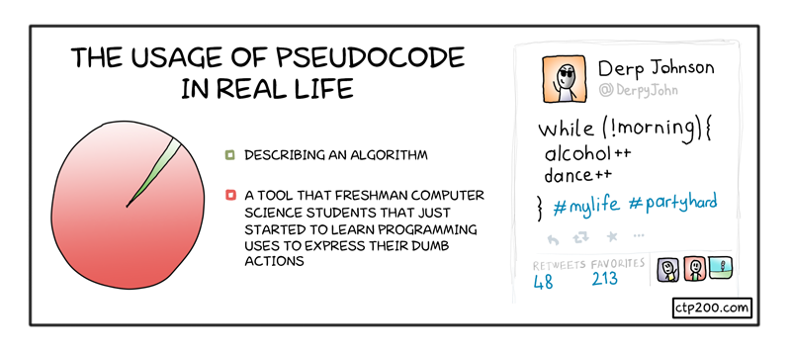
Pseudocode in Real Life

Slide 6
The importance of comments in the program
They explain to the reader what is going on.
They enhance both memory and understanding.
They divide the program in smaller parts, which are easier to grasp.
They show the logic and thoughts behind the design.
They give opportunity to explain hard parts.
They tie neatly into the pseudocode, which you already made.
Comments need to be structured, as they can also confuse the issue instead of enlighten it.
There is a limit to how many comments you should make. A rule of thump is 1 line of comment for every 5-10 lines of code. It is fine to have 5-10 lines of comments to explain the function of a difficult part. However coding/comment style is very individual, and can vary with the complexity of the differents parts of the program.

Slide 7
Bad example
Num1 = input('Enter a number:')
Num2 = input('Enter a second number higher or lower:')
#Transforming inputs to integers
Num1 = int(Num1)
Num2 = int(Num2)
if Num1 > Num2: #If Num1 is greater than Num2
while (Num1-1) > Num2:
Num2 += 1 # Num2 is slowly adding up to Num1-1 which will break the loop
print(Num2) #Print all the numbers in between excluding Num1 and Num2
elif Num1 < Num2: #If Num2 is greater than Num1
while Num1 < (Num2-1):
Num1 += 1 # Num1 is slowly adding up to Num2-1 which will break the loop
print(Num1) #Print all the numbers in between excluding Num1 and Num2
elif Num1 == Num2: #If the numbers are equal, the user is prompted to run the program again.
print('The numbers need to differ, rerun the program')
The comments are confusing the code. Some are self-evident. Some too long. Some badly placed.

Slide 8
Bad example made good
# Get input as integers
Num1 = input('Enter a number:')
Num2 = input('Enter a second number higher or lower:')
Num1 = int(Num1)
Num2 = int(Num2)
# Decide which loop depending on order of Num1 and Num2
if Num1 > Num2:
# Looping from smallest number to biggest number
while (Num1-1) > Num2:
Num2 += 1 # increment Num2
print(Num2) # print current value of Num2
elif Num1 < Num2:
while Num1 < (Num2-1):
Num1 += 1 # increment Num1
print(Num1) # print current value of Num1
elif Num1 == Num2: # if same number, run again
print('The numbers need to differ, rerun the program')
A long comment should be placed right above the statement or block of statements it concerns, at the same indention level.
A short comment can be placed on the same line tabbed away from the code in such fashion that all short comments start the same place.
Empty lines can be used to good effect to create space between elements of code.

Slide 9
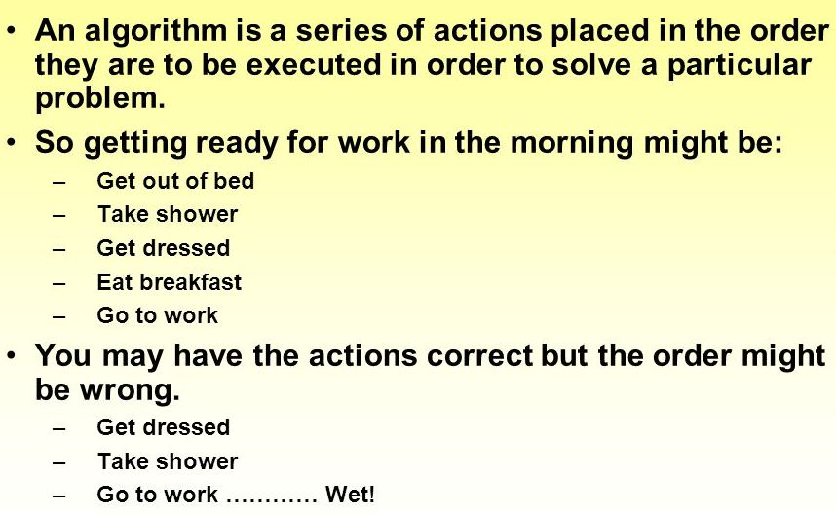
Practical logic and algorithm design
Borrowed from the web

