Slide 1
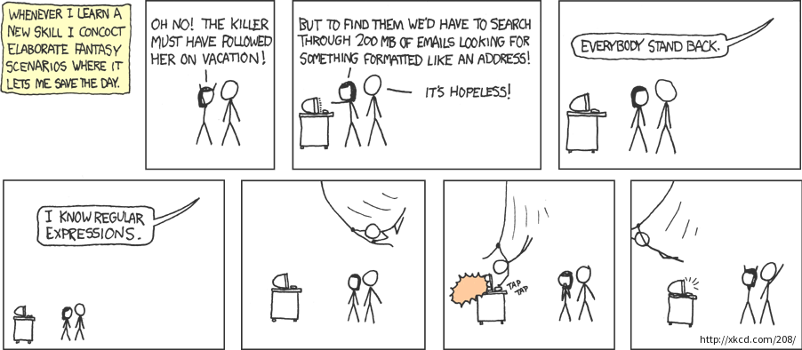
Python
Pattern Matching and Regular Expressions
Peter Wad Sackett

Slide 2
Simple matching with string methods
Just checking for the presence of a substring in a string, use in
mystr = ’I am here’
if ’am’ in mystr: print(’present)
if ’are’ not in mystr: print(’absent’)
The in operator also works with lists, tuples, sets and dicts.
Finding the position of the substring, returns -1 if not present.
mystr.find(’am’)
mystr.find(’am’, startpos, endpos)
Method rfind does the same from the other direction.
index is similar to find, but raises ValueError if not present.
mystr.index(’are’)
Methods startswith and endswith can be considered special cases of find. They give a True/False value.
mystr.startswith(’I’)
mystr.endswith((’ere’,’bla’)) # giving more choices of ending

Slide 3
Examples
Input is a swissprot file. Job is to find how many accession numbers are on the AC line(s). Main idea – there is a semicolon per accession on that line. Count the semicolons fast with find.
count = 0
for line in infile:
if line.startswith(’AC’):
start = line.find(’;’)
while start >= 0:
count += 1
start = line.find(’;’, start+1)
print(”Accession number count:”, count)
A similar idea could be used if you wanted to count (or find the positions) of start codons (ATG) in DNA.

Slide 4
Simple checks of strings
The following methods returns True if the string only contains character of the appropriate type, False otherwise. Needs at least one char to return True.
isalpha() alphabetic
isdigit() digits
isdecimal() float numbers, etc
isnumeric() similar, covers special chars like ½
isalnum() all of above
islower() contains only lowercase
isupper() contains only uppercase
isspace() contains only whitespace
These methods are not used much. Here is an example:
myStr = input(’I want an integer: ’)
if myStr.isdigit():
print(”Thank you for giving it to me”)

Slide 5
Replacement and removal
Returns a string with all occurrences of substring replaced.
myStr = ’Fie Fye Foe’ # What giants says in Disney shows
new_myStr = myStr.replace(’F’, ’L’)
Result: ’Lie Lye Loe’
You can replace something with nothing. Where is that useful?
Stripping strings – removing chars from the ends, default whitespace
rightStripppedString = myStr.rstrip()
leftStripppedString = myStr.lstrip()
bothSidesStripppedString = myStr.strip()
You can specify which chars should be stripped.
All are stripped until one is encountered, which should not be removed.
new_myStr = myStr.strip(’ieF’)
Result: ’ Fye Fo’ ← Notice the leading space

Slide 6
Examples
Counting nucleotides. The method shown is not very intuitive or straightforward, but illustrates very well how creative thinking can solve a problem using a method in an unexpected manner.
# A DNA string possibly polluted with N or other chars
DNA = ’TAGACTCATACGCATGCNTAGACNACT’
no_A = len(DNA) – len(DNA.replace(’A’,’’))
no_T = len(DNA) – len(DNA.replace(’T’,’’))
no_C = len(DNA) – len(DNA.replace(’C’,’’))
no_C = len(DNA) – len(DNA.replace(’G’,’’))
no_X = len(DNA) – no_A – no_T – no_G – no_G
print(”A:”, no_A)
print(”T:”, no_T)
print(”C:”, no_C)
print(”G:”, no_G)
print(”Other:”, no_X)
Later, another more intuitive method will be shown.

Slide 7
Translation
Translation is an efficient method to replace chars with other chars.
First make a char-to-char translation table.
translationTable = str.maketrans(’ATCG’,’TAGC’)
Then use the table.
dna = ’ATGATGATCGATCGATCGATGCAT’
complementdna = dna.translate(translationTable)
The dna has now been complemented.
Chars not mentioned in the translation table will be untouched.
This method has a use-case close to our hearts.
There is a way to delete chars not mentioned in the table – look it up.
Old | New
A | T
T | A
C | G
G | C

Slide 8
Regular Expressions - regex
Regular expressions are very powerful pattern matching.
Uses the re library.
Regex’es are about matching patterns and extracting matches.
Full and complex documentation at
https://docs.python.org/3/library/re.html
The general form of a regex is:
result = re.method(pattern, string_to_search_in)
method is here a method from the re library.
The following slides will explain what the pattern is, but it should be a raw string in order to avoid string interpretation (like \n means newline in a string). A raw string is completely literal – what you see is what you get. A string is made raw by putting an r in front.
Example: r’^ID\s+(\w+)’

Slide 9
Regex Patterns – Classes – what is the char
Any simple chars just matches themselves.
Built-in character classes:
\s matches a whitespace
\S matches a non-whitespace
\d matches a digit
\D matches a non-digit
\w matches a wordchar which is a-zA-Z0-9_
\W matches a non-wordchar
\n matches newline
. 1 char, matches anything but newline
\. escaping (backslash) a special char gives normal char
Make your own classes with []
[aB4-6] matches only one of the chars aB456
[^xY] matches anything but x and Y

Slide 10
Regex Patterns – Quantifiers – how many
A single simple char just matches itself, but a quantifier can be added to determine how many times.
? Zero or one time
+ One or more times
* Zero or more times
The {} can be used to make a specific quantification.
{4} Four times
{,3} At most three times
{5,} Minimum five time
{3,5} Between three and five times
Quantifiers are greedy, can be made non-greedy with extra ?
A few examples:
A{3,4}C? Match AAAA AAA AAAAC AAAC
\s\w{4}\s Match any four-letter word in a sentence

Slide 11
Regex Patterns – Groups – what goes together
The parenthesis denote a group. A group belongs together.
Example:
ABC(xyz)?DEF matches both ABCDEF and ABCxyzDEF
Either the entire group xyz is matched once or not (?)
The content of the group can be captured, see later.
Non-capturing group (?: )
The pipe sign | means or
A(BC|DEF)G matches either ABCG or ADEFG
Other special chars
^ Must be first, bind a match to the start of line
$ Must be last, bind a match to the end of line
\b Word-boundary (whitespace, comma, BoL, EoL, etc) 0-span

Slide 12
Benefits of using a regex
Regular expressions are often used in loops.
mymatchobject = re.search(pattern, string)
The match object can be investigated for matches - capturing
mymatchobj.group(0) # Entire match
mymatchobj.group(1) # First group
mymatchobj.start(1) # Start of first group in string
mymatchobj.end(1) # End of first group in string

Slide 13
Examples
Testing if there is a match.
myStr = ’In this string is an accession AB232346 somewhere’
if re.search(r”\b[A-Z]{1,2}\d{6,8}\b”, myStr) is not None:
print(’Yeah, there is an accession number somewhere”)
Capturing a match, notice parenthesis.
myStr = ’In this string is an accession AB232346 somewhere’
result = re.search(r”\b([A-Z]{1,2}\d{6,8})\b”, myStr)
if result is None:
print(’No match”)
else:
print(”I got one”, result.group(1))

Slide 14
Examples
Input is a swissprot file. Job is to find the first accession number on the first AC line. This is a fairly typical way to use a regular expression when parsing a file.
acc = None
for line in infile:
if acc is None:
result = re.search(r’^AC\s+(\w+);’, line):
if result is not None:
acc = result.group(1)
print(”Accession number:”, acc)
Achieving the same in a different manner.
acc = None
for line in infile:
if acc is None and line.startswith(’AC’):
acc = re.search(r’^AC\s+(\w+);’, line).group(1):
print(”Accession number:”, acc)

Slide 15
Commonly used methods of the re library
Find a match anywhere in the string.
result = re.search(pattern, string)
Find a match only in the beginning of the string.
result = re.match(pattern, string)
Split string on a pattern.
resultList = re.split(pattern, string)
Return all matches as list of strings.
resultList = re.findall(pattern, string)
Return string where matches are replaced with replacement string. Count = 0 means all occurrences.
resultString = re.sub(pattern, replacement, string, count=0)
The last method is surprisingly useful and versatile.

