Slide 1
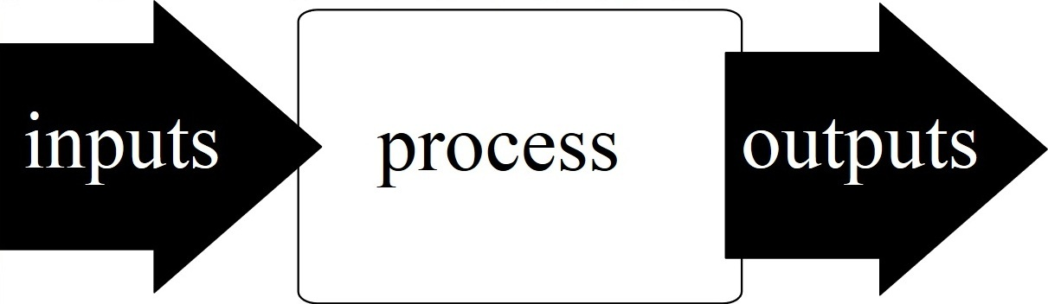
Python
I/O
Peter Wad Sackett

Slide 2
Classic file reading 1
Files are opened and closed
infile = open(’filename.txt’, ’r’)
for line in infile:
print(line) # doing something with the line
infile.close()
open opens the file ’filename.txt’ for reading; ’r’.
The associated filehandle is here called infile, but can be anything.
The for loop iterates through each line in the file.
The variable is called line (appropiate), but can be anything.
After reading the lines, the file is closed by calling the close method on the filehandle object. This is quite similar to file reading with the with statement.

Slide 3
Classic file reading 2
Alternative file reading
infile = open(’filename.txt’, ’r’)
line = infile.readline()
while line != ””:
print(line) # doing something with the line
line = infile.readline() # getting the next line
infile.close()
By calling the method readline on the filehandle object, a line will be read and returned. If there are no more lines in the file to read the empty string will be returned.
Notice that the lines contain a newline in the end.
Warning: You use this method or the previous method, but NOT A MIX. NEVER use ”for line in infile:” together with ”infile.readline()”.

Slide 4
Classic file writing
File writing
# Opening the file
outfile = open(’filename.txt’, ’w’)
# Method 1: Using write method on the file handle
outfile.write(”First line in the file\n”)
# Method 2: Using print function
print(”Second line in the file”, file=outfile)
# Closing the file
outfile.close()
By calling the method write on the filehandle object, a string will be written to the file.
One string will be written. It can be a constructed string like:
”I am ” + name + ”. Hello\n”
Notice, if you want a newline, you must specify it.
print can be used in a familiar way, if adding the file=
You can append text to an already written file with file mode ’a’.
You can also use the with statement for writing files.

Slide 5
Examples
Doing a simpel copy of a text file
# Opening the files
infile = open(’original.txt’, ’r’)
outfile = open(’copy.txt’, ’w’)
# The copy work
for line in infile:
outfile.write(line)
# Closing the files
infile.close()
outfile.close()
Every string/line read is simply being written in its entirety to the output file – including newlines.

Slide 6

Python libraries
Python has a lot of standard libraries
The libraries has to be imported to be used
import sys
A library gives access to ”new” functions. For example the sys library gives access to an exit function (and lot of other stuff).
sys.exit(1) # ends the program with exit code 1
A library function is called by
libname.funcname()

Slide 7
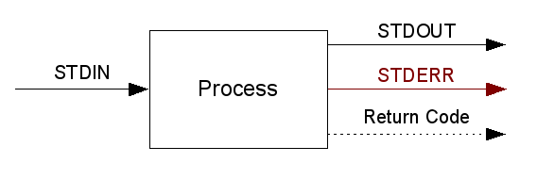
The sys library: STDIN and STDOUT
The STDIN and STDOUT filehandles can be imported
import sys
line = sys.stdin.readline()
sys.stdout.write(”Output to stdout\n”)
The sys library is big and has many interesting and important functions which have to do with the platform and even the hardware. Not many are useful for a beginner.
Full documentation:
https://docs.python.org/3/library/sys.html

Slide 8

The os library
Miscellaneous operating system interfaces
import os
os.system(”ls -l”)
The os library is bigger than sys. Contains many useful functions.
Common functions are:
mkdir, rmdir, chdir, rename, remove, chmod, system, getpid, getenv
Lots of low level I/O functions. Requires fairly good understanding of computers and operating systems.
Full documentation:
https://docs.python.org/3/library/os.html

Slide 9

Standard math library
Advanced math functions are imported from library
import math
squareroot2 = math.sqrt(2)
Lots of mathematical functions. The more common are:
sqrt, log, pow, cos, sin, tan, acos, asin, atan, ceil, floor, isinf, isnan.
Has also some useful constants:
pi, e.
Full documentation:
https://docs.python.org/3/library/math.html

Slide 10
Examples
Doing a copy of a text file – special attention to STOP and ERROR lines
# Importing libraies
import sys
# Opening the files
infile = open(’original.txt’, ’r’)
outfile = open(’copy.txt’, ’w’)
# The copy work
for line in infile:
if line == ”STOP\n”:
break
if line == ”ERROR\n”:
print(”Error found, stopping”)
sys.exit(1)
outfile.write(line)
# Closing the files
infile.close()
outfile.close()

Slide 11
Strings and parts of them
Strings are immutable objects.
A string is a sequence, a data type that supports certain operations.
# Finding the length of a string, a sequence operation
mystring = ’0123456789’
stringlength = len(mystring)
# extract a char at a specific position, sequence operation
thechar = mystring[3]
# extract a substring/slice, sequence operation
substring = mystring[2:5]
print(stringlength, thechar, substring)
Output is:
10 3 234
Strings/sequences are zero-based, i.e. first position is 0.
Strings have several useful string-only operations.

Slide 12
More with strings
Starting from the end of the string with negative numbers
print mystring[-1] # print last char
print mystring[5:-1] # result 5678
print mystring[:-1] # everything but the last char
print mystring[4:] # from position 4 and onward
print mystring[8:100] # result 89
If you ask for more chars than actually are in a string, like the last statement, python will give you what it has. There is no error.
If you start outside the string, there will be an error.
Iteration over a string
Printing a string, one char on each line.
mystring = ’0123456789’
for position in range(len(mystring)):
print(mystring[position])
for character in mystring:
print(character)

Slide 13
Examples
Is the word ’Red’ in the string?
The idea is to define what word to look for and then check all substrings in the line. Set a flag (boolean value) if the word is seen.
searchWord = ’Red’
line = ’Green YellowRed Blue Ultraviolet’
wordPresent = False
for i in range(len(line)):
if line[i:i+3] == searchWord:
wordPresent = True
if wordPresent:
print(searchWord, ”is present in the line”)
else:
print(searchWord, ”is NOT present in the line”)
A problem that may need solving in this code is, if the word we look for has to be a ”real stand-alone” word or it can be part of something else.

