Slide 1



PYTHON PEPTALK
22110 Python and Unix for Bioinformaticians
By Line Egerod Lund
Date: 19/09/19

Slide 2

WHO AM I?
B.Sc. in Human Life Science Engineering
M.Sc. in Bioinformatics and Systems Biology
Student Assistant at iCOPE.
iCOPE
The interregional Childhood Oncology Precision medicine Exploration
Technical University of Denmark Lund University University Hospital Rigshospitalet

Slide 3
LEARNING CURVE
Project Work
EXPERIENCE
TIME
Line’s breaking point

Slide 4
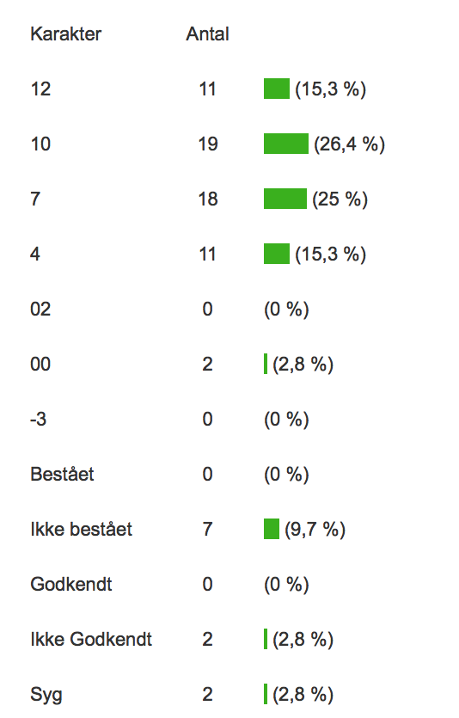
RESULTS (F19)
~ 5% Autodidact coding geniuses
~ 10% Taken x number of python courses
~ 85% Hard work
Hard work?
Put in the hours.
(10 ETCS point = 280 hours to pass the course)
Start the project work on time.
DO THE EXERCISES!

Slide 5
OPPORTUNITIES
Offered a student assistant job at iCOPE.
Python course
February
March
April
May
June
iCOPE’s new student assistants
In common?: Took course 22110

Slide 6



WORK EXAMPLE
FASTQ
Setting up
the pipeline
Error checking
Data from
Rigshospitalet
~ 2 years
~ 30 minutes
Finished pipeline
Finale results

Slide 7
THE END

