Slide 1
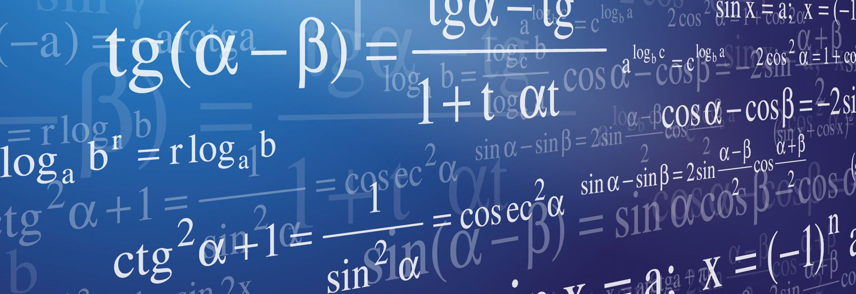
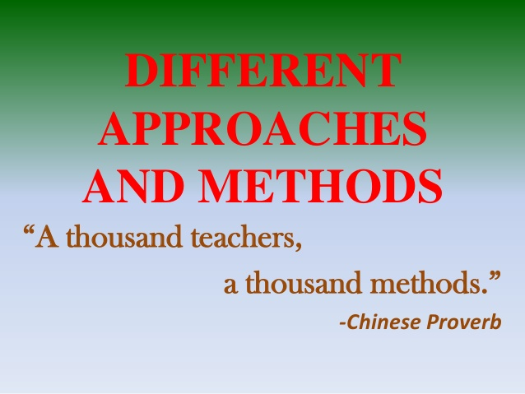
Python
Useful Functions and Methods
Peter Wad Sackett

Slide 2
Nothing more to learn ?
There are quite a few built-in functions not mentioned yet, see
https://docs.python.org/3/library/functions.html
So far has been mentioned 15 out of 68:
dict(), float(), format(), input(), int(), isinstance(), len(), list(), open(), print(), range(), reversed(), set(), sorted(), str() and tuple()
Many of the unmentioned functions works with python’s object model or the inner workings of python.
Useful for advanced python code.
Classes for making your own python objects, with methods working on them.

Slide 3
Nice to know built-in functions
The following are nice to know for a beginner:
abs(number) returns absolute value of a number
dir(object) returns info on an object
enumerate(iterable) returns an enumerated list of tuples
help(string) returns help in the subject given
id(object) returns the id of an object, guaranteed to be unique
iter(iterable) returns an iterable – dicts as key/value tuples
max(iterable) returns the maximum value
min(iterable) returns the minimum value
round(number) rounds a number
sum(iterable) returns the sum of the iterable
zip(iterables) returns a list of tubles of the input in ”pairs”

Slide 4
New built-in data types
The type bytes is similar to strings; immutable and supports all string methods. Efficient, uses the ascii charset, seems like a list of numbers.
name = b’Peter’ # the b denotes a bytes type
print(name[0])
#result: 80
The type bytearray is like mutable strings and supports all string methods. It is more efficient when your strings change. It seems like a list of numbers that can’t hold a value bigger than 255, just like bytes.
name = bytearray(b’Peter’)
name[2] = 100 # change t to d
The type frozenset is a immutable set and supports all set methods, that does not change the frozenset, obviously.
Can be used as keys in dicts and sets. Frozensets are to sets, what tuples are to lists or bytes to bytearrays.
fruits = frozenset(’apple’, ’banana’, ’cherry’, ’date’)

Slide 5
New sequence method
sequencetype.count(item) returns the number of occurrences. This can be used to count nucleotides in DNA.
DNA = ’TGCACTCGACTCAGATCGACTACG’
A_count = DNA.count(’A’)
T_count = DNA.count(’T’)
Due to the fast performance of the method, it is faster to count 4 times (where each count is an iteration over the DNA-string), than to make a standard for loop and count all bases in a single iteration over the string.
Since all sequencetypes support the count method, it can also be used with lists, tuples, bytes, bytearray, etc.

Slide 6
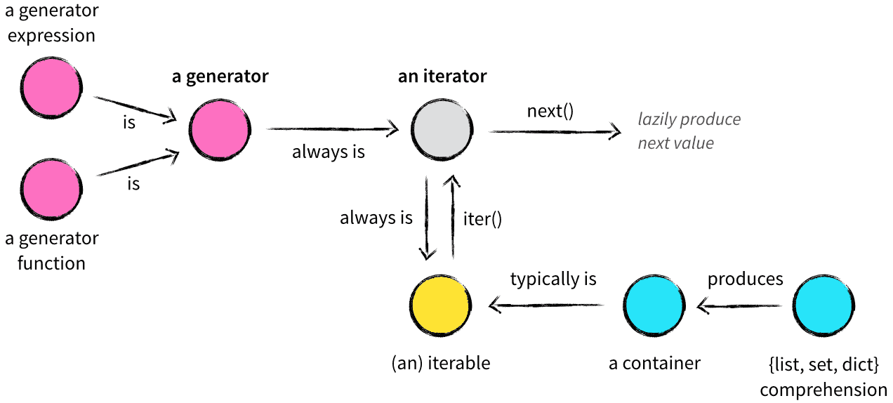
Python concepts on iteration
This overview of various iteration concepts will be explored on the next slides.
Figure by Vincent Driessen

Slide 7
Concepts - iteration
A container is ”holding data” – typically lists, sets, dict or strings. What defines a container is that it can be queried for membership of an element – does it contain the element.
An iterable is often a container but can also be an open file or other object that can return an iterator.
An iterator is stateful helper object. It keeps track of the iteration over the iterable. It can be created by using the iter() function call on an iterable. It is created automatically in for loops.
# The container, but also the iterable
numbers = [1, 2, 3]
# Creating two iterators
iter1 = iter(numbers)
iter2 = iter(numbers)
# Using the next function call – non-looping iteration
next(iter1) # gives 1
next(iter1) # gives 2
next(iter2) # gives 1
next(iter1) # gives 3
next(iter1) # raises the exception StopIteration

Slide 8
Lambda, the anonymous function
The lambda is a small anonymous function which can be put any place, where a function is required. It has been put into Python to support functional programming. Here shown with method sort:
names = [’Aiz’, ’Cain’, ’Gemini’, ’Zenia’]
# The names shold be sorted according to the last letter
names.sort(key=lambda x: x[-1])
# Result: [’Zenia’, ’Gemini’, ’Cain’, ’Aiz’]
It is equal to:
def lastChar(myStr):
return myStr[-1]
names = [’Aiz’, ’Cain’, ’Gemini’, ’Zenia’]
# The names shold be sorted according to the last letter
names.sort(key=lastChar)
The generel syntax of the lambda is:
lambda argument_list: expression
lambda x,y: x*y-4

Slide 9
Lambda, map and filter – equal to comprehension
The lambda function is most often used together with the functions map and filter, which both return an iterator. By applying the list function on an iterator a list will be returned. This has been previously shown/used in sets and dicts.
The map and filter function will perform the given function on the entire sequence and return the result:
map(function, sequence)
filter(function, sequence)
Using lambda/map to take a list of names and reverse the spelling and create a new list. The comprehension way is also shown.
reverse_names = list(map(lambda x: x[::-1], names))
reverse_names = [ x[::-1] for x in names ]
The filter function is choosing which elements to keep. The lambda function is used to make a True/False evaluation of each element, so the filter can pick it – or not.
a_names = list(filter(lambda x: ’a’ in x, names))
a_names = [ x for x in names if ’a’ in x ]

Slide 10
Standard libraries
Python has many standard libraries, far too many to memorize. Look them up, when you need something.
https://docs.python.org/3/library/
Each library contains several functions, all relevant and appropriate to the core functionality of the library. You won’t find string functions in the math library.
In the course the following standard libraries have been used:
string – string operations
re – regular expressions
math – mathmatical functions
os – operating system interfaces
sys – system specific functions
Some new ones which are surprisingly often useful:
random – pseudo random numbers
copy – shallow and deep copy operations
argparse – parsing arguments/options from command line

Slide 11
Scientific libraries
Python also has many scientific libraries. They are part of what makes Python great. You can get most with the free Anaconda distribution.
https://www.anaconda.com/download/
To mention some of the most wellknown libraries:
NumPy – support for large multi-dimensional matrices plus large collection of high-level mathematical functions.
Matplotlib – plotting graphs.
pandas – data manipulation and analysis.
SymPy – symbolic computation.
tensorflow – machine learning
sklearn – machine learning
SciPy – meta package including many of above libraries plus more.

