Slide 1
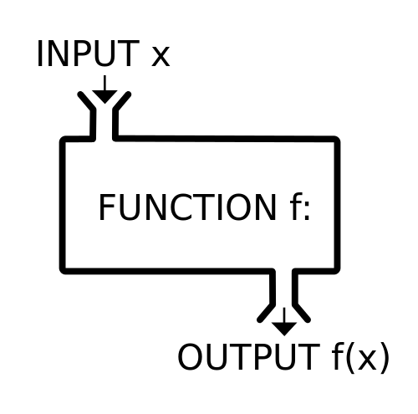
Python
Functions
Peter Wad Sackett

Slide 2
Purpose of functions
Code reuse
A function can be used several times in a program
Can be used in several programs
Minimize redundancy
Generalize to enhance utility
Hide complexity
Will allow a higher view of the code
Removes unimportant details from sight
Allows ”Divide and Conquer” strategy – sub tasks

Slide 3
Function declaration
def funcname(arg1, arg2, arg3, … argN):
”””Optional but recommended Docstring”””
statements
return value
The name of the function follows the same rules as variables.
There can be any number of complex python statements, if’s, loops, other function calls or even new function definitions in the statements that make up the function.
The special statement return returns the computed value of the function to the caller
There can be any number of return’s in the function body.
A return with no value gives None to the caller. Any object/data structure, can be returned - that includes a list of objects.
If the function ends with no return, None is returned.

Slide 4
Function arguments 1
def funcname(arg1, arg2, arg3, … argN):
The arguments can be positional or keyword
def subtract(firstnumber, secondnumber):
return firstnumber-secondnumber
Use as
result = subtract(6, 4)
result = subtract(secondnumber=6, firstnumber=11)
An argument can have a default value
def increment(arg1, arg2=1):
return arg1 + arg2
Other forms of argument passing exists.

Slide 5
Function arguments 2
def funcname(arg1, arg2, arg3, … argN):
The arguments are assigned to local variables.
Any assignment to the arguments inside the function will not affect the value from the caller.
def change(number):
number += 5
mynumber = 6
change(mynumber)
print(mynumber) # mynumber is still 6
However if an argument is mutable, like a list, dict or set, then changes made to the argument is seen by the caller.
def addtolist(alist):
alist.append(5)
mylist = [1, 2, 4]
addtolist(mylist)
print(mylist) # mylist is now [1, 2, 4, 5]

Slide 6
Function Docstring
def funcname(arg1, arg2, arg3, … argN):
”””The Docstring”””
The Docstring is the first ”statement” of a function.
It describes the function. Documentation.
It uses triple quotes for easy recognition and change.
Further documentation of Docstring
https://www.python.org/dev/peps/pep-0257/

Slide 7
Function scope
def funcname(arg1, arg2, arg3, … argN):
IamLocal = 4
NobodyKnowsMeOutside = ’unknown’
global KnownOutside
KnownOutside = 7 # Global change
When a variable is assigned to inside a function, it becomes local to the function.
No namespace clash.
A global variable can be used/read inside a function, if no assignment is made to it, or it is declared with the global keyword.
Functions that uses the global keyword can only be used in that specific code, due to the dependency on outside variables. Using global makes the code less flexible and this is generally a bad thing.

Slide 8
Function recursion
A function can call itself - recursion
def print_numbers(number):
if number > 1:
print_numbers(number -1)
print(number)
print_numbers(10)
There must be a way to stop the recursion or we have a never ending loop.

Slide 9
Examples
This function determines if the input is a prime.
import math
def isprime(number):
if number < 2 or (number % 2 == 0 and number != 2):
return False
for i in range(3, int(math.sqrt(number))+1, 2):
if number % i == 0:
return False
return True
for i in range(20):
print("Is", i, "a prime:",isprime(i))
Notice how the two uses of the variable i does not interfere with each other. We assume that the input is an integer. How to verify this?

Slide 10
What type is a variable?
It can be useful to know what type a variable is. This becomes more important and useful when your program grows in size and you start working with functions. A function might behave in one way if the parameter is a string and another of it is a number or a list.
The function isinstance(object, classinfo) will do that.
myVar = 5
# The classic names can be used:
# int, float, str, list, set, dict
if isinstance(myVar, int):
print(myVar, ”is an integer”)
# Test for more than one type using a tuple
if isinstance(myVar, (int, float)):
print(myVar, ”is a number”)

Slide 11
Examples
Returning to the isprime function, now with input control. If the input is meaningless for the function, None will be returned.
import math
def isprime(number):
if not isinstance(number, (int, float)):
return None
if isinstance(number, float):
if int(number) != number:
return None
number = int(number)
if number < 2 or (number % 2 == 0 and number != 2):
return False
for i in range(3, int(math.sqrt(number))+1, 2):
if number % i == 0:
return False
return True
for i in range(20):
print("Is", i, "a prime:",isprime(i))

