Slide 1
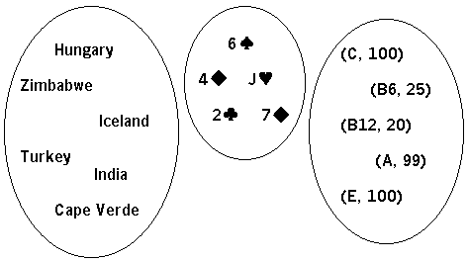
Python
Sets and Dictionaries
Peter Wad Sackett

Slide 2
Set properties
What is a set?
A set is a mutable collection of unique unordered immutable objects.
The set can change.
The elements of the set can not change,
however an element can be removed or inserted.
There can only be one.
A simple set assignment:
fruits = set()
fruits = {’apple’, ’pear’, ’orange’, ’lemon’, ’banana’}
print (fruits)
Sets work like the mathematical concept of sets

Slide 3
Set methods
Size of the set – how many elements in the set.
len(fruits)
Adding one element to a set.
fruits.add(’kiwi’)
Adding several elements (as list) to a set, performance for long list.
fruits.update([’strawberry’, ’elderberry’])
Removing element, KeyError if not present.
fruits.remove(’kiwi’)
Removing element, no error if not present.
fruits.discard(’kiwi’)
Making a shallow copy.
f = fruits.copy()
Clearing a set. Keeps the list identity.
fruits.clear()

Slide 4
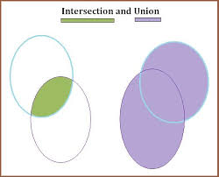
Set methods - mathematical
Set membership, tests.
’banana’ in fruits
’plum’ not in fruits
exotic = {’mango’, ’pomelo’}
fruits.isdisjoint(exotic)
fruits.issubset(exotic)
fruits.issuperset(exotic)
Creating new sets with math.
common = fruits.intersection(exotic)
all = fruits.union(exotic)
diff = fruits.difference(exotic)
eitheror = fruits.symmetric_difference(exotic)
Iteration over a set. What did you expect??
for f in fruits:
print(f)
Disjoint
Green is subset
Green is superset

Slide 5
Examples
How many different fruits can you input? Using a set to keep track.
print(”Please, enter as many fruits as you can. One per line”)
print(”Input STOP when you are finished.”)
fruits = set()
fruit = input(”Enter fruit: ”)
while fruit != ’STOP’:
fruit = fruit.lower()
if fruit in fruits:
print(”Cheater, you have already mentioned”, fruit)
else:
fruits.add(fruit)
fruit = input(”Enter fruit: ”)
print(”Fantastic, you know”, len(fruits), ”different fruits.”)
Looking at the code, the structure is quite similar to reading a file line by line using the readline method.

Slide 6
Examples
Imagine that we have somehow created a set with all known fruits. Then the program could be extended like this and we could have competitions in who knows most fruits.
print(”Please, enter as many fruits as you can. One per line”)
print(”Input STOP when you are finished.”)
allFruits = set() # Magically filled set with all fruits
fruits = set()
fruit = input(”Enter fruit: ”)
while fruit != ’STOP’:
fruit = fruit.lower()
if fruit not in allFruits:
print(”This is not a fruit, try again,”)
elif fruit in fruits:
print(”Cheater, you have already mentioned”, fruit)
else:
fruits.add(fruit)
fruit = input(”Enter fruit: ”)
print(”Fantastic, you know”, len(fruits), ”different fruits.”)

Slide 7
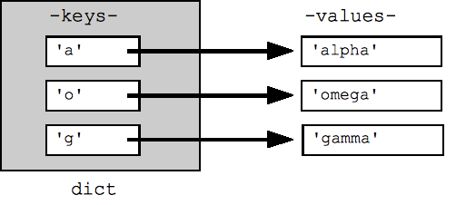
Dictionary properties
What is a dictionary – dict ?
A dict is a mutable collection of unique unordered immutable keys paired with a mutable object
The dict can change
The keys of the of the dict can not change,
however an key/value pair can be removed or inserted
There can be only one unique key in the dict
A simple dict assignment:
person = dict()
person = {’name’: ’Hannah’, ’age’: 40, ’height’: 172, ’weight’: 66}
print (person)
print (person[’name’])

Slide 8
Dictionary methods
Size of the dict
len(person)
Adding one key/value pair to a dict
person[’eyecolor’] = ’green’
Removing key/value pair, KeyError if not present – see tips
del person[’age’]
Returns value, returns None if not present – see tips
person.get(’age’)
Making a shallow copy
p = person.copy()
Clearing a dict
person.clear()

Slide 9
Dictionary methods - iteration
Dict membership, test
if ’weight’ in person:
# some code
if ’gender’ not in person:
# some code
Iteration with dicts – see tips
for k in person.keys():
print(k)
for v in person.values():
print(v)
for i in person.items():
print(i, i[0], i[1])

Slide 10
Examples
Counting occurrences of different chars in a string – not knowing in advance which are present. Could be DNA.
unknownStr = ’TCAGAACTGNACTACGCANTACGACTCAG’
counts = dict()
for char in unknownStr:
if char in counts:
counts[char] += 1
else:
counts[char] = 1
print(”Occurrences in string”)
# We want the output sorted by the char
for char in sorted(counts.keys()):
print(”{}: {:4d}”.format(char, counts[char]))

Slide 11
Tips and Tricks – iteration
Dict methods keys() and values() do not return a list. They return an iterable, meaning you can iterate over them ”like a list”. You can make the iterable into a real list by applying the list() function. Then you can use list methods on the resulting list. Remember, the list is a copy.
keysList = list(person.keys())
It will mess up the dict if you iterate over it while removing elements.
for k in testDict.keys(): # Do not
if testDict[k] < 10: # use this method
del testDict[k] # to remove elements
Below is the safe way to do it, as your keyList is different (copy) from the Dict_Keys iterable the keys() method returns.
keyList = list(testDict.keys()) # Removing
for k in keyList: # elements
if testDict[k] < 10: # like this
del testDict[k] # is safe

Slide 12
Tips and Tricks - sorting
Both sets and dicts are unordered collections, but sometimes it can be nice to have a sorted list of the elements. That can be achieved with the sorted() function. For sets this is really easy.
setSortedList = sorted(mySet)
With dicts it is quite similar to get a sorted list of the keys or values.
dictKeysSortedList = sorted(myDict.keys())
dictValuesSortedList = sorted(myDict.values())
But what if a list of the keys must be sorted according to the value. Here is the dict method get() very useful.
keysSortedByValue = sorted(myDict.keys(), key=myDict.get)
Any function/method can be used as sort key, including those you make yourself, as long as it only takes one parameter.
Notice the sorted() function returns a list, i.e. it listifyes the inputted iterable, no matter if it was a set or dict keys or something else.

Slide 13
Tips and Tricks - performance
A look-up in a set or a dict is very fast – constant time. This means that if does not matter how big the set/dict is, the look-up takes the same amount of time. This is completely different from lists where the look-up scales with the size of the list.
myList = [’A’, ’B’, ’C’]
mySet = {’A’, ’B’, ’C’}
myDict = {’A’: 5, ’B’: 2, ’C’: 7}
if ’A’ in myList: # slow
if ’A’ in mySet: # fast
if ’A’ in myDict: # fast
However, if you know the position of the wanted element in the list, then it is faster to get the value from the list than the dict.
val = myList[0] is faster than val = myDict[’A’]

