Slide 1
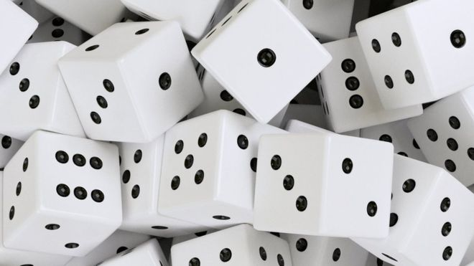
Python
Random numbers
Peter Wad Sackett

Slide 2
The need for randomness
Humans have an intrinsic need for randomness, possibly based on a need for fairness or ”having a chance”. Who would participate in a lottery or card game if the winning numbers/cards were not chosen by chance?
Much of statistical theory is based on randomness and everyday practices like participating in experimental trials or surveys or performing your civic duty as juror are based on randomly selected people.
Signal analysis must deal with random noise and (computer) simulations of various kinds expects or uses random events.
Mutations - caused by exposure to radiation or chemicals – are random.
Randomness is part of both our science and consciousness and the way we think about events. Quite often the randomness has some bias attached to it – whether we perceive it or not..

Slide 3
Types of randomness
Truly random numbers - unpredictable
Used in cryptography and gambling
Expensive and hard to generate – based on quantum mechanics
Pseudo random numbers – predictable
Used everywhere, when true randomness is not required
Cheap – based on a deterministic computer algorithm
A strong use-case for pseudo-random numbers is computer programs where you need to be able to repeat a run or experiment. By setting the seed (beginning point) you can repeat the series of ”random” numbers.
Seed
Direction
Circular list of numbers, where the next is generated from the previous

Slide 4
Python random library
import random
# Initializing the seed
random.seed(’I am a string seed’)
# Get a random integer from a range – similar to range
myInt = random.randrange(1, 11)
# Get a random element from a sequence
myList = [’Yes’, ’No’, ’Maybe’, ”Don’t know”]
myChoice = random.choice(myList)
# Random shuffe of a sequence
random.shuffle(myList)
# Get a random float between 0 and 1 (1 not inclusive)
myFloat = random.random()
More random functions and distributions exists.
https://docs.python.org/3/library/random.html

Slide 5
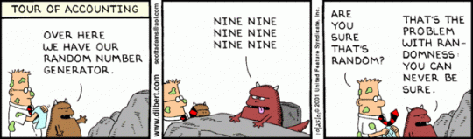
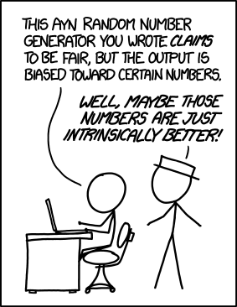
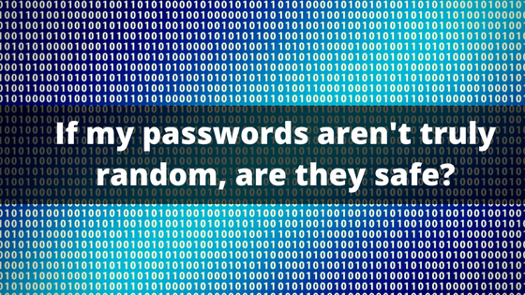
The nature of randomness

