Slide 1


QSAR Ready Biodegradability Prediction
EECS E6690 Project Presentation
Lei Lyu (ll3433)
Yang Yu (yy3102)
Wenxiang Zhou (wz2542)
Yi Chen (yc4029)
TRANSCENDING DISCIPLINES, TRANSFORMING LIVES
Notes:
‹#›

Slide 2

Part 1: Dataset description
QSAR biodegradation Data Set
‹#› | QSAR Ready Biodegradability Prediction
Notes:
‹#›

Slide 3

Dataset Description
Various kinds of chemicals are left in the environment by industry
Many of the chemicals are not biodegradable
Information about biodegradability of chemicals are not yet abundant
‹#› | QSAR Ready Biodegradability Prediction
Notes:
‹#›

Slide 4
Dataset Description
QSAR (Quantitative Structure-Activity Relationships) is used to predict the biodegradability of chemicals
QSAR biodegradation data set was built to develop QSAR models for studying the relationship between chemical structure and biodegradability of molecules
Experimental values collected from webpage of the National Institute of Technology and Evaluation of Japan (NITE)
‹#› | QSAR Ready Biodegradability Prediction
Notes:
‹#›

Slide 5
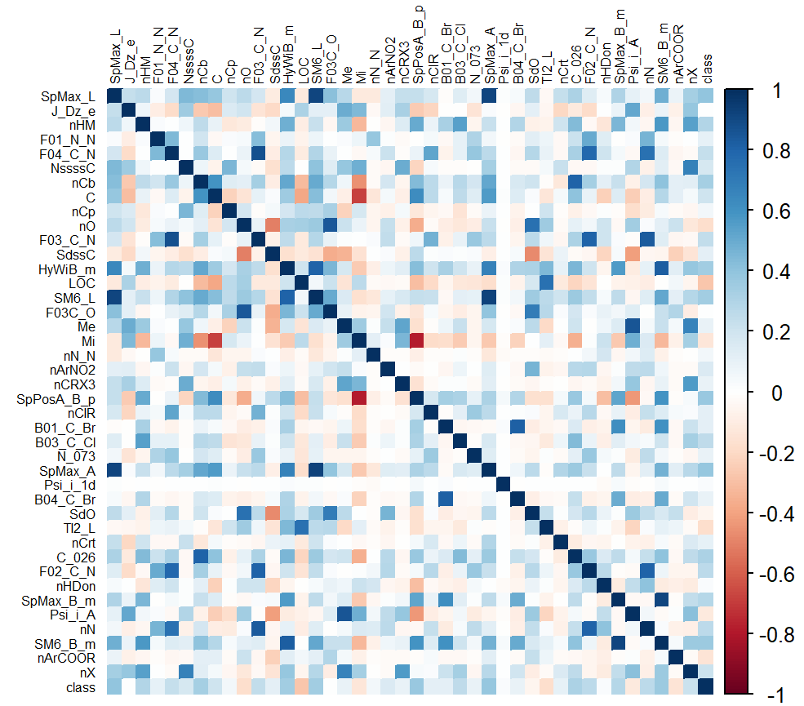
Dataset Description
Heatmap of variable correlations
Number of Instances: 1055
where 356 molecules are ready biodegradable (RB) and 699 are not ready biodegradable (NRB)
Number of Attributes: 41
selected using many classification modeling methods combined with genetic algorithms
Correlations between descriptors:
‹#› | QSAR Ready Biodegradability Prediction
Notes:
linear, non-linear, local models and consensus models
to select the optimal subsets of molecular descriptors
‹#›

Slide 6
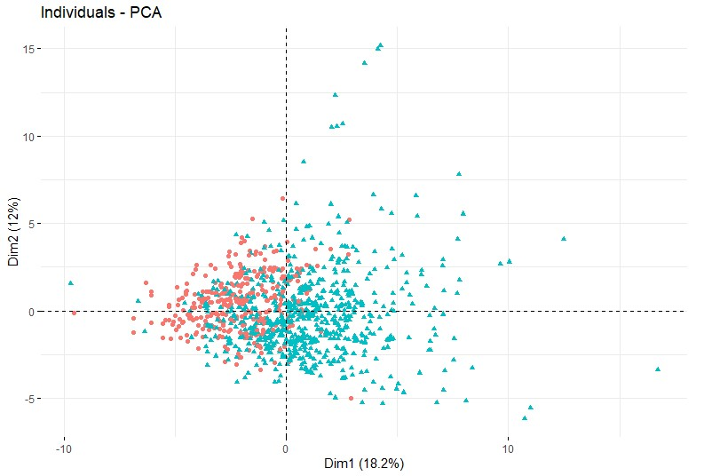
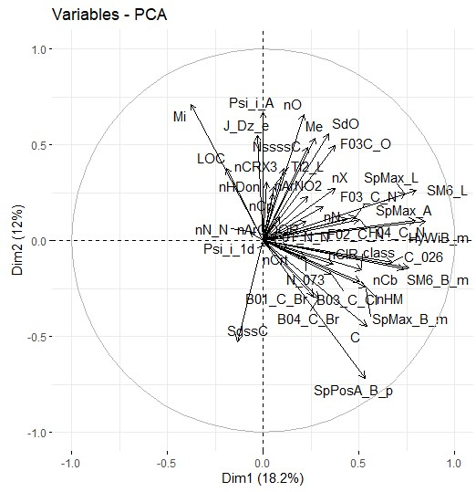
All Descriptors PCA
Score Plot
Loading Plot
‹#› | QSAR Ready Biodegradability Prediction
Notes:
‹#›

Slide 7
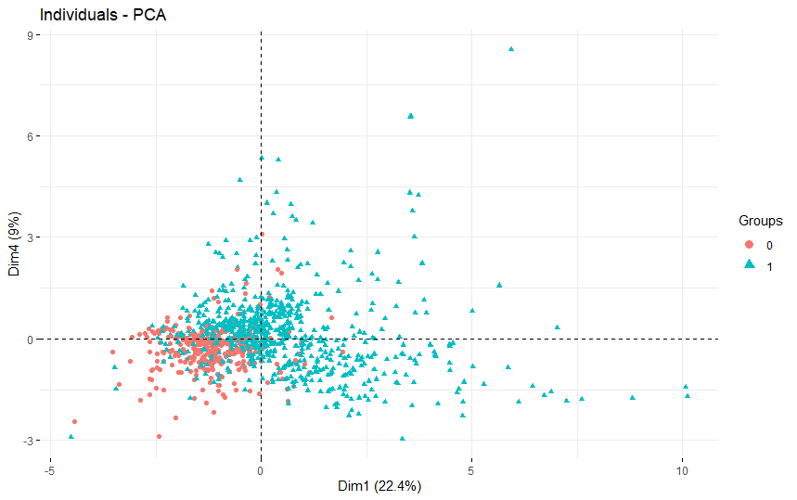
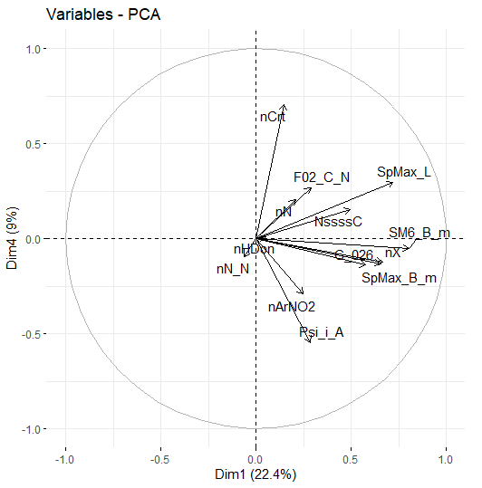
Paper’s SVM Descriptors PCA
Score Plot
Loading Plot
‹#› | QSAR Ready Biodegradability Prediction
Notes:
‹#›

Slide 8
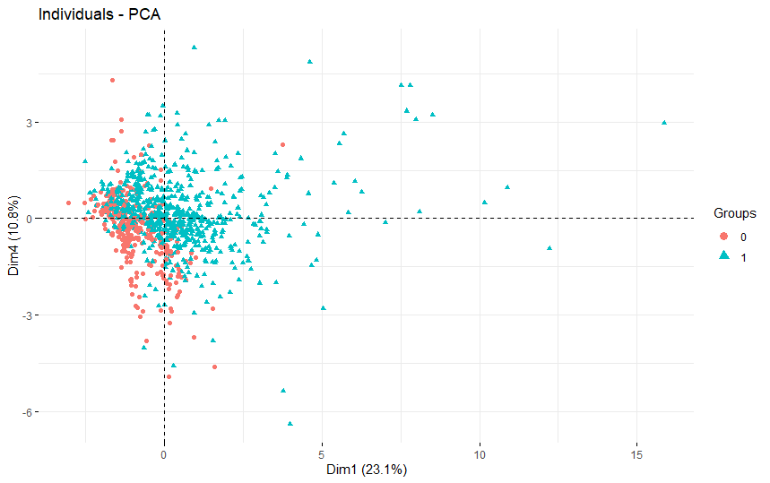
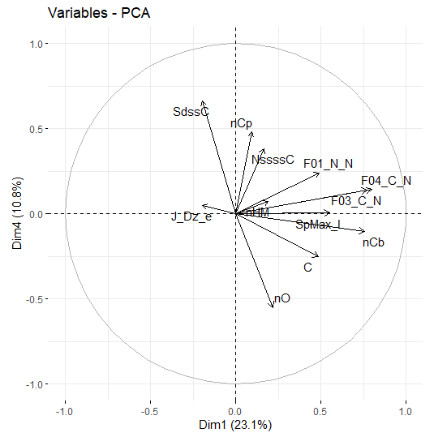
Paper’s kNN Descriptors PCA
Score Plot
Loading Plot
‹#› | QSAR Ready Biodegradability Prediction
Notes:
‹#›

Slide 9
Part 2: Paper detail and reproduce
KNN, PLSDA, SVM
‹#› | QSAR Ready Biodegradability Prediction
Notes:
‹#›

Slide 10
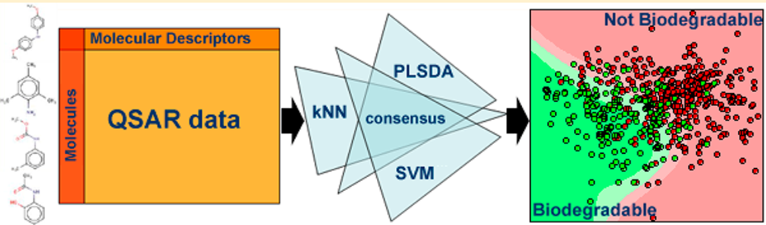
Quick View
Data set dividing:
41 Attributes, 1055 instances
training set: 837 test set: 218
5-fold cross-validation
2 Class:
RB: ready biodegradable
NRB: not ready biodegradable
‹#› | QSAR Ready Biodegradability Prediction
Notes:
‹#›

Slide 11

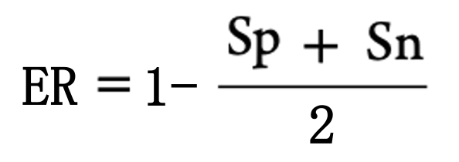
Model Validation
Specificity:
the ability to correctly predict RB molecules
TN: # true negatives
FP: # false positives
Sensitivity:
the ability to correctly predict NRB molecules
TP: # true positives
FN: # false negatives
ER:
the classification error rate
‹#› | QSAR Ready Biodegradability Prediction
Notes:
‹#›

Slide 12
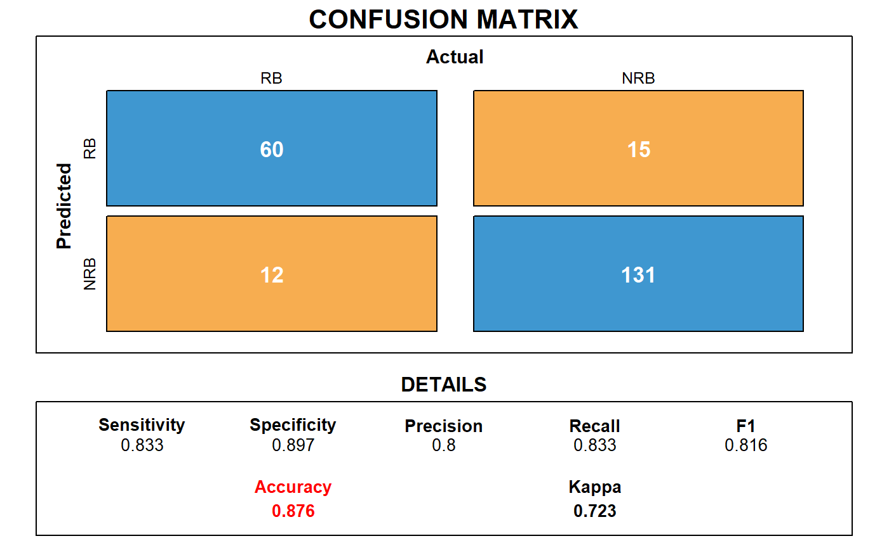
1. k Nearest Neighbors (kNN)
Our reproduce result:
12 descriptors selected
Euclidean distance
Techniques | ER | Sp | Sn
KNN (paper) | 0.15 | 0.90 | 0.81
KNN (reproduced) | 0.12 | 0.90 | 0.83
‹#› | QSAR Ready Biodegradability Prediction
Notes:
‹#›

Slide 13
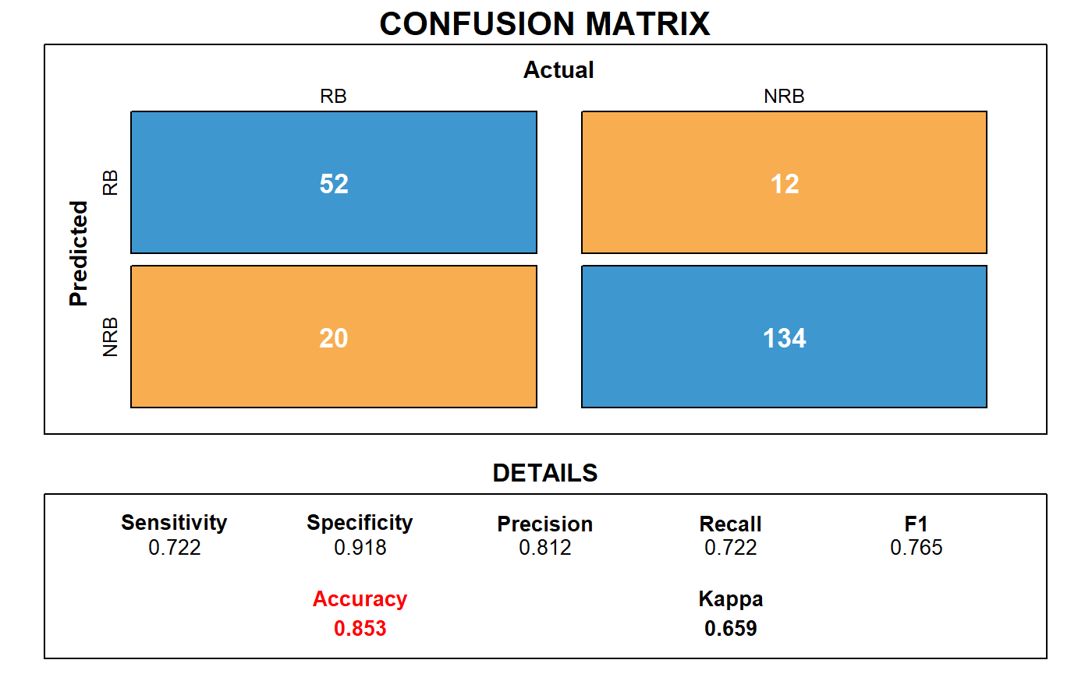
2. Partial Least Squares Discriminant Analysis (PLSDA)
Our reproduce result:
23 descriptors selected
Techniques | ER | Sp | Sn
PLSDA (paper) | 0.15 | 0.87 | 0.83
PLSDA (reproduced) | 0.15 | 0.92 | 0.72
‹#› | QSAR Ready Biodegradability Prediction
Notes:
‹#›

Slide 14
3. support vector machines (SVM)
Our reproduce result:
14 descriptors selected
Techniques | ER | Sp | Sn
SVM (paper) | 0.14 | 0.91 | 0.82
SVM (reproduced) | 0.15 | 0.92 | 0.72
‹#› | QSAR Ready Biodegradability Prediction
Notes:
‹#›

Slide 15

SVM-improved
Our reproduce result:
all descriptors
5-fold cross-validation ==>7-fold
Techniques | ER | Sp | Sn
SVM (paper) | 0.14 | 0.91 | 0.82
SVM (reproduced) | 0.15 | 0.92 | 0.72
SVM (improved) | 0.12 | 0.93 | 0.76
‹#› | QSAR Ready Biodegradability Prediction
Notes:
‹#›

Slide 16
Part 3: Other Techniques Implementation
‹#› | QSAR Ready Biodegradability Prediction
Notes:
‹#›

Slide 17
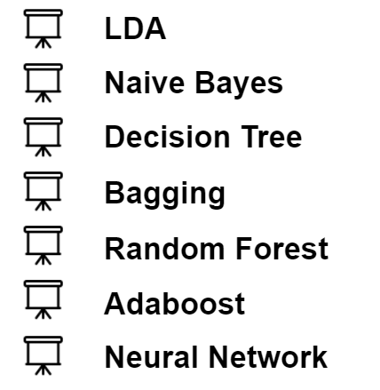
Overview
Methods
‹#› | QSAR Ready Biodegradability Prediction
Notes:
use all the predictors in out implementation
‹#›

Slide 18
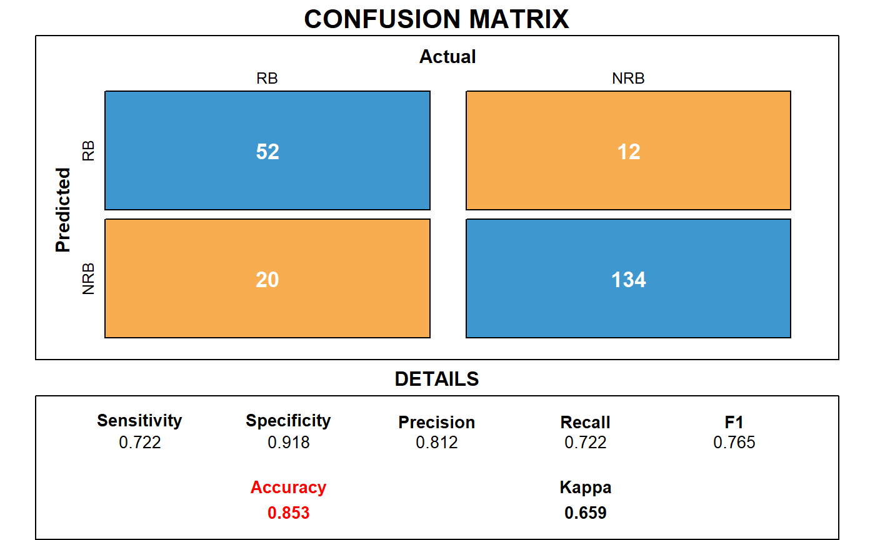
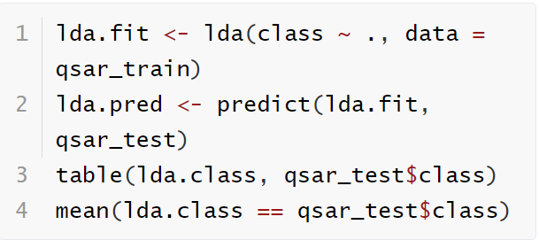
LDA(Linear Discriminant Analysis)
R Code
‹#› | QSAR Ready Biodegradability Prediction
Notes:
‹#›

Slide 19
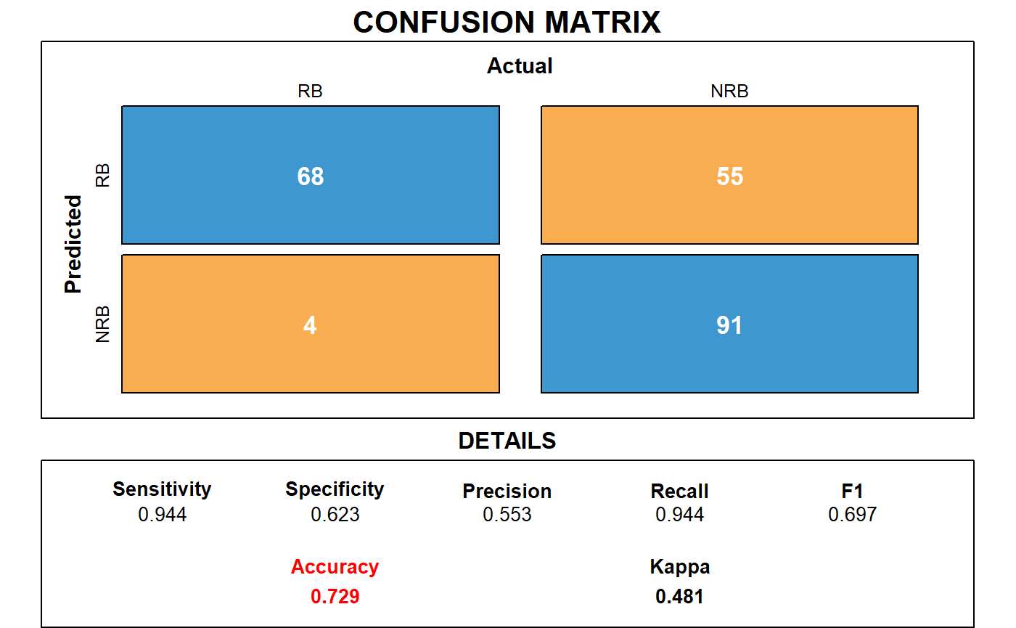
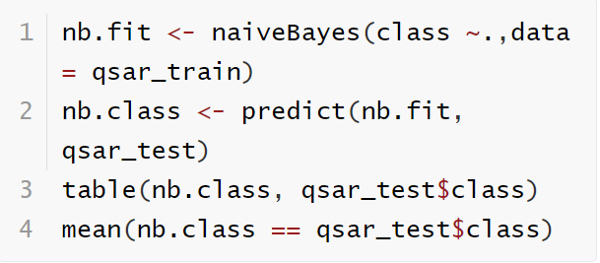
Naive Bayes
R Code
‹#› | QSAR Ready Biodegradability Prediction
Notes:
‹#›

Slide 20
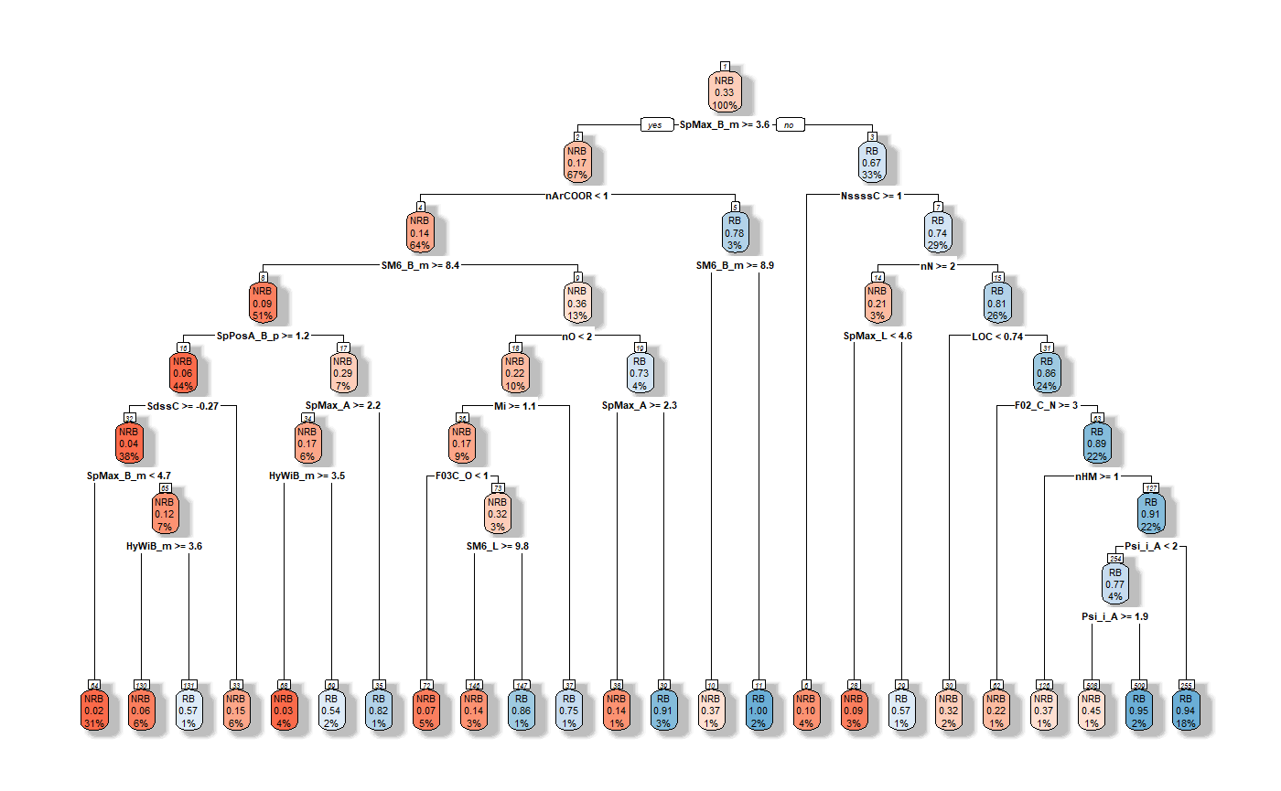
Decision Tree(Without pruning)
‹#› | QSAR Ready Biodegradability Prediction
Notes:
‹#›

Slide 21

Decision Tree(Without pruning)
‹#› | QSAR Ready Biodegradability Prediction
Notes:
‹#›

Slide 22
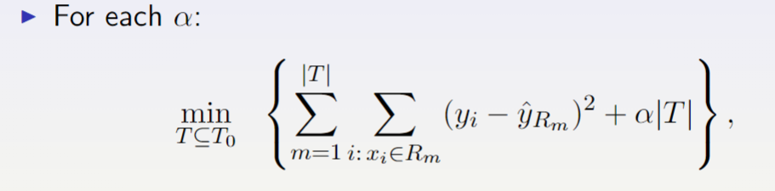
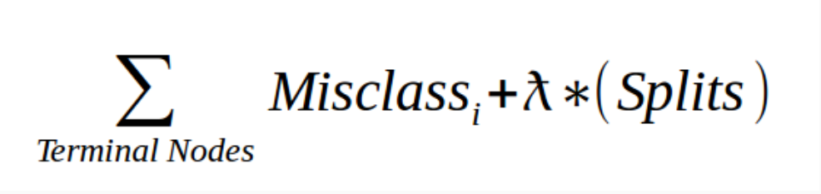
Decision Tree(Pruning)
CP(Complexity Parameter) in rpart
‹#› | QSAR Ready Biodegradability Prediction
Notes:
‹#›

Slide 23
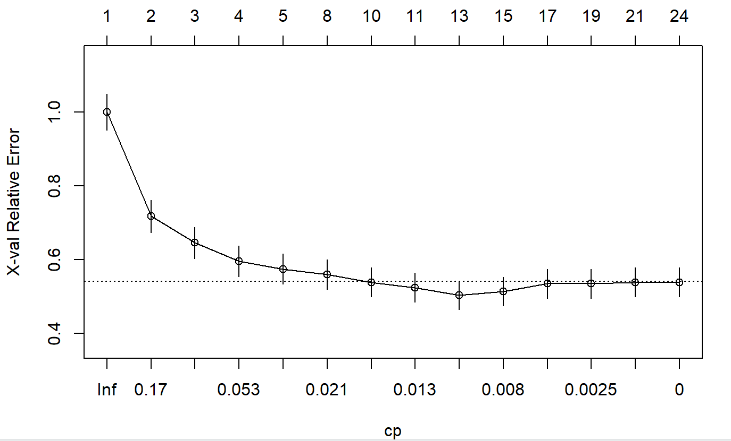
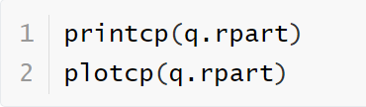
Decision Tree(Pruning)
R Code
‹#› | QSAR Ready Biodegradability Prediction
Notes:
‹#›

Slide 24
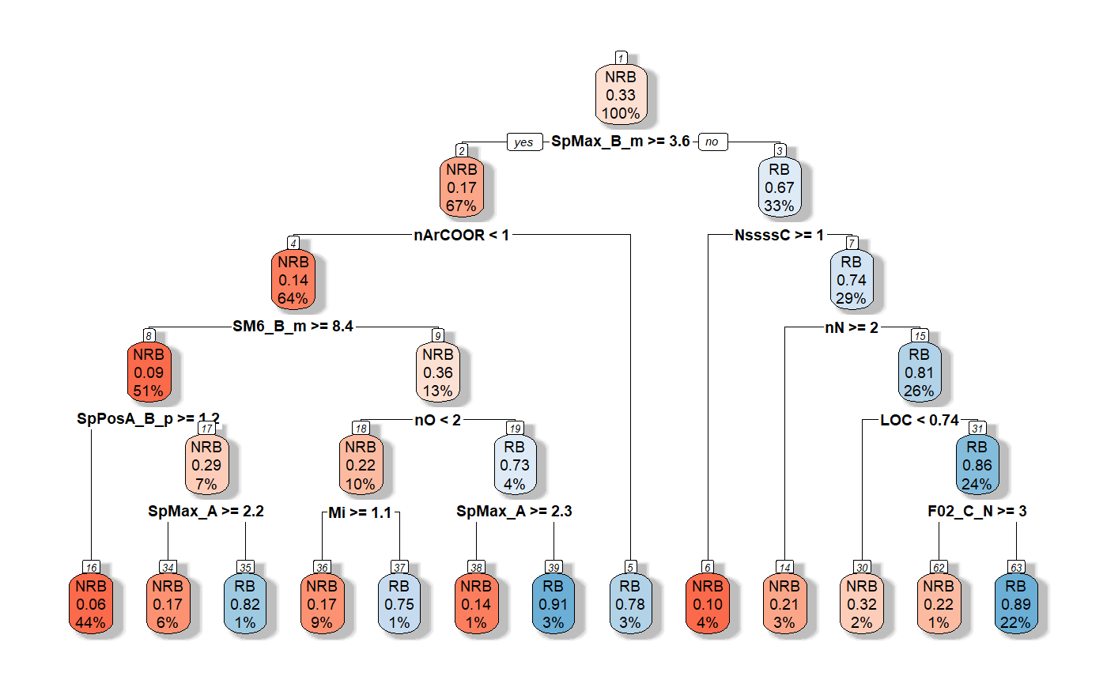
Decision Tree(Pruning)
‹#› | QSAR Ready Biodegradability Prediction
Notes:
‹#›

Slide 25

Decision Tree(Pruning)
‹#› | QSAR Ready Biodegradability Prediction
Notes:
‹#›

Slide 26
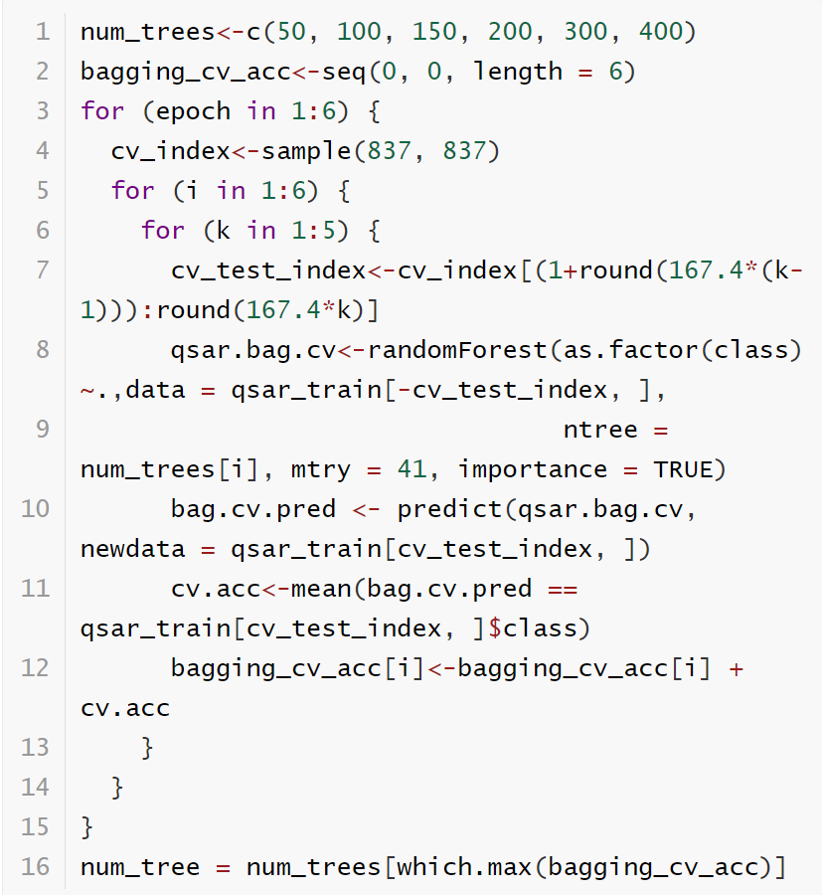
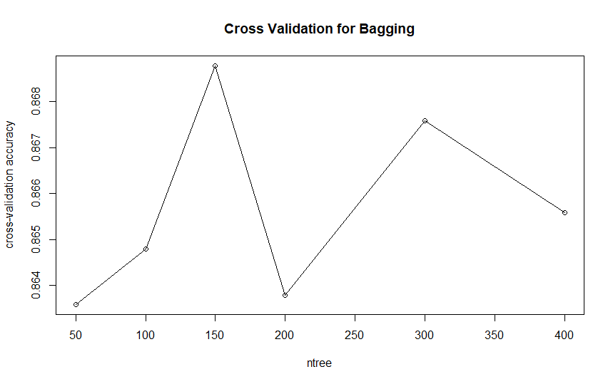
Bagging
Cross Validation
‹#› | QSAR Ready Biodegradability Prediction
Notes:
‹#›

Slide 27

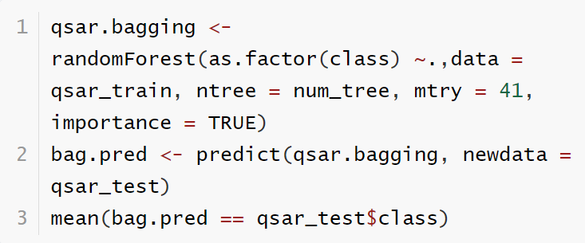
Bagging
R Code
‹#› | QSAR Ready Biodegradability Prediction
Notes:
‹#›

Slide 28
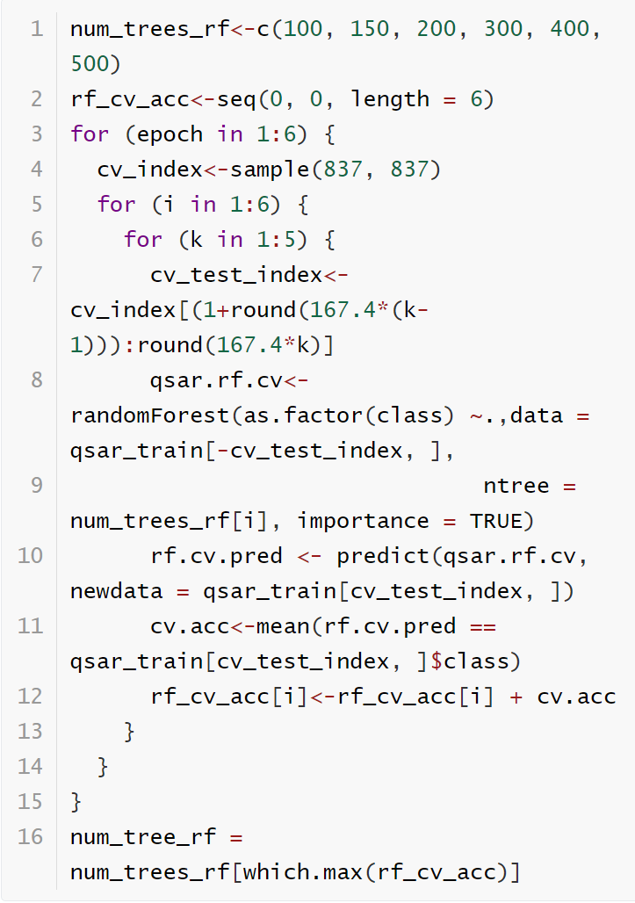
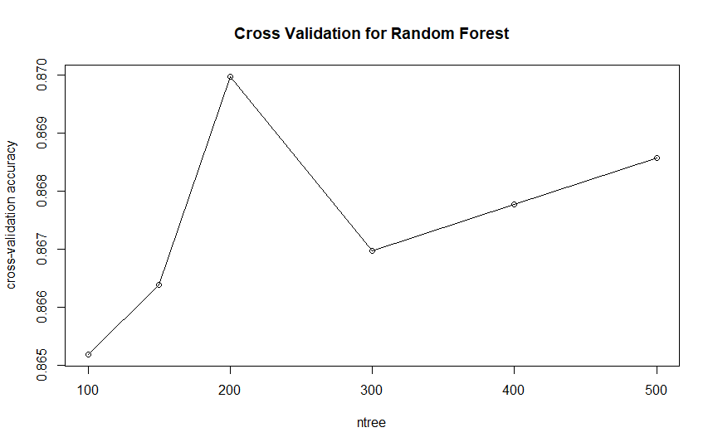
Random Forest
Cross Validation
‹#› | QSAR Ready Biodegradability Prediction
Notes:
‹#›

Slide 29

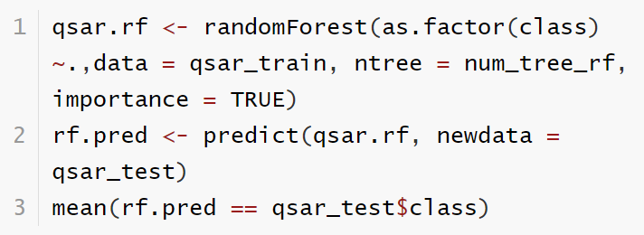
Random Forest
R Code
‹#› | QSAR Ready Biodegradability Prediction
Notes:
‹#›

Slide 30
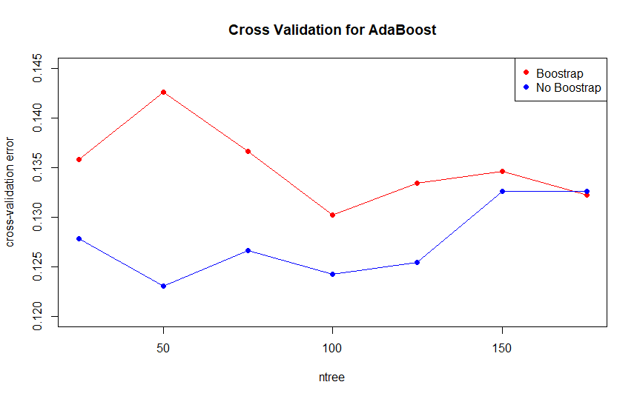
AdaBoost (with Freund coefficient)
‹#› | QSAR Ready Biodegradability Prediction
Notes:
‹#›

Slide 31

AdaBoost (with Freund coefficient)
‹#› | QSAR Ready Biodegradability Prediction
Notes:
‹#›

Slide 32
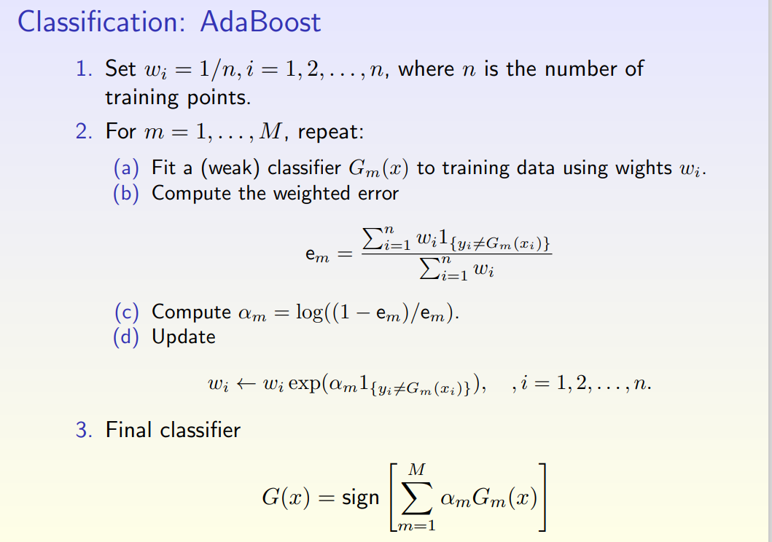

AdaBoost with Breiman coefficient
‹#› | QSAR Ready Biodegradability Prediction
Notes:
‹#›

Slide 33
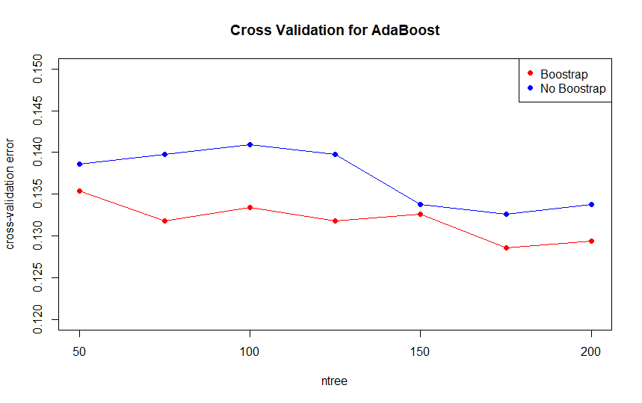
AdaBoost with Breiman coefficient
‹#› | QSAR Ready Biodegradability Prediction
Notes:
‹#›

Slide 34

AdaBoost with Breiman coefficient
‹#› | QSAR Ready Biodegradability Prediction
Notes:
‹#›

Slide 35
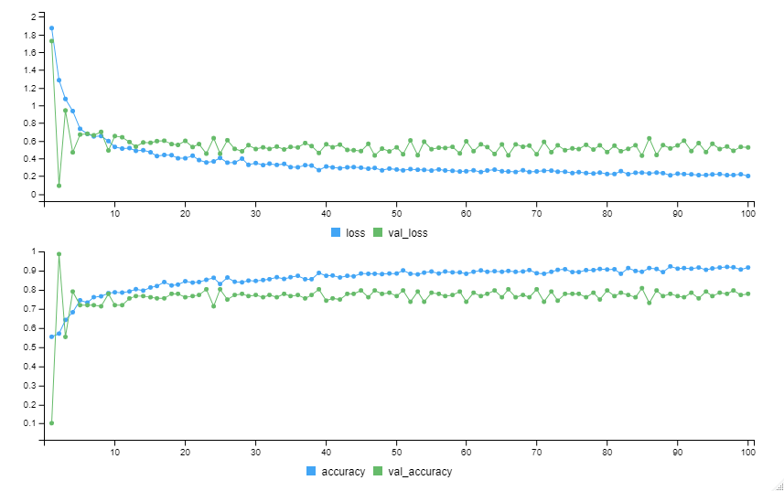
Neural Network (NN): 1 hidden layer
Input Layer
Hidden Layer 1: 400 units
ReLu
Dropout Layer
Output Layer: 2 units
Softmax
‹#› | QSAR Ready Biodegradability Prediction
Notes:
‹#›

Slide 36
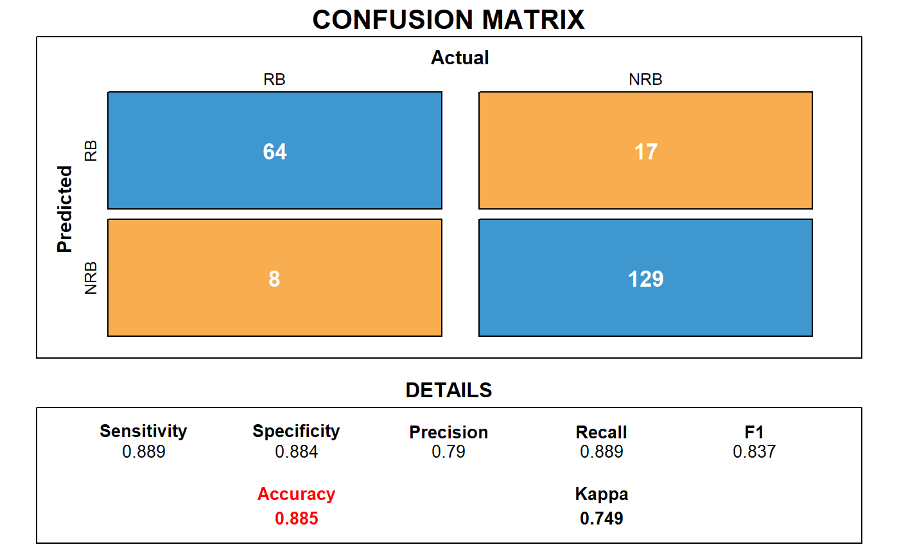
Neural Network (NN): 1 hidden layer
‹#› | QSAR Ready Biodegradability Prediction
Notes:
‹#›

Slide 37
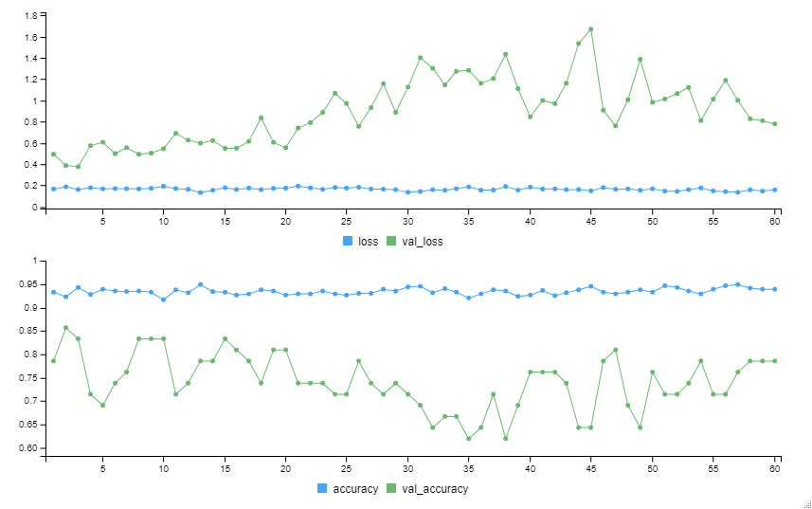
Deep Neural Network (DNN): 2 hidden layers
Input Layer
Hidden Layer 1: 400 units
ReLu
Dropout Layer
Hidden Layer 2: 50 units
ReLu
Dropout Layer
Output Layer: 2 units
Softmax
‹#› | QSAR Ready Biodegradability Prediction
Notes:
‹#›

Slide 38

Deep Neural Network (DNN): 2 hidden layers
‹#› | QSAR Ready Biodegradability Prediction
Notes:
‹#›

Slide 39
Part 4: Conclusion
‹#› | QSAR Ready Biodegradability Prediction
Notes:
‹#›

Slide 40
Individual Model Summary
D.S. = descriptors selection
Techniques | Accuracy | Specificity | Sensitivity
SVM+D.S. | 85.3% | 91.8% | 72.2%
KNN+D.S. | 87.6% | 89.7% | 83.3%
PLSDA+D.S. | 85.3% | 91.8% | 72.2%
LDA | 85.3% | 91.8% | 72.2%
Naive Bayes | 72.9% | 62.3% | 94.4%
Tree | 78.4% | 75% | 80.3%
Pruning Tree | 81.7% | 75% | 85.2%
SVM | 87.6% | 93.2% | 76.4%
Techniques | Accuracy | Specificity | Sensitivity
Bagging | 87.6% | 93.8% | 75.0%
Random Forest | 88.1% | 95.2% | 73.6%
Adaboost (with Breiman coef.) | 87.2% | 92.5% | 76.4%
Adaboost (with Freud coef.) | 85.8% | 91.1% | 75.0%
Neural Network (NN) | 88.5% | 88.4% | 88.9%
DNN | 87.6% | 92.5% | 77.8%
‹#› | QSAR Ready Biodegradability Prediction
Notes:
‹#›

Slide 41
Individual Model Summary
‹#› | QSAR Ready Biodegradability Prediction
Notes:
‹#›

Slide 42
Consensus Model
Consensus Model | Accuracy | Specificity | Sensitivity
C1: (SVM+D.S.) + (KNN+D.S.) + (PLSDA+D.S.) | 87.61% | 93.15% | 76.39%
C2: NN + SVM + (KNN+D.S.) | 88.99% | 92.47% | 81.94%
C3: NN + DNN + (KNN+D.S.) | 89.91% | 92.47% | 84.72%
C4: NN + Adaboost (with Breiman coef.) + (KNN+D.S.) | 90.37% | 93.15% | 84.72%
C5: NN + Random Forest + (KNN+D.S.) | 89.91% | 93.15% | 83.33%
C6: NN + Bagging + (KNN+D.S.) | 88.99% | 91.78% | 83.33%
C7: NN + Adaboost (with Freund coef.) + (KNN+D.S.) | 90.37% | 93.84% | 83.33%
C8: NN * 2 + Adaboost (with Freud coef.) + Adaboost (with Breiman coef.) + (KNN+D.S.) | 90.83% | 93.84% | 84.72%
‹#› | QSAR Ready Biodegradability Prediction
Notes:
‹#›

Slide 43

Thanks For Listening
Lei Lyu (ll3433)
Yang Yu (yy3102)
Wenxiang Zhou (wz2542)
Yi Chen (yc4029)
TRANSCENDING DISCIPLINES, TRANSFORMING LIVES

