Slide 1


QSAR Ready Biodegradability Prediction
EECS E6690 Project Presentation
Lei Lyu (ll3433)
Yang Yu (yy3102)
Wenxiang Zhou (wz2542)
Yi Chen (yc4029)
TRANSCENDING DISCIPLINES, TRANSFORMING LIVES
Notes:
‹#›

Slide 2

Part 1: Dataset description
QSAR biodegradation Data Set
‹#› | QSAR Ready Biodegradability Prediction
Notes:
‹#›

Slide 3

Dataset Description
Various kinds of chemicals are left in the environment by industry
Many of the chemicals are not biodegradable
Information about biodegradability of chemicals are not yet abundant
‹#› | QSAR Ready Biodegradability Prediction
Notes:
‹#›

Slide 4
Dataset Description
QSAR (Quantitative Structure-Activity Relationships) is used to predict the biodegradability of chemicals
QSAR biodegradation data set was built to develop QSAR models for studying the relationship between chemical structure and biodegradability of molecules
Experimental values collected from webpage of the National Institute of Technology and Evaluation of Japan (NITE)
‹#› | QSAR Ready Biodegradability Prediction
Notes:
‹#›

Slide 5
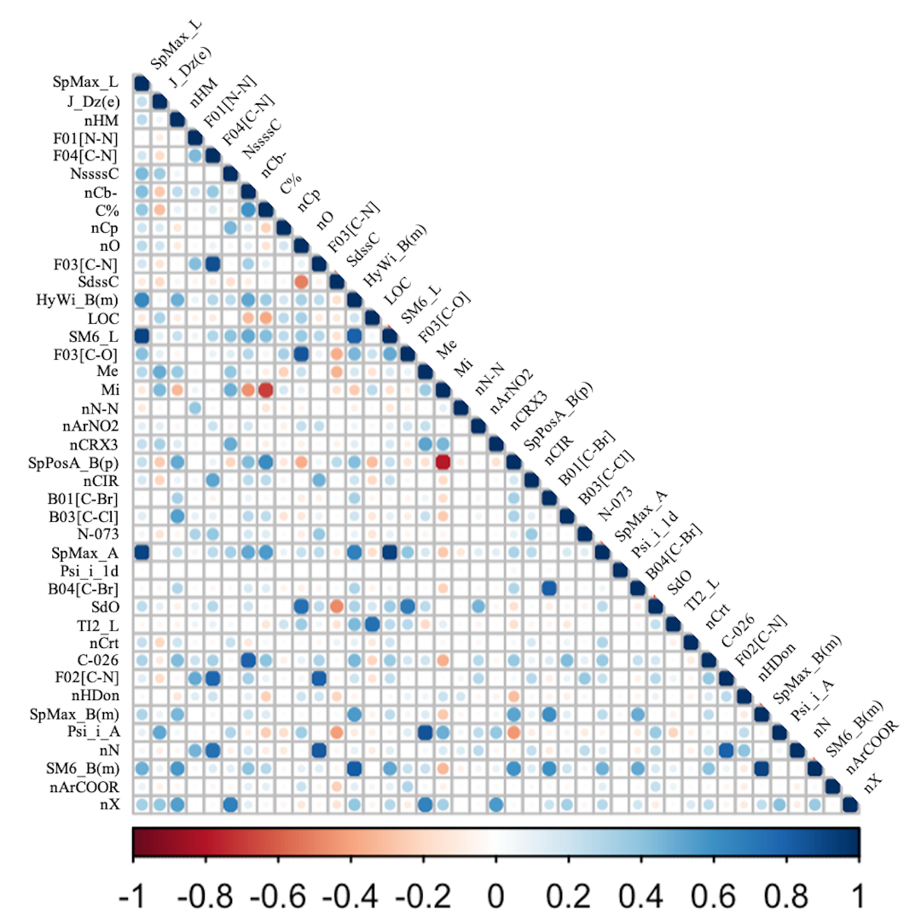
Dataset Description
Number of Instances: 1055
where 356 molecules are ready biodegradable (RB) and 699 are not ready biodegradable (NRB)
Number of Attributes: 41
selected using many classification modeling methods combined with genetic algorithms
Correlations between descriptors:
Heatmap of variable correlations
‹#› | QSAR Ready Biodegradability Prediction
Notes:
linear, non-linear, local models and consensus models
to select the optimal subsets of molecular descriptors
‹#›

Slide 6
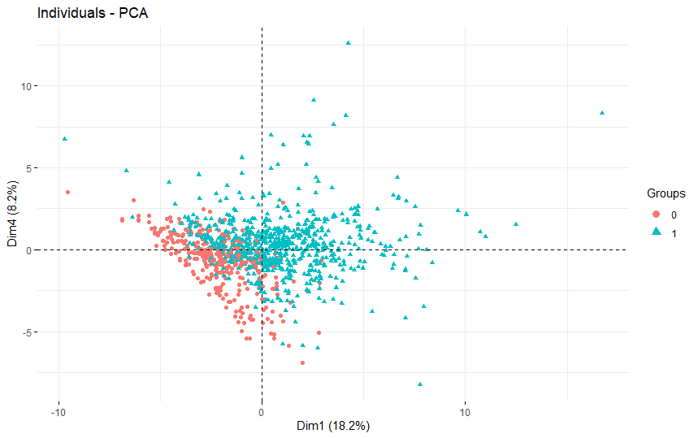
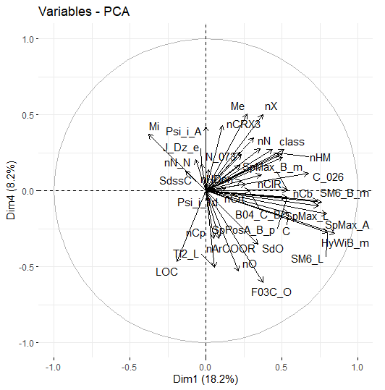
All Descriptors PCA
Score Plot
Loading Plot
‹#› | QSAR Ready Biodegradability Prediction
Notes:
‹#›

Slide 7
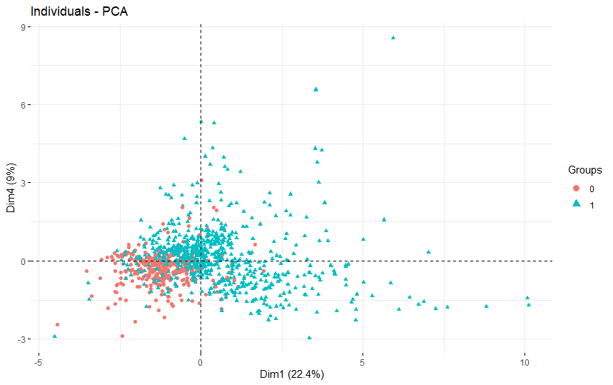
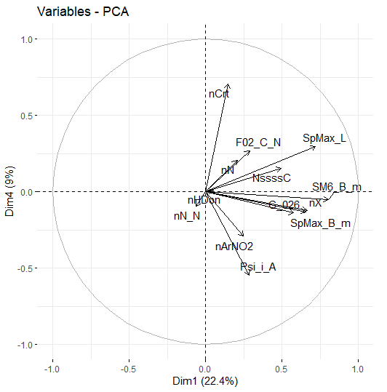
Paper’s SVM Descriptors PCA
Score Plot
Loading Plot
‹#› | QSAR Ready Biodegradability Prediction
Notes:
‹#›

Slide 8
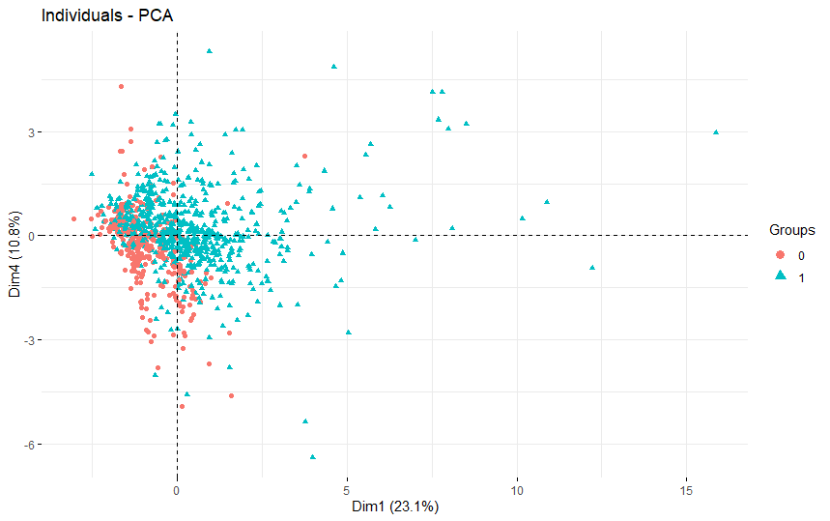
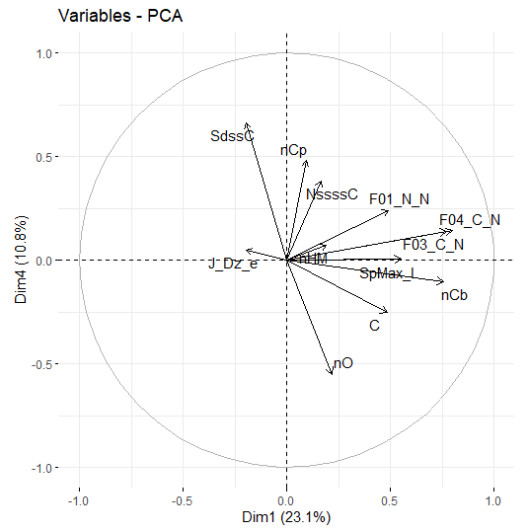
Paper’s KNN Descriptors PCA
Score Plot
Loading Plot
‹#› | QSAR Ready Biodegradability Prediction
Notes:
‹#›

Slide 9
Part 2: Paper detail and reproduce
KNN, PLSDA, SVM
‹#› | QSAR Ready Biodegradability Prediction
Notes:
Ok, let me introduce the paper detail and our reproduce to you.
‹#›

Slide 10
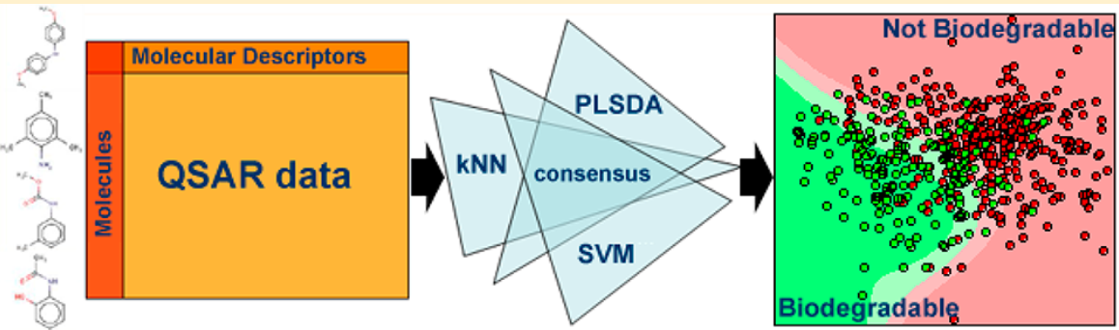
Quick View
Data set dividing:
41 Attributes, 1055 instances
training set: 837 test set: 218
5-fold cross-validation
2 Class:
RB: ready biodegradable
NRB: not ready biodegradable
‹#› | QSAR Ready Biodegradability Prediction
Notes:
The original paper used k nearest neighbors, partial least squares discriminant analysis, and support vector machines, as well as their consensus models.
The dataset has 41 attributes and 1055 instances, the paper divided it into training set with 837 instances and test set with 218 instances. It used 5-fold cross-validation.
‹#›

Slide 11

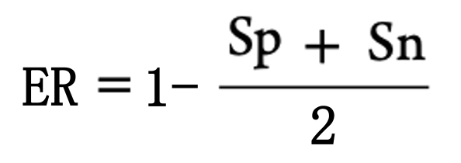
Model Validation
Specificity:
the ability to correctly predict RB molecules
TN: # true negatives
FP: # false positives
Sensitivity:
the ability to correctly predict NRB molecules
TP: # true positives
FN: # false negatives
ER:
the classification error rate
‹#› | QSAR Ready Biodegradability Prediction
Notes:
Classification models were evaluated on the basis of specificity and sensitivity, which are the ability to correctly predict RB and NRB molecules, respectively. In particular, Sp and Sn were calculated with the following equations:
where, TN and TP are the number of true negatives and true positives, and FN and FP are the number of false negatives and false positives, respectively. Being a two-class model, consider that the sensitivity of one class corresponds to the specificity of the other class. In addition, the classification error rate (ER) was calculated.
(These indices were used in order to better estimate classification performances in presence of a data set with unequal number of molecules in each class. )
‹#›

Slide 12
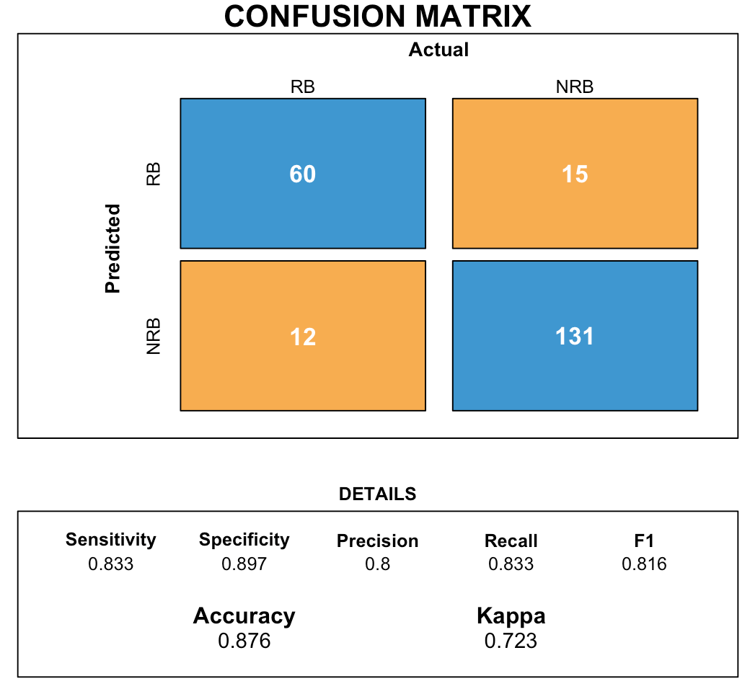
1. k nearest neighbors (KNN)
Our reproduce result:
12 descriptors selected
Euclidean distance
Techniques | ER | Sp | Sn
KNN (paper) | 0.15 | 0.90 | 0.81
KNN (reproduce) | 0.12 | 0.90 | 0.83
‹#› | QSAR Ready Biodegradability Prediction
Notes:
In KNN, a molecule is classified according to the majority of its k nearest neighbors in the descriptors space. This work use Euclidean distance. The k value giving the lowest classification error in cross-validation was selected as the optimal one.
This is our reproduce work result compared with the original paper work. Our reproduce work has lower ER.
‹#›

Slide 13
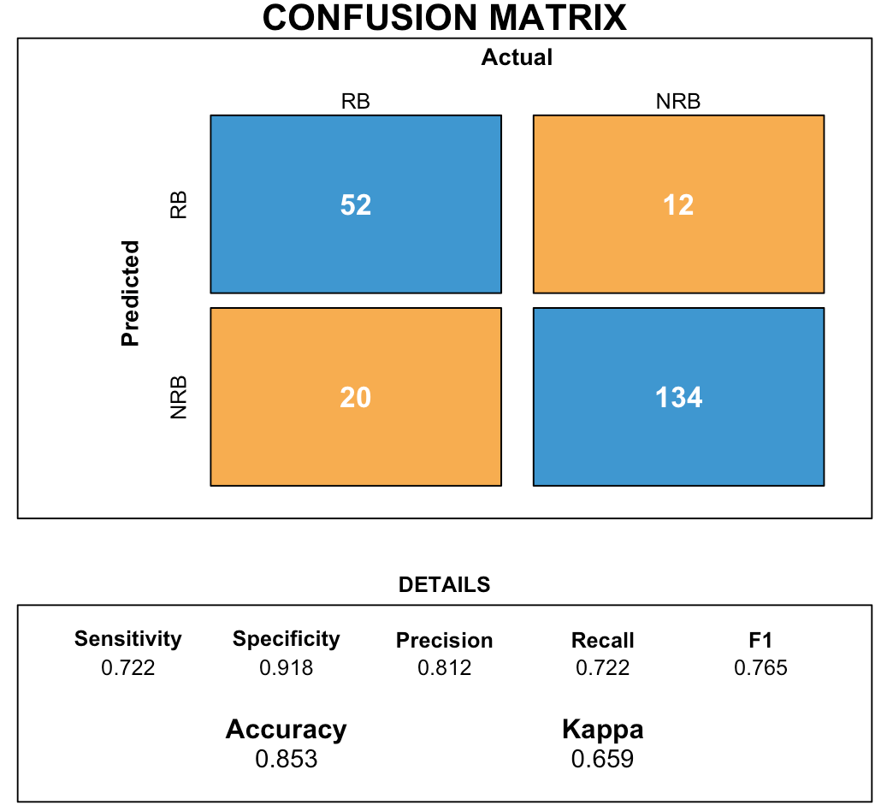
2. partial least squares discriminant analysis (PLSDA)
Our reproduce result:
23 descriptors selected
Techniques | ER | Sp | Sn
PLSDA (paper) | 0.15 | 0.87 | 0.83
PLSDA (reproduce) | 0.15 | 0.92 | 0.72
‹#› | QSAR Ready Biodegradability Prediction
Notes:
PLSDA is a classification technique that profits the properties of partial least squares regression with the discrimination power of a classification technique. It finds fundamental relations between the matrix of descriptors and the class vector by calculating latent variables (LVs).
From the result, we can see that our reproduce work has the same ER with higher Sp.
‹#›

Slide 14
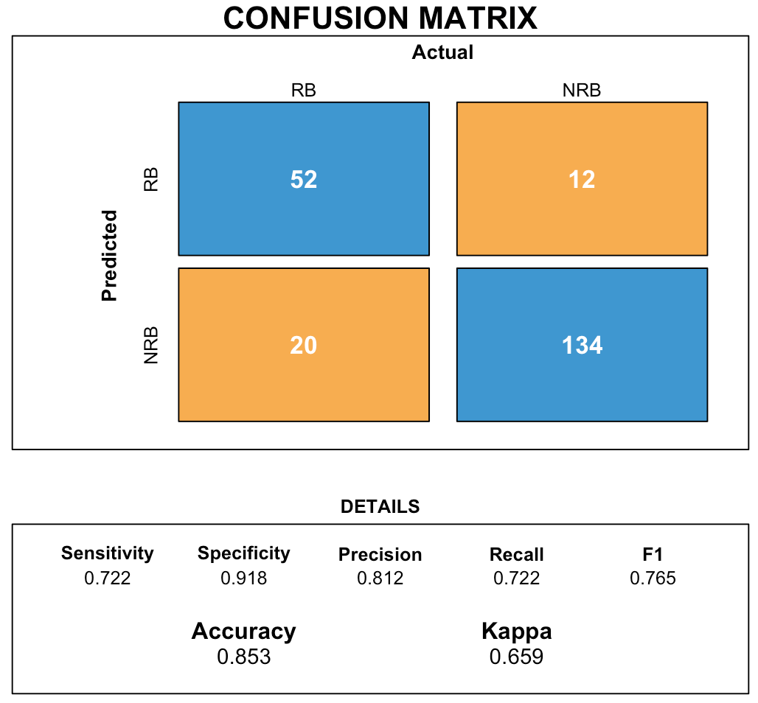
3. support vector machines (SVM)
Our reproduce result:
14 descriptors selected
Techniques | ER | Sp | Sn
SVM (paper) | 0.14 | 0.91 | 0.82
SVM (reproduce) | 0.15 | 0.92 | 0.72
‹#› | QSAR Ready Biodegradability Prediction
Notes:
SVM define a decision boundary that optimally separates two classes by maximizing the distance between them.
From the result, we can see that our reproduce work seems no so good.
‹#›

Slide 15

SVM-improved
Our reproduce result:
14 descriptors selected
5-fold cross-validation ==>7-fold
Techniques | ER | Sp | Sn
SVM (paper) | 0.14 | 0.91 | 0.82
SVM (reproduce) | 0.15 | 0.92 | 0.72
SVM (reproduce-improved) | 0.12 | 0.93 | 0.76
‹#› | QSAR Ready Biodegradability Prediction
Notes:
So we improved the SVM by change 5-fold cross-validation to 7-fold. and it has great result.
‹#›

Slide 16
Part 3: Other Techniques Implementation
‹#› | QSAR Ready Biodegradability Prediction
Notes:
‹#›

Slide 17
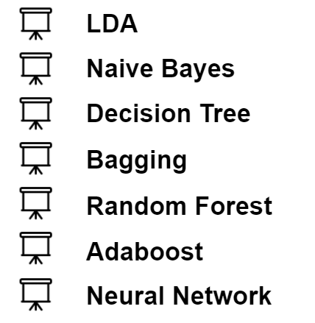
Overview
Methods
‹#› | QSAR Ready Biodegradability Prediction
Notes:
use all the predictors in out implementation
‹#›

Slide 18

LDA(Linear Discriminant Analysis)
lda.fit <- lda(class ~ ., data = qsar_train)
lda.pred <- predict(lda.fit, qsar_test)
table(lda.class, qsar_test$class)
mean(lda.class == qsar_test$class)
‹#› | QSAR Ready Biodegradability Prediction
Notes:
‹#›

Slide 19
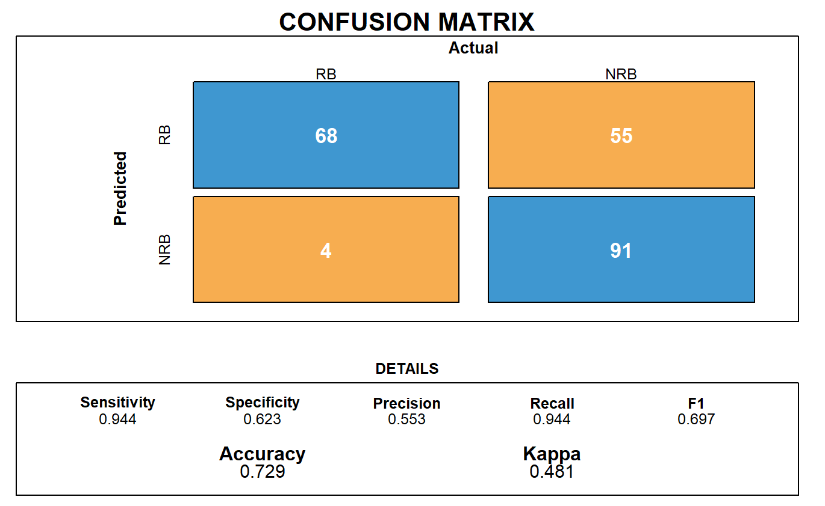
Naive Bayes
nb.fit <- naiveBayes(class ~.,data = qsar_train)
nb.class <- predict(nb.fit, qsar_test)
table(nb.class, qsar_test$class)
mean(nb.class == qsar_test$class)
‹#› | QSAR Ready Biodegradability Prediction
Notes:
‹#›

Slide 20
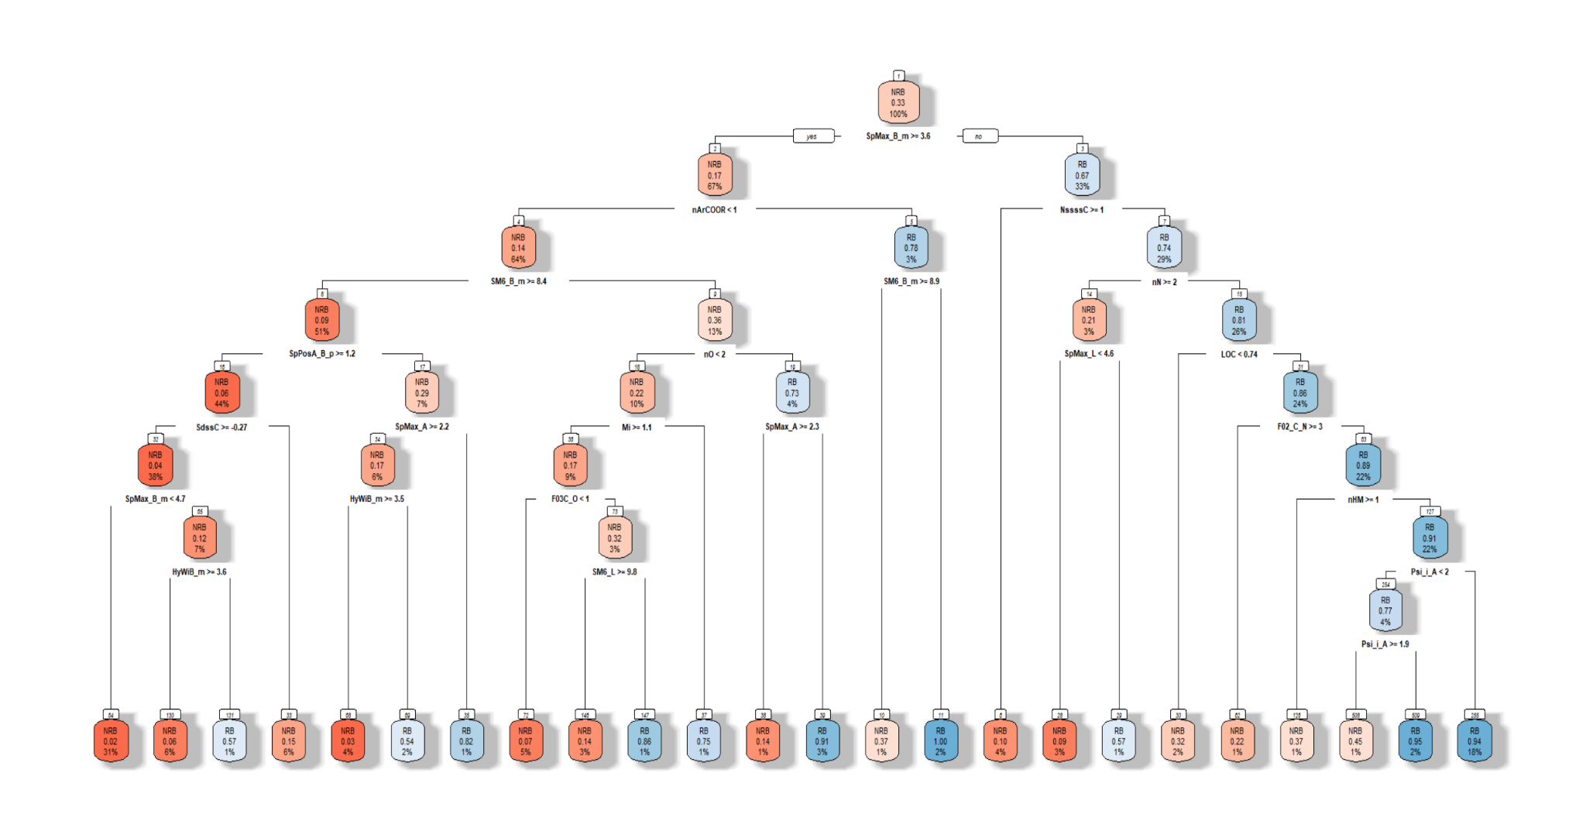

Decision Tree(Without pruning)
q.rpart <- rpart(class~., data=q_train, method = 'class', cp=0)
‹#› | QSAR Ready Biodegradability Prediction
Notes:
‹#›

Slide 21
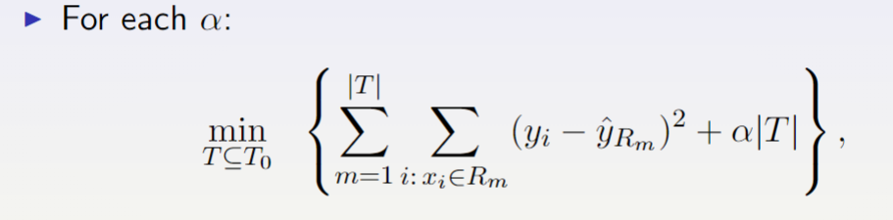
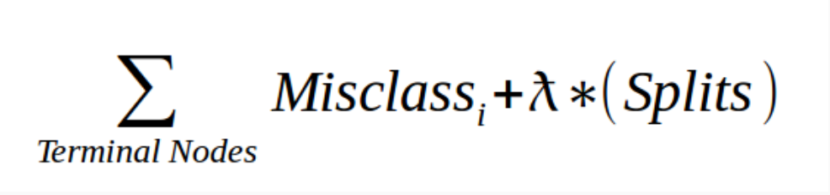
Decision Tree(Pruning)
CP(Complexity Parameter) in rpart
‹#› | QSAR Ready Biodegradability Prediction
Notes:
‹#›

Slide 22
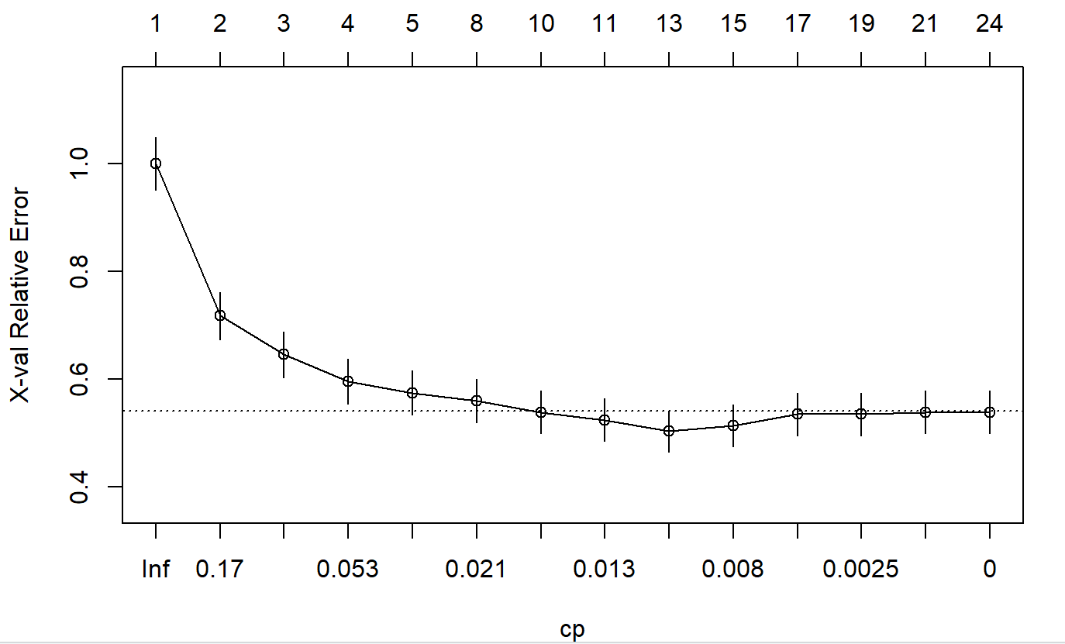
Decision Tree(Pruning)
printcp(q.rpart)
plotcp(q.rpart)
‹#› | QSAR Ready Biodegradability Prediction
Notes:
‹#›

Slide 23
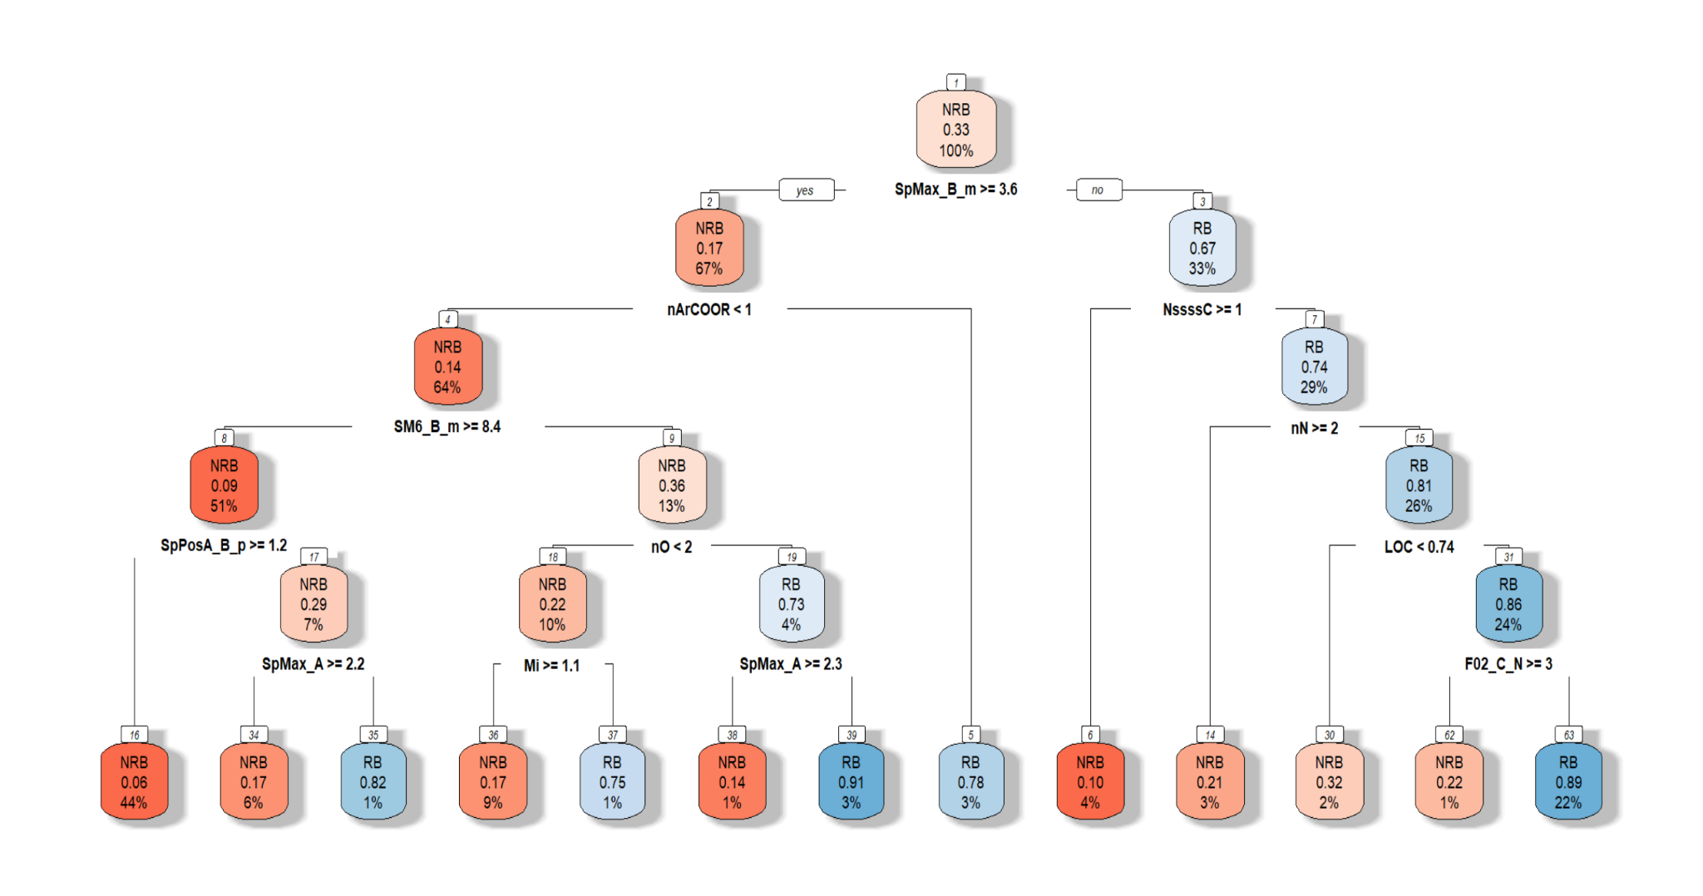

Decision Tree(Pruning)
q.prune <- rpart(class~., data=q_train, method = 'class', cp=0.0089286)
‹#› | QSAR Ready Biodegradability Prediction
Notes:
‹#›

Slide 24
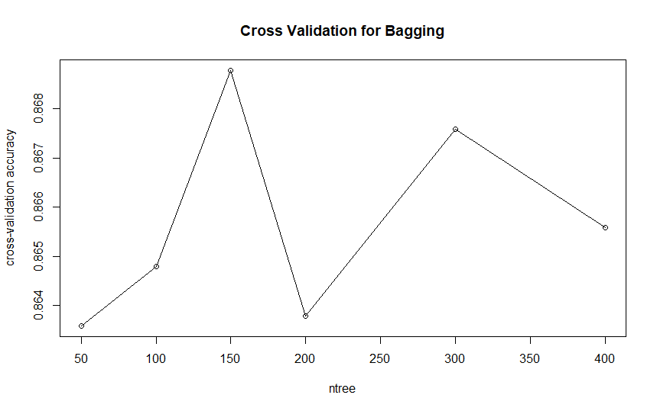
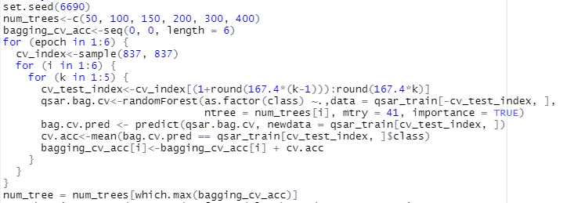
Bagging
Parameter choose: How many trees to build?
We use Cross Validation
‹#› | QSAR Ready Biodegradability Prediction
Notes:
‹#›

Slide 25
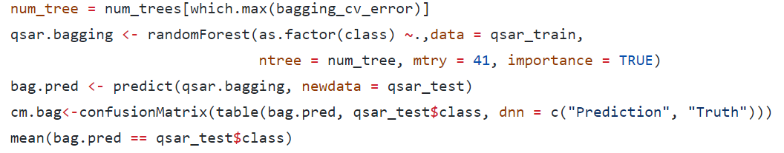

Bagging
‹#› | QSAR Ready Biodegradability Prediction
Notes:
‹#›

Slide 26
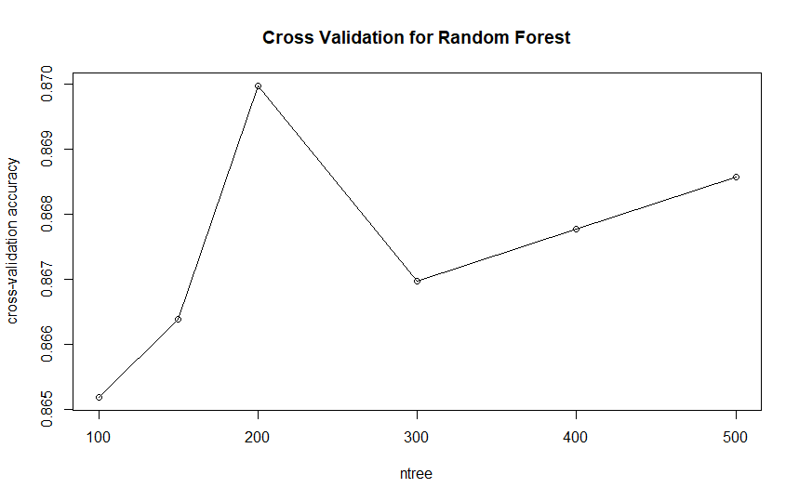
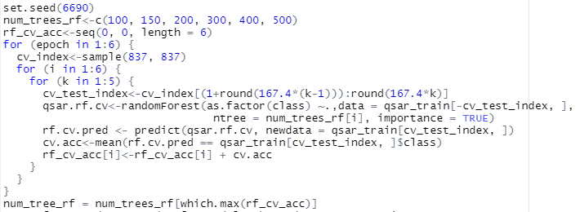
Random Forest
Cross Validation
‹#› | QSAR Ready Biodegradability Prediction
Notes:
‹#›

Slide 27

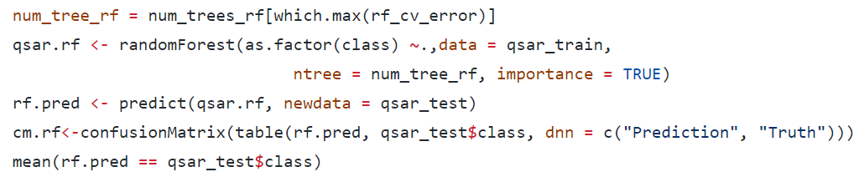
Random Forest
‹#› | QSAR Ready Biodegradability Prediction
Notes:
‹#›

Slide 28
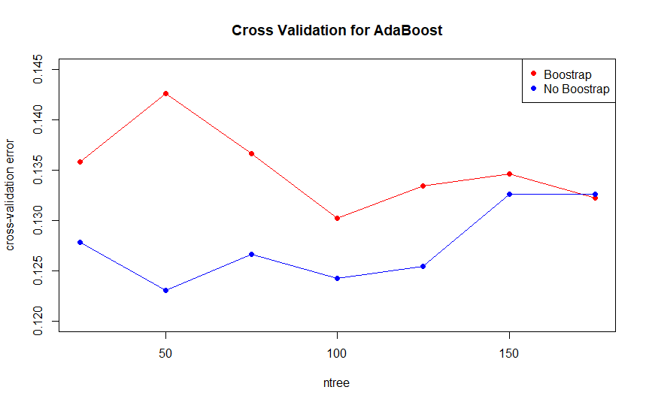
AdaBoost (with Freund coefficient)
‹#› | QSAR Ready Biodegradability Prediction
Notes:
‹#›

Slide 29
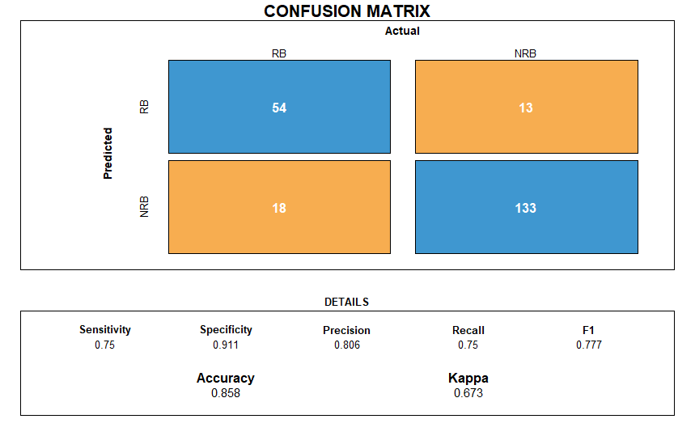
AdaBoost (with Freund coefficient)
‹#› | QSAR Ready Biodegradability Prediction
Notes:
‹#›

Slide 30
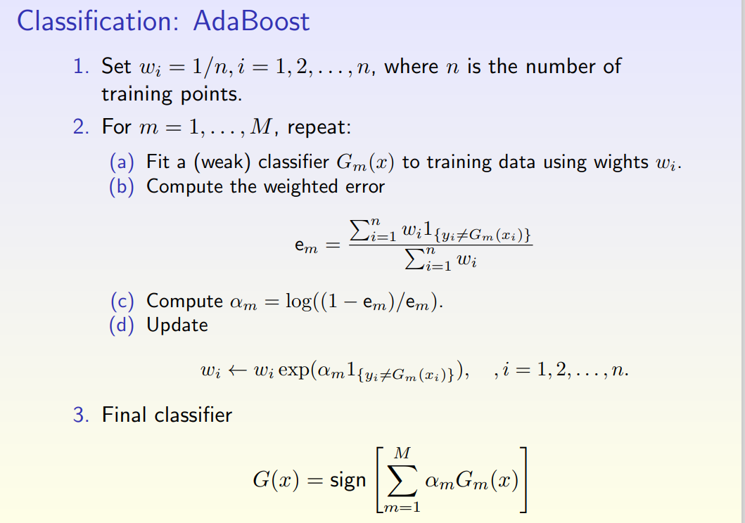

AdaBoost with Breiman coefficient
‹#› | QSAR Ready Biodegradability Prediction
Notes:
‹#›

Slide 31
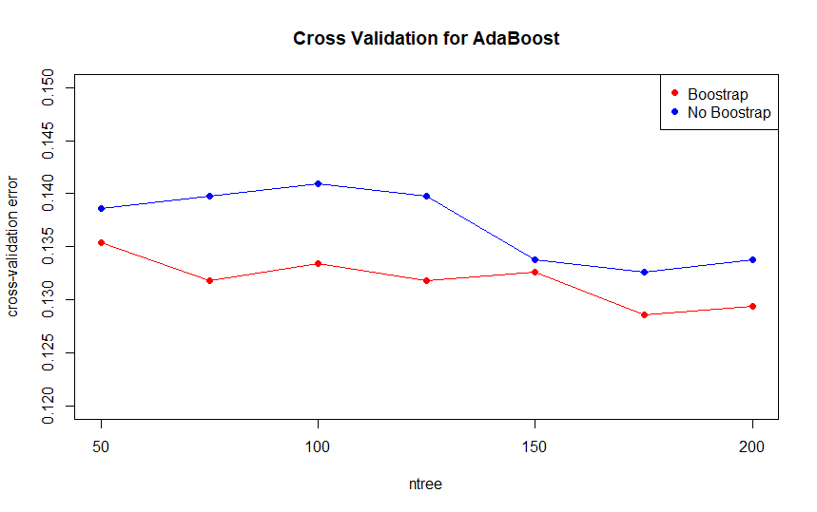
AdaBoost with Breiman coefficient
‹#› | QSAR Ready Biodegradability Prediction
Notes:
‹#›

Slide 32

AdaBoost with Breiman coefficient
‹#› | QSAR Ready Biodegradability Prediction
Notes:
‹#›

Slide 33
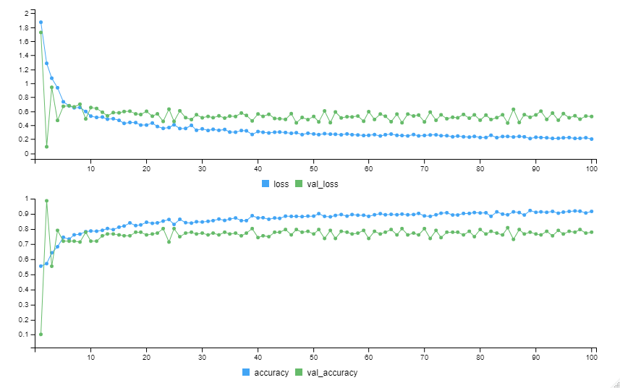
Neural Network (NN): 1 hidden layer
Input Layer
Hidden Layer 1: 400 units
ReLu
Dropout Layer
Output Layer: 2 units
Softmax
‹#› | QSAR Ready Biodegradability Prediction
Notes:
‹#›

Slide 34

Neural Network (NN): 1 hidden layer
‹#› | QSAR Ready Biodegradability Prediction
Notes:
‹#›

Slide 35
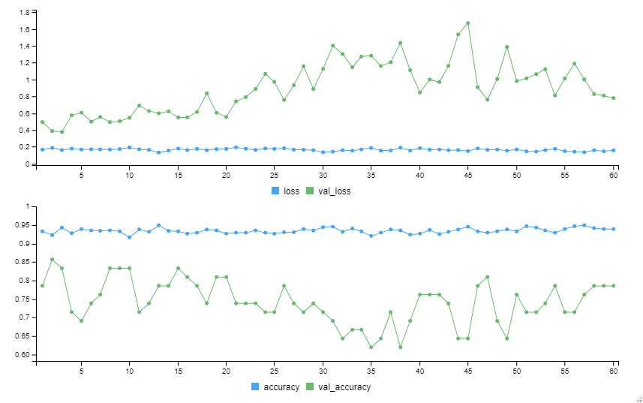
Deep Neural Network (DNN): 2 hidden layers
Input Layer
Hidden Layer 1: 400 units
ReLu
Dropout Layer
Hidden Layer 2: 50 units
ReLu
Dropout Layer
Output Layer: 2 units
Softmax
‹#› | QSAR Ready Biodegradability Prediction
Notes:
‹#›

Slide 36

Deep Neural Network (DNN): 2 hidden layers
‹#› | QSAR Ready Biodegradability Prediction
Notes:
‹#›

Slide 37
Part 4: Conclusion
‹#› | QSAR Ready Biodegradability Prediction
Notes:
‹#›

Slide 38
Individual Model Summary
D.S. = descriptors selection
Techniques | Accuracy | Specificity | Sensitivity
SVM+D.S. | 85.3% | 91.8% | 72.2%
KNN+D.S. | 87.6% | 89.7% | 83.3%
PLSDA+D.S. | 85.3% | 91.8% | 72.2%
LDA | 85.3% | 91.8% | 72.2%
Naive Bayes | 72.9% | 62.3% | 94.4%
Tree | 78.4% | 75% | 80.3%
Pruning Tree | 81.7% | 75% | 85.2%
SVM | 87.6% | 93.2% | 76.4%
Techniques | Accuracy | Specificity | Sensitivity
Bagging | 87.6% | 93.8% | 75.0%
Random Forest | 88.1% | 95.2% | 73.6%
Adaboost (with Breiman coef.) | 87.2% | 92.5% | 76.4%
Adaboost (with Freud coef.) | 85.8% | 91.1% | 75.0%
Neural Network (NN) | 88.5% | 88.4% | 88.9%
DNN | 87.6% | 92.5% | 77.8%
‹#› | QSAR Ready Biodegradability Prediction
Notes:
‹#›

Slide 39
Consensus Model
Consensus Model | Accuracy | Specificity | Sensitivity
C1: (SVM+D.S.) + (KNN+D.S.) + (PLSDA+D.S.) | 87.61% | 93.15% | 76.39%
C2: NN + SVM + (KNN+D.S.) | 88.99% | 92.47% | 81.94%
C3: NN + DNN + (KNN+D.S.) | 89.91% | 92.47% | 84.72%
C4: NN + Adaboost (with Breiman coef.) + (KNN+D.S.) | 90.37% | 93.15% | 84.72%
C5: NN + Random Forest + (KNN+D.S.) | 89.91% | 93.15% | 83.33%
C6: NN + Bagging + (KNN+D.S.) | 88.99% | 91.78% | 83.33%
C7: NN + Adaboost (with Freund coef.) + (KNN+D.S.) | 90.37% | 93.84% | 83.33%
C8: NN * 2 + Adaboost (with Freud coef.) + Adaboost (with Breiman coef.) + (KNN+D.S.) | 90.83% | 93.84% | 84.72%
‹#› | QSAR Ready Biodegradability Prediction
Notes:
‹#›

Slide 40

Thanks For Listening
Lei Lyu (ll3433)
Yang Yu (yy3102)
Wenxiang Zhou (wz2542)
Yi Chen (yc4029)
TRANSCENDING DISCIPLINES, TRANSFORMING LIVES

