Slide 1
Data Mining HW2
Q56074051
醫資碩一
机一帆

Slide 2
Goal
Understand what classification systems do
Understand the difference between real behavior of classification model and observed data
Construct a classification model
Observe the difference between real ‘right’ data and modeled data

Slide 3
Problem
According these feature, ‘light’, ‘Space’ , ‘Rent’, and ‘Electricity’, rank the rental room
Feature name | Light | Space | Rent | Electricity | Rank (Answer)
Value type | Rank | Value | Value | Rank | Rank
Value range | 1-3 | 10-25 | 2000-10000 | 3-5 | 1-3

Slide 4
Data
Generate the data in this form
Data | Light | Space | Rent | Electricity | Rank
499筆 | Random.randrange(1,3,1) | Random.randrange(10,25,1) | Random.randrange(2000,10000,1) | Random.randrange(3,5,1)
 | 1-3隨機挑選一個數 | 10-20隨機挑選一個數 | 2000-10000隨機挑選一個數 | 3-5隨機挑選一個數

Slide 5
Data
Rank | Rule
1 | Light>=2 AND Space >15 AND Rent <5500 AND Electricity ==3
3 | Light ==3 OR Space <10 OR Rent >8000 OR Electricity ==5
2 | else
According this rule rank the data, that will be the answer
Transfer into DataFrame

Slide 6
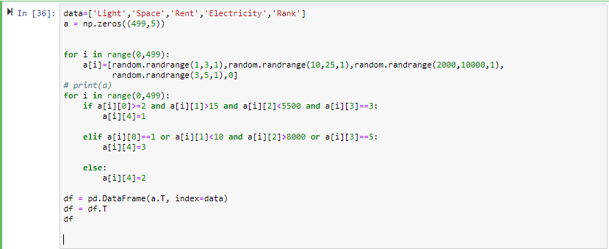
Data
Code

Slide 7
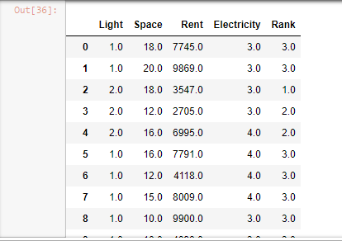
Data
result

Slide 8

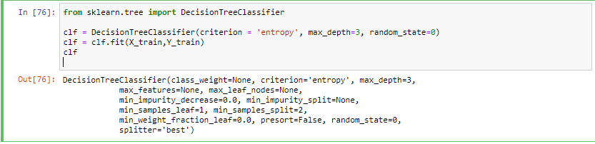
Decision Tree
Spare data into training data and testing data
Use entropy, generate the decision tree

Slide 9
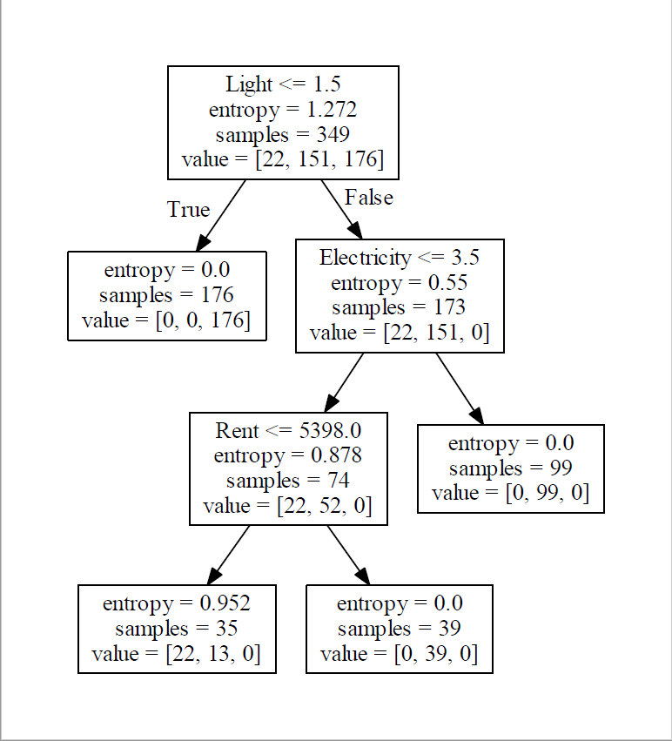
Decision Tree
Tree plot
Result
Accuracy

Slide 10
END

