Slide 1
Data Mining Project3
Q56074051 醫資所 机一帆

Slide 2
HITS
V
Adj
ethon
HITS
HITSAns
V=unique(graph)
Adj: adjacency matrix
Ethon: stop condition
 | Authority | Hob
Each node |  | V*2

Slide 3
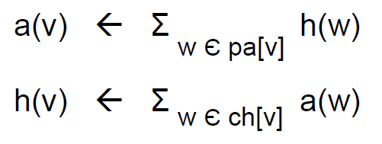
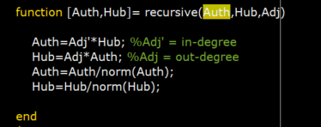
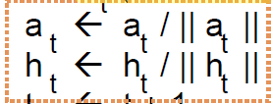
HITS

Slide 4
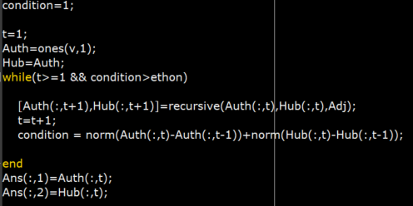
HITS
norm
 | Auth(:,t) | Auth(:,t+1)
Each node |  | V*t
norm
< ethon
 | Hub(:,t) | Hub(:,t+1)
Each node |  | V*t

Slide 5

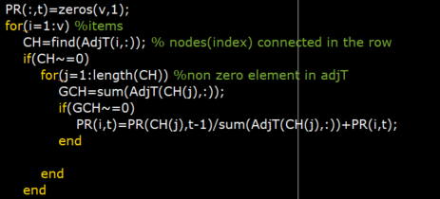


PageRank
Step1
Step2
Step3
$${PR}_{t+1}(Pa(i))=\sum_{j}{\frac{{PR}_{t}(Ch(j))}{GrandCh. nums}}$$
Stop condition
 | t | t+1
1 | 1/3
2 | 1/3
3 | 1/3
v | 1/v

Slide 6
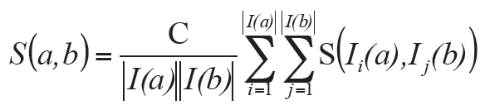
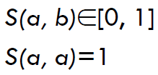
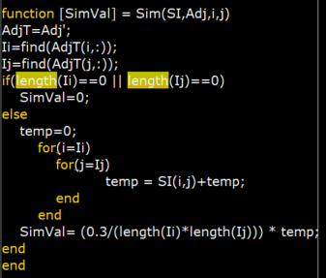
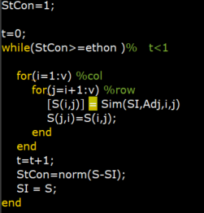

SimRank
Step2
Step1
Step3
1 | 0 | 0
0 | 1 | 0
0 | 0 | 1
As C is 0.3

Slide 7
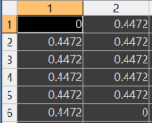
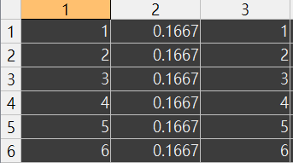
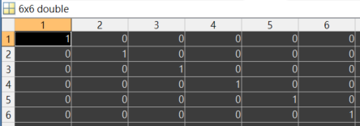
Graph1 Result
1
2
3
4
5
6
Auth
Hub
PageRank
Discussion
In HITS Analysis, we know all pages are the same authority and hub
There’s not any page links to 1st , so authority is 0, and 6th don’t link out any page, so hub is 0
In PageRank, we can know all pages are equl
In SimRank, there’s any pages similar
SimRank

Slide 8
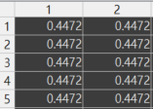
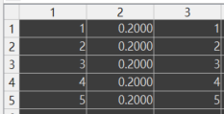
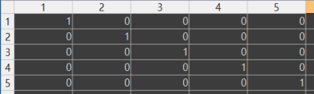
Graph2 Result
PageRank
Discussion
In HITS Analysis, we know all pages are the same authority and hub
In PageRank, we can know all pages are equal
In SimRank, there’s any pages similar
Because each page links in ones and links out ones, they are equally importance
Auth
Hub
1
2
3
4
5
SimRank

Slide 9



Graph3 Result
In HITS Analysis, we can see the authority and hub of 2nd and 3rd page is more than 1st and 4th
In PageRank, we can know 2nd and 3rd page is most significance
In SimRank, we can know 1st and 3rd are similar, and 2nd and 4th are similar
We can found 2nd and 3rd is more importance, because these pages are bridge
I think 2nd and 3rd is similar, but SimRank result isn’t like that
Auth
Hub
PageRank
SimRank
1
2
3
4

Slide 10
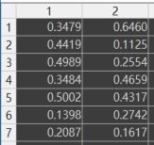
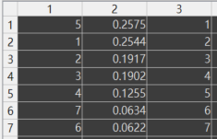
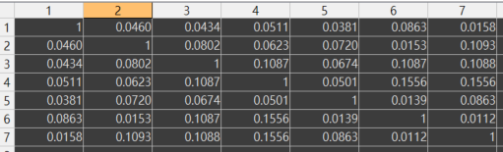
Graph4 Result
3
5
2
1
4
6
7
Auth
Hub
PageRank
Discussion
In HITS Analysis, we can see 5th page has most authority, but the 4th has most hub
In PageRank, 5th page is most significance
In SimRank, we can found 4th page is similar with 6th page and 7th
We can truly found most importance page, 5th and 1st by these analysis
SimRank

Slide 11
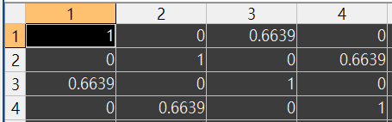
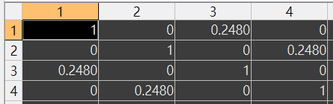
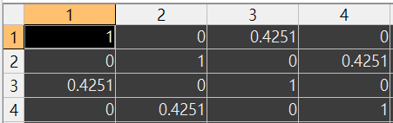
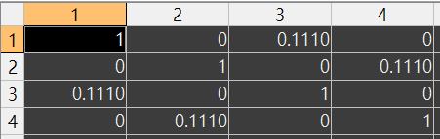
Questions & Discussion
What is the effect of “C” parameter in SimRank?
Graph3 as example, t is recursive times
We can see C is larger, similar value more larger, the relation distinctly, but the recursive getting longer
C=0.8, t=6
C=0.4, t=3
C=0.6, t=4
C=0.2, t=3

