Slide 1
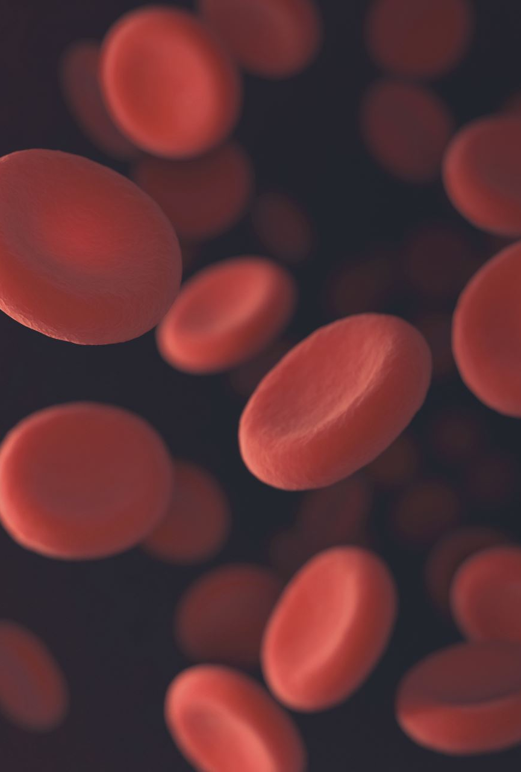
Liver Disease Prediction
YiHui ho

Slide 2
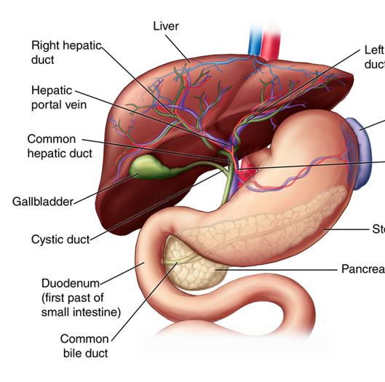
Introduction
The liver easily gets affected due to
The intake of alcohol
Pain killer tablets
Food habits, etc.
The liver related diseases are identified by analyzing liver function blood test reports and scan reports.
It takes more time as well as expensive.
Employing different data mining algorithms to ease this process
Reduce the time for diagnosing the liver disease.
Provide healthcare practitioners with actionable insights
Pin-point risks associated with liver disease
Identify whether a person is suffering from liver disease or not

Slide 3

Problem Statement
Given a dataset containing biological and diagnostic data of patients, figure out a suitable machine learning algorithm which is capable of identifying whether a person has liver disease or not.

Slide 4
Outline
Obtain: searched Kaggle for a dataset I could use
Scrub: cleaned and manipulated the data using Pandas
Explore: derived statistics and created visualizations using Matplotlib and Seaborn
Model: classification machine learning algorithms using Sklearn
Conclusion: drew conclusions from the data and evaluated meaning of results

Slide 5
Dataset
collected from UCI machine Learning Repository
The collected data set included 583 liver disease and non- diseased data with 10 attributes and one outcome

Slide 6
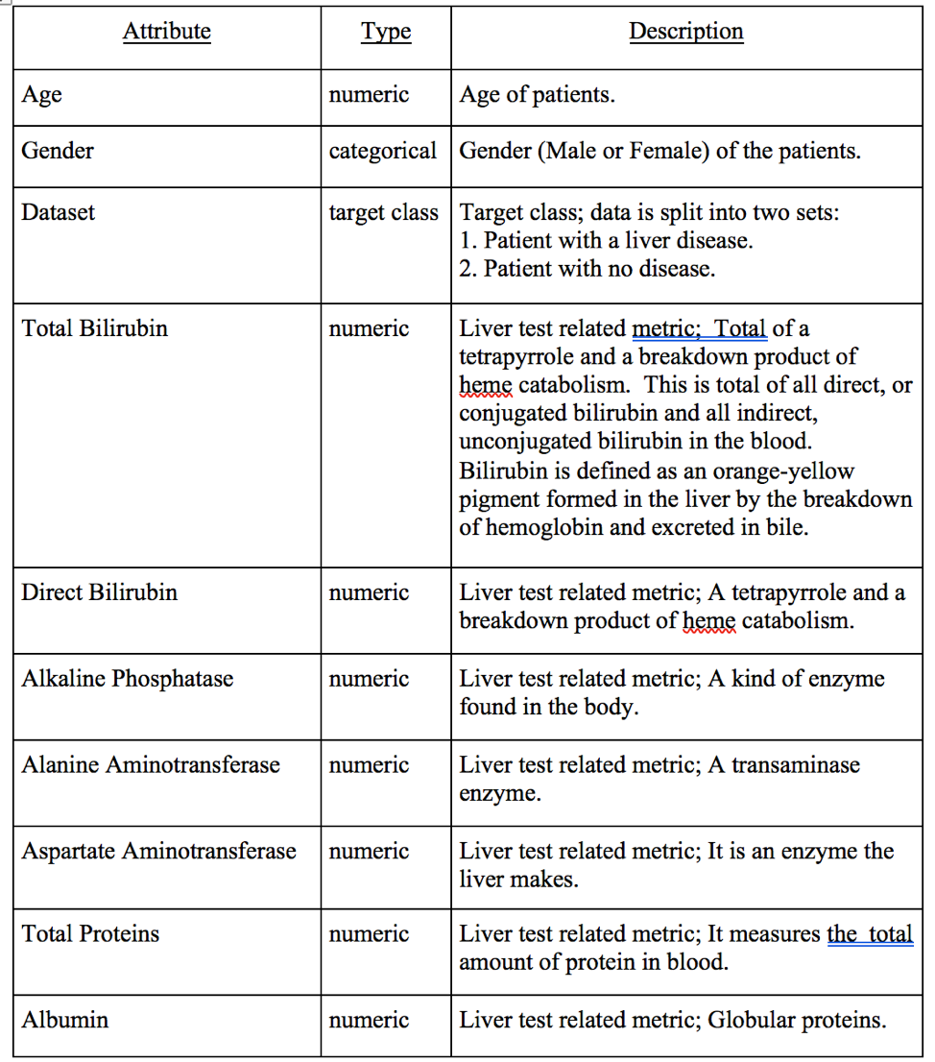
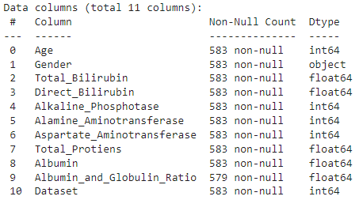

Slide 7
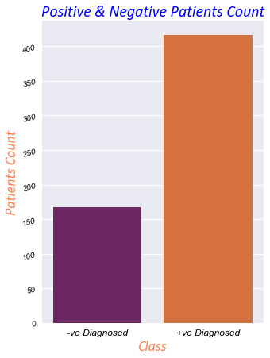
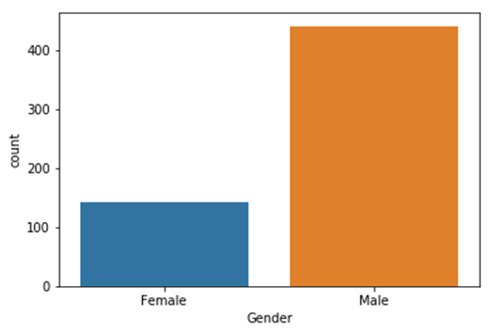
Male v.s. Female & Diseased v.s. Not Diseased
Male: 441 v.s. Female: 142
Diseased: 416 v.s. Not Diseased: 167
This shows us that there is a class imbalance in this dataset.
-ve patients are less than the 50% of the +ve ones.

Slide 8
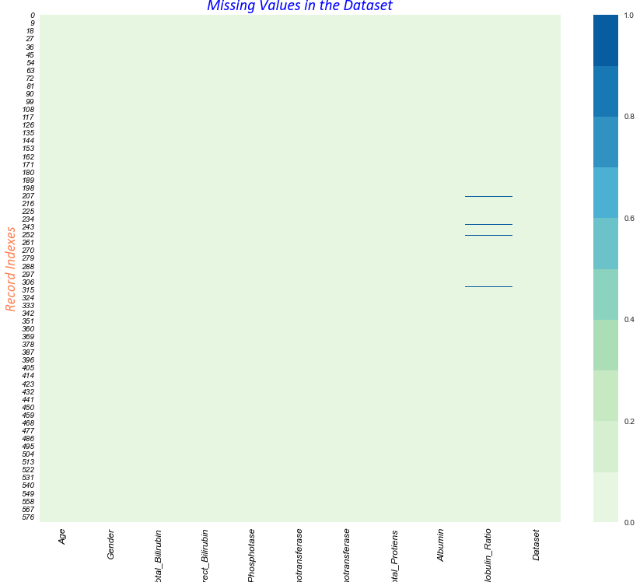
Missing Values
This shows us that there are 4 missing records in the dataset in column "Albumin_and_Globulin_Ratio".
Replace missing values with median

Slide 9
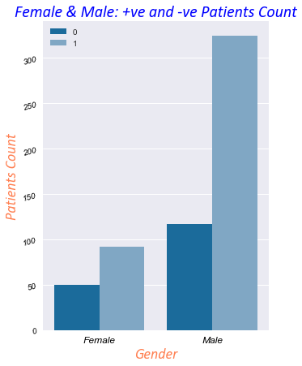
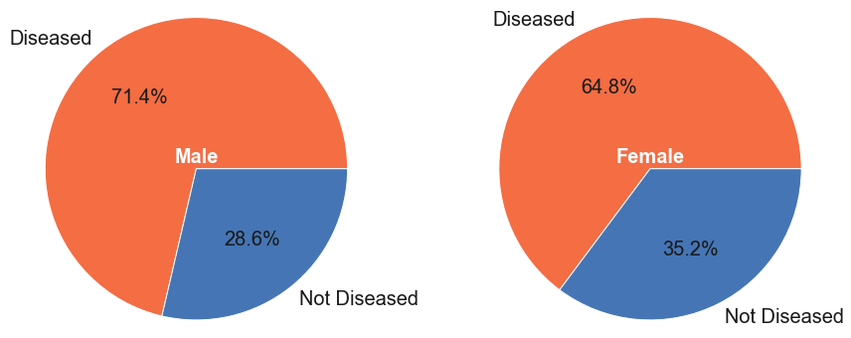
Gender & Disease
This shows us that for Males there is a significant difference among +ve and -ve patients.
Targeted preventive care for male patients

Slide 10
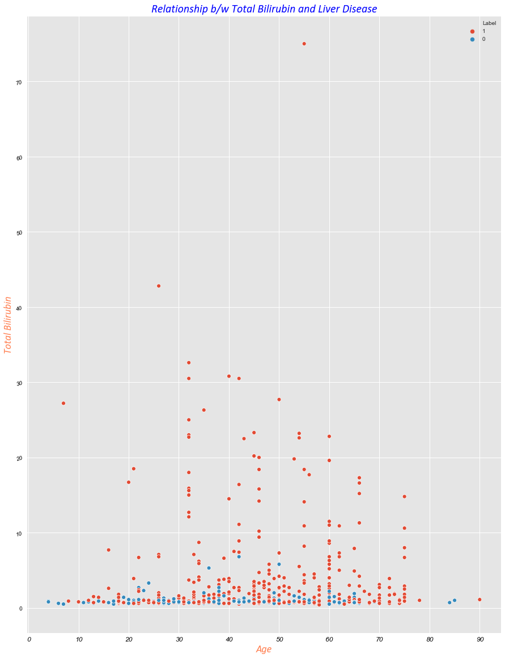
Does higher value of Total Bilirubin leads to Liver Disease?
This is clearly evident that higher value of Total Bilirubin does leads to Liver disease. However, there are positive cases at the lower value as well.

Slide 11
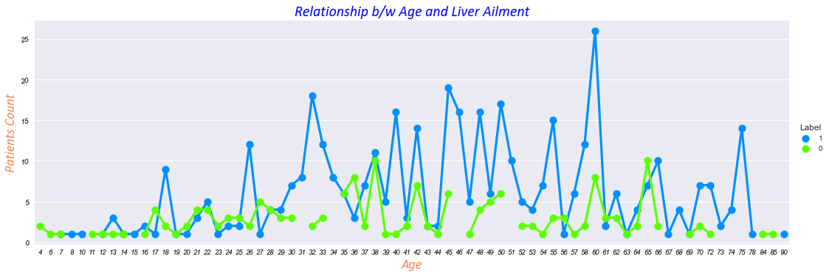
Does liver problems are more prominent at a higher age?
The spikes across every age.
Very less number of non-diseased people exist after 66 years of age
A significant jump in the number of cases at 75 years of age
Adults between the ages of 31-60 years old seem to be the most in danger.
This can be attributed to these adults being tested more often for liver disease than young people and the elderly

Slide 12
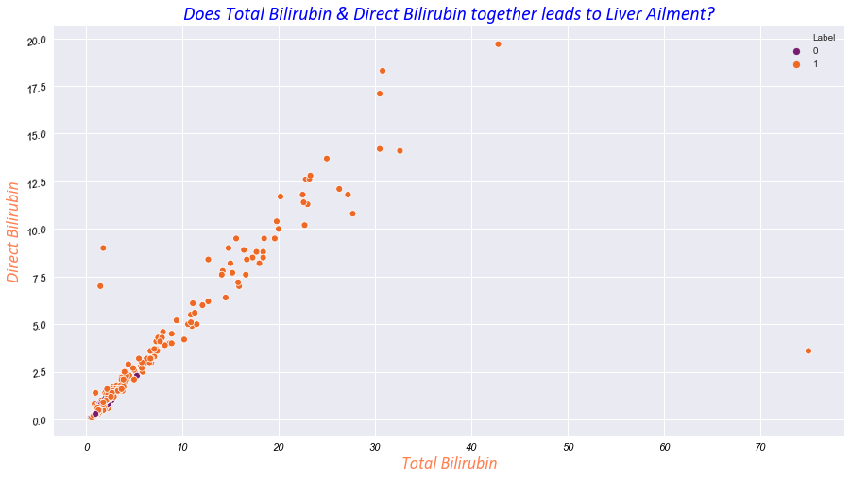
Does Total Bilirubin and Direct Bilirubin together leads to liver problems?"
Statistically speaking it looks like Total Bilirubin & Direct Bilirubin both are correlated with each other and shows good sign of relationship
They almost have a similar distribution.

Slide 13
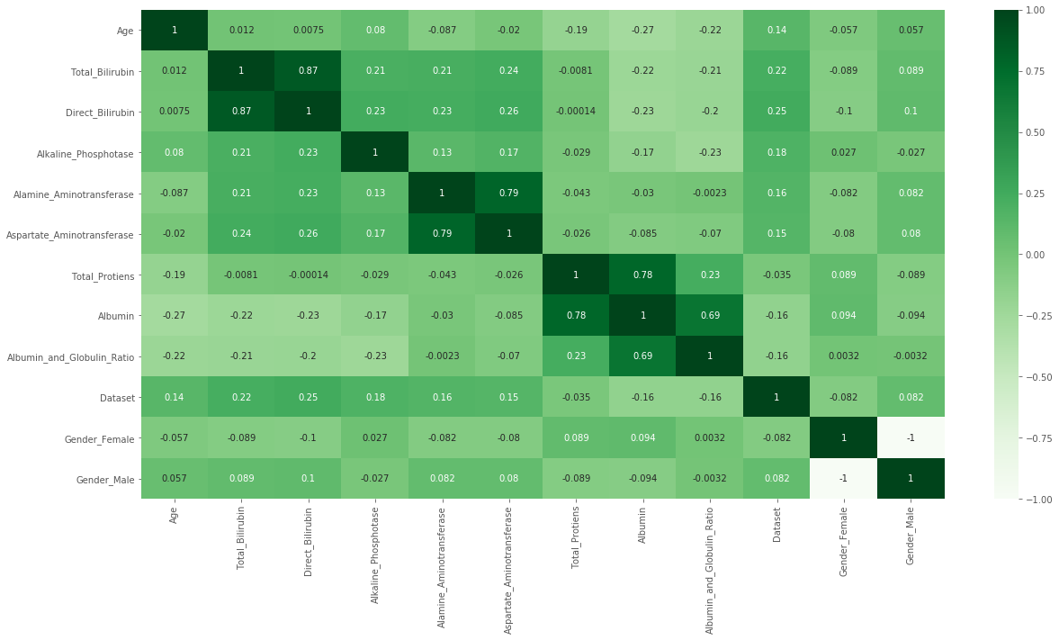
Let’s see the correlation between all the features to understand how close the features are
It reflects there is a strong correlation of 87% between direct bilirubin and total bilirubin.
If a patient were to come in with high levels of direct bilirubin, we would be safe to assume that the likelihood that they also have a high incidence of total bilirubin is quite high.
Healthcare practitioners may choose only administer certain tests and not others
Speed-up the diagnosis:
save both the healthcare practitioner and patient vast amounts of time and resources.

Slide 14
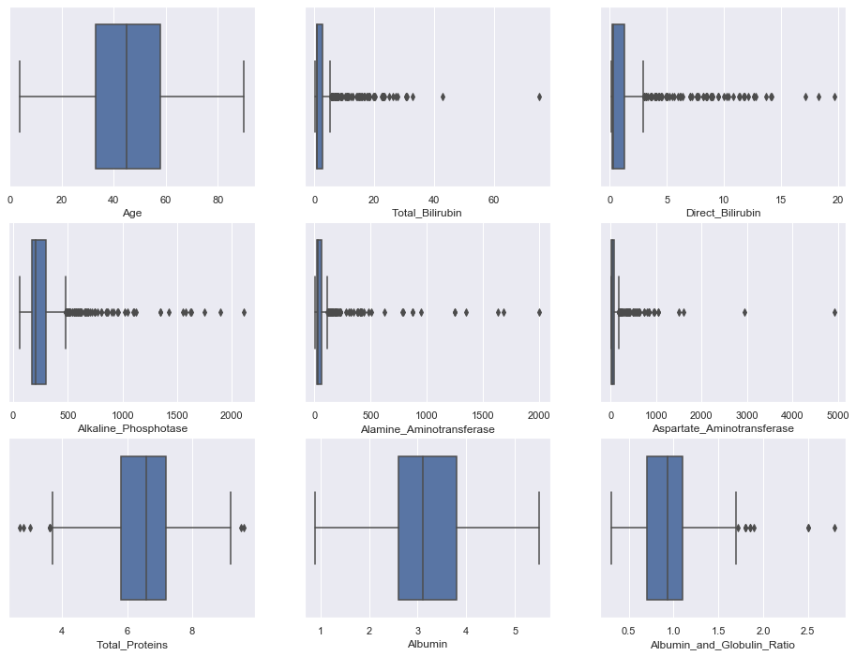
Outlier
Inspecting some features one by one
Removed outliers from certain features:
Total_Bilirubin > 40,
Direct_Bilirubin > 15.0,
Alkaline_Phosphotase > 1250, Alamine_Aminotransferase > 1000, Aspartate_Aminotransferase > 2000,
Albumin_and_Globulin_Ratio > 2.0.

Slide 15
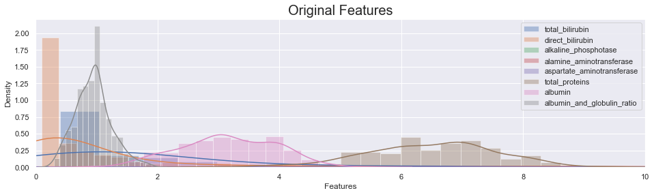
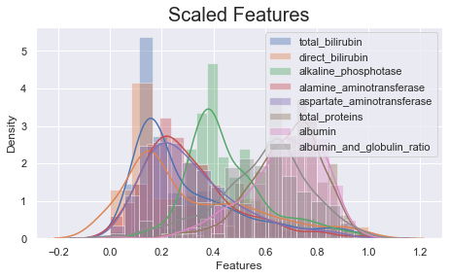
Feature Scaling
log-transforming
min-max scaling

Slide 16
Final data
Missing
Dealing with missing values
Outlier
Removing Outliers
Imbalance
Dealing with imbalanced data
Scaling
Feature Scaling

Slide 17
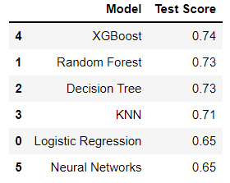
Model Evaluation:

Slide 18
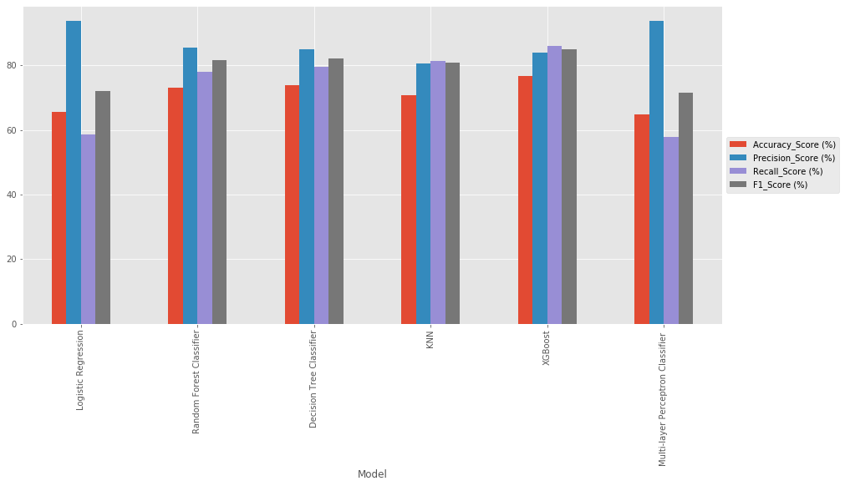
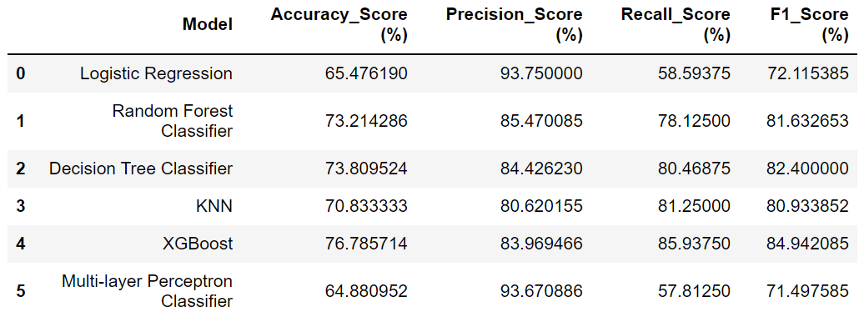
Result

Slide 19
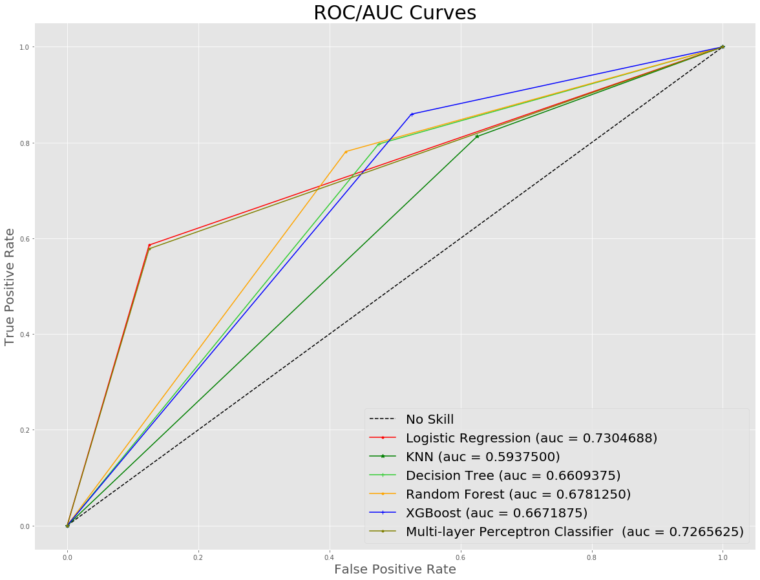
ROC/AUC Curves

Slide 20
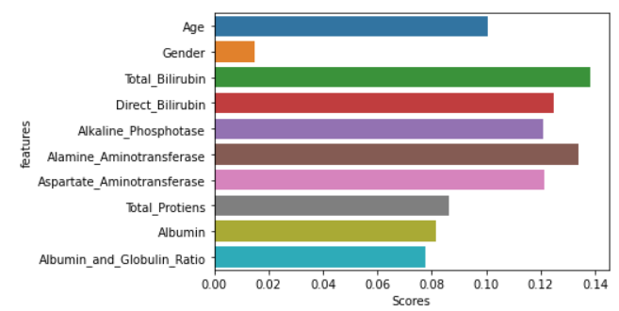
Feature Importance

Slide 21
Future Work
Fine-tune parameter of a model
1
More research on getting data
2
Expand dataset with possible concatenation
3
Conduct feature selection
4

Slide 22


