Slide 1

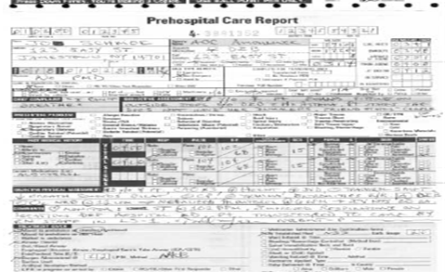
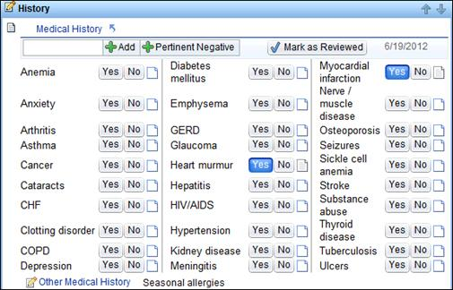
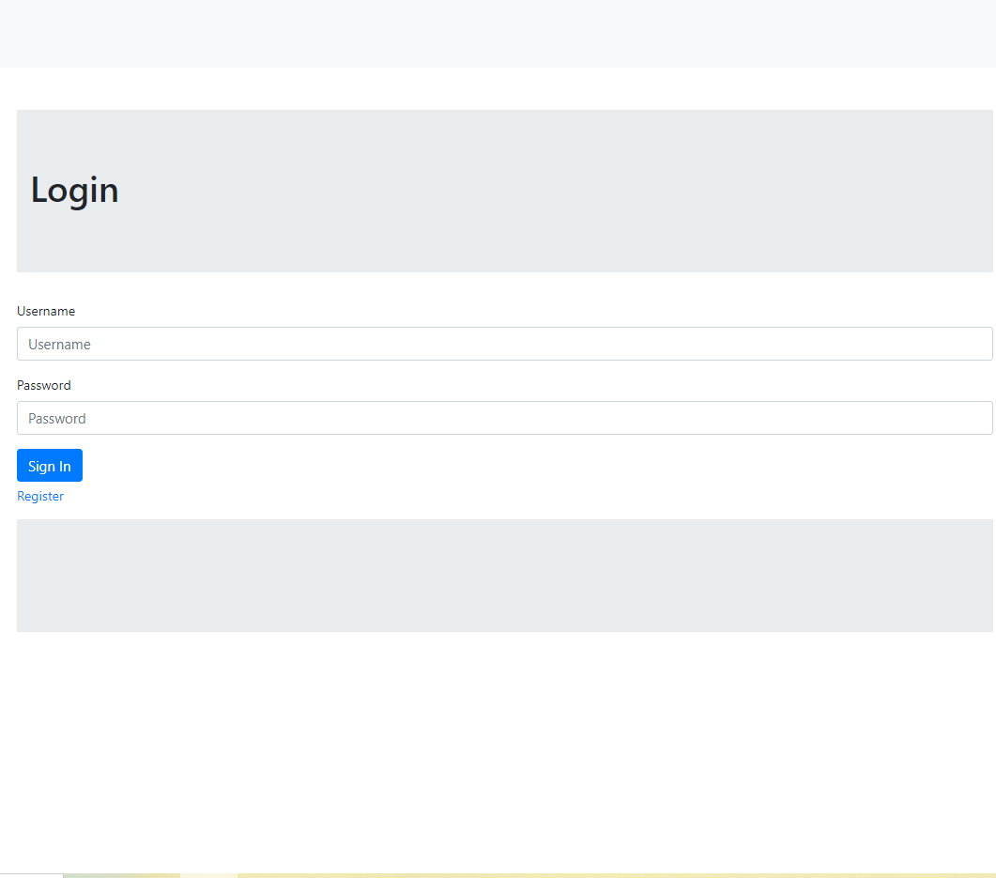
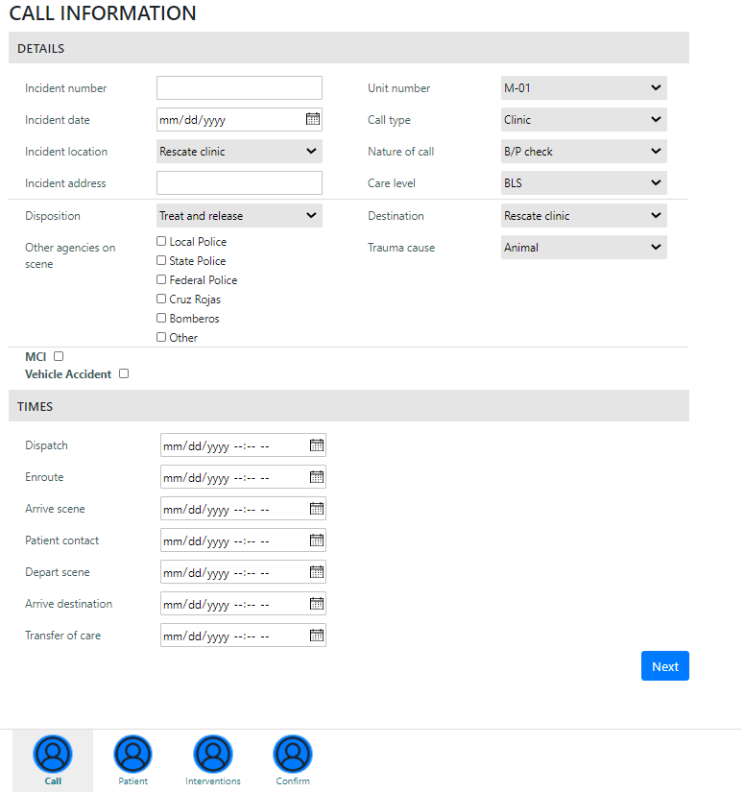
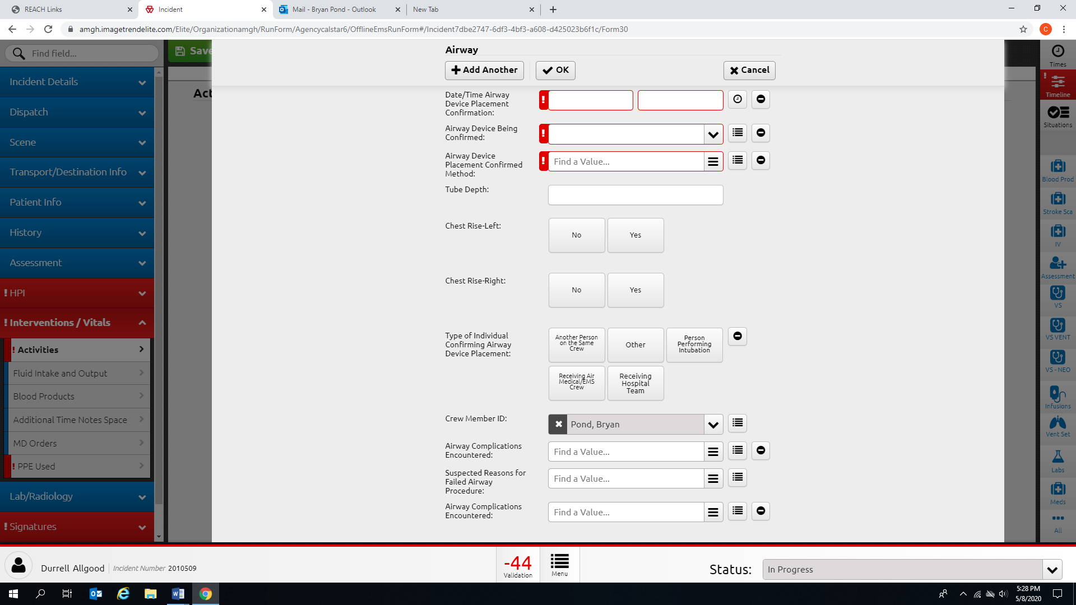
ePCR System
Team Members: Kennedy Anukam, Mason Harlan, Yi Jiang, Alec Moore
Department of Computer Science and Engineering, University of Nevada, Reno
Instructors: Devrin Lee, Dr. David Feil-Seifer
External Advisor: Bryan Pond RN, CFRN, CCRN from San Carlos Rescue Ambulance Service
CSE
Abstract
Features
Future Work
The ePCR system is a web and mobile patient record tracking and entry system designed for use by the San Carlos Rescue ambulance service in Sonora Mexico. The project is significant for the Rescate ambulance service as it is replacing their current method of handwritten records. The main goals include providing a secure environment for logging patient records, accessing records with ease, running analysis on reports, and an intuitive design supporting English and Spanish. The system has the potential to have an impact on healthcare in lower income regions. This project is open source to benefit as many healthcare providers as possible.
The ePCR system consists of several features that help the Rescate team accomplish their tasks quickly and efficiently.
Login and authentication is implemented to safely secure the patient records by only giving authorized users accessibility. Figure 3 displays the login page of the system.
The admin has the ability to add, delete, and elevate users, as well as assign certifications to users.
The system supports two languages (English and Spanish), where users can freely toggle between languages.
As previewed by Figure 4, users can create charts. They can fill in the required information for the call incident, the patient demographics & history, physical exams, and the treatments given to the patient.
Users can search and filter charts by patient’s first name, last name, date of birth, and a specific date range of chart reports.
Users can view charts and add notes to existing charts, as well as download the chart report as a PDF.
Users can download summary reports and trend call analysis results of a given date range.
Additional Language Translations
The system was designed for additional language support with the provision of translation files. Adding more languages to the system will make the system accessible to more medical professionals.
Backup All Charts
The ability to backup all the charts in the system will make the ePCR system more reliable. Adding in this feature will improve reliability.
Autonomous Setup
Not all medical organizations are technologically oriented. An autonomous setup that does not require manual code setup to match the medical charting parameters will make the system more adaptable.
Problem
Architecture
User Interface
The system utilizes a client-server architecture. The client makes requests to the server and the server processes the requests and sends the appropriate response back. A model-view-controller architecture is used on the server-side. The model performs database accesses, the view renders the display, and the controller sends the response back.
Figure 2: A digital form asking the user to select the patient’s medical history.
Figure 1: A cluttered patient chart used by the ambulance team.
Figure 1 shows the difficulty of reading and sorting paper charts. The ambulance team can spend several hours a week searching through paper charts to find the information and aggregate the statistic that they need.
Conclusion
Figure 3: A similar ePCR tool with multiple steps. It is also extensive (requiring many input fields), which is not quick and efficient for use by the Rescate team.
The ePCR System was successfully developed for the San Carlos Rescue ambulance service. As it stands, the system allows simple access to otherwise commercially expensive electronic form storage for only the cost of a server and database. The system has the potential to be propagated, modified and adopted anywhere for any language. It’s capability to aid rescue workers and their patients in any community is a positive and exciting outcome.
Figure 3: The login page for the ePCR system. Users must have a valid account in order to access the system. On the login page, the user can navigate to the registration page or the Forgot Password page to reset their account.
Figure 4: The first portion of the chart creation system. On this page, the user can enter the call information related to the patient encounter. The system has additional pages to further log the patient encounter such as a physical assessment page.
Figure 2 and Figure 3 shows the various digital tools that offer medical services a way to store patient records. However, digital solutions are often expensive and have outdated workflows.
This project was developed in Spring 2021 as part of the course CS 426 Senior Projects in Computer Science

