Slide 1
Churn Prediction
From dissatisfaction to loyalty
Andrea Pan - 514555

Slide 2
The problem
Context
Objectives
Challenges
The company has reported increasing risks of churning, negatively impacting the order value and overall customer lifetime value.
Identify customers in ‘at-risk’ segment
Explain the reasons behind the growing churn rate
Apply strategies to turn unhappy customers to loyal ones
Imbalanced data
Interpretability
Changing behavior
Actionability

Slide 3
Solution
We propose a machine learning classification model, capable of labeling customers in risk of churning with high consistency.
This approach is not only accurate, capturing non-linear relationships, but also explainable: we can build strategies around the predictors of the model.
Machine Learning Model

Slide 4
The dataset

Slide 5
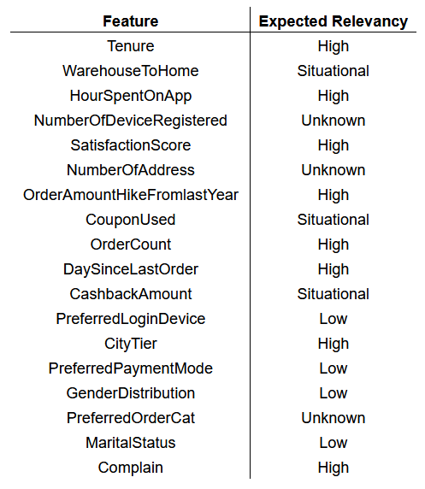
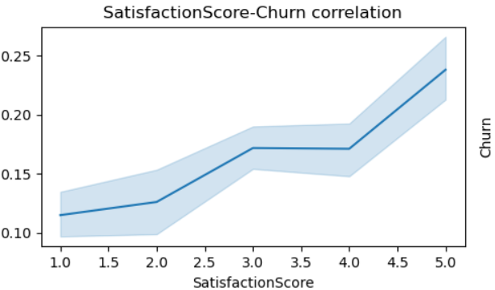
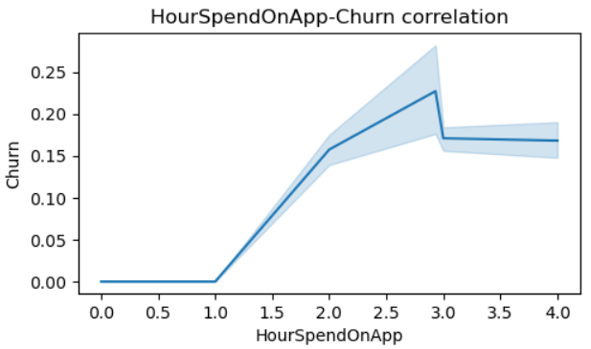
Results from Exploratory Data Analysis (EDA)
5630 entries
1860 total missing values 20 columns
Aliases merged
Unexpected
correlations
Some data relationships are non-linear
Overall weak linear correlation
Most significant features: 1. Tenure 2. DaySinceLastOrder 3. Complain

Slide 6
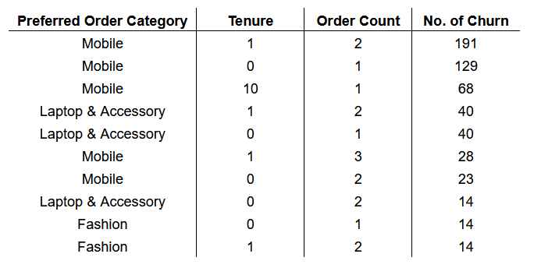
Results from Exploratory Data Analysis (EDA)
We discovered a strong association between Churn and PreferredOrderCat. Thus, the question is:
What categories of order are the most likely to churn? What about their tenure and order count?
It appears that we have many one-timers, with many of them buying a mobile phone or a laptop and then never returning.
We can already make a suggestion for a strategy to take: Make offers for accessories on their recently bought mobile or laptop to retain engagement.

Slide 7
The model

Slide 8
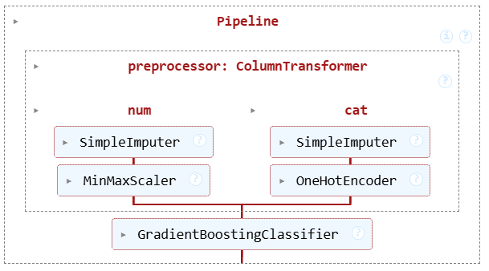
The Workflow
Pipeline Definition
Grid Search
Hyperparameter Tuning
Structure:
Performed for both finding the best model, and for hyperparameter optimization.
We tested Random Forest, Linear Regression and Gradient Boosting.
Linear Regression was discarded.
After much optimization of hyperparameters of both Random Forest and Gradient Boosting (a total of 3060+ fits!) we decided on the latter.
Note: Both performed flawlessly, but Gradient Boosting was marginally better in training.

Slide 9
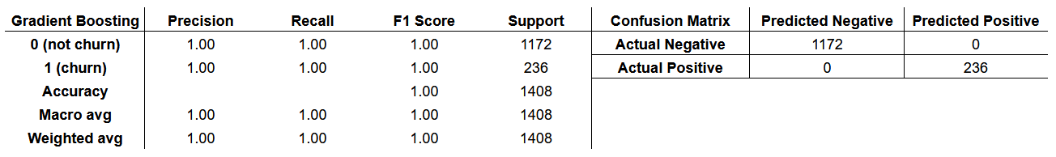
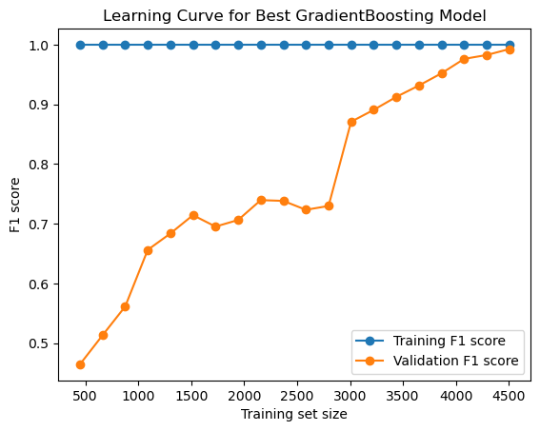
Model Results
The classification report is based on the test set: we can be sure the model is not overfitted.
To further prove it, we plotted the learning curve, and we can see the validation score keeps raising.
The model's performance jumped dramatically once the critical mass of around 3000 training size.
Any less data, and we’d have a suboptimal model.

Slide 10
Explainability & Strategies

Slide 11
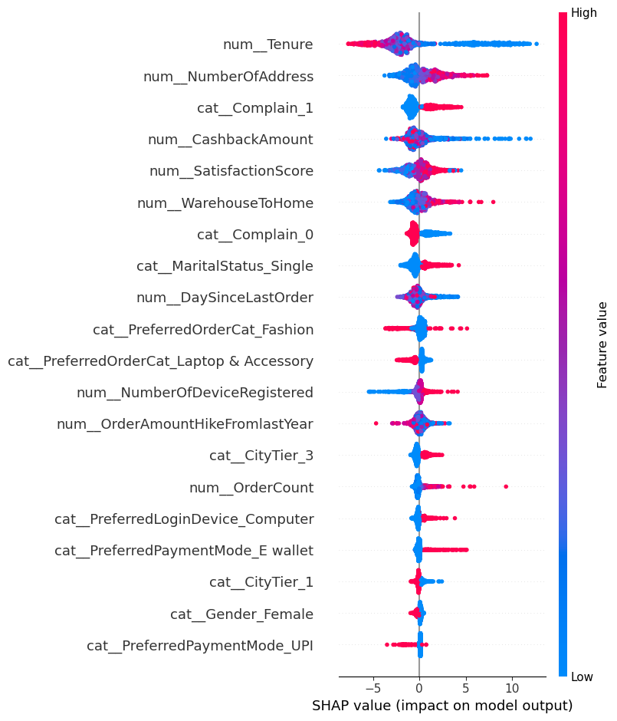

SHAP Explainability
SHAP (SHapley Additive exPlanations) is a method used to explain how machine learning models make predictions.
How it works:
Each feature is considered a player
Each player contributes to the prediction
A payout is divided across players based on contribution
SHAP works really well with Gradient Boosting Models.

Slide 12
Suggested Strategies
At-Risk Segment
Complaints
Personalization
Watch out!
Low Tenure
Onboarding campaign and loyalty programs.
High Number of Addresses
Might be movers. Offers based on home utilities or free delivery service.
Complaint Resolution
Email focusing on empathy, accountability, and give offers to turn dissatisfaction into loyalty.
Based on Demography or Geographics
Singles and Tier 3 Cities are more likely to churn in our data.
Research about personal/regional preferences, and give bonuses through referral.
Cashback has most SHAP data points on 0, but there’s a blue trail that leans into higher SHAP values.
High cashback: no churn reduction.
Low cashback: high chance of churn.
Consider other strategies.

Slide 13
Thanks for the attention!

